Slide 1

SaMD (Software as a Medical Device) ,
SiMD (Software in a Medical Device) &
IEC Standards
Madhura Ramojwar

Slide 2
Agenda
SaMD and SiMD
IEC 15408
IEC 62443
IEC 60601-4-5

Slide 3

SaMD (Software as a Medical Device)
Defined by the International Medical Device Regulators Forum (IMDRF).
It is a software intended to be used for one or more medical purposes that perform these purposes without being part of a hardware medical device.
The applications of SaMD are not just limited to diagnosis but have also made their place in the monitoring and treatment process.
Example:
  Software that is processing a patient image to detect diseases like cancer
  EEG Analysis
  Software that regulates an installed medical device, like a pacemaker.

Slide 4

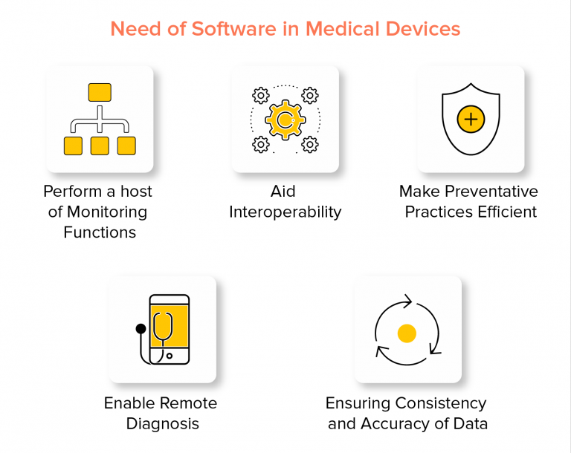
Clinical evaluation of SaMD is conducted to generate, collect, analyze and assess the data related to the device to ensure its safety and efficacy.
Following are the major components of the clinical evaluations performed on SaMD:
  Valid Clinical Association – Verifies the association between the output of the SaMD and the target clinical condition
  Analytical Validation – Demonstrates the technical relevance of the output of the SaMD
  Clinical Validation – Demonstrates that reliable outcomes are generated from the SaMD after testing it on the target population

Slide 5
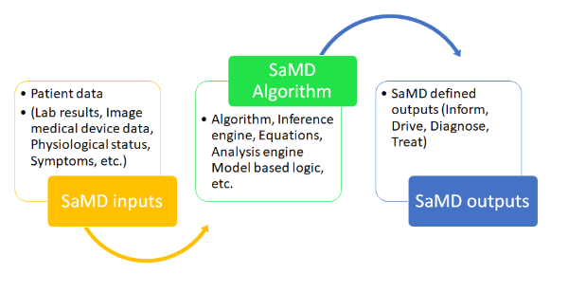
Input data source for SaMD could be medical devices, lab results, medical images, IVD instrument results, vital signs, medication, patient demography, allergies etc.
SaMD can have algorithm to process this and provide output that could be used for medical purpose (Inform, Drive, Diagnose, Treat).

Slide 6
Classification of SaMD
SaMD can be classified based on following two criteria:
  Based on the type of information provided by the device
    For treatment or diagnosis
    For driving clinical management
    For informing clinical management

Slide 7
  Based on the impact on treatment
    Critical
    Serious
    Non-serious

Slide 8
SaMD Categories
There are 4 categories ( I, II, III , IV ) based on the level of impact on the patient's health.
Category IV is the highest level of impact and Category I is the lowest.
Category IV – Provides information for the treatment or diagnosis of diseases or conditions that are critical and are considered “very high impact”
Category III – Provides information for the treatment or diagnosis or clinical management of diseases or conditions that are serious and are considered “high impact”
Category II – Provides information for the treatment or diagnosis or clinical management of diseases or conditions that are non-serious and are considered “moderate impact”
Category I – Provides information for the clinical management of diseases or conditions that are non-serious and are considered “low impact”

Slide 9
SiMD (Software in a Medical Device)
It is a software that is part of functioning of a medical device.
It does not have a medical purpose independent of a medical device with hardware components.
Purely embedded software within medical equipment , includes desktop, mobile and cloud software.
The fact that you cannot use the medical device without this software, makes it SiMD.
Example:
  Software within mobile applications that control a medical device through Bluetooth, Wi-Fi or other functionality.
  Embedded software that operates a pacemaker.
  Mobile application which is an interface for reading waveforms.

Slide 10
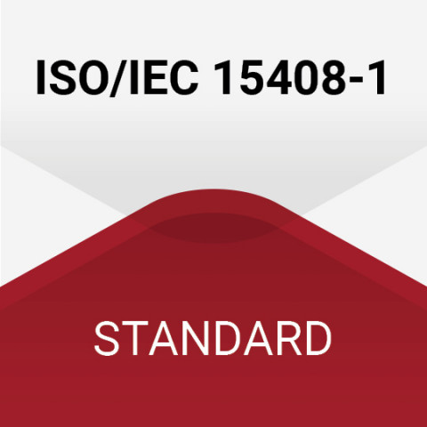
IEC 15408 (The Common Criteria for Information Technology Security Evaluation)
Also referred to as Common Criteria or CC i.e., an international standard (ISO/IEC 15408) for computer security certification.
Current version 3.1 revision 5.
Designed for products - highly security-intensive markets, such as governmental, banking, or military sectors.
It is a framework where users can specify their Security functional / Assurance requirements (SFR/ SAR) in a Security target (ST) taken from a Protection profile (PP).
Certification of a specific version only applies to that version and not the newer version.

Slide 11
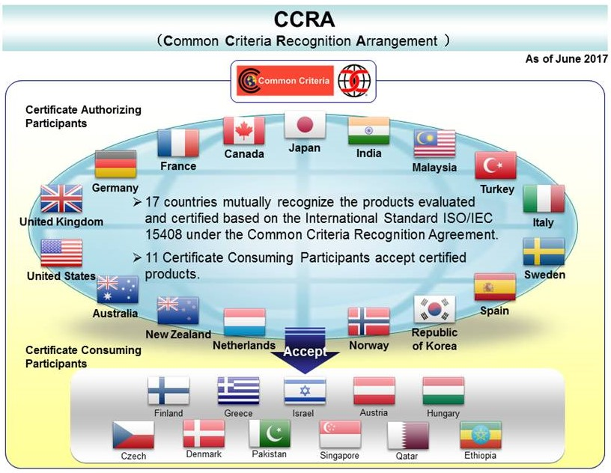

Slide 12
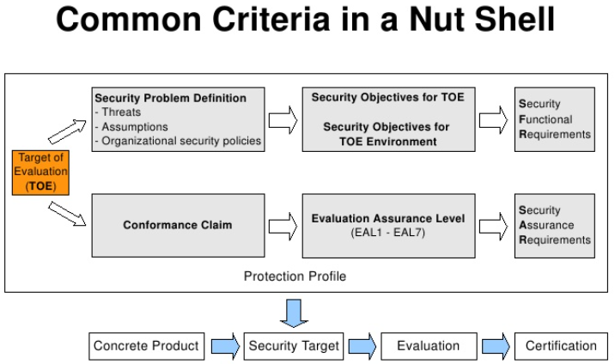
Evaluation Procedure:
  With the support of a third party contracted laboratory, Common Criteria evaluations of your computer security products and systems are performed.
  The partner laboratory must first define a target of evaluation (TOE) allowing for further assessment of current and applicable documentation.
  Upon completion of the documentation review and a thorough CC evaluation, we can provide you support and help you attain your IT product security certification.

Slide 13
IEC 15408 Components
TOE (target of evaluation):
  The product or system that is the subject of the evaluation.
  It is the product to be tested.

Slide 14
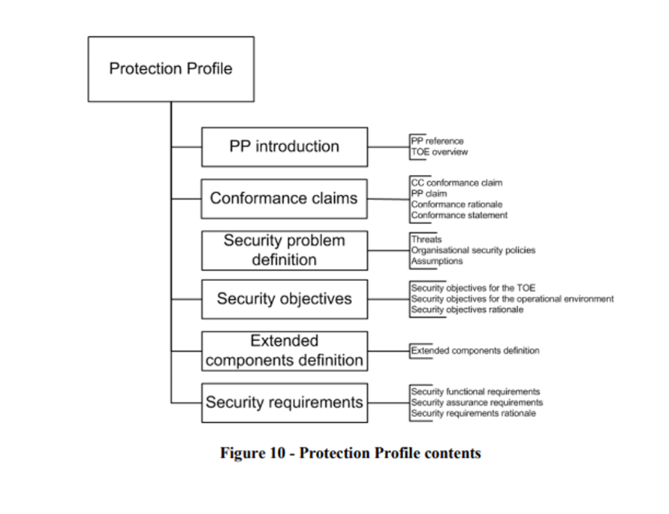
Protection Profile : (TYPE OF PRODUCT)
  It identifies security requirements for a class of security devices (for example, smart cards used to provide digital signatures, or network firewalls) to the user.
  Description about the needed security solutions.
  PP serves as a template.
  A document created by a user/ user community.

Slide 15
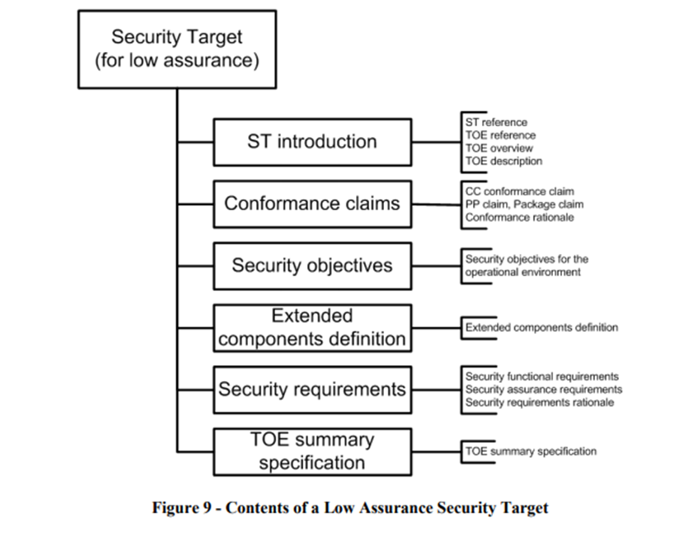
Security Target:
  It is a document that identifies the security properties of the target of evaluation.
  Allows to make changes for the evaluation to accurately match the intended capabilities / requirements of their product.

Slide 16
Quality Assurance processes
The Evaluation Assurance Level (EAL)
  It is the numerical rating used to describe the depth and rigor of a CC evaluation.
  Each EAL is corresponded to a package of security assurance requirements for the development of the product.
  There are 7 EAL’s from EAL 1-7 (low security to high security).
EAL 1 | Functionally tested (Black Box)
EAL 2 | Structurally tested (Black & White Box)
EAL 3 | Methodically tested and checked
EAL 4 | Methodically designed, tested, and reviewed
EAL 5 | Semi formally designed and tested
EAL 6 | Semi formally verified, designed, and tested
EAL 7 | Formally verified, designed, and tested

Slide 17
Services offered by IEC 15408:
  Professional support and help with the evaluation along with certification of your product.
  Well-trained personnel with in-depth knowledge of the Common Criteria standard.
  Reliable and extensive evaluation services from an independent Certification Body.
  Tailored consultancy on IT product security and certification.

Slide 18
IEC 62443
Developed by the ISA99 committee and adopted by the International Electrotechnical Commission (IEC).
It helps organizations to reduce both the risk of system failure and the exposure to cyber threats.
Main security objectives of IEC 62443 are in-depth defense.
  i.e., taking low level requirements and extending security to other areas to consider different attacks.

Slide 19
Fundamental requirements of IEC 62443
The seven fundamental requirements of the IEC 62443 standard:
  Identify and authenticate all users (people, software processes and devices) before authorizing access to a system.
  control use (enforce the privileges assigned to an authenticated user).
  ensure the integrity of data, software, and equipment.
  ensure the confidentiality of information in data flows, and in data storage spaces.
  restrict unnecessary data flows.
  respond to attacks by informing the competent authority in a timely manner.
  and ensure that the system is resilient against a DDoS attack.

Slide 20
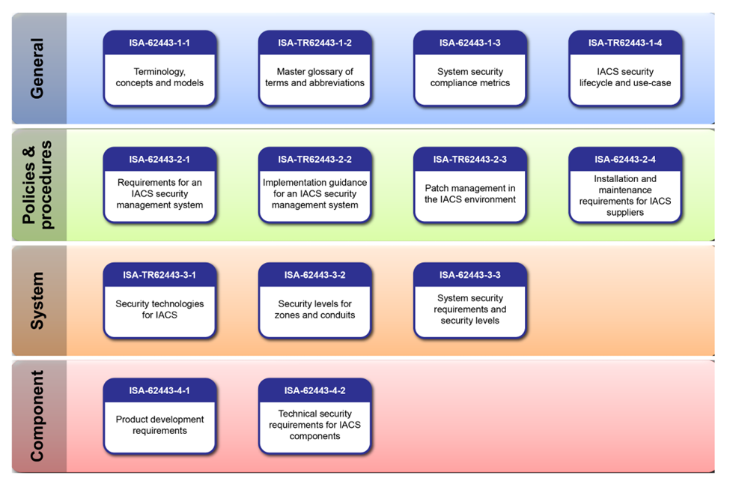
ISA/ IEC 62443 consists of 14 documents divided into four groups:
  General
  Policies and Procedures
  System
  Component.

Slide 21
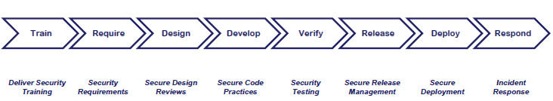
The key standards in the IEC 62443 series
IEC 62443-4-1 ( Secure development lifecycle requirements )
Specifies process requirements for the secure development of products.
Lifecycle includes security requirements definition, secure design, secure implementation (including coding guidelines), verification and validation, defect management, patch management and product end-of-life.
These requirements can be applied to new / existing processes for
- developing
- maintaining
- retiring hardware, software, or firmware.

Slide 22
  IEC 62443-4-2 ( IACS components security specifications )
Provides the cyber security technical requirements for components that make up an IACS.
  Mostly for embedded devices, network components, host components and software applications.
The standard sets forth security capabilities that enable a component to mitigate threats.
  IEC 62443-3-3 ( security requirements and the security level )
Defines the security assurance levels of the IACS components.
It includes the 4 security levels.

Slide 23
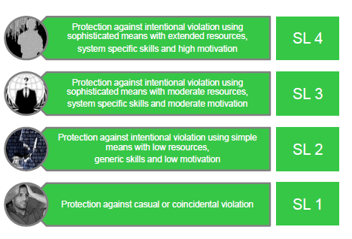
Level 1 and Level 2 correspond to threats originating from either insiders, such as careless or disgruntled employees or contractors, or intruders with low skills and motivation.
Levels 3 and Level 4 are related to threats from “professional” cyber criminals, industrial espionage or state-sponsored malicious actors.

Slide 24
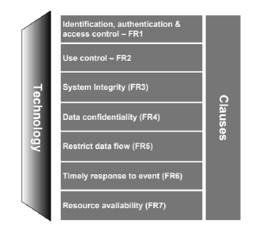
  In addition, IEC 62443-3-3 defines the security Foundational Requirements,
  It includes :
    processes for user authentication
    enforcement of roles and responsibilities
    change management
    use of encryption
    network segmentation
    audit logs
    system backup and recovery.

Slide 25
ISA/IEC 62443 Cyber security Certification Programs
Certificate 1: ISA/IEC 62443 Cyber security Fundamentals Specialist.
Certificate 2: ISA/IEC 62443 Cyber security Risk Assessment Specialist.
Certificate 3: ISA/IEC 62443 Cyber security Design Specialist.
Certificate 4: ISA/IEC 62443 Cyber security Maintenance Specialist.
ISA/IEC 62443 Cyber security Expert: Individuals who achieve Certificates 1, 2, 3, and 4 are designated as ISA/IEC 62443 Cyber security Experts.
Link for the certification requirements and training course:
https://www.isa.org/training-and-certification/isa-certification/isa99iec-62443/isa99iec-62443-cybersecurity-certificate-programs

Slide 26
IEC 60601-4-5
It is currently available as a draft.
Provides detailed technical specifications of security features for MEDICAL DEVICES used in MEDICAL IT-NETWORKS.
This standard will help you to
  Develop safe products
  Avoid unnecessary expenses.
This standard gives you instructions
  On which measures to implement to improve IT security
  On which factors this obligation is dependent.

Slide 27
Security Levels – The central concept of IEC 60601-4-5
The standard works with three types of security level (SL):
SL-T: The Target Security Level, that one must achieve for the network including the networked medical devices, to achieve the set protection goal.
SL-C: The Capability Security Level, that can actually achieve for the medical product and the network, if one takes measures to improve IT security.
SL-A: The Achieved Security Level, the level one actually achieves.
IEC 60601-4-5 encourages the implementation of safety:
  Basic Safety
  Essential Performance
  Minimum of necessary clinical functionality
  Availability of the medical device

Slide 28

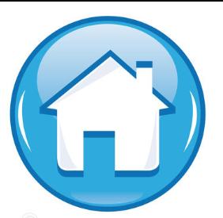
Thank You !

