Slide 1

Design of Analog & Digital Data Acquisition System
Genesis Shadow Project
Unmesh Sameer Deshpande
Lakshmisha Gowda B
Asha N
Lakshmi Narayana S

Slide 2
Introduction

Slide 3




Project Highlights
Project Mentors
BU Mentor: Jagdish Prasad Sahu
GEA Mentor: Bhargav N
GENESIS Track Code: 2009BLRMED01
Intern Name: Unmesh Sameer Deshpande
PS#: 99002485
Intern Name: Lakshmi Narayana S
PS#: 99002536
Intern Name: Lakshmisha Gowda B
PS#: 99002625
Intern Name: Asha N
PS#: 99002646

Slide 4
Problem Statement
Design & Software Implementation of Analog & Digital Data Acquisition System

Slide 5
Key Deliverables
Requirements specifications
Detailed design calculations and schematics
Firmware Design, Flow Chart, Pseudo Code or Python Code

Slide 6
Introduction
Analog Data Acquisition System
Data acquisition is the process of sampling signals that measure real world physical conditions and converting the resulting samples into digital numeric values that can be manipulated by a computer.

Slide 7
Design and Implementation

Slide 8
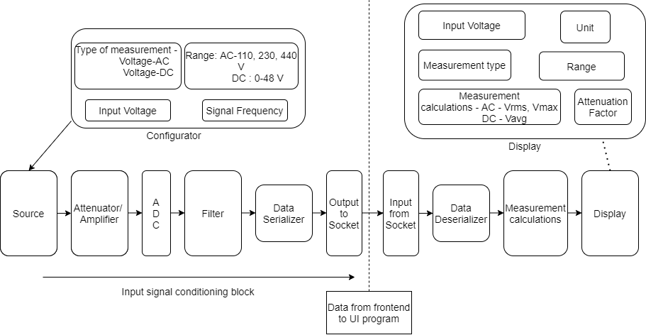
Block Diagram

Slide 9
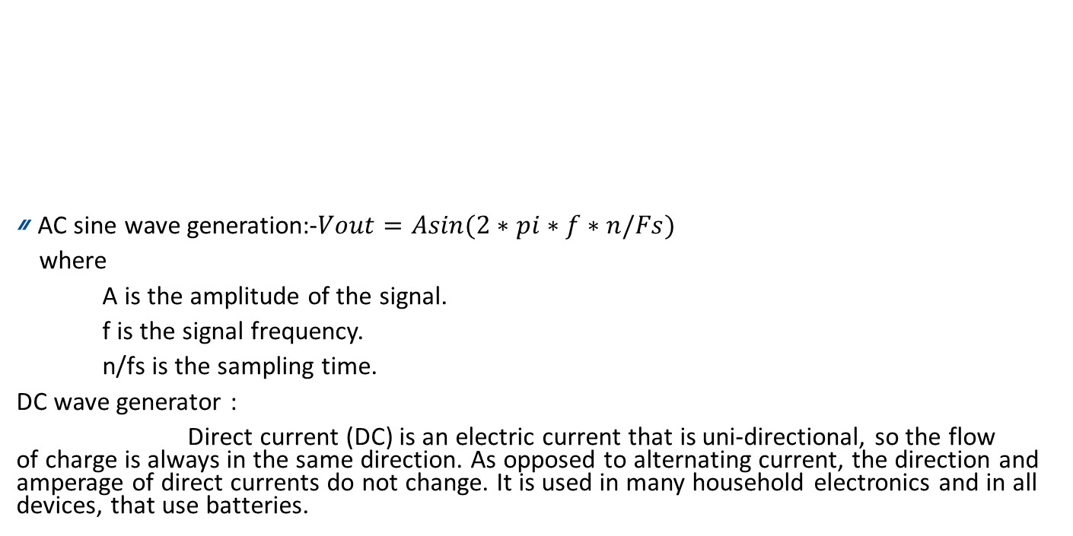
Source
AC sine wave generation:-$Vout=Asin(2∗pi∗f∗n/Fs)$
where
A is the amplitude of the signal.
f is the signal frequency.
n/fs is the sampling time.
DC wave generator :
Direct current (DC) is an electric current that is uni-directional, so the flow of charge is always in the same direction. As opposed to alternating current, the direction and amperage of direct currents do not change. It is used in many household electronics and in all devices, that use batteries.
Source Generator
(AC Wave/DC wave)
Attenuator
Analog to digital converter
Noise

Slide 10
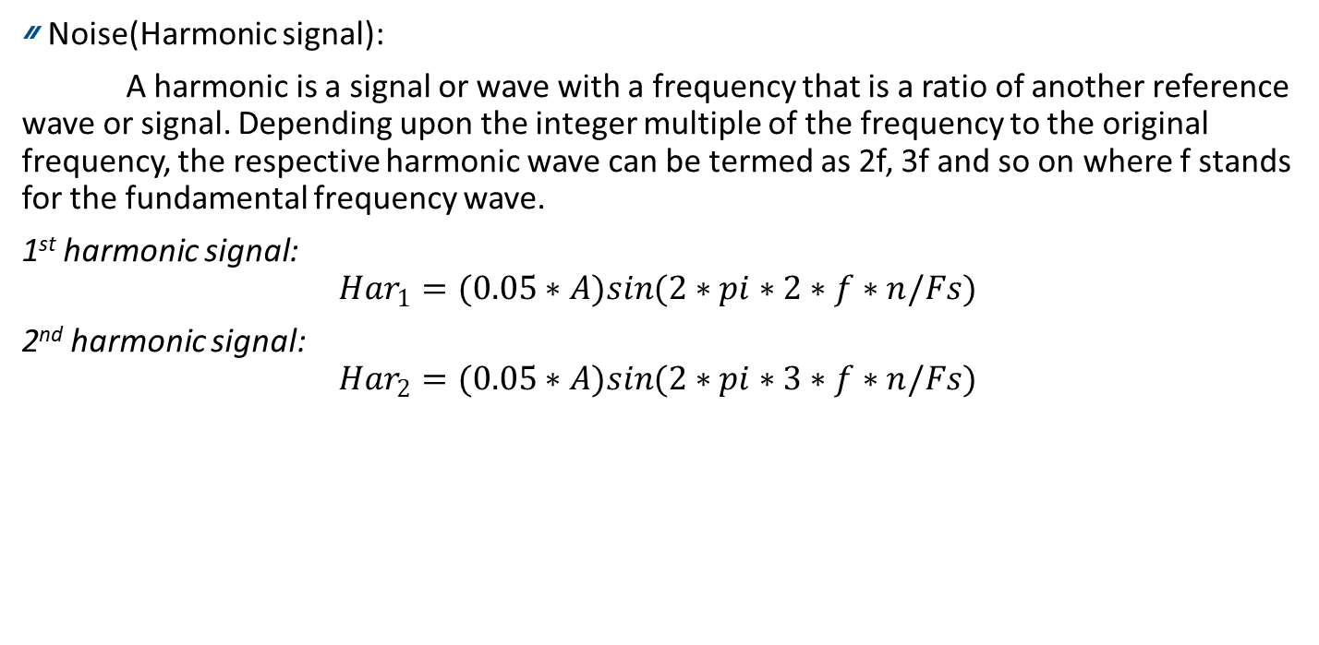
Noise(Harmonic signal):
A harmonic is a signal or wave with a frequency that is a ratio of another reference wave or signal. Depending upon the integer multiple of the frequency to the original frequency, the respective harmonic wave can be termed as 2f, 3f and so on where f stands for the fundamental frequency wave.
1st harmonic signal:
$$Har_{1}=(0.05∗A)sin(2∗pi∗2∗f∗n/Fs)$$
2nd harmonic signal:
$$Har_{2}=(0.05∗A)sin(2∗pi∗3∗f∗n/Fs)$$

Slide 11
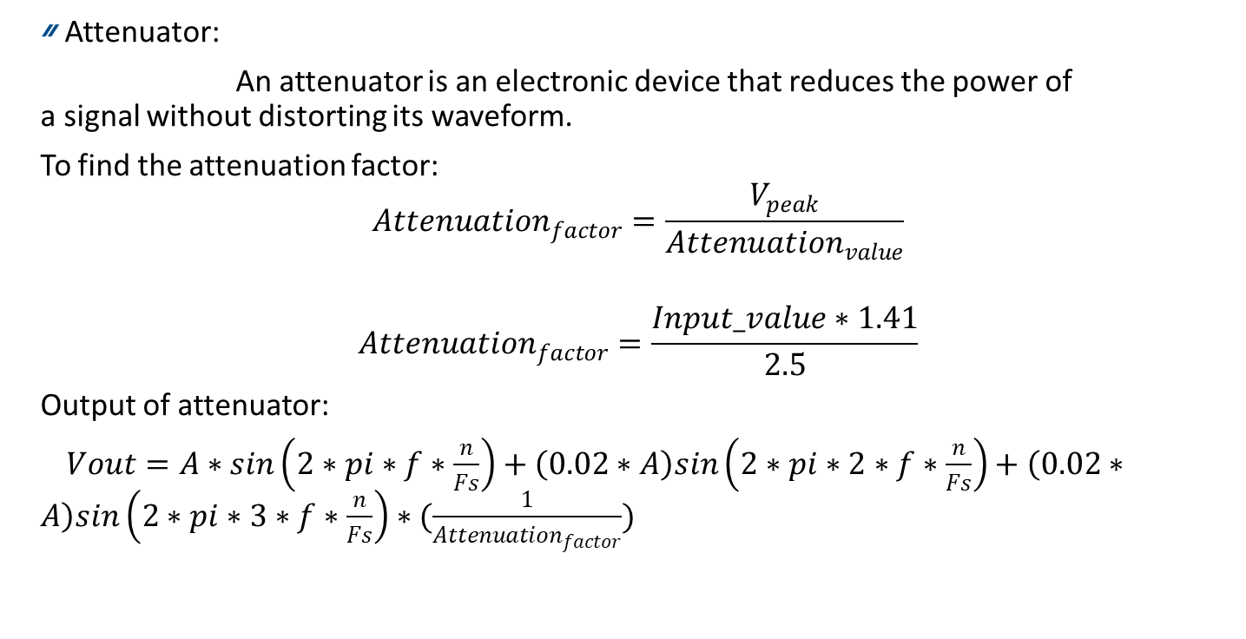
Attenuator:
An attenuator is an electronic device that reduces the power of a signal without distorting its waveform.
To find the attenuation factor:
$$Attenuation_{factor}=\frac{V_{peak}}{Attenuation_{value}}$$
$$Attenuation_{factor}=\frac{Input_value∗1.41}{2.5}$$
Output of attenuator:
$Vout=A∗sin\left(2∗pi∗f∗\frac{n}{Fs}\right)+\left(0.02∗A\right)sin\left(2∗pi∗2∗f∗\frac{n}{Fs}\right)+\left(0.02∗A\right)sin\left(2∗pi∗3∗f∗\frac{n}{Fs}\right)∗(\frac{1}{Attenuation_{factor}})$

Slide 12
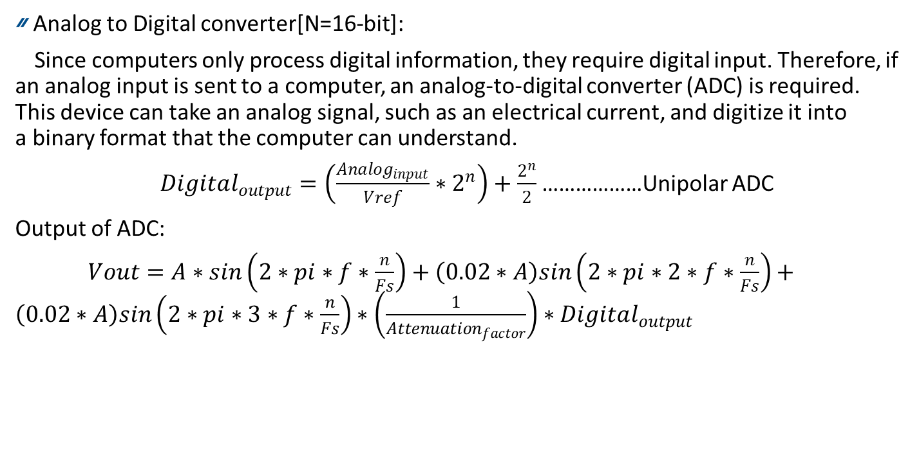
Analog to Digital converter[N=16-bit]:
Since computers only process digital information, they require digital input. Therefore, if an analog input is sent to a computer, an analog-to-digital converter (ADC) is required. This device can take an analog signal, such as an electrical current, and digitize it into a binary format that the computer can understand.
$Digital_{output}=\left(\frac{Analog_{input}}{Vref}∗2^{n}\right)+\frac{2^{n}}{2}$………………Unipolar ADC
Output of ADC:
$Vout=A∗sin\left(2∗pi∗f∗\frac{n}{Fs}\right)+\left(0.02∗A\right)sin\left(2∗pi∗2∗f∗\frac{n}{Fs}\right)+\left(0.02∗A\right)sin\left(2∗pi∗3∗f∗\frac{n}{Fs}\right)∗\left(\frac{1}{Attenuation_{factor}}\right)∗Digital_{output}$

Slide 13
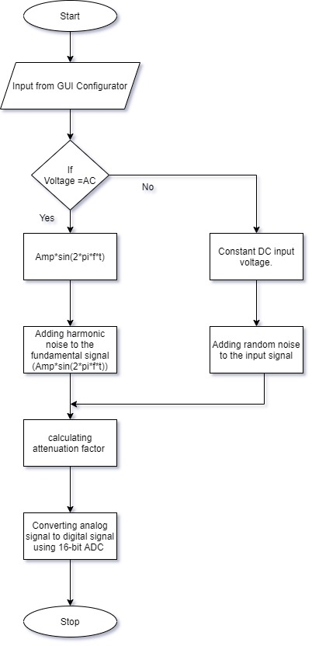
Flow chart

Slide 14
Digital Filters
Filter Circuit is different for AC as well as DC input signals
For AC signal Butterworth Bandpass filter is used to filter out the Harmonic Noise from the input Signal. The characteristics of the filter are as follows:
Order = 3
Lower Cutoff Frequency = 40Hz
Upper Cutoff Frequency = 70Hz
Sampling Rate = 1kHz
For DC signal a Butterworth Low Pass Filter coupled with a 1D Gaussian Filter is used to eliminate the random noise. The characteristics of the lowpass filters are as follows:
Order = 2
Cutoff Frequency = 25Hz
Sampling Rate = 1khz
The characteristics of the Gaussian Filter are as follows:
Order = 1
Sigma = 7

Slide 15
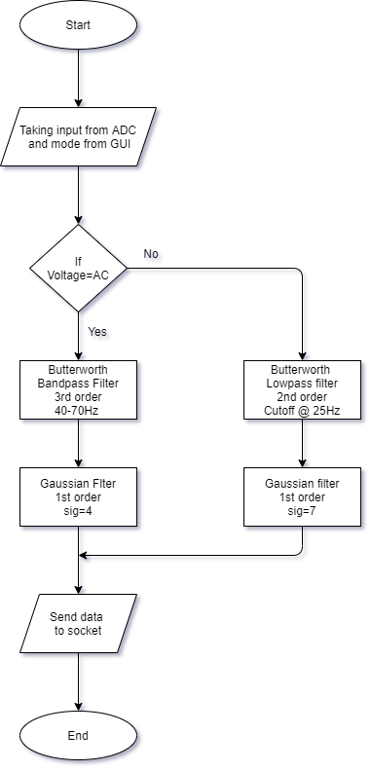
Filtering Flowchart

Slide 16
Data serialization
The output from filters is of 2bytes.
The 2 bytes data must be converted into individual single bytes by serialization.
The converted data is sent as input to the sockets.
Filters output(2 bytes)
serializer
1 Byte
Socket

Slide 17
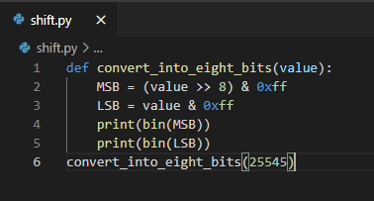
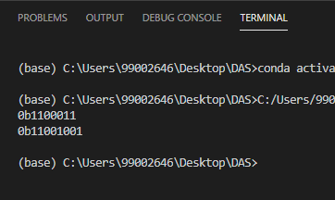
Shift operators are binary and bit working operators.
In the socket 1 we have used right shift operator. Where the values passed will be converted into 8 bits each.
These converted bits are sent over the sockets.

Slide 18
Sockets
A socket is a two-way communication link between two programs running on the network.
Initially the Socket-1 program is executed to establish a connection to Socket-2.
The data from Socket-1 such as type of measurement, Attenuation factor, Range, Input voltage and data values are passed through Socket-2.
type of measurement
Attenuation factor
Range
Input voltage
data values
Socket-1
Socket-2

Slide 19
De-serializer
The data from socket-2 has to be de-serialized to 16 bit.
The 16 bit data is sent further for measurement calculations.
Socket-2
De-serializer
2-byte
Measurement calculation

Slide 20
Measurement Calculations
The physical quantities coming from the socket after being deserialised need to be converted to a physical quantity value which is in a human readable form.
The converted values are then used to find the Vrms & Vmax for the AC inputs and Vavrg for DC inputs
These values are thus displayed on the GUI

Slide 21
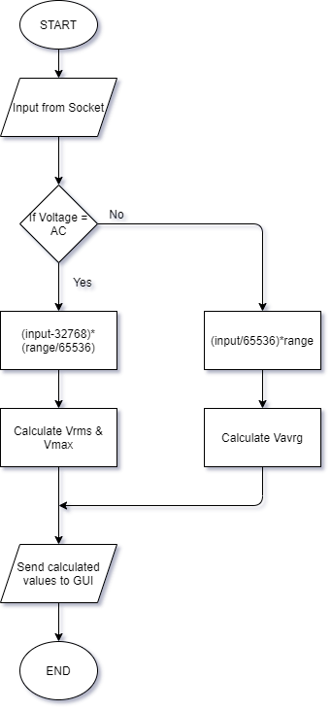

Slide 22
User Interface
The User Interface is designed in Python language by using TKinter Module.
The User Interface has different widgets like Buttons, Labels, Entry box, Option Menu.
Libraries used to design User Interface:
Tkinter: Used to create widgets in user interface.
Matplotlib: This library mainly used for plotting graph.
Animation: Animation library used for plot the continuous graph.

Slide 23
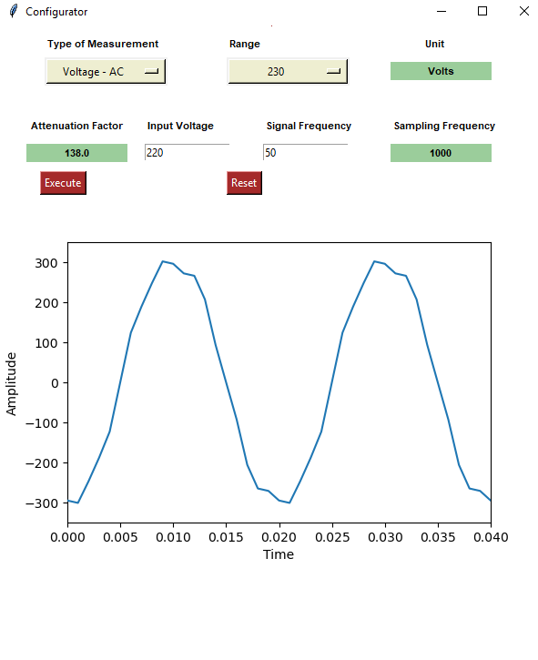
User Interface for Configurator
The Configurator UI has
Option menu for selecting type of measurement and range.
Label for displaying the unit, attenuation factor and sampling frequency.
Entry for taking input of voltage and signal frequency from user.
Button for read data and plot the input signal.
The input from the user will read from the Configurator GUI.
That data will have sent to source.
Then it plots the input signal

Slide 24
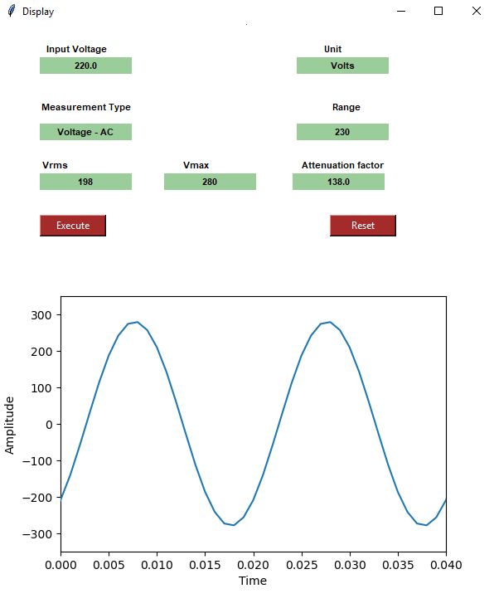
User Interface for Display
The Display UI has
Label for displaying the input voltage, unit, measurement type, range and attenuation factor.
If the measurement type is AC, the Vrms and Vmax value will be displayed in the GUI.
If the measurement type is DC, only the Vavg value will be displayed in the GUI.
Button to plot the output signal

Slide 25
Thank you

