Slide 1


Slide 2
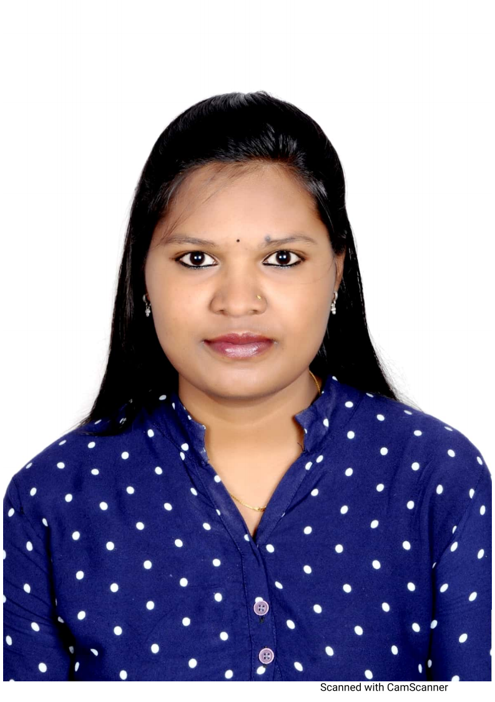
Project Highlights
Project Name : Matrix Multiplication Using Threading
Team Size : 1
BU Mentor Name : Jagdish Prasad Sahu Mentor PS#20008728
Team Members Details
Asha N
PS#99002646
2009BLRMED01
B.E(Computer Science and Engineering)

Slide 3
Project Video Snippet

Slide 4
Future development that can be implemented further
Taking inputs from the user
Implementing the deadlock concepts
GitHup repository link:
https://github.com/99002646/MiniProject_Linux.git

Slide 5

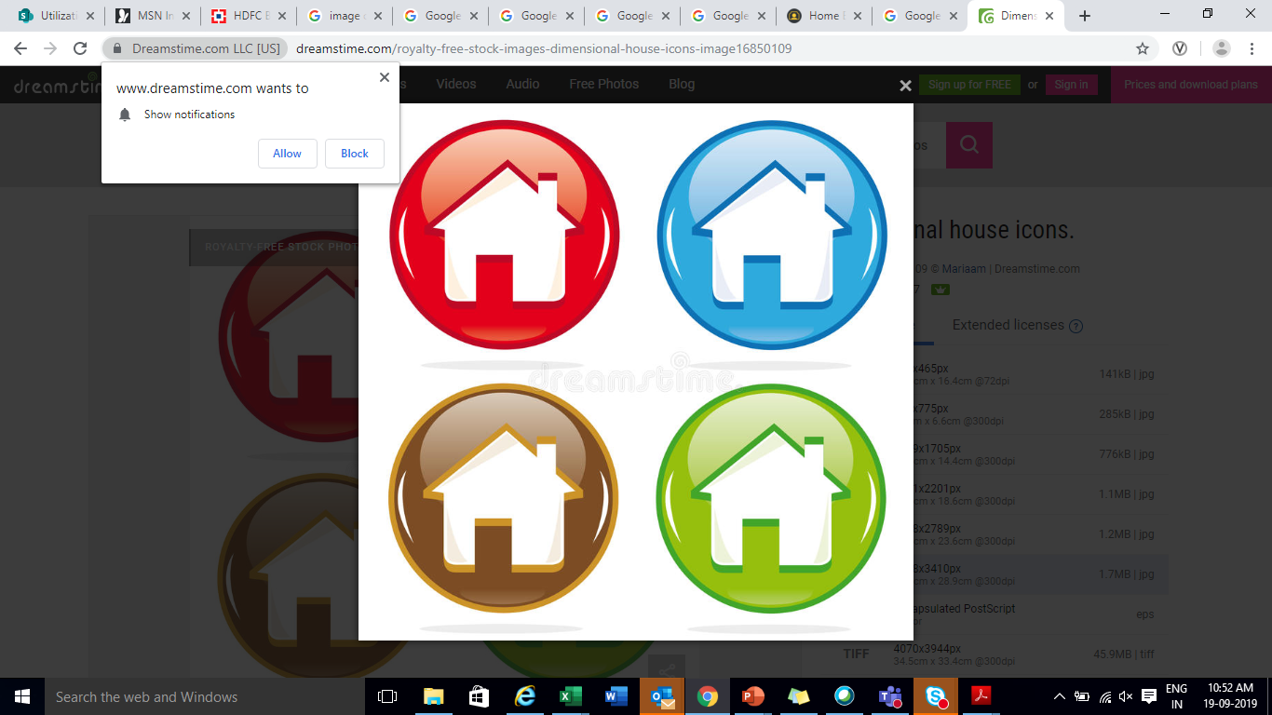
Thank You !

