Slide 1


Slide 2
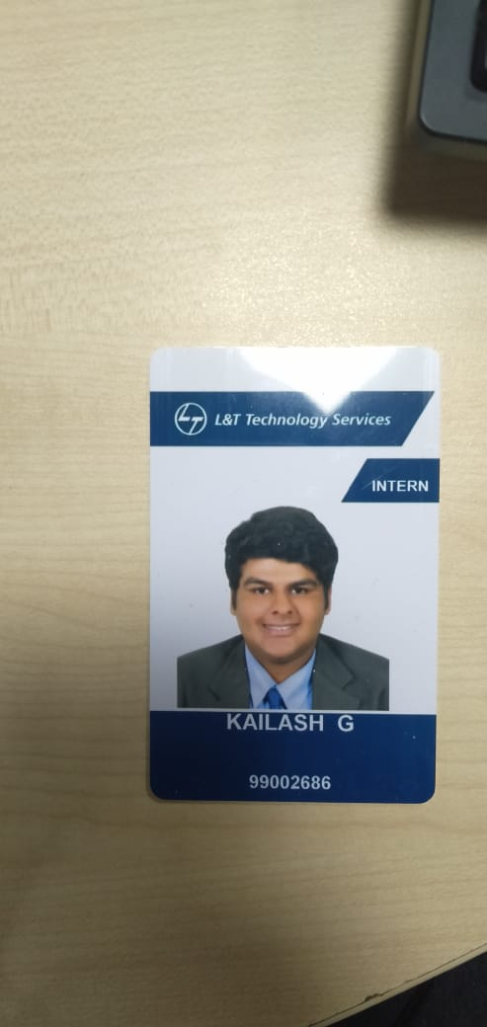
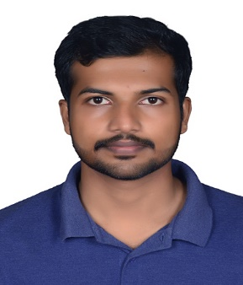
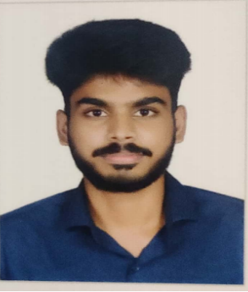
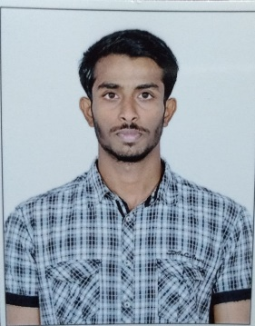
Project Highlights
Project Name : Reverse Sensor with camera and ultrasonic
Team Size : 4
Team Members Details
Kailash G
99002686
2009MYSEMB01
B.E in ECE
Rejith Retnan
99002677
2009MYSEMB01
B.tech in ECE
Devadath G
99002676
2009MYSEMB01
B.tech in AI
Ashwin M
99002601
2009MYSEMB01
B.E in EEE

Slide 3
Project Video Snippet

Slide 4
Future development that can be implemented further
The system developed by this process would be used as an alternative to traditional CCTV cameras in the field of surveil-lance and security.
With the help of this development board open source developers and other hobbyists will have the expandability of desktop machines without the problems of expense, bulk or noise.
Since the Beagle board and Beagle bone are supported by a vast open-source community, there is a large scope for many potential future projects. Viz
1. Web services development
2. Notebook TV-out via USB
3. USB class conversion (software support must be added where drivers aren't available on the PC)
4. telemetric and automation of vehicles
5. Kitchen computer
Many workshops can be conducted on the same topic to spread the knowledge among the student body and also to enable various student projects without the need of heavy infrastructure to come to fruition.
It is powerful and low cost, its size is very small, com-pared it is smaller than index card size.

Slide 5

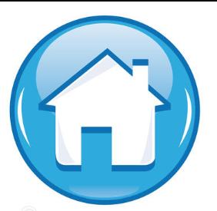
Thank You !

