Slide 1
TEAM MEMBERS
1)
2)
3)
4)
5)

Slide 2
FMEA(FAILURE MODES EFFECTS ANALYSIS)
A FMEA Looks at realistic potential problems
It rates the problems with a numerical score
Evaluation has 3 numeric categories
severity – How bad it is to be
occurrence – frequency of happening
Detectability – probability to detect that

Slide 3
Process of FMEA in Automotive industry

Slide 4
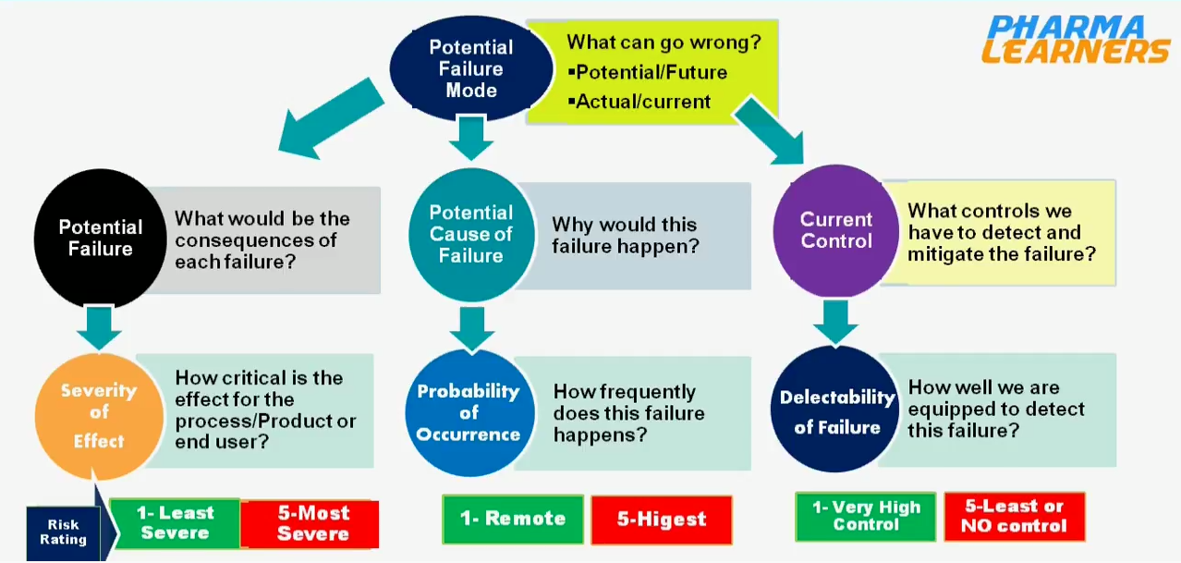
Approach how to give rating numbers

Slide 5
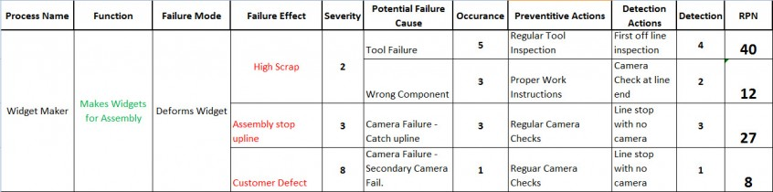
RPN Calculation and reducing the risk
RPN calculation
RPN(Risk Priority Number)= (severity * occurrence *Detectability )
As RPN is high risk involved is high and vice versa
RPN reduction
severity cant be changed where occurrence and detectability can be changed
For multiple failure mode(processes) RPN’s of individual process gets added up

