Slide 1

MATH IN CONTROL SYSTEMS

Slide 2

Contents
1
DIFFERENTIAL EQUATIONS
2
LAPLACE TRANSFORM
3
INITIAL VALUE THEOREM
4
FINAL VALUE THEOREM
5
FOURIER TRANSFORM

Slide 3

DIFFERENTIAL EQUATIONS

Slide 4
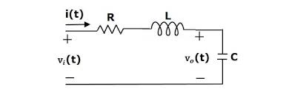
WHY MATHEMATICAL MODELLING?
To represent a physical system in the form of mathematical equations and this is done by applying the fundamental physical laws of science and engineering.
The first and foremost modelling is the differential equation modelling.
Image Reference: https://www.google.com/search?q=image+of+converting+physical+system+in+the+form+of+mathematical+equation&rlz=1C1GCEU_enIN940IN940&sxsrf=ALeKk0149A_hQDud0HpMRU-k40ijqfPlSQ:1616396493044&source=lnms&tbm=isch&sa=X&ved=2ahUKEwj3oaKWqsPvAhWt63MBHfTrCr4Q_AUoAXoECAEQAw&biw=1280&bih=913

Slide 5

DIFFERENTIAL EQUATION MODEL
Let us consider a simple RLC Circuit
Using Kirchhoff's Voltage Law
Kirchhoff’s Voltage Law or KVL, states that “in any closed loop network, the total voltage around the loop is equal to the sum of all the voltage drops within the same loop”
Vi = Ri+ L(di/dt) + Vo……………………(1)
Converting Current ‘i’ in terms of voltage
i = C(dVo/dt)
Vi = RC(dVo/dt) + LC (d^2Vo/dt^2) +Vo
(1/LC) = (R/L)(dVo/dt) + d^2Vo/dt^2 + (1/LC)Vo

Slide 6
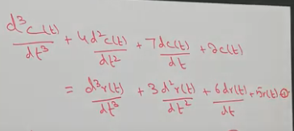
THIRD ORDER DIFFERENTIAL EQUATION
It is very difficult to solve higher order differential equations
So, to overcome this Laplace transform and Fourier transform came into picture.
r(t) c(t)
Image Reference: https://www.youtube.com/watch?v=jy6Fro2K9QY
System

Slide 7
LAPLACE TRANSFORM

Slide 8
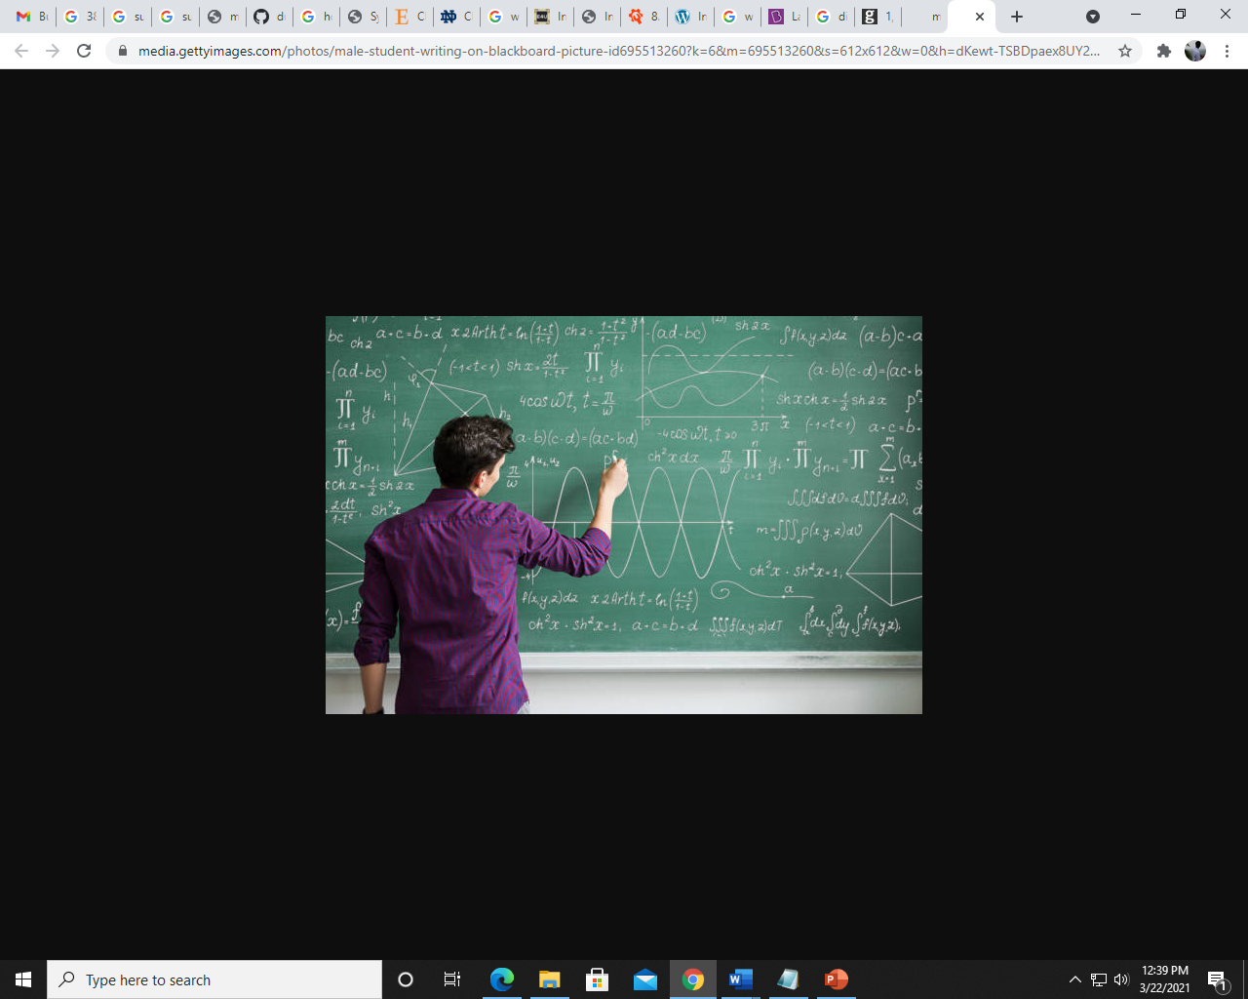
WHY LAPLACE TRANSFORM?
It is more difficulty in solving the differential equations.
Change the differential equations to other transform which can be solved easily.
So Laplace is used to convert differential to algebraic equations.
Algebraic equations can be easily solved compared to differential equations.
Image source : google pic

Slide 9
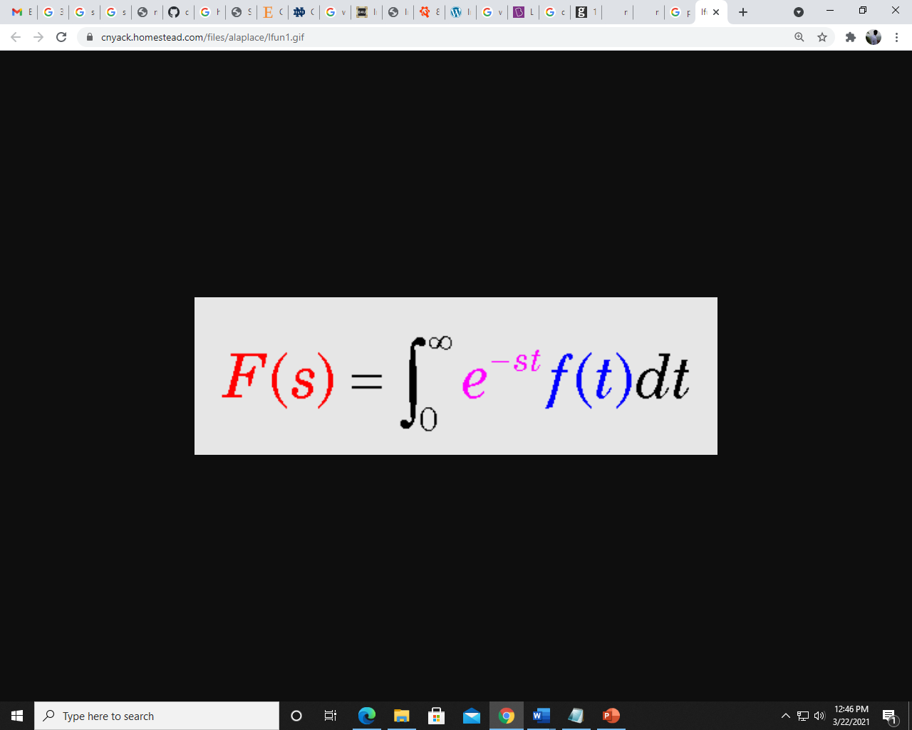
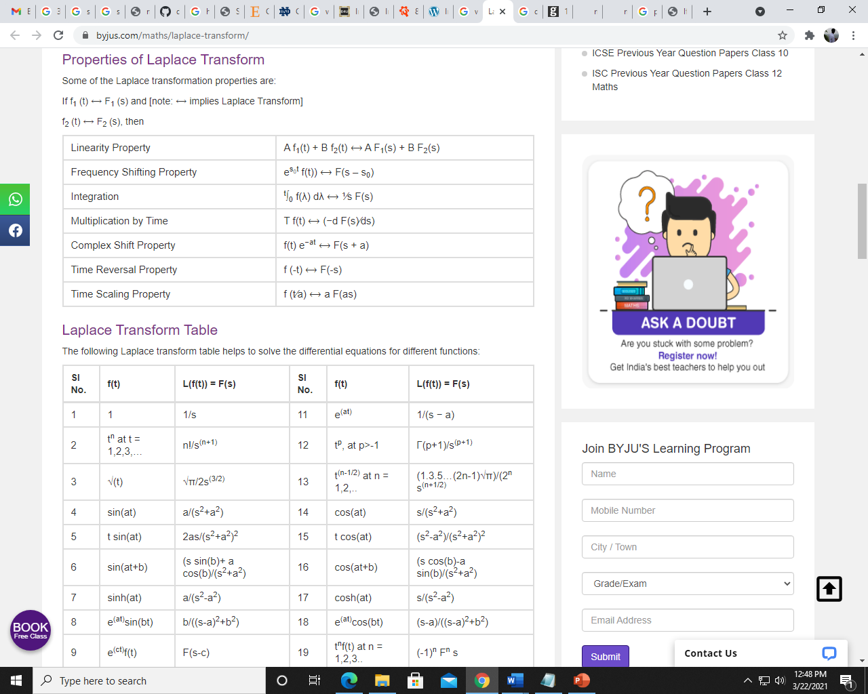
FORMULA AND PROPERTIES OF LT
Laplace transform is the integral transform of the given derivative function with real variable t to convert into a complex function with variable s.
The Laplace transform of f(t), that is denoted by L{f(t)} or F(s) .

Slide 10
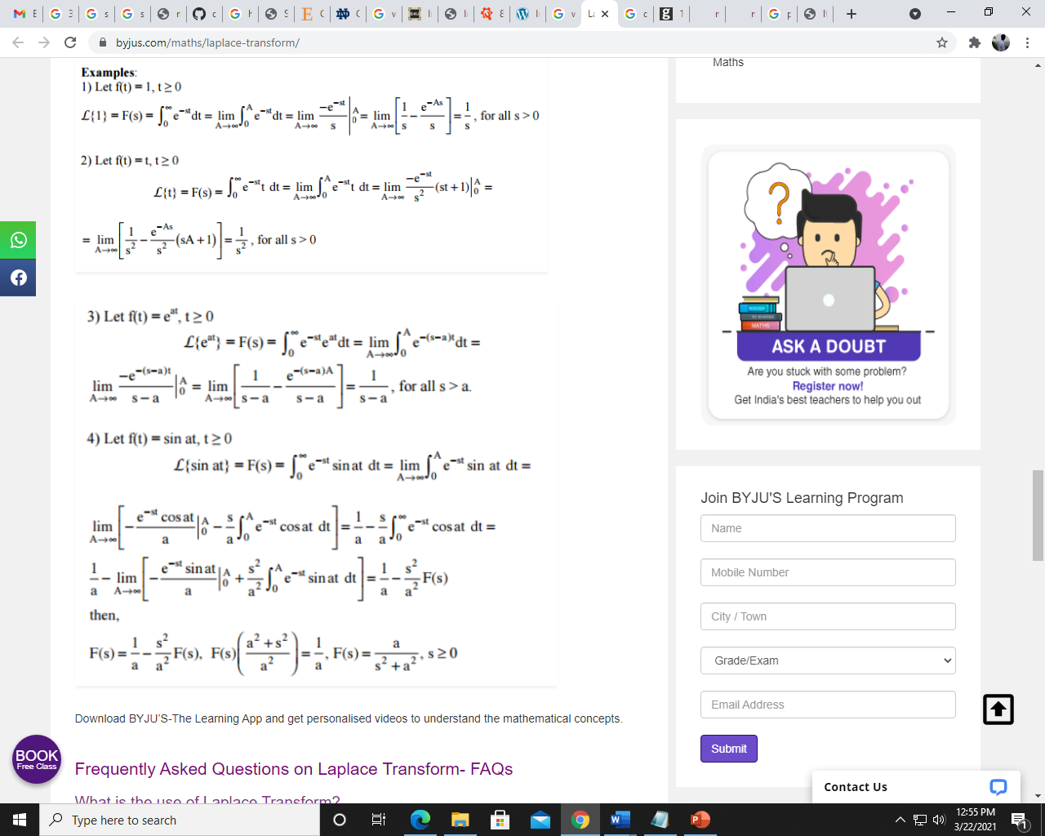
APPLICATIONS AND EXAMPLE
It is used to convert complex differential equations to a simpler form having polynomials.
It is used to convert derivatives into multiple domain variables and then convert the polynomials back to the differential equation using Inverse Laplace transform.
It is also used for many engineering tasks such as Electrical Circuit Analysis, Digital Signal Processing, System Modelling, etc.
For more information on Laplace Transform : https://byjus.com/maths/laplace-transform/
Image source : google pic

Slide 11
INITIAL VALUE THEOREM

Slide 12
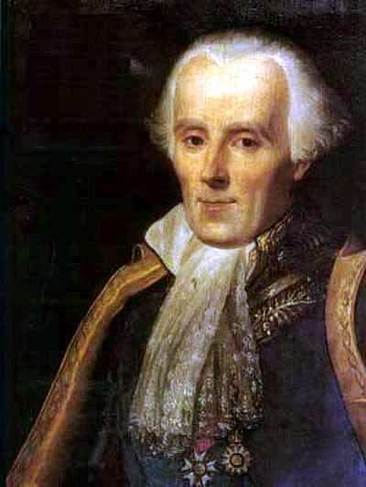
WHAT IS IVT? WHY IVT?
WHAT?
Value of the function at t=0.
It was given by prominent French Mathematical Physicist Pierre De Laplace.
Initial value theorem and Final value theorem are together called as Limiting Theorems.
WHY?
Gives us the ease of not needing to convert back to time domain.

Slide 13
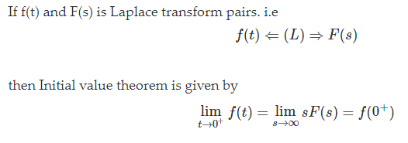
CONDITION FOR IVT
Applicable only when f(t)=0 for t<0.
f(t) must not contain any impulse or higher order singularities at t=0.
If above 2 are satisfied, then IVT can be used:

Slide 14
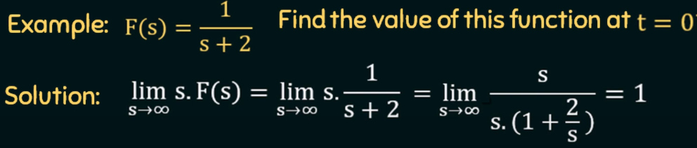
EXAMPLE FOR IVT

Slide 15
FINAL VALUE THEOREM

Slide 16
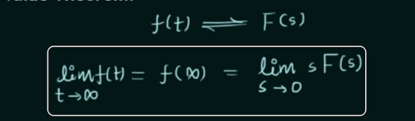
FINAL VALUE THEOREM
WHAT
IT IS PROPERTY OF LAPLACE TRANSFORM.
It is used to find out the final value of time domain signal f(t) when we are available with the spectrum of that function F(s).
CONDITIONS
It is applicable If and only if f(t) and its first derivative must be Laplace transformable.
Applicable only when f(t)= 0,t<0 (when ROC is given)
SF(S) must have poles in the left half of the S plane.
Property :

Slide 17
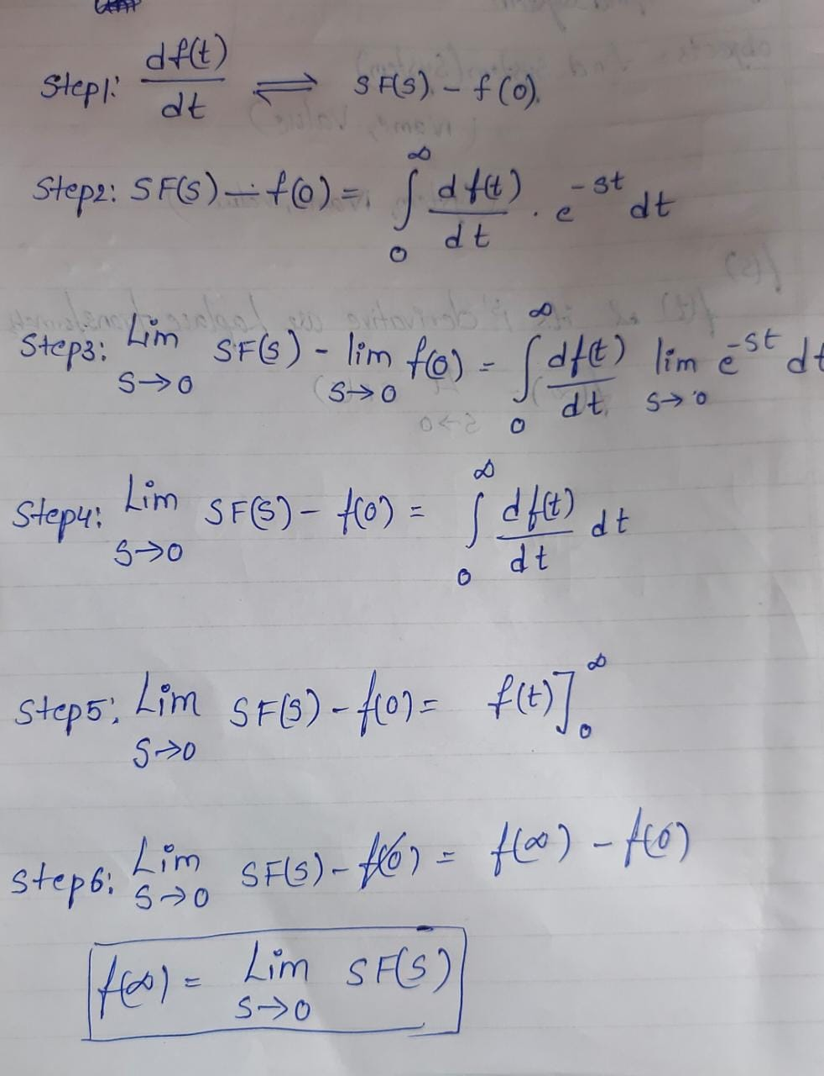
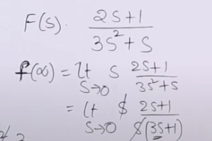
PROOF OF FVT AND EXAMPLE
Final Value of This system is 1
Example source: https://www.youtube.com/watch?v=wjfjuridTEs

Slide 18
APPLICATIONS AND LIMITATIONS
APPLICATIONS:
Steady state gain can be found by applying Final Value Theorem without inverse Laplace Transform.
Steady State Gain = lim [sT / (1+sT)]
s→0
= lim [T / (1/s+T)]
s→0
= 0
To find out the final value of a spectrum.
LIMITATIONS:
It cannot be applicable for unstable system.
systems without damping.
References: https://www.google.com/search?q=REAL+TIME+applications+and+uses+of+Final+Value+Theorem+&rlz=1C1GCEU_enIN940IN940&sxsrf=ALeKk03IuM0FudytDjZ65Ll9jrqRVoWgWg%3A1616398402054&ei=QkhYYKP0AojAz7sP5tyl6Aw&oq=REAL+TIME+applications+and+uses+of+Final+Value+Theorem+&gs_lcp=Cgdnd3Mtd2l6EAM6BwgjELADECc6BwgAEEcQsAM6BwgjEK4CECc6BQgAEM0CULoMWKhtYOtxaARwAngAgAGhAogBrxmSAQYwLjE1LjKYAQCgAQGqAQdnd3Mtd2l6yAEJwAEB&sclient=gws-wiz&ved=0ahUKEwijncekscPvAhUI4HMBHWZuCc0Q4dUDCA0&uact=5

Slide 19
FOURIER TRANSFORM

Slide 20


INTRODUCTION
Why do we need Fourier analysis?
A transformation is an operation that translates one mathematical representation of a signal into another. Ideally, you would want your transformation to be a one-to-one mapping, meaning you can translate back and forth between your starting signal and your transformed signal without losing too much information
The Fourier Transform is used to break a time-domain signal into its frequency domain components. The Fourier Transform is very closely related to the Laplace Transform, and is only used in place of the Laplace transform when the system is being analyzed in a frequency context.
Fourier Transform:
Inverse Fourier Transform:
Reference:https://en.wikipedia.org/wiki/Fourier_transform

Slide 21


PROPERTIES OF FOURIER TRANSFORM
They are:
Linearity
Translation/ time shifting
Modulation/ frequency shifting
Time scaling
Parseval’s Theorem:
Duality Principle:
Reference:https://en.wikipedia.org/wiki/Fourier_transform

Slide 22
APPLICATIONS OF FOURIER TRANSFORM
They are:
Analysis of differential equations
Fourier transform spectroscopy
Quantum mechanics
Signal Processing
Reference:https://en.wikipedia.org/wiki/Fourier_transform

Slide 23
TEAM MEMBERS

Slide 24
TEAM MEMBERS
PS:NO | NAME | CONTRIBUTION
99003725 | Sai Kalki Patamsetti | FINAL VALUE THEOREM
99003727 | Shivakumar Naga Vankadhara | FOURIER TRANSFORM
99003729 | Pushkar Antony | INITIAL VALUE THEOREM
99003759 | Rama Subba Reddy | LAPLACE TRANSFORM
99003778 | Jyothi Swaroopa Rani | DIFFERENTIAL EQUATIONS

Slide 25
THANK YOU!

