Slide 1


Automotive Systems and Overview

Slide 2

Agenda
Session 1
Session 2
Session 3
Session 4
Session 5
Session 6
Summary

Slide 3

Version
Version | Reviewed by | Approved by | Remarks

Slide 4
Outcome of the Sections

Slide 5
Internal Combustion Engine

Slide 6
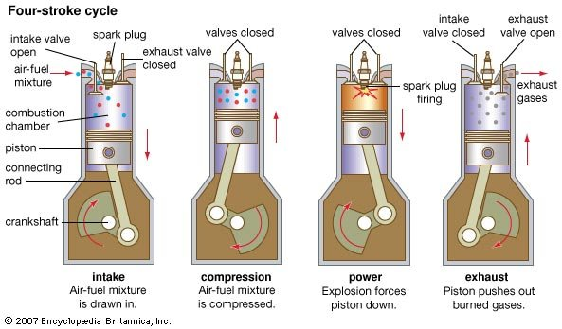
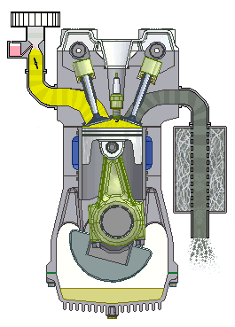
4-Stroke Petrol Engine Working:
Intake Cycle
Compression Cycle
Power Cycle
Exhaust Cycle

Slide 7
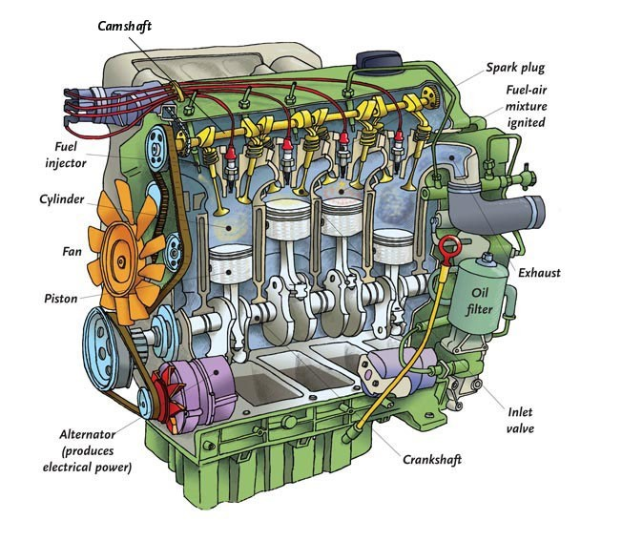
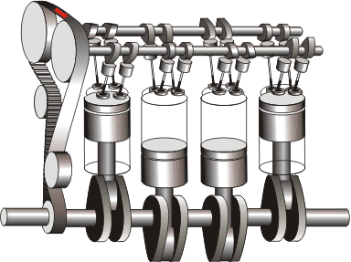
4-Stroke Diesel Engine:
Intake Cycle
Compression Cycle
Power Cycle
Exhaust Cycle

Slide 8
Type | Definition | Advantage | Disadvantage | Vehicles used in
DC series motor | It was the most widely used motor for traction application in the early 1900s. It contains brushes and commutators | DC motor delivers a good high accelerating during overload | Bulky structure High maintenance | Indian railways Tesla
Brushless DC motors | It is called brushless because it does not have the commutator and brush arrangement. The commutation is done electronically in this motor because of this BLDC motors are maintenance free. | Increased efficiency Reduced noise No sparking effect | Short constant power range | Electric vehicles Volta automotive Speego vehicles
Permanent magnet synchronous motor | This motor is also similar to BLDC motor which has permanent magnets on the rotor. The difference is that PMSM has sinusoidal back EMF whereas BLDC has trapezoidal back EMF. | Efficient High torque even at low speed | Cost is too high | Toyota Prius Ford focus electric BMW I3

Slide 9
Types of energy sources in EV

Slide 10
1. Batteries
Battery type can vary based on if the vehicle is all-electric (AEV) or plug-in hybrid electric (PHEV).
Battery electric vehicle can last typically p to 8 years or 100,000 miles
All-electric vehicles have an electric traction motor in place of the internal combustion engine used in gasoline-powered cars.
For AEVs, the battery is typically charged through a standard connector and receptacle that works with any Level 1 (120 V AC) or Level 2 (240 V for residential/208 V for commercial) plug.

Slide 11
2. Fuel cells
A FCEVs produce electricity using a fuel cell powered by hydrogen, rather than drawing electricity from only a battery.
Fuel cell is an electrochemical cell that converts the chemical energy of a fuel (often hydrogen) and an oxidizing agent (often oxygen) into electricity through a pair of redox reactions.
Fuel cells can produce electricity continuously for as long as fuel and oxygen are supplied.

