Slide 1


Shadow project Final-Review

Slide 2

Agenda
Synergy Tool Enhancement
Python Scripting
Configuring Jenkins
SCA tool Analysis
Learnings

Slide 3
Project Title: Synergy Tool Enhancement
Synergy tool identifies the gaps between synergy and artefacts and DOORS
Helps traceability mismatches in Doors
Helps improving the quality of the test artifacts which are escaped through oversight
Helps in improving the Artefacts
Navigate to the actual mismatches as the generated report indicates which are all are the mismatches

Slide 4
Python Scripting of Synergy tool
At first I have to write a script which searches the keyword E2 SPDA in synergy tool python file and remove them from that code.
Need to find the error in synergy tools python script.
The first error I encountered is its not accepting the excel file, the problem is its xlrd library has end the excel file reading feature so I need to convert into openpyxl library.
The synergy code is written in python 2.7 version so need to run in same verison
After debugging and resolving the errors in python script need to make the executable file i.e. exe format
To make the python file to executable you need to install pyinstaller library to work in python 2.7 version.
The previous version of synergy tool has the size of 35MB but after the modification and replacing the xlrd library with openpyxl the size becomes 12MB so there is a drastic change in the synergy tool executable.

Slide 5
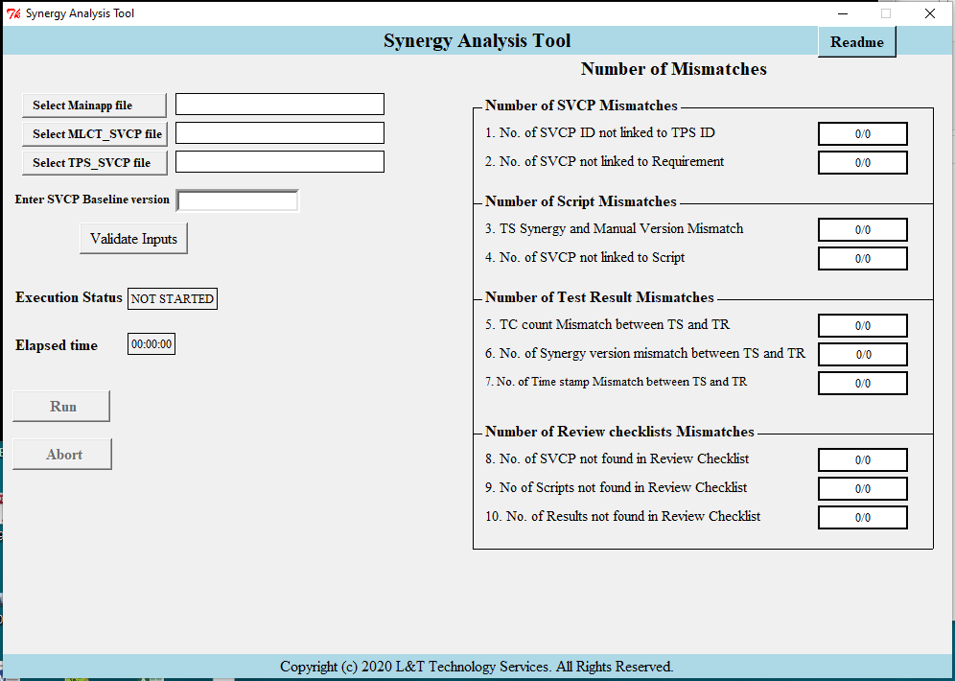
Synergy tool Main Screen
SVCP Mismatches-
SVCP ID’s not linked to TPS ID’s
SVCP not linked to Requirements
Script Mismatches-
Mismatch between Synergy version and Manual versions
SVCP ID not linked to Scripts
Test Result Mismatches-
Test Case count mismatch between scripts and results
Version mismatch between scripts and results
Time stamp mismatch between scripts and results
Review checklists Mismatches-
SVCP not found in review checklists
Scripts not found in review checklists
Results not found in review checklists

Slide 6
Jenkins Software Configuration
Jenkins is a free and open source automation server. It helps automate the parts of software development related to building, testing, and deploying, facilitating continuous integration and continuous delivery.
Plugins have been released for Jenkins that extend its use to projects written in languages other than Java. Plugins are available for integrating Jenkins with most version control systems and bug databases.
From installation to configuration, so that if there is changes in the folder it will trigger it within the time schedules
There are various obstacles while installing the software but it’s the matter of time and hence rectified.
The plugin name FSTrigger is the plugin which trigger automatically when there is any changes in the folder or files

Slide 7
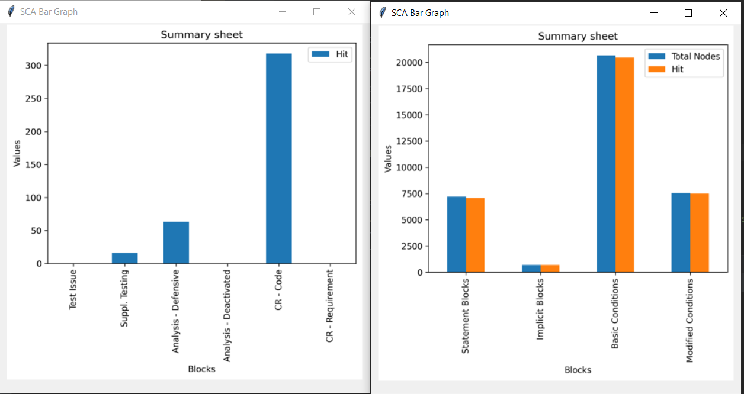
SCA Tool Analysis
This tool is used to take the reports which are generated from Jenkins software and the data is exctracted from html file and placed it in Excel format.
The excel format contains multiple sheet but we need to analyze the “Summary” sheet and plot the graph on that basis.
Combining data of all excel workbook and plotting the graph.

Slide 8
SCA Tool Enhancement
SCA Stands for Static coverage analysis
This tool generate tio and FDC files and output of this is Excel multiple workbooks like SITE, EMULATOR, HSIT each states that how many coverage are passed and how many are remaining
This time what enhancement is done, the GUI takes four excel data i.e. the summary sheet of excel workbook and on the basis of that it plot the graph and display it in html file and it automatically opens in browser with the graphs and labelling displayed in the browser.
The graph consist of percentage covered divided by total number of Nodes.

Slide 9
SCA Codes and Display
SCA code consist of different libraries like tkinter for GUI formation , openpyxl for opening the excel workbook and matplotlib for plotting he graph.

Slide 10
SCA tool and Jenkins Integration
The document states that how to placed the tio and FDC folder in Jenkins so that if anything changes the Jenkins trigger automatically and integrate with python so that it automatically plots the graph.

Slide 11
Learnings
Applying python in building the real world application is so fascinating because you learn a lot with it.
Learning new software which exist like Jenkins Automation tool.
Debugging and understanding the code helps to learn what are the best practices others have applied in the code.

Slide 12


Thank You !

