Slide 1


Shadow Project – CAT Embedded
Arpita A Kulkarni - 99003757

Slide 2
Tool Training

Slide 3
1.Introduction to CANalyzer
CANalyzer is a universal development tool for CAN bus systems, which can assist in observing, analyzing and supplementing data traffic on the bus line.
Measurement Setup
Analysis window:
Trace Window.
Data Window.
Statistics Monitor.
Graphics Window
IG
Data logging
Offline mode

Slide 4
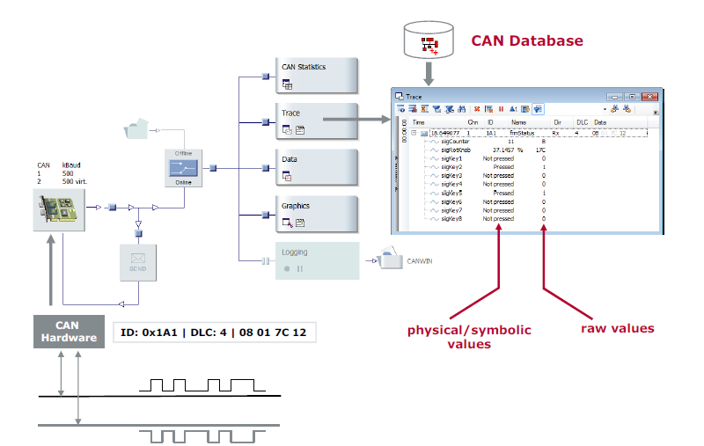
Measurement setup
Represents the data flow
graphically
Insertable function blocks
Centralized configuration
Six analysis blocks
Sending branch
Source: Vector User Guide

Slide 5
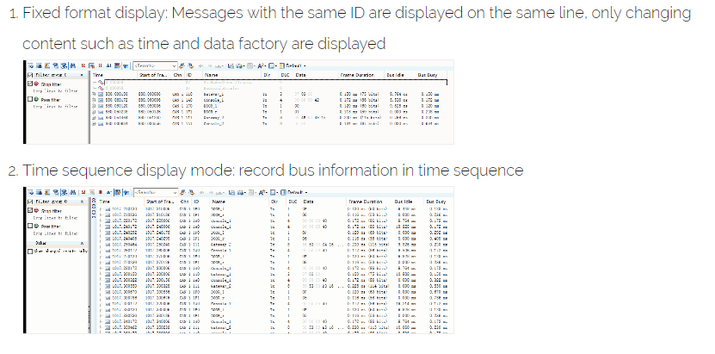
Trace Window
Fixed Format display
Messages with the same ID are displayed on the same line, only changing content such as time and data factory are displayed.
Source: https://programmersought.com/article/87775346106/

Slide 6
Trace window
Time sequence display
Record Bus information in time sequence.
Source: https://programmersought.com/article/87775346106/

Slide 7
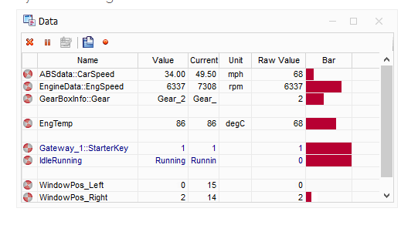
Data window
Data Window for displaying preselected data, eg. numeric or bar graph data.
Source: https://programmersought.com/article/87775346106/

Slide 8
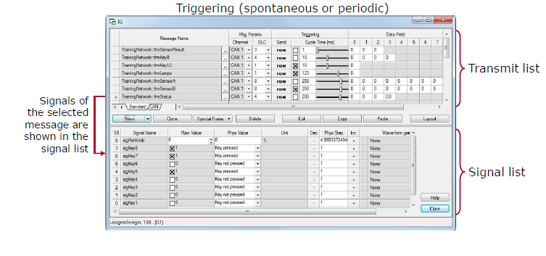
Interactive generator
Interactive Generator messages and
their signals can be configured before
or during the measurement.
Source: Vector User Guide

Slide 9
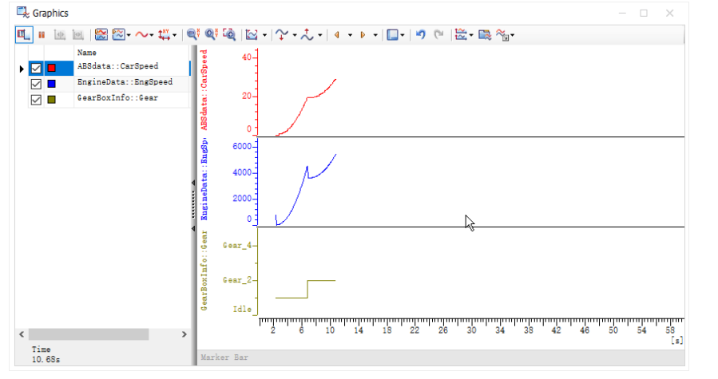
Graphic window
Source: https://programmersought.com/article/87775346106/

Slide 10
2. Introduction to CANape
Configure hardware in vector Hardware found in control panel.
Use A2L files.
Inserting measurement signals.
Hardware Configuration
Control Panel → Vector Hardware → CANcardXL → CANcab 1050opto directories → CANape→ CAN1 and CAN2
Device Configuration
Device→ configuration → Database→ flash a2l files and MAP files(elf).

Slide 11
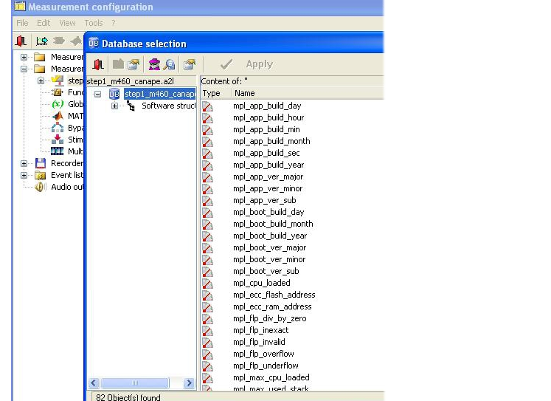
Measurement Configuration
Source:http://support.openecu.com/doc_user/openecu_user_guide_simulink_chunk/tool_canape.html

Slide 12
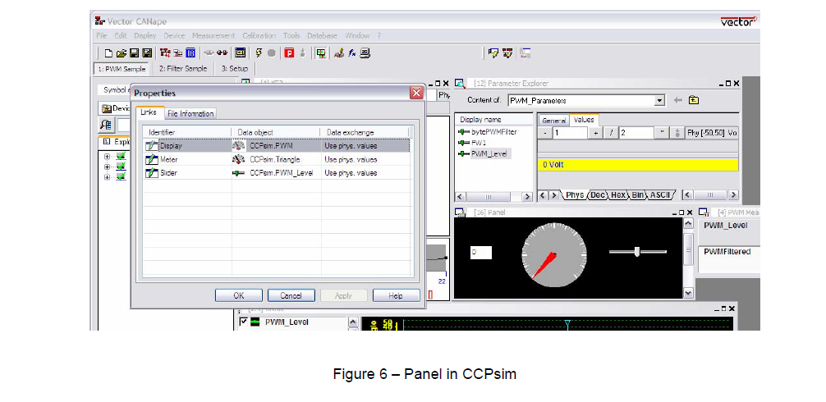
Measurement windows
Numeric Measurement signal
Graphic ,digital, bar , Text, Data.

Slide 13
3. Introduction to CAT ET
Cat ET is the program that customers use to diagnose and repair problems quickly.
Cat ET is a PC based service and electronic information tool which obtains information from electronically controlled Caterpillar equipment.
Cat ET allows customers to view status parameters.
Configuration.
Diagnostic tests.
Diagnostic codes and events.
Active codes
Logged codes
Status flag
Data log
Win flash

Slide 14
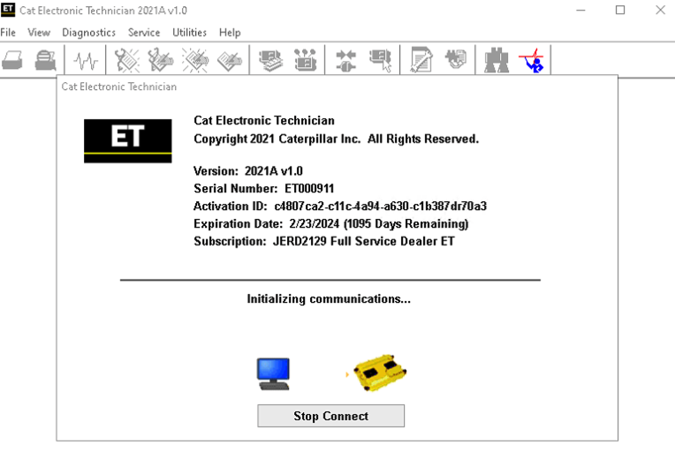
CAT ET- Win flash
Source:
https://the-best-manuals-online.com/products/electronic-technician-et2019a-for-all-caterpillar-models-diagnostics-software-latest-version-2019-online-installation-service?variant=20809425387579

Slide 15
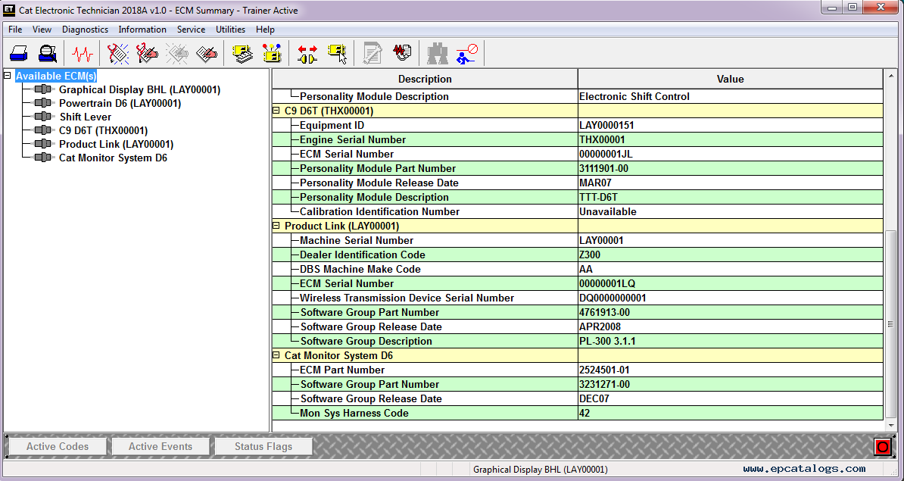
ECM Summary

Slide 16
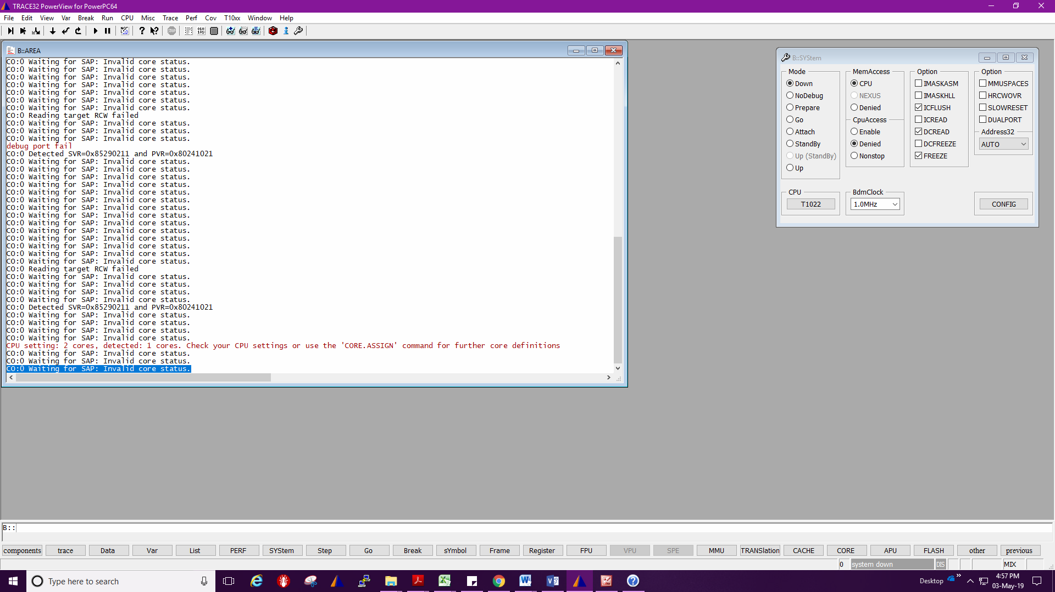
4. Introduction to TRACE32
TRACE32 debugger allows you to test your embedded hardware and software by using the on chip debug interface.
System Configuration.
Target load.
Watch window.
Break points.
List.
Source: Vector user guide

Slide 17
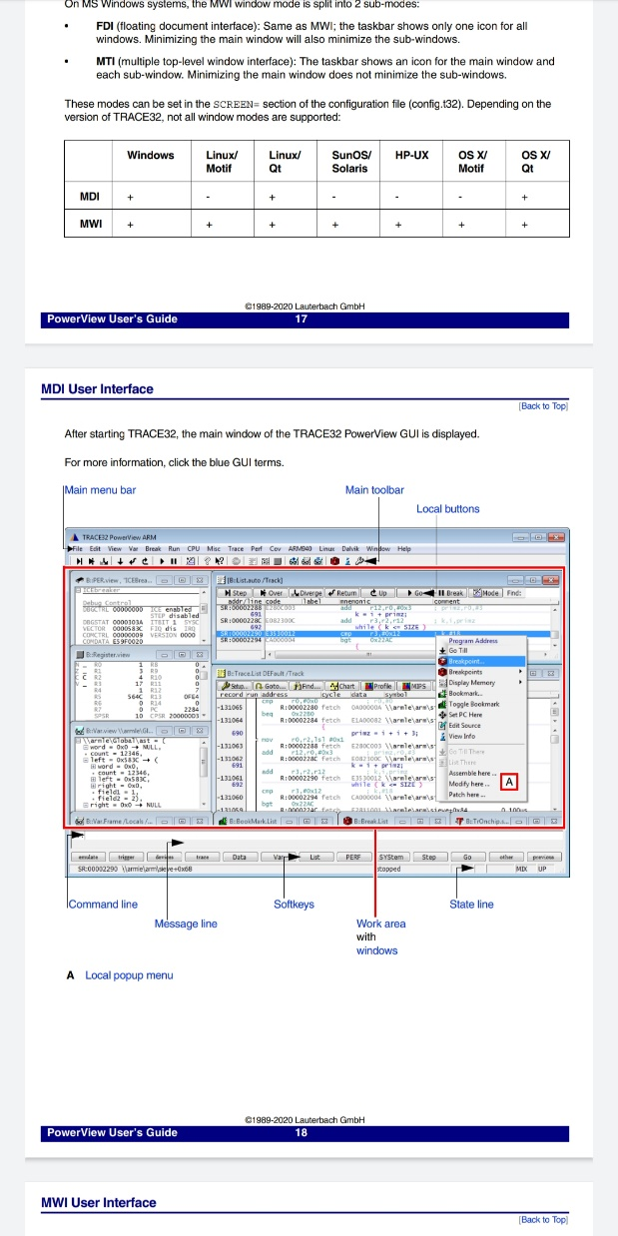
Source: Vector user guide

Slide 18
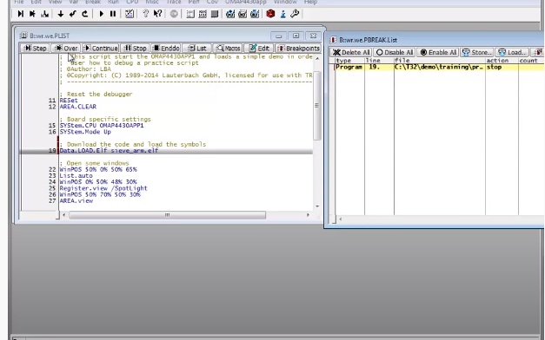
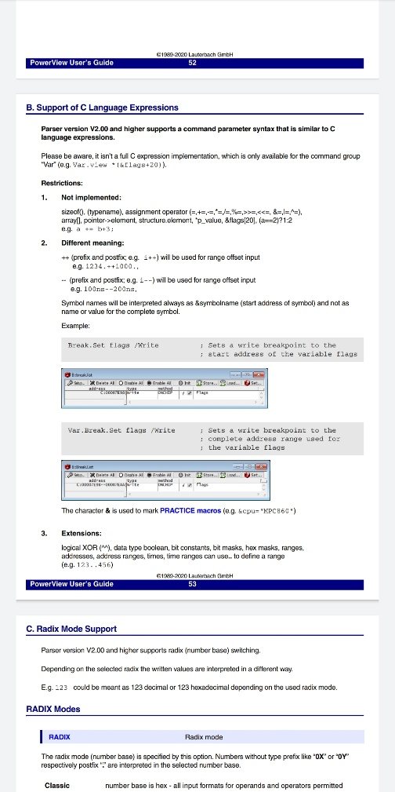
Break points
Source: Vector user guide

Slide 19
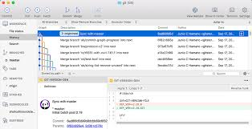
Introduction to GIT tool
Branch.
Commits.
Push.
l Palette

Slide 20
Project DETAILS

Slide 21
Project DETAILS
aim
Re-architect/refactor features associated with TTT application
Document feature architecture and design
Develop and implement re-architected/refactored feature
Create feature interaction test plans, test scripts, automated testing
Report test results
Problem statement:
Requirement to support TTT Application Release.
Objectives & Learning outcomes of the project
Fixing the bug or enhancement in the code as per the change request
Debugging and Testing the software changes
Key Deliverables
Test Report
Design summary

Slide 22
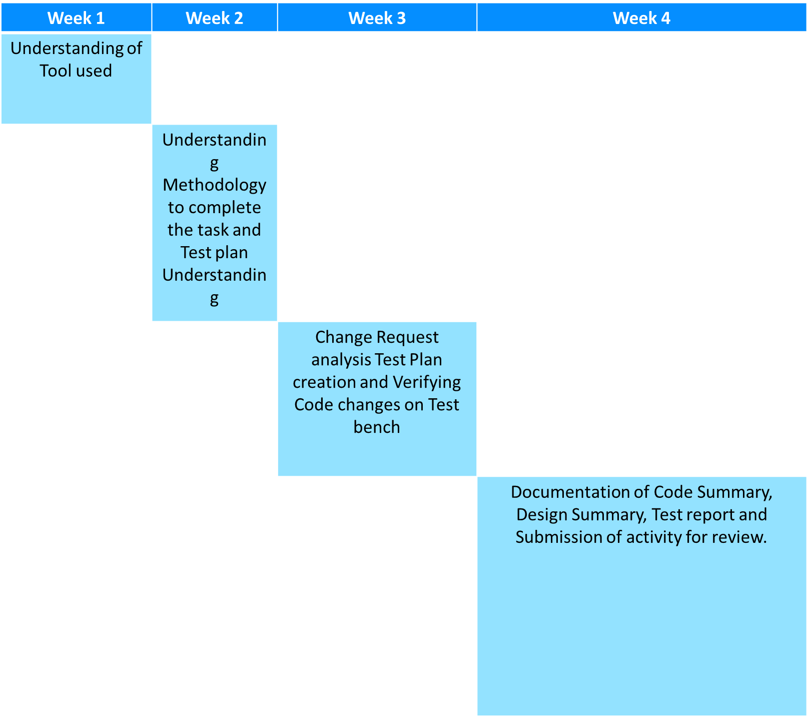
Project Plan

Slide 23
Classification Of Tractor

Slide 24
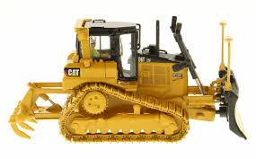
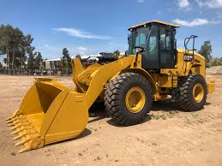
Classification of tractors on drive type
Based on type of drive :
(a) Track type tractors – vehicle that runs on continuous tracks instead of wheels.
(b) Wheel type of tractors – These are most commonly used agricultural tractors. They can run fast and wheel tires absorb a certain amount of field shocks also.

Slide 25
Classification of 4-Wheel type tractor
Four-wheel tractors – These are most commonly used tractors in the country. These are also known as all purpose tractors. On the basis of available power, these have been classified as
(1) Small wheel loader /tractors – 15 to 25 hp.
(2) Medium wheel loader /tractors – 25 to 45 hp.
(3) Large wheel loader /tractors – more than 45 hp.

Slide 26
TTT

Slide 27
TTT-Track Type Tractor
A crawler tractor (track-type tractor/ track-laying vehicle)
In this type of tractors, instead of wheels; one track is fitted on either side. This track gets drive from the sprocket run by rear axle shaft. To steer the tractor, there is not steering gear fitted. The tractor is steered by applying brakes to one side of the track with the other track moving.
TTT have contact with a larger surface area than the wheeled tractor, and as a result exert a much lower force per unit area on the ground than a conventional wheeled tractor of the same weight.
Where it is used?
In agriculture they are used for land clearing and land leveling works.

Slide 28
Extra
While the basic operation of a tracked vehicle is similar to a wheeled vehicle, the main difference lies in steering. Instead of a steering wheel, a track vehicle utilizes a twin stick braking system. The operator applies the brake on the track in the direction of the turn. To turn right, the right track is stopped and the left track drives the vehicle to the right. For a left turn, the brake is applied to the left track and the right track pushes the vehicle around to the left.
This makes them suitable for use on soft, low friction and uneven ground such as mud, ice and snow.

Slide 29
Advantages of tracked loaders?
Low ground pressure
Traction - traction is very high including on slippery surfaces such as snow or wet concrete.
Efficient energy - in comparison to the wheels, the high performance tracks and the well-optimized traction system offer additional energy efficiency.
Rough terrain - tracked machines can work very well on rough terrain. They can climb and descend stairs, overcome obstacles or cross trenches.
Weight distribution - the weight of tracked tractors is very well distributed throughout its surface.
Appearance - Tracked tractors give a feeling of a much stronger product.

Slide 30
Disadvantages
Low speed - due to the much more complex mechanical system, tracked tractors have a much lower speed than those on wheels; • More difficult to handle - Tracked tractors are more precise in terms of maneuverability and require more rotational power; • Short life- the life of the tracks is quite small, which is much more available at break or blocking.
Possible PTO and drawbar interference when making sharp turns
Reduced steering control under heavy draft load (following terraces, contours)
Rough ride and/or vibration on hard surfaces
Not compatible with loaders and dozers
Can’t change tread spacing
Soil berming and more crop damage on end rows
Higher upfront cost
Slower in transport mode than tyres

Slide 31
LWL- Large wheel loader
On the high end, a large wheel loader could deliver over 900 horsepower. The top operating weight is over 290,000 lbs. A wheel loader also has a bucket at the front. You can use it to move debris, carry loads, and clear the ground.

Slide 32
Why?
Its large bucket is handy for scooping and moving dirt and rocks away from an excavation site and loading it into trucks. Loaders can also help to transport material around site. The larger wheel loaders are 7 – 8 yards. These machines are popular for loading gravel trucks or on more heavy-duty projects
Where it is used?
A wheel loader is a piece of heavy machinery. It is a tractor-like cab fitted with four large tires and has a bucket loader at the front. It is used mainly for scooping and moving material in construction, agriculture, or landscaping industries

Slide 33
BENEFITS OF TYRE TRACTORS
Better turning under load
Good compaction
Better for dozing and loader applications
Smoother hard-surface ride
Easier steering
Less maintenance required
Easier to change out tyres for different uses
Less cost upfront
Faster transport
DOWNSIDES OF TYRE TRACTORS
Not great in muddy/wet conditions
Higher slippage
Bumpier ride than tracked, except on hard surfaces
Power hops
Possibility of going flat

Slide 34
Work flow
User story Analysis.
Need to check machine type and platform, depend on machine type location codes varies.
Understanding Issue.
By its description need to understand the issue and Requirements.
Download view for user story.
By doing GIT bash using command for particular machine, we can download source code.
Code changes to meet the acceptance criteria.
Push and commit in Git.
To know the code changes and can merge branch to origin during release.
Build to get elf and fl2 files.
after code changes build to check on unit bench.

Slide 35
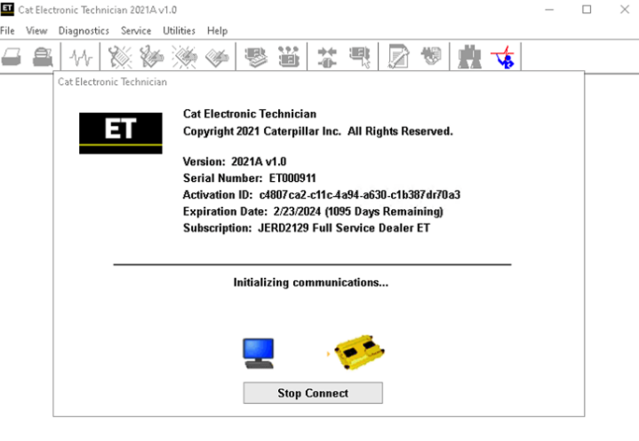
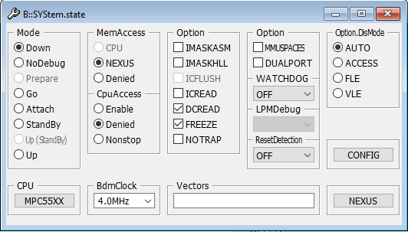
Check for code changes on TRACE32 and CAT ET.
Step 1: Select WinFlash in CATET to load fl2/fls file.
Modify Product ID in the ECM configuration tab
of the CAT ET tool.
Step 2: Connect Trace 32 debugger to the machine ECU and to the PC. Open the Trace 32 debugger application and setup as shown in the pictures below to select the file to download to the target.

Slide 36
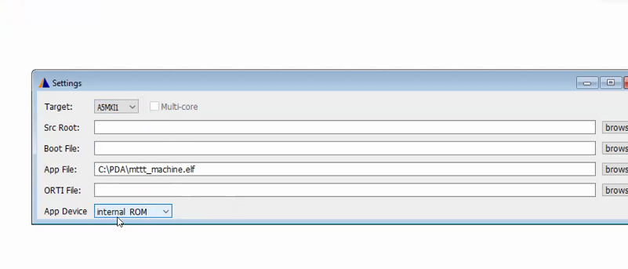
Step 3: Flash the elf file to the Machine ECM, Click the button next to Reset Target to load the application
Need to Check for Platform A5 or A6
Step4: Run

Slide 37
Step 4: If the need to put the breakpoint, then you can add the required source code files in the folder where .elf file is placed.
y.spath = Path
We can check source file by list view or using Symbol.spath.list
Step 5: Add watch variables if you want to see the values in real time.
For each variable there exist 3 parameter value, status and Override.
By Making override=1, we can change value and status accordingly.
Output is checked for all different Input conditions until meet the acceptance criteria.

Slide 38
Test Plan.
TestId, Input, Excepted Output , Actual Output and Result
Test Report.
Design summary.
Code change summary.
Submission of Activity for review.

Slide 39
Work done till now
User story No : 56231(TTT)
Machine Power Test changes(Closed).
User story No :3599 (LWL)
Functional Safety :Operator Not Present(Test Plan)

Slide 40

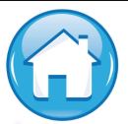
Thank You !

