Slide 1


Shadow Project – CAT Embedded
Arpita A Kulkarni - 99003757

Slide 2
Tool Training

Slide 3
1.Introduction to CANalyzer
CANalyzer is a universal development tool for CAN bus systems, which can assist in observing, analyzing and supplementing data traffic on the bus line.
Measurement Setup
Analysis window:
Trace Window.
Data Window.
Statistics Monitor.
Graphics Window
IG
Data logging
Offline mode

Slide 4
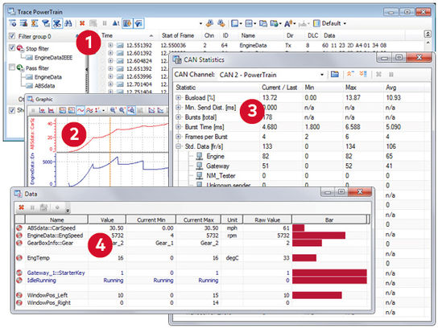

Slide 6
Intelligent CANalyzer analysis windows
As a CANalyzer user you can analyze the network communication of ECUs or entire systems at your work desk or right in the vehicle. These intelligent analysis windows support you:
GrapTrace Window for listing all network activities such as messages or error frames. For each message there is the possibility of displaying the individual signal values.
hics Window for graphical online display for values transmitted in messages and diagnostic requests, such as rpm or temperature values, over a time axis.
Statistics Window for displaying useful network and node statistics, e.g. bus load on node and frame levels, burst counter/duration, counter/rate for frames and errors, controller states.
Data Window for displaying preselected data, eg. numeric or bar graph data.
Further CANalyzer windows and blocks:
Measurement setup for graphic representation and parameterization of function blocks and evaluation functions
Scope window for offline display of measurements of the network levels, logged with option .Scope
Interactive Generator for stimulating the networks and for easy sending of modified signals
Logging/Replay for logging and later analysis or replay of measurements
Triggers and filters to make specific reactions to network events and to reduce the volume of displayed or logged data
Write window for system messages and user-specific outputs from CAPL programs

Slide 7
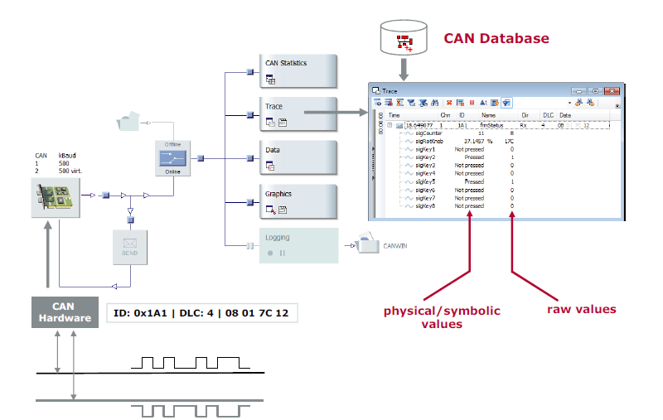
Measurement setup
Represents the data flow
graphically
Insertable function blocks
Centralized configuration
Six analysis blocks
Sending branch
Source: Vector User Guide

Slide 8
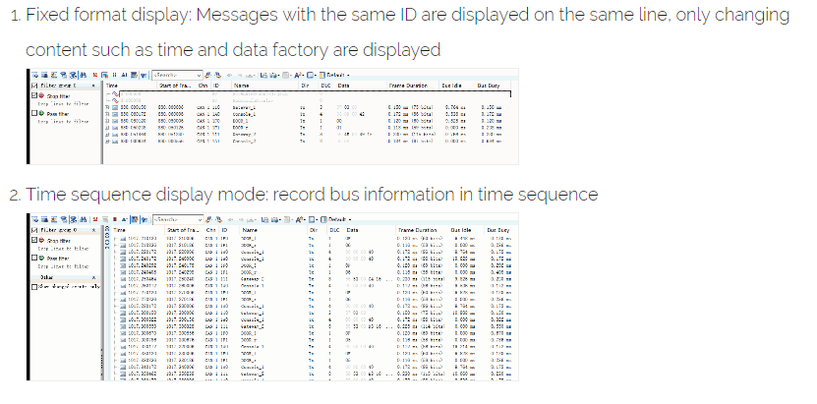
Trace Window
Fixed Format display
Messages with the same ID are displayed on the same line, only changing content such as time and data factory are displayed.
Source: https://programmersought.com/article/87775346106/

Slide 9
Trace window
Time sequence display
Record Bus information in time sequence.
Source: https://programmersought.com/article/87775346106/

Slide 10
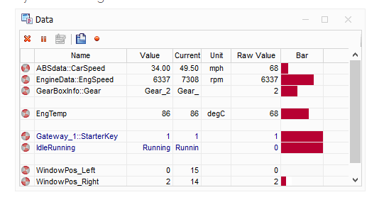
Data window
Source: https://programmersought.com/article/87775346106/

Slide 11
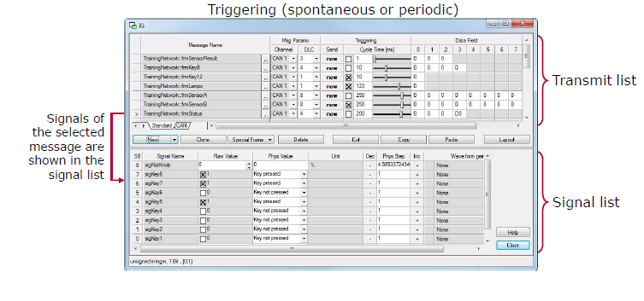
Interactive generator
Interactive Generator messages and
their signals can be configured before
or during the measurement.
Source: Vector User Guide

Slide 12
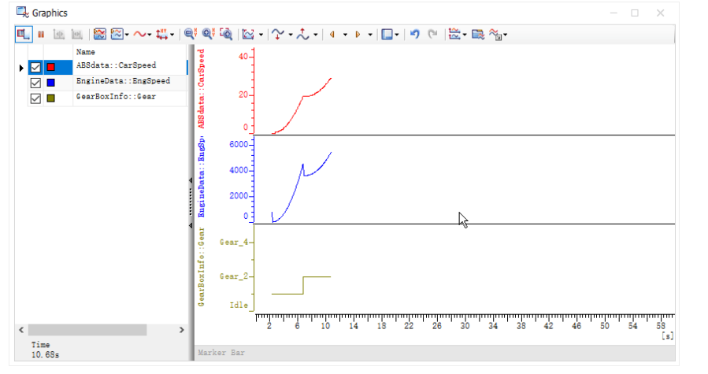
Graphic window
Source: https://programmersought.com/article/87775346106/

Slide 13
2. Introduction to CANape
Configure hardware in vector Hardware found in control panel.
Use A2L files.
Inserting measurement signals.
Hardware Configuration
Control Panel → Vector Hardware → CANcardXL → CANcab 1050opto directories → CANape→ CAN1 and CAN2
Device Configuration
Device→ configuration → Database→ flash a2l files and MAP files(elf).

Slide 14
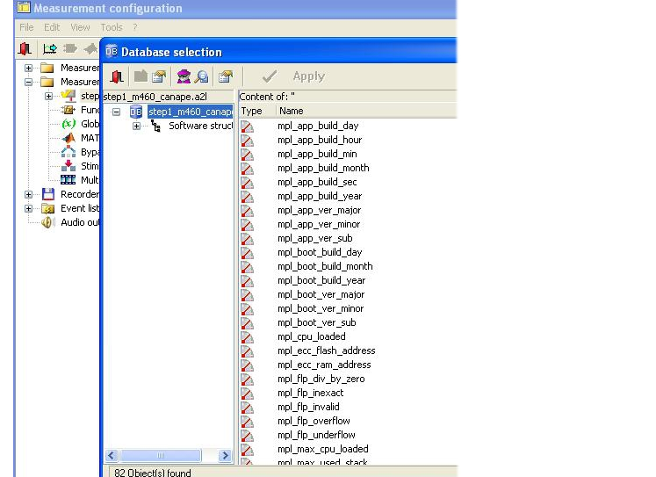
Measurement Configuration
Source:http://support.openecu.com/doc_user/openecu_user_guide_simulink_chunk/tool_canape.html

Slide 15
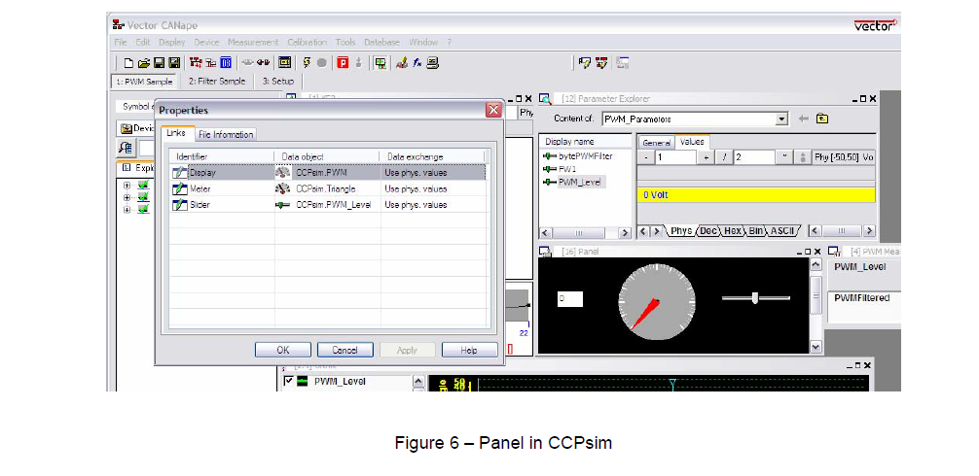
Measurement windows
Numeric Measurement signal
Graphic ,digital, bar , Text, Data.

Slide 16
3. Introduction to CAT ET
Cat ET is the program that customers use to diagnose and repair problems quickly.
Cat ET is a PC based service and electronic information tool which obtains information from electronically controlled Caterpillar equipment.
Cat ET allows customers to view status parameters.
Configuration.
Diagnostic tests.
Diagnostic codes and events.
Active codes
Logged codes
Status flag
Data log
Win flash

Slide 17
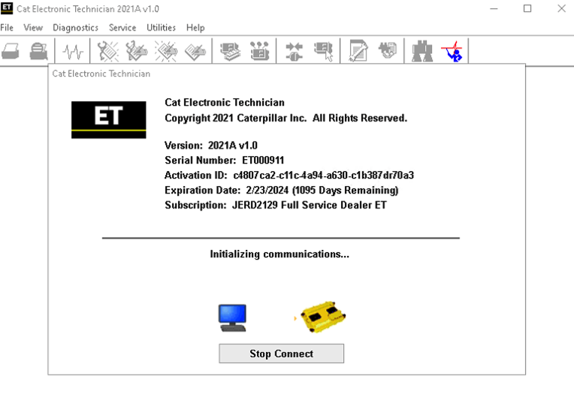
CAT ET- Win flash
Source:
https://the-best-manuals-online.com/products/electronic-technician-et2019a-for-all-caterpillar-models-diagnostics-software-latest-version-2019-online-installation-service?variant=20809425387579

Slide 18
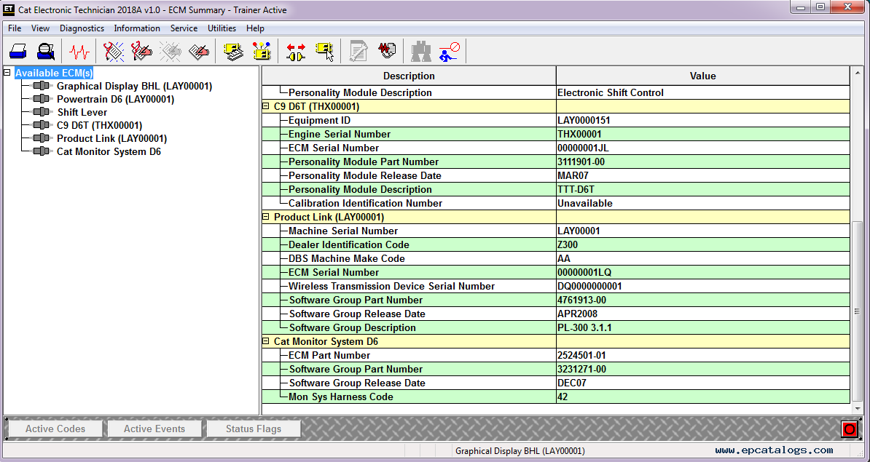
ECM Summary

Slide 19
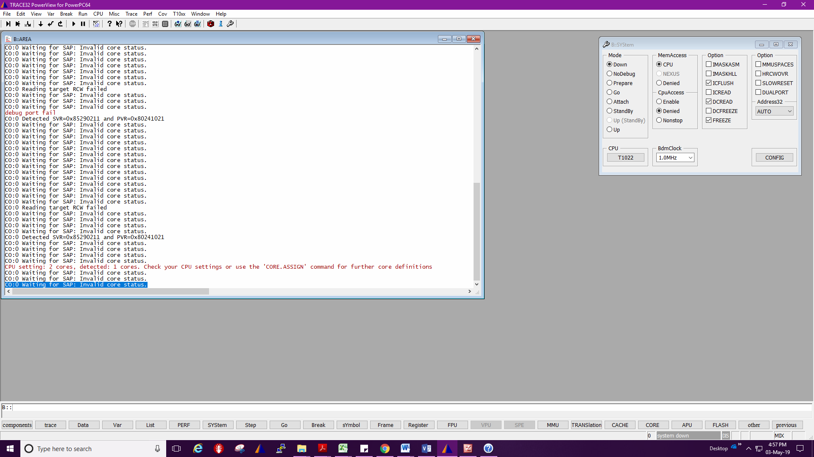
4. Introduction to TRACE32
TRACE32 debugger allows you to test your embedded hardware and software by using the on chip debug interface.
System Configuration.
Target load.
Watch window.
Break points.
List.
Source: Vector user guide

Slide 20
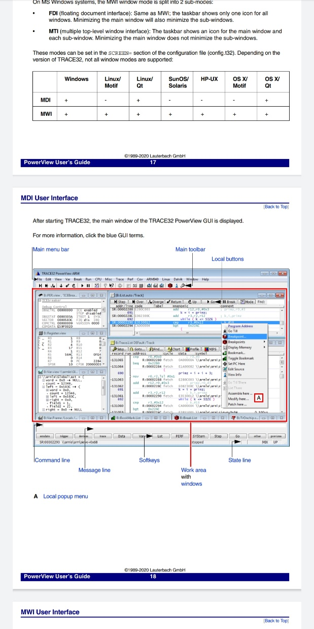
Source: Vector user guide

Slide 21
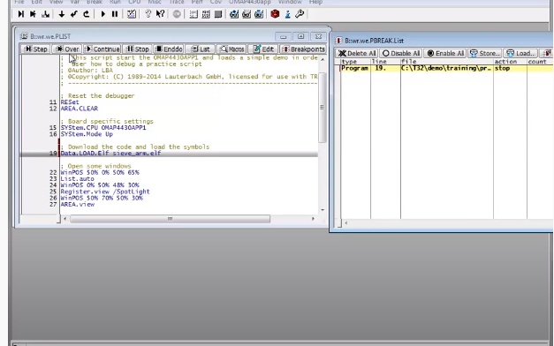
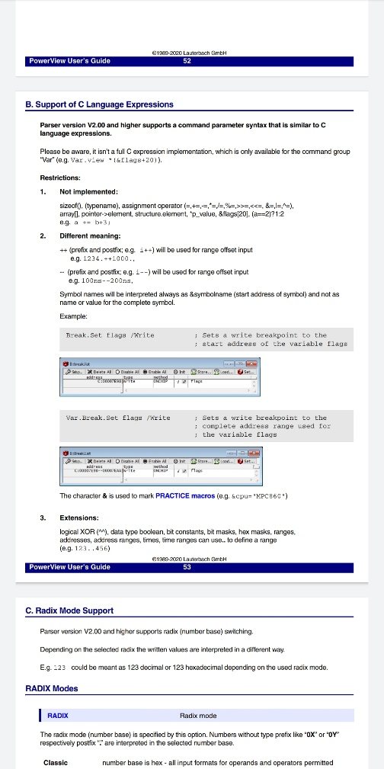
Break points
Source: Vector user guide

Slide 22
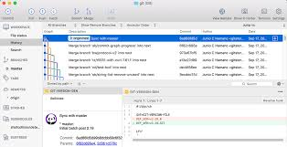
Introduction to GIT tool
Branch.
Commits.
Push.
l Palette

Slide 23
Classification Of Tractor

Slide 24
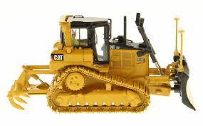
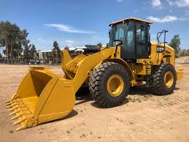
Classification of tractors on drive type
Based on type of drive :
(a) Track type tractors – vehicle that runs on continuous tracks instead of wheels.
(b) Wheel type of tractors – These are most commonly used agricultural tractors. They can run fast and wheel tyres absorb a certain amount of field shocks also.

Slide 25
Classification of 4-Wheel type tractor
Four-wheel tractors – These are most commonly used tractors in the country. These are also known as all purpose tractors. On the basis of available power, these have been classified as
(1) Small wheel loader /tractors – 15 to 25 hp.
(2) Medium wheel loader /tractors – 25 to 45 hp.
(3) Large wheel loader /tractors – more than 45 hp.

Slide 26
TTT

Slide 27
TTT-Track Type Tractor
A crawler tractor (track-type tractor/ track-laying vehicle)
In this type of tractors, instead of wheels; one track is fitted on either side. This track gets drive from the sprocket run by rear axle shaft. To steer the tractor, there is not steering gear fitted. The tractor is steered by applying brakes to one side of the track with the other track moving.
TTT have contact with a larger surface area than the wheeled tractor, and as a result exert a much lower force per unit area on the ground than a conventional wheeled tractor of the same weight.
Where it is used?
In agriculture they are used for land clearing and land leveling works.
This makes them suitable for use on soft, low friction and uneven ground such as mud, ice and snow.

Slide 28
While the basic operation of a tracked vehicle is similar to a wheeled vehicle, the main difference lies in steering. Instead of a steering wheel, a track vehicle utilizes a twin stick braking system. The operator applies the brake on the track in the direction of the turn. To turn right, the right track is stopped and the left track drives the vehicle to the right. For a left turn, the brake is applied to the left track and the right track pushes the vehicle around to the left.

Slide 29
What are the main advantages of tracked loaders?
· Low ground pressure
· Good maneuverability in confined work places
· Versatility for various jobs
· High gradeability up to 30%
· Ability to work on very wet or icy ground
· Ability to work with a ripper
· Ability to work on very hot areas
Traction - traction is very high including on slippery surfaces such as snow or wet concrete; • Efficient energy - in comparison to the wheels, the high performance tracks and the well-optimized traction system offer additional energy efficiency; • Rough terrain - tracked machines can work very well on rough terrain. They can climb and descend stairs, overcome obstacles or cross trenches; • Weight distribution - the weight of tracked tractors is very well distributed throughout its surface; • Appearance - Tracked tractors give a feeling of a much stronger product.

Slide 30
Disadvantages
Low speed - due to the much more complex mechanical system, tracked tractors have a much lower speed than those on wheels; • More difficult to handle - Tracked tractors are more precise in terms of maneuverability and require more rotational power; • Short life- the life of the tracks is quite small, which is much more available at break or blocking.
Possible PTO and drawbar interference when making sharp turns
Reduced steering control under heavy draft load (following terraces, contours)
Rough ride and/or vibration on hard surfaces
Not compatible with loaders and dozers
Can’t change tread spacing
Soil berming and more crop damage on end rows
Higher upfront cost
Slower in transport mode than tyres

Slide 31
LWL- Large wheel loader
On the high end, a large wheel loader could deliver over 900 horsepower. The top operating weight is over 290,000 lbs. A wheel loader also has a bucket at the front. You can use it to move debris, carry loads, and clear the ground.

Slide 32
Why?
Its large bucket is handy for scooping and moving dirt and rocks away from an excavation site and loading it into trucks. Loaders can also help to transport material around site. The larger wheel loaders are 7 – 8 yards. These machines are popular for loading gravel trucks or on more heavy-duty projects
Where it is used?
A wheel loader is a piece of heavy machinery. It is a tractor-like cab fitted with four large tires and has a bucket loader at the front. It is used mainly for scooping and moving material in construction, agriculture, or landscaping industries

Slide 33
BENEFITS OF TYRE TRACTORS
Better turning under load
Good compaction
Better for dozing and loader applications
Smoother hard-surface ride
Easier steering
Less maintenance required
Easier to change out tyres for different uses
Less cost upfront
Faster transport
DOWNSIDES OF TYRE TRACTORS
Not great in muddy/wet conditions
Higher slippage
Bumpier ride than tracked, except on hard surfaces
Power hops
Possibility of going flat

Slide 34
Work flow
User story Analysis.
Need to check machine type, depend on machine type location codes varies.
Understanding Issue.
By its description need to understand the issue and Requirements.
Download view for user story.
By doing GIT bash using command for particular machine, we can download source code.
Code changes to meet the acceptance criteria.
Push and commit in Git.
To know the code changes and can merge branch to origin while release.
Build to get elf and fl2 files.
after code changes build to check on unit bench.

Slide 35
Check for code changes on TRACE32 and CAT ET.
we need to keep it in Mode as no debug mode, MemAccess as Denied in system configuration
Test Plan.
Test Report.
Design summary.
Code change summary.

Slide 36
Work done till now
User story No : 56231(TTT)
Machine Power Test changes(Closed).
User story No :3599 (LWL)
Functional Safety :Operator Not Present(Test Plan)

Slide 37

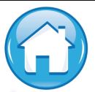
Thank You !

