Slide 1

Differentials in an AutoMobile

Slide 2
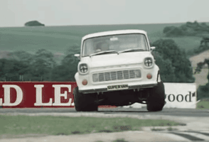
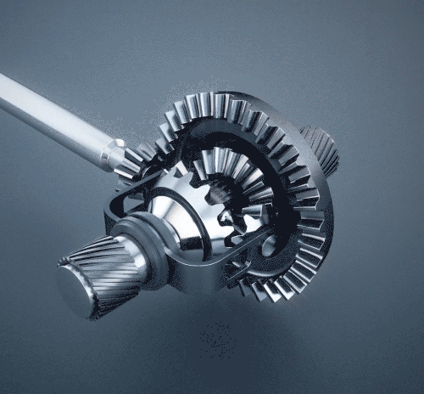
What is Differential:
A differential is a system that transmits an engine’s torque to the wheels. The differential takes the power from the engine and splits it, allowing the wheels to spin at different speeds.
Applications:-
when the vehicle takes turn at circular path the wheels opposite to the driver side turns at bigger diameter than the driver side.

