Slide 1


PROJECT :- CREATE A SENTIMENT MODEL ANALYSIS
BY
PRATHAM BIKRAM SAHI
KHUSHI KUMARI SAH
ARNAB SARKAR
SANJAY SINGHA

Slide 2
INTRODUCTION
SENTIMENT ANALYSIS
Sentiment analysis is the process of using natural language processing, text analysis, and statistics to analyze customer sentiment. The best businesses understand the sentiment of their customers—what people are saying, how they’re saying it, and what they mean. Customer sentiment can be found in tweets, comments, reviews, or other places where people mention your brand. Sentiment Analysis is the domain of understanding these emotions with software, and it’s a must-understand for developers and business leaders in a modern workplace.
As with many other fields, advances in deep learning have brought sentiment analysis into the foreground of cutting-edge algorithms. Today we use natural language processing, statistics, and text analysis to extract, and identify the sentiment of words into positive, negative, or neutral categories.

Slide 3
Modules Used
OpenCV(OPEN SOURCE COMPUTER VISION LIBRARY) :-
OpenCV was built to provide a common infrastructure for computer vision applications and to accelerate the use of machine perception in the commercial products.
2. NUMPY
NumPy can be used to perform a wide variety of mathematical operations on arrays. It adds powerful data structures to Python that guarantee efficient calculations with arrays and matrices and it supplies an enormous library of high-level mathematical functions that operate on these arrays and matrices.

Slide 4
3.PANDAS:-
Pandas is a Python library used for working with data sets. It has functions for analyzing, cleaning, exploring, and manipulating data. The name "Pandas" has a reference to both "Panel Data", and "Python Data Analysis" and was created by Wes McKinney in 2008.

Slide 5
Application
Sentiment analysis is target-oriented, aiming to identify opinions or attitudes towards topics or entities (e.g., product, movie). Emotion recognition, on the other hand, focuses on recognizing either the emotion expressed in text or evoked by the text, with no attachment to a specific target.
It is a machine learning tool that analyzes texts for polarity, from positive to negative. By training machine learning tools with examples of emotions in text, machines automatically learn how to detect sentiment without human input.

Slide 6
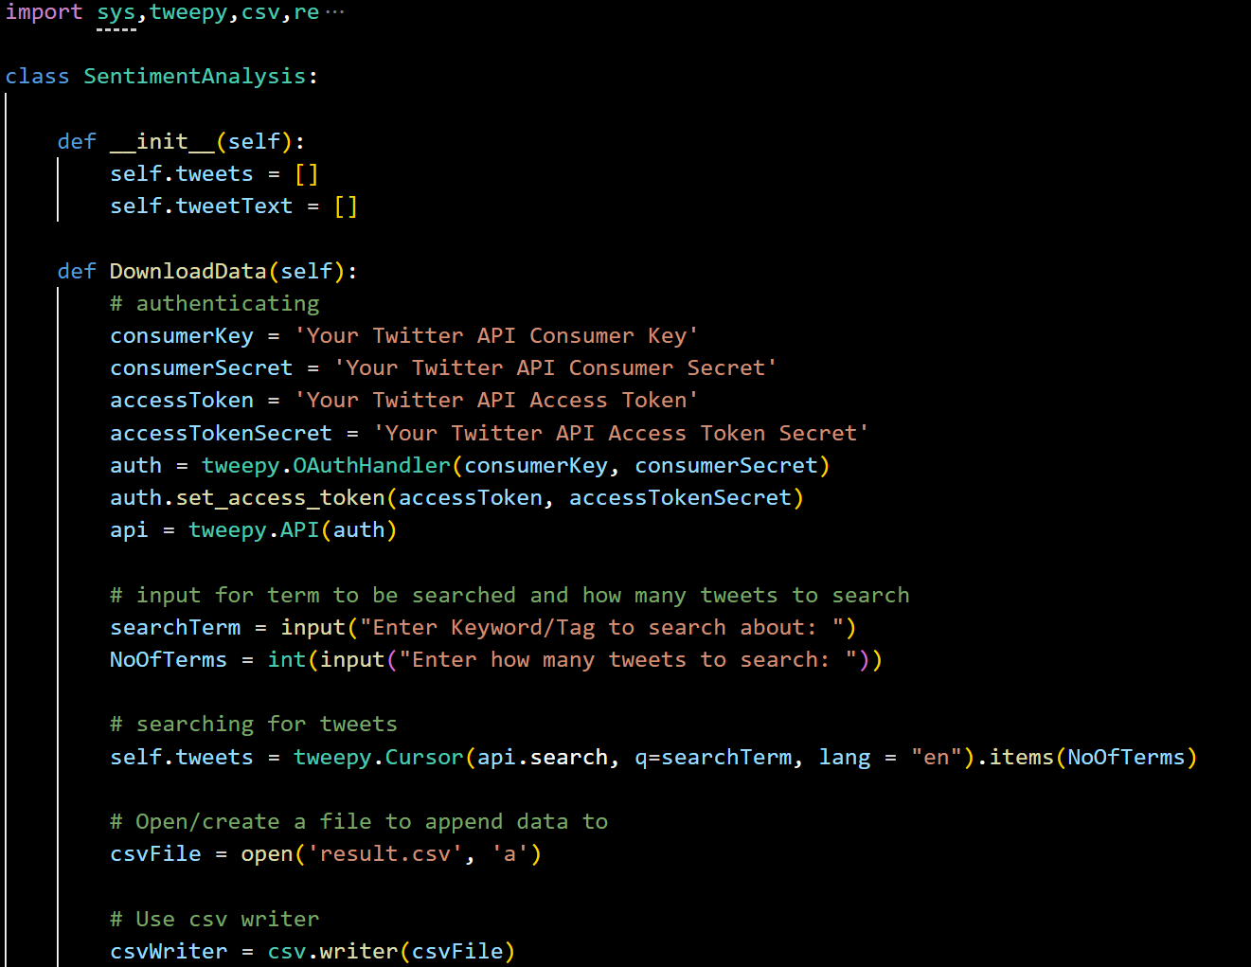
SOURCE CODE:-

Slide 7
FUTURE SCOPE OF THE PROJECT
Our project will be able to implement in future after making some changes and modification as we make our project at a very low level.
So the modification that can be done in our project are:
Specifically, sentiment analysis suffers from one major drawback: it is context and language specific. In this article, I am talking about some potential issues that might arise when you try to apply sentiment analysis to some domains.

Slide 8
Project Name:-CREATE A SENTIMENT MODEL ANALYSIS contribution :- 1.Arnab Sarkar:-Data Profiling, Data Accumulation 2.Sanjay Singha:-Data Processing, Data Visualization(Plotting) 3.Pratham Bikram sahi :- PPT making, document making 4.Khushi kumari sah :- data profiling, information research

Slide 9
REFERENCE
www.datascientist.com
www.datarobot.com
www.google.com
www.numpy.org
www.wikipedia.com

