Slide 1
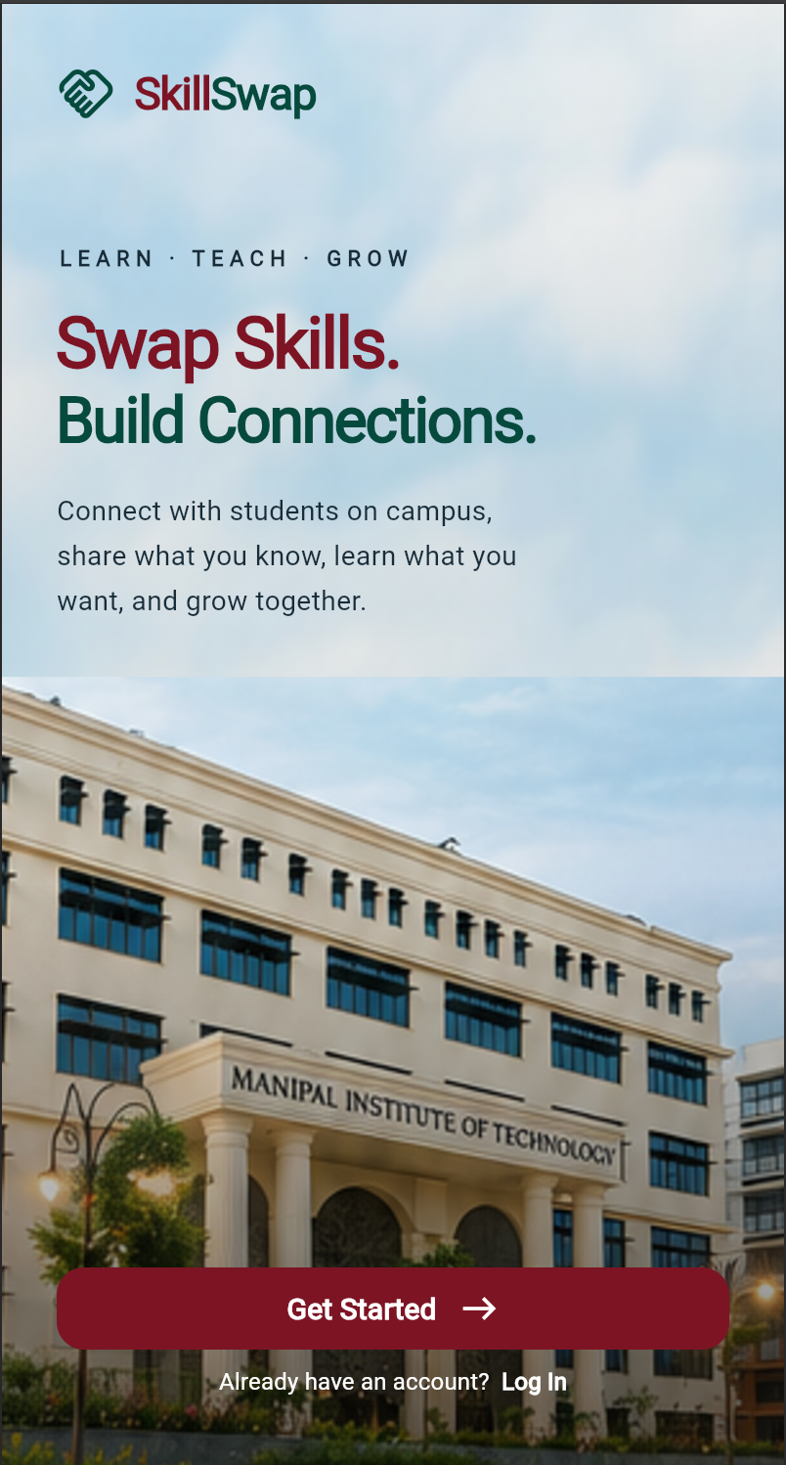
SKILLSWAP / UI DESIGN
01 / 12
A CAMPUS LEARNING COMMUNITY
Your next skill.
Your own campus.
SkillSwap
Teach what you know.
Learn what you love.
MOBILE + DESKTOP / PRODUCT UI
CAMPUS CONNECTIONS, BUILT AROUND SKILLS
Notes:
Good morning everyone. SkillSwap starts with a simple idea: the skill you want to learn may already belong to someone on your campus. Our app helps students share what they know, discover what they want to learn, and build meaningful connections. Today, I’ll walk you through the interface, the student journey, and how the experience extends from mobile to desktop.

Slide 2
SKILLSWAP / UI DESIGN
02 / 12
01 / THE OPPORTUNITY
A campus full of talent. A missing connection.
01
02
03
Skills stay hidden
Discovery takes effort
Exchange creates value
Students have useful abilities
beyond their course or branch.
Finding a suitable learning partner
often depends on existing friends.
Each student can contribute
and learn from someone else.
DESIGN GOAL
Make the right peer easier to discover and approach.
CAMPUS CONNECTIONS, BUILT AROUND SKILLS
Notes:
Students often have valuable skills that others never discover. Someone may know Flutter, another may be good at design, and a third may understand photography. Yet finding the right person usually depends on existing friends. SkillSwap brings these abilities into one campus community and makes the exchange visible, so students have a clear reason to connect.

Slide 3
SKILLSWAP / UI DESIGN
03 / 12
02 / THE MATCHING IDEA
Two students. Two goals. One useful exchange.
Dheeraj
Swara
↔
CAN TEACH
CAN TEACH
Flutter
UI/UX Design
WANTS TO LEARN
SAME CAMPUS
WANTS TO LEARN
UI/UX Design
Flutter
Proposed logic: campus eligibility + reciprocal skill interests
CAMPUS CONNECTIONS, BUILT AROUND SKILLS
Notes:
The matching idea is reciprocal. For example, Dheeraj can teach Flutter and wants to learn UI design. Swara can teach UI design and wants to learn Flutter. They are useful learning partners because both can contribute. The proposed algorithm first keeps discovery within the same campus, then looks for complementary teaching and learning interests. This explains the concept, rather than claiming an implemented matching engine.

Slide 4
SKILLSWAP / UI DESIGN
04 / 12
03 / VISUAL LANGUAGE
Warm, credible, unmistakably SkillSwap.
#841329
#005348
#F8F6F0
#19313D
Burgundy
Evergreen
Warm ivory
Deep slate
Primary actions
Skills and trust
Calm canvas
Readable text
Aa
Aa
Expressive headlines
Clear interface typography
Editorial serif for presentation moments
Sans serif • rounded cards • consistent actions
CAMPUS CONNECTIONS, BUILT AROUND SKILLS
Notes:
The visual system follows the supplied screens. Burgundy highlights primary actions, evergreen represents skills and positive states, and warm ivory keeps the interface approachable. Rounded cards group related information. For the presentation, expressive serif headlines add personality while clean sans serif text keeps explanations readable. The goal is a consistent identity that feels welcoming to students and credible as a campus product.

Slide 5
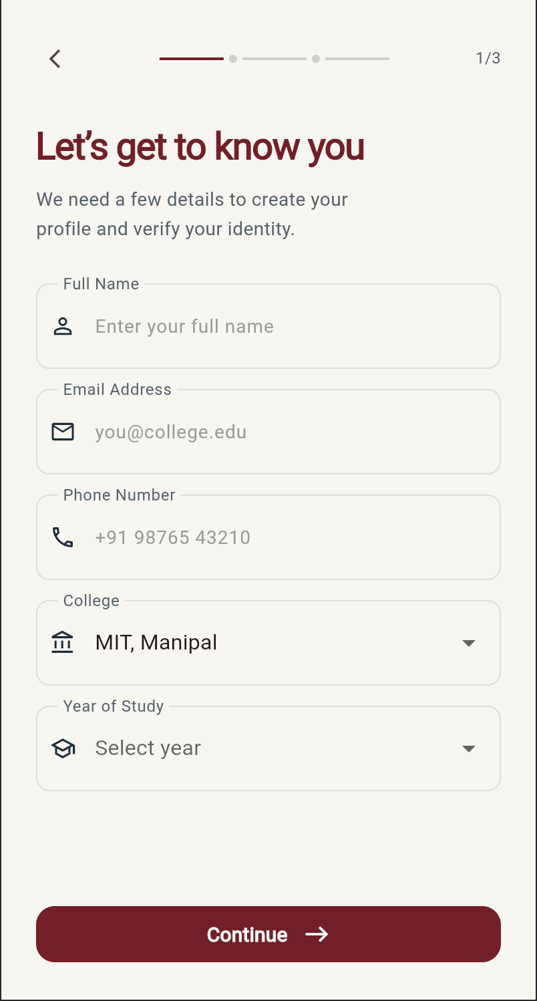
SKILLSWAP / UI DESIGN
05 / 12
04 / MOBILE ENTRY
A clear first impression. A guided start.
01 Communicate the value
A simple promise and one prominent
Get Started action.
02 Make progress visible
A three-step indicator gives students
a sense of where they are.
Supplied mobile screens
Landing page + profile details
CAMPUS CONNECTIONS, BUILT AROUND SKILLS
Notes:
The landing page immediately explains the benefit: swap skills and build connections. Campus imagery reinforces the local community, while a prominent Get Started button gives students a clear next action. The details screen then introduces a visible three-step journey. Clear labels and familiar form fields help students understand what information is needed without crowding the screen.

Slide 6
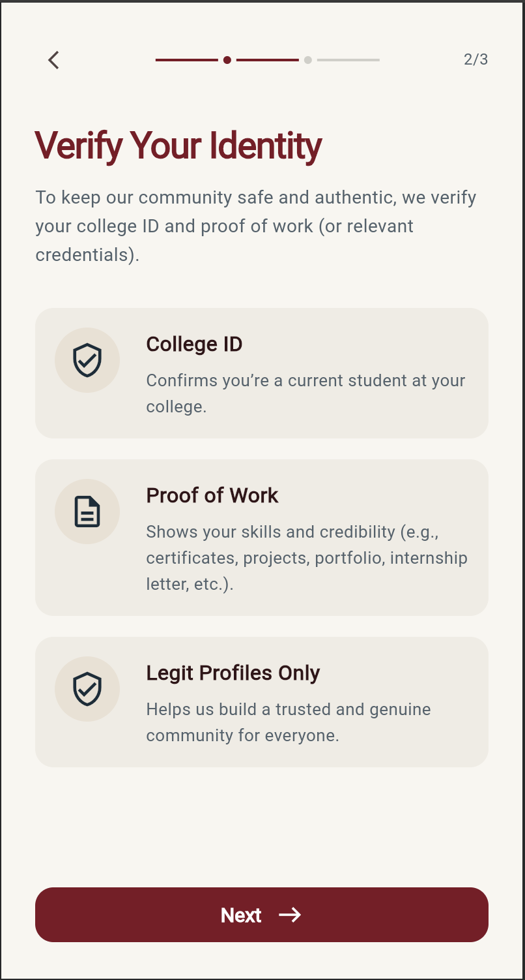
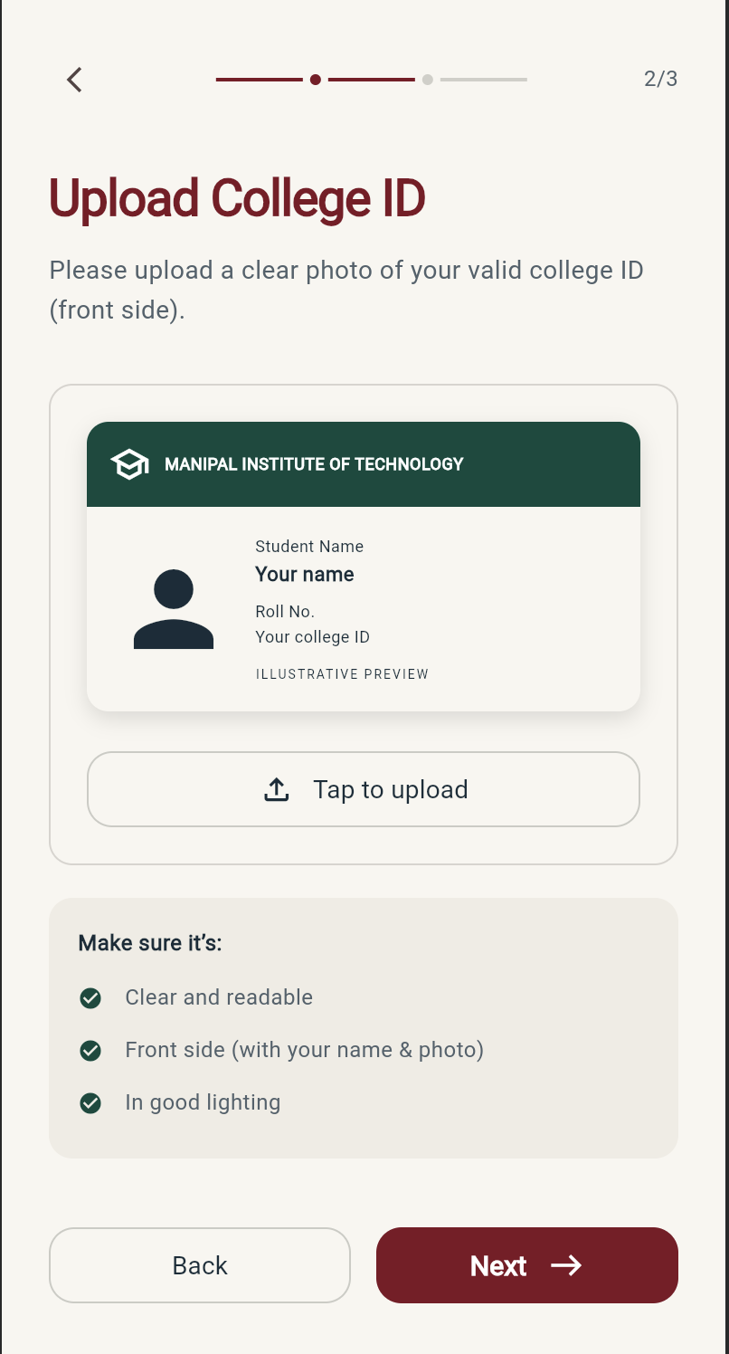
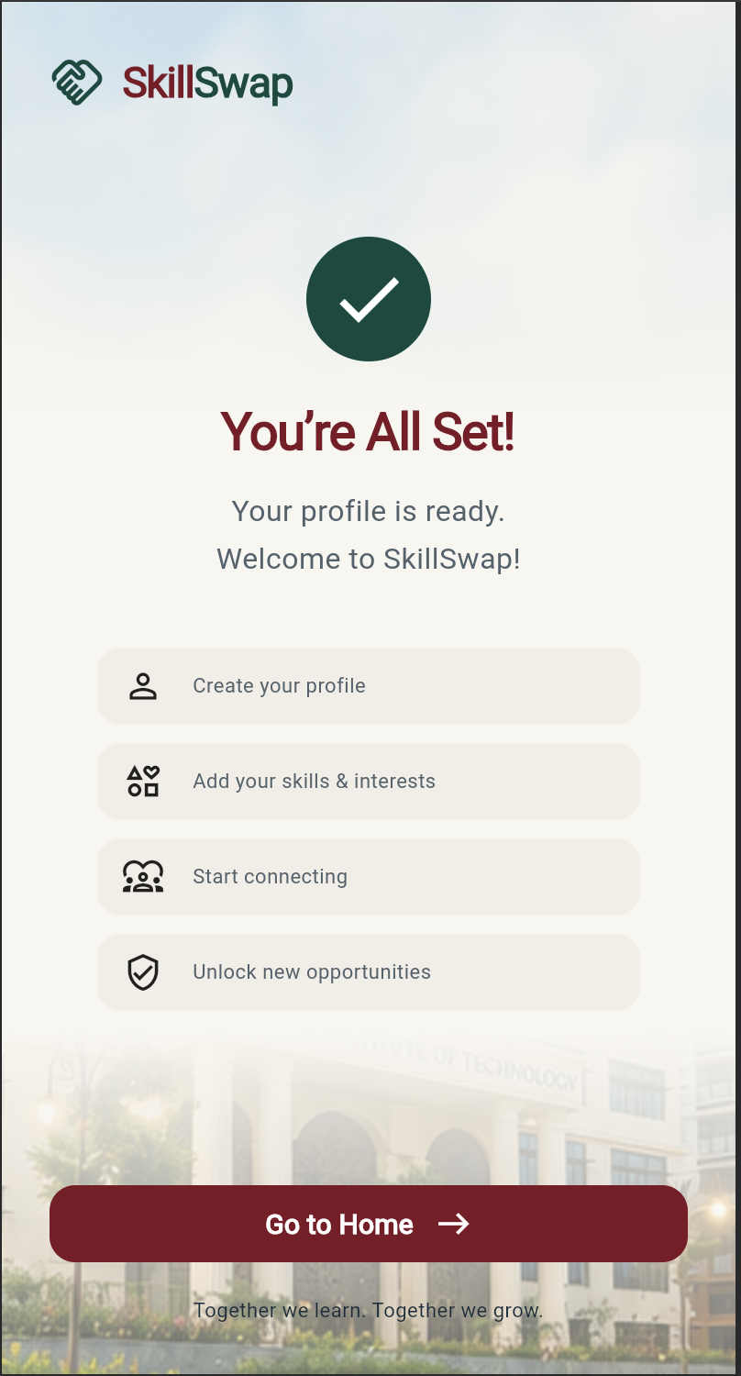
SKILLSWAP / UI DESIGN
06 / 12
05 / TRUST AND COMPLETION
Build trust at every step.
WHY VERIFY
HOW TO UPLOAD
WHAT HAPPENS NEXT
UI prototype: identity verification is not connected.
CAMPUS CONNECTIONS, BUILT AROUND SKILLS
Notes:
These screens explain why identity information is requested, show how to upload a college ID, and confirm that the profile is ready. This creates a more understandable onboarding sequence. However, the supplied prototype states that identity verification is not connected. The presentation therefore treats these as interface designs; a production release would still need a working verification process and clear handling of student documents.

Slide 7
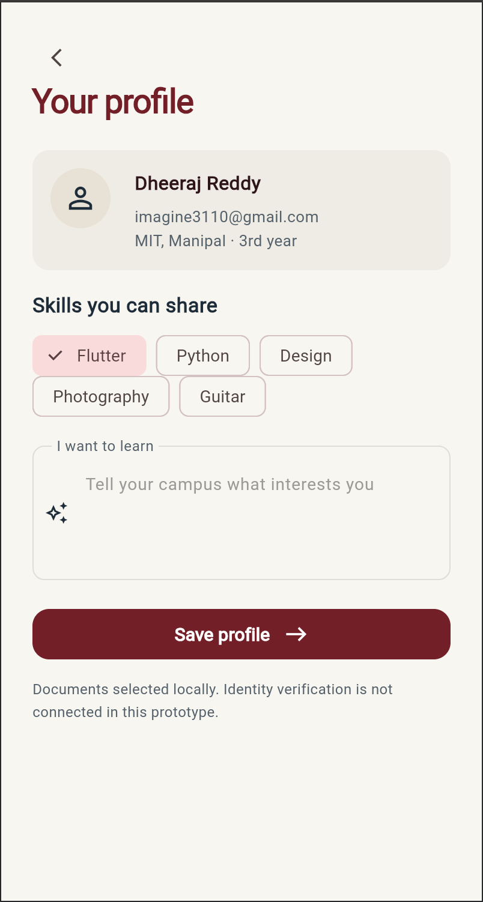
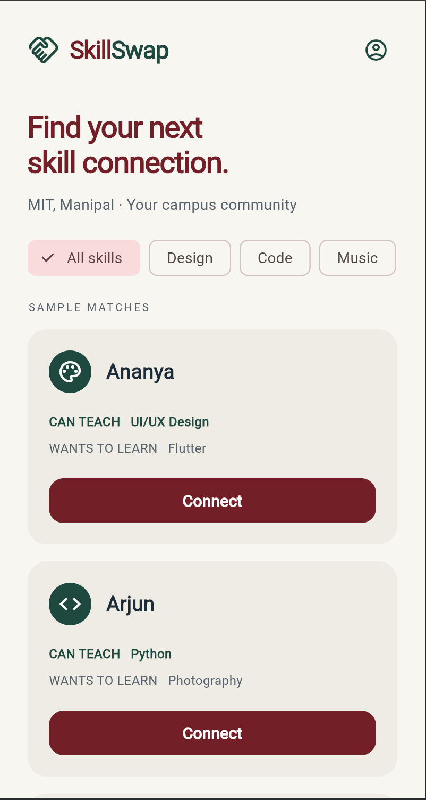
SKILLSWAP / UI DESIGN
07 / 12
06 / PROFILE AND DISCOVERY
Make the exchange visible before the first message.
What I can teach
Skill chips make strengths easy to scan.
What I want to learn
Learning goals give the match a purpose.
A clear invitation
Each card shows both sides of the exchange
and a consistent Connect action.
CAMPUS CONNECTIONS, BUILT AROUND SKILLS
Notes:
The profile captures the two sides of a skill exchange: what a student can share and what they want to learn. Discovery cards repeat those same labels, so students can quickly judge whether a connection makes sense. Category filters support browsing, and a consistent Connect button provides the next step. The people shown in the supplied discovery screen are sample matches, not verified recommendations.

Slide 8
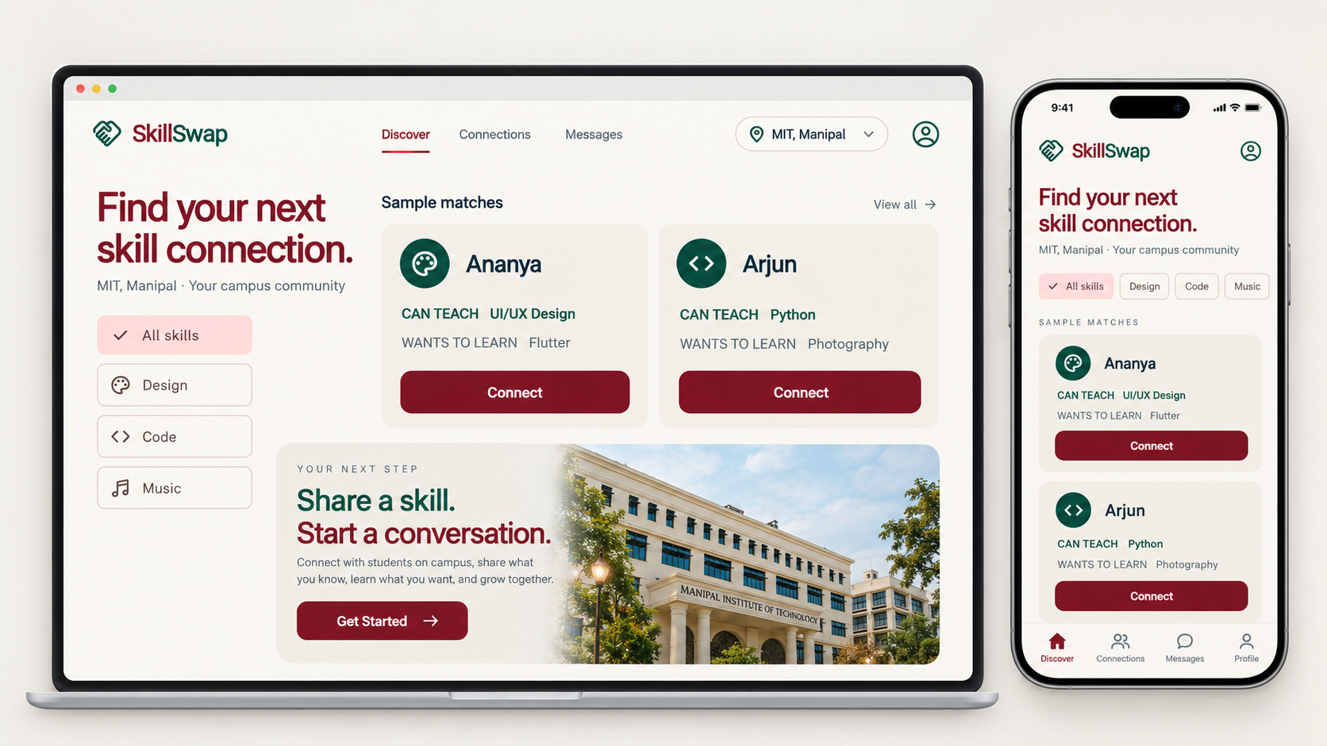
SKILLSWAP / UI DESIGN
08 / 12
07 / RESPONSIVE CONCEPT
One identity. More room to explore.
PROPOSED DESKTOP + MOBILE ADAPTATION
CAMPUS CONNECTIONS, BUILT AROUND SKILLS
Notes:
This new concept extends the same visual identity to desktop and mobile. On a larger screen, filters and multiple profiles can stay visible together, making comparison easier. On mobile, the content becomes a focused vertical feed. The burgundy actions, green skill labels, and ivory background stay consistent. This is a proposed responsive design, including navigation for future connections and messaging features.

Slide 9
SKILLSWAP / UI DESIGN
09 / 12
08 / BEYOND THE MATCH
Turn a connection into a learning session.
01
02
03
Connect
Agree
Exchange
Send a request based on
shared learning interests.
Discuss goals, availability
and a suitable campus venue.
Meet, practise and share
feedback after the session.
PROPOSED NEXT PHASE
Connection requests • chat • session planning • feedback
CAMPUS CONNECTIONS, BUILT AROUND SKILLS
Notes:
Matching is only the beginning. The proposed next phase helps students send a connection request, discuss what they want to learn, and agree on a session. After the exchange, feedback could help both students improve. These communication and planning features are part of the product direction, rather than screens already demonstrated in the supplied prototype.

Slide 10
SKILLSWAP / UI DESIGN
10 / 12
09 / TECHNOLOGY STACK
The technology behind SkillSwap.
DART / FRONTEND
PYTHON / BACKEND
Flutter
FastAPI
Cross-platform UI for mobile, web
and desktop, with reusable widgets.
API layer for profiles, connections
and application logic.
RECOMMENDED SUPPORTING TECHNOLOGIES
PostgreSQL
Supabase
GitHub + Docker
Profiles, skills and
connection records.
Authentication and
private file storage.
Version control and
backend packaging.
Flutter and FastAPI are confirmed; supporting tools are recommendations.
CAMPUS CONNECTIONS, BUILT AROUND SKILLS
Notes:
We use Flutter for our cross-platform frontend and FastAPI for our Python backend. Flutter helps us build a consistent interface across devices, while FastAPI handles application requests and logic. For the supporting stack, we recommend PostgreSQL for structured data, Supabase for authentication and private uploads, and GitHub with Docker for development and backend packaging. These supporting tools are recommendations, not confirmed implementations.
Official references: https://docs.flutter.dev/ ; https://fastapi.tiangolo.com/ ; https://supabase.com/docs ; https://docs.docker.com/get-started/docker-overview/

Slide 11
SKILLSWAP / UI DESIGN
11 / 12
10 / THE VISION
A campus where everyone
has something to teach.
Discover
Exchange
Grow
Find relevant peers.
Learn through contribution.
Build skills and connections.
SkillSwap
Share what you know. Learn what comes next.
CAMPUS CONNECTIONS, BUILT AROUND SKILLS
Notes:
SkillSwap brings together three ideas: discover the right peers, exchange useful knowledge, and grow through real campus connections. The current UI establishes a welcoming identity and a clear onboarding and discovery journey. The next step is to complete reciprocal matching, verification, and communication, then test the full experience with students. Our vision is a campus where everyone has something to teach. Thank you.

Slide 12
SKILLSWAP / UI DESIGN
12 / 12
THANK YOU / QUESTIONS & DISCUSSION
Thank you.
Let’s make learning
a campus connection.
Questions & discussion
SkillSwap
Teach. Learn. Grow. Together.
CAMPUS CONNECTIONS, BUILT AROUND SKILLS
Notes:
Thank you for your time. SkillSwap is about helping students discover the knowledge already present on their campus and turn it into meaningful connections. We look forward to your questions and feedback.

