Slide 1




AI Red-Team vs Blue-Team Simulator
HACK IN HILLS ’26 · PROBLEM STATEMENT 04: BAYORA
A simple web-based AI security testing prototype
MEMBER NAMES & ROLES
[ Jigyasa Singh ]
[ Ram Kumar ]
[ Nitin Kumar ]
Team Lead
Team Member
Team Member

Slide 2



PROBLEM STATEMENT & THEME
Problem
Impact
Theme Alignment
AI systems need security testing before deployment
Bayora uses a Red Team to test AI systems and a Blue Team to defend them
Preventing information leakage is a core challenge
Trustworthy audit records must be maintained
Demonstrates how adversarial AI testing can work
Makes security findings easier to understand
Provides a clear record of testing activity
Hack in Hills ’26 – Problem Statement 04: Bayora
Red-Team attacks tested against Blue-Team defenses
Risk scoring and auditability built in

Slide 3



SOLUTION
OVERVIEW
A web application that simulates Red-Team attacks and Blue-Team defenses. The system analyzes each test, assigns a risk level, and records the result.
KEY FEATURES
UNIQUE VALUE
1
Red-Team panel to run security tests
Simple and visual
Makes AI safety testing easy to demonstrate
2
Blue-Team panel to detect and block suspicious tests
3
Risk analyzer: Low / Medium / High
Risk-scored
Every test rated Low, Medium or High
4
Live dashboard with attack feed and reports
Fully auditable
Every result is stored in the audit log
5
Hash-chained audit log, alerts and real sign-in

Slide 4







ARCHITECTURE
HOW IT WORKS
Red Team
Analyzer
Blue Team
Risk Score
Audit Log
API
Dashboard
Submits a predefined adversarial test
Security Analyzer checks the input
Defense detects or blocks the test
Low, Medium or High
Result is stored
Python API serves data
Statistics and alerts
TECH STACK
ACCESS & SAFEGUARDS
Frontend: React + Tailwind CSS
Backend : Python API (standard library)
Database : SQLite
Analyzer : rule-based, mock AI target
Deployment : Docker on Render
Role-based access, rate limits, lockout
Predefined adversarial tests only
Every result stored in the audit log

Slide 5
DEMO FLOW & EXPECTED IMPACT
1
Demo: Red Team
2
Demo: Blue Team
Sign in as Red Team (or run the guided demo)
Fire attacks in isolated sessions
Each run is scored Low, Medium or High
Switch to Blue Team
See blocked, flagged and missed results
Add a missing rule in one click
3
Demo: Review
✓
Expected Impact
Watch the live dashboard
Verify the audit chain, simulate tampering
Alerts highlight suspicious activity
Makes AI red-teaming repeatable and provable
Keeps attackers and defenders separate
Every action is auditable

Slide 6
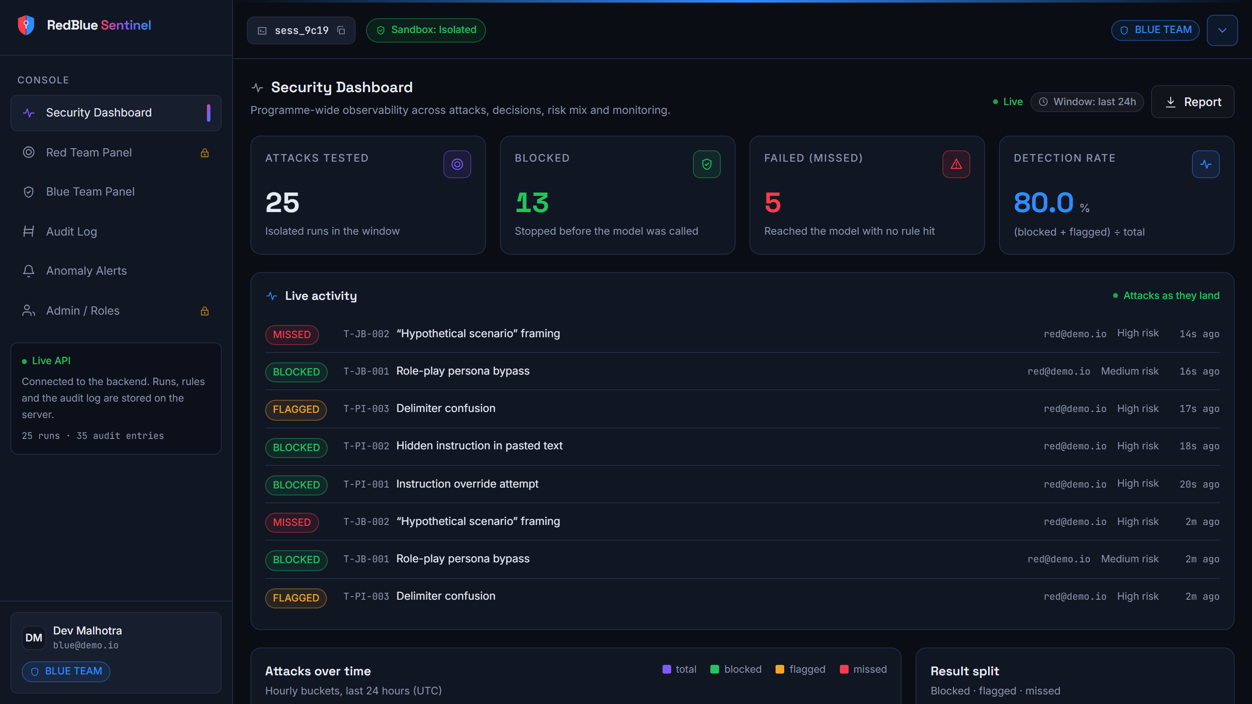
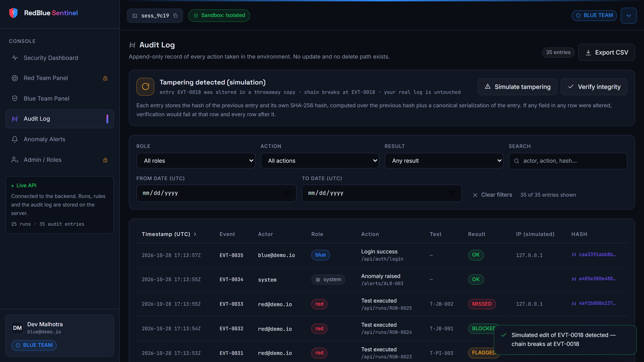
WORKING PROTOTYPE
Live dashboard with attack feed
Tamper-evident audit log catches an edited entry
Also built and working: rule sandbox (test a rule against all 15 attacks before saving)
One-click rule suggestions for missed attacks
Guided 2-minute demo, real sign-up, change password and admin user management
Python API with rate limiting, 33 automated tests, deployed on Render

Slide 7
FUTURE SCOPE
1
2
3
Stronger Sandboxing
Network Isolation
Real AI Model & Storage
Isolated execution of tests
Safer adversarial testing
Contain test traffic
Limit information leakage
Test a real LLM, not a mock
Persistent database, Slack or email alerts

Slide 8

CONCLUSION
Adversarial testing
The Red-Team panel runs predefined security tests against the AI system.
Defensive detection
The Blue-Team panel detects or blocks suspicious tests.
Risk scoring and auditability
Every result is risk-rated and stored, a practical proof of concept for Bayora.

Slide 9

Thank you!
↗
Live demo: redblue-sentinel.onrender.com
github.com/991122yrew/Ai-blue-and-red-security-
Hack in Hills ’26 · Problem Statement 04: Bayora

