Slide 1

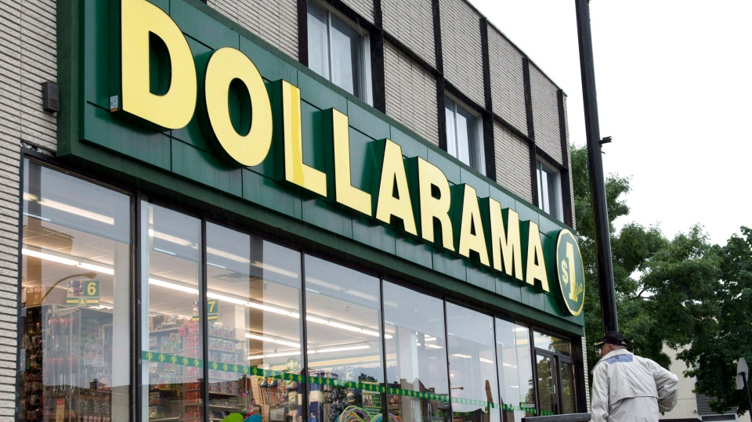

Dollarama & NCR
Presented By- Divyansh Srivastava

Slide 2
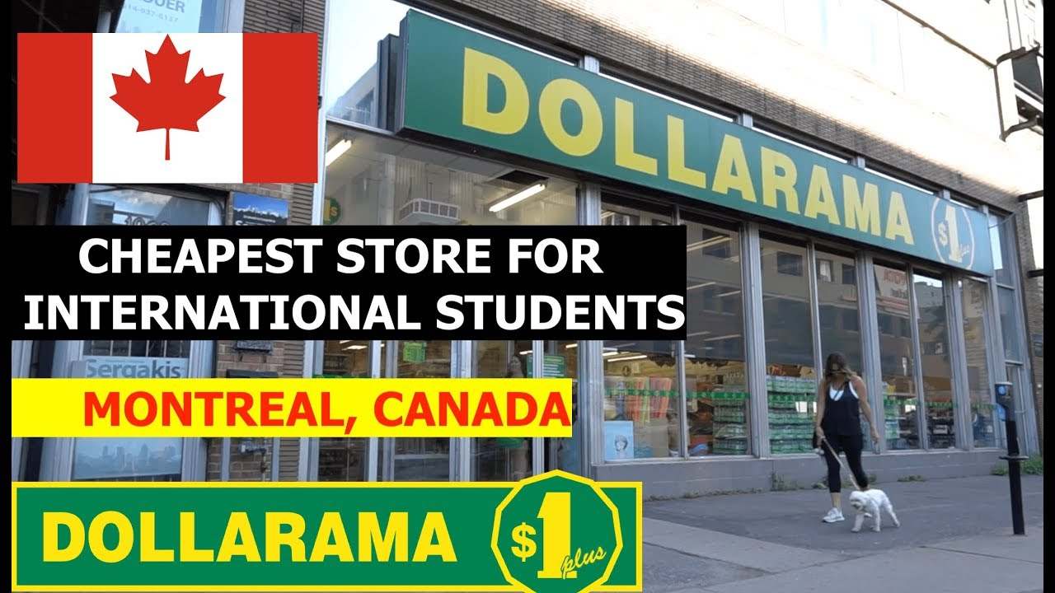
Agenda:
Dollarama stores types
How many stores/lanes
Hardware/Software types
Business locations
Wiki History
Customer goals and how we are supporting them
Evaluation the Campaign
Recent business changes/decisions
Roadmaps

Slide 3
Dollarama Introduction
Dollarama is a Canadian dollar store retail chain headquartered in Montreal.
Now Canada's largest retailer of items for four dollars or less.

Slide 4
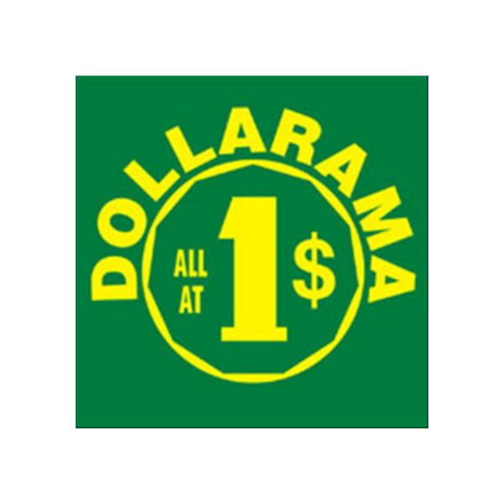
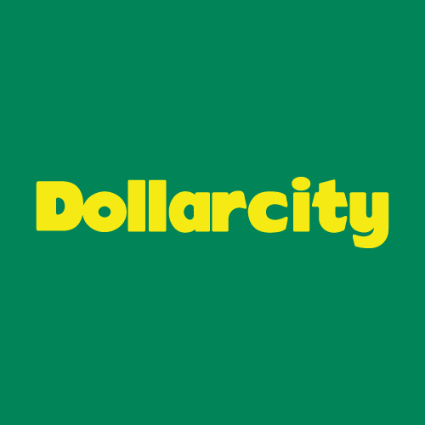
Type of stores :
Online Store
Web app
Mobile App
Dollar City sells home, basic necessities, accessories in decoration, kitchen, office, pets, gardening, seasonal products and much more.
Dollarama sells everyday consumer products, general merchandise and seasonal items at low, fixed price points.

Slide 5
Dollarama In numbers (As per Dollarama Website)
Dollarama expands its distribution center, located in the Town of Mount Royal, Quebec, and increased distribution capacity by approximately 50% in support of its long-term Canadian growth plans.
In August of 2019, Dollarama acquires a 50.1% interest in Latin American value retailer Dollarcity following a six-year commercial partnership and by the end of 2019, Dollarcity has over 200 stores.
By the end of 2021, Dollarama has over 1,368 stores across Canada.
In 2017 NCR SCO was only in 50 Lanes and now its 10 times more which is 624 NCR SCO Lanes (R6C, R6C+) .

Slide 6
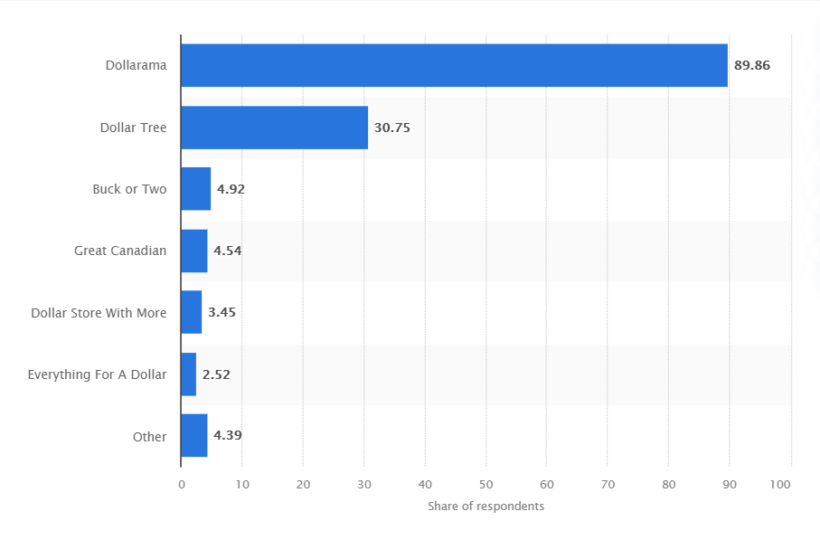
Dollar stores visited most frequently in Canada as of August 2019
Notes:
Source Website:
https://www.statista.com/statistics/436732/dollar-stores-visited-most-frequently-in-canada/
Region
Canada
Survey time period
August 2019
Method of interview
Online survey
Supplementary notes
*Original survey question: "Which dollar store(s) do you visit frequently?" Respondents were able to select multiple answers.

Slide 7
Hardware type
SAP POS Store Servers v13.3.7
SAPM POS v13.3.7
NCR Self Check out lanes.
Version 6,R6C+
Software type
NCR SCO lanes.
SAPM POS v13.3.7
SCOTAPP: ADK 6.2.5, ADK 6.0.5

Slide 8
Store locations
Canada ( Ottawa, Ontario)
Latin America (Colombia, El Salvador, Guatemala)
Online Delivery
Only in Canada
Not in Latin America

Slide 9
Mobile App Shopping
Only in Canada
Not in Latin America

Slide 10
WIKI Details
Founded in 1910, Salim Rossy opens his first S.Rossy Inc. store on Craig Street in Montreal, Quebec.
In 2004, Private equity group Bain Capital invests in Dollarama through the purchase of a majority stake to support its continued growth.
In 2007, Dollarama reaches a symbolic milestone with the opening of its 500th store in Ottawa, Ontario, with more plans for growth.
In 2009, Dollarama starts offering products at three new price points: $1.25, $1.50 and $2.00.
In 2011, Bain Capital sells its remaining stake in Dollarama.
In August of 2019, Dollarama acquires a 50.1% interest in Latin American value retailer Dollarcity following a six-year commercial partnership.
By the end of 2021, Dollarcity has 230 stores.
By the end of 2021, Dollarama has 1368 stores.

Slide 11
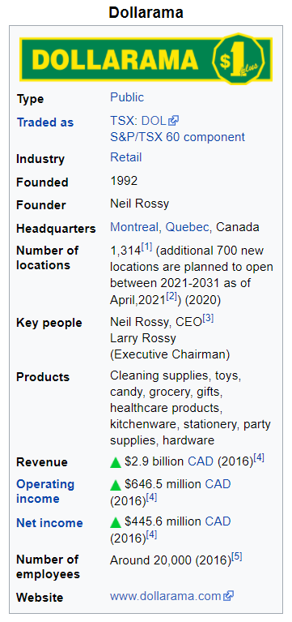

Slide 12
Customer Goals
Background Research
Typical consumer profile:
Female
25-54 years of age
Annual income of $20k-$80k
Strong brand recognition and reputation for delivering value
Brand awareness across Canada is at 98%

Slide 13
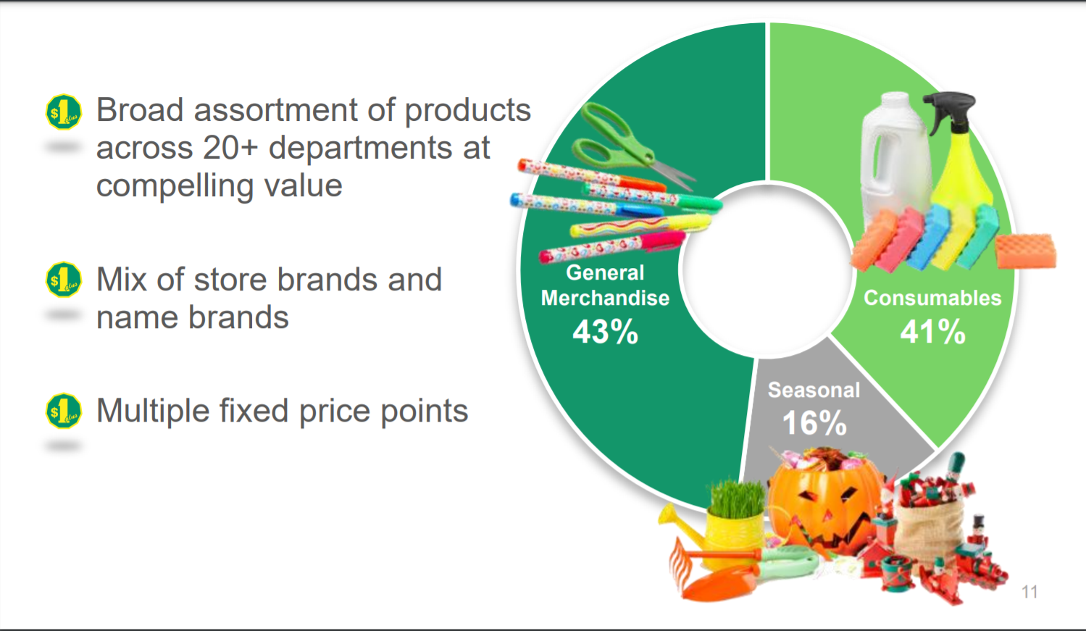
Customer Goals

Slide 14
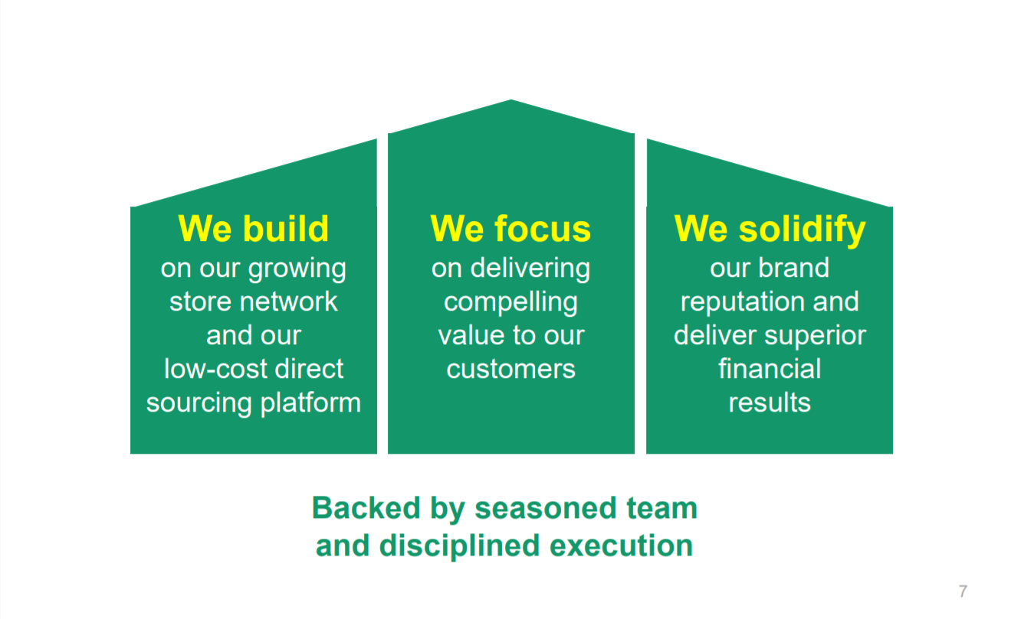
Goals v/s objective
Dollarama growth-oriented business model.

Slide 15
Goals v/s objective
The campaign objectives included:
Continuous in-store productivity improvements
POS systems
Kronos advanced scheduling
NCR point of sale terminals
WIFI and mobile-driven projects
Benefits of direct sourcing:
Creates different, more compelling product selection
Reduces costs associated with intermediaries
Longstanding relationships with low-cost supplier network:
~50% merchandise sourced directly from over 25 countries (primarily China)
The marketing plan included:
Strong brand recognition and reputation for delivering value
Unrivaled presence across Canada in convenient locations
Destination store appealing to broad customer base
Consistent in-store shopping experience

Slide 16
HOW SCO helped
Support for Dollarama GIFT card, Cash Management (Simplify management of Cash)
Better Customer experience (Feel Good factor)
Short Waiting time(Q buster).
New and refreshed look .
Reduced operative cost and less manual error.
Easy sales procedure
Easy for employee training .

Slide 17
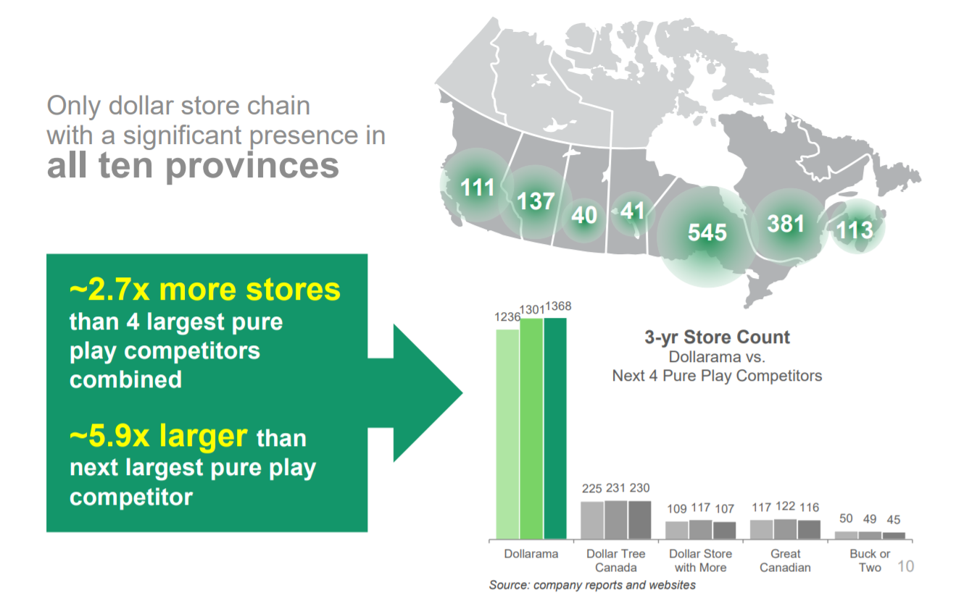
Evaluation of the campaign
Robust financial performance
LTM(2) EBITDA: $1,165M (28.2% of sales)
LTM(1) sales: $4.14B
Strong value proposition at select fixed price points up to $4
Broad assortment of everyday goods
~50% of merchandise sourced directly
~75% of sales from products priced above $1.25
Largest and only national dollar store chain in Canada
1,368 corporate-owned and operated stores
Avg. of 10,336 sq. ft. per store
Avg. store annual sales of $3.1 million
Notes:
For the last twelve months ended May 2nd, 2021
Inclusive of direct costs related to COVID-19 measures implemented for the last twelve months ended May 2, 2021
(approximately $87.3 million)
EBITDA=Earnings Before Interest, Taxes, Depreciation, and Amortization
E=net income
I=interest
T=taxes
D=depreciation
A=amortization

Slide 18
Recent Business changes
Entered the Peruvian market in May 2021.
Fiscal 2022 First Quarter Results Highlights (Compared to Fiscal 2021 First Quarter Results)
Sales increased by 13.0% to $954.2 million;
Comparable store sales (excluding temporarily closed stores) increased by 5.8%
Gross margin was 42.3% of sales, compared to 41.3% of sales
EBITDA increased by 16.1% to $248.2 million, or 26.0% of sales, compared to 25.3% of sales
Operating income increased by 18.1% to $176.8 million, or 18.5% of sales, compared to 17.7% of sales
Incremental direct costs related to COVID-19 measures amounted to $18.3 million, compared to $15.0 million
The Corporation opened 12 net new stores compared to 10 net new stores
Notes:
EBITDA=Earnings Before Interest, Taxes, Depreciation, and Amortization
E=net income
I=interest
T=taxes
D=depreciation

Slide 19
Road maps
Mobile shopper they are currently planning to provide.
Integrate with western union money transfer functionality in SCO.
New long-term target of 2,000 Dollarama stores by 2031.
Target of 600 Dollarcity stores by 2029 in the initial 3 countries

Slide 20
Thank You

