Slide 1

S3
Simple Storage service

Slide 2
Topics to cover
Buckets and Objects
Versioning & MFA – Delete
Encryption
Secure with Policies
S3-Hosting & CORS
Cross Region Replication
Storage tiers and Glacier
S3-Lifecyle policies
Access logs
Pre-signed URL
S3-Perfomance
S3-Select and Glacier Select
Athena
Object Lock & Glacier Vault Lock

Slide 3
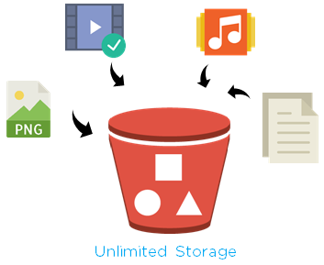
Buckets and Objects
Buckets are the containers for objects. You can have one or more buckets. For each bucket, you can control access to it (who can create, delete, and list objects in the bucket), view access logs for it and its objects, and choose the geographical region where Amazon S3 will store the bucket and its contents.
The bucket name must:
Be unique across all of Amazon S3.
Be between 3 and 63 characters long.
Not contain uppercase characters.
Start with a lowercase letter or number.
After you create the bucket, you can't change its name.
Choose a Region close to you to minimize latency and costs and address regulatory requirements.
Objects stored in a Region never leave that Region unless you explicitly transfer them to another Region
By default Amazon S3 blocks all public access to your buckets

Slide 4
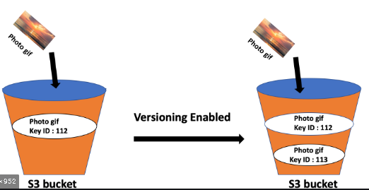
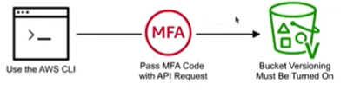
Versioning
Versioning is a means of keeping multiple variants of an object in the same bucket.
Benefits:
Preserve the older versions
Retrieve, and restore every version of every object stored in your Amazon S3 bucket
Easily recover from both unintended user actions and application failures like deleting
S3 automatically generates a unique version ID
Once you version-enable a bucket – It applies to the objects which are uploaded there after and the files which are uploaded before will have the version “null”
MFA Delete
Another layer of security by configuring a bucket to enable MFA (multi-factor authentication) Delete, which requires additional authentication for either of the following operations:
Change the versioning state of your bucket
Permanently delete an object version
The bucket owner, the AWS account that created the bucket (root account), and all authorized IAM users can enable versioning, but only the bucket owner (root account) can enable MFA Delete. You tube video

Slide 5
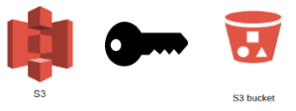
Encryption
SSE-S3: encrypts S3 objects using keys handled & managed by AWS
SSE-KMS: leverage AWS Key Management Service to manage encryption keys
SSE-C: when you want to manage your own encryption keys
Client Side Encryption – You are fully managing the encryption and S3 treats it as a normal object
Please visit this document
Access logs
For audit purpose, you may want to log all access to S3 buckets
Any request made to S3, from any account, authorized or denied, will be logged into another S3 bucket
That data can be analyzed using data analysis tools…
Or Amazon Athena as we’ll see later in this section

Slide 6
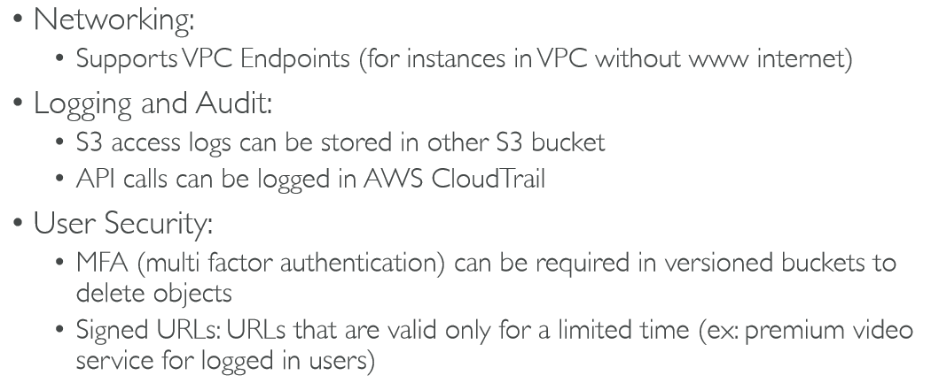


Secure Encryption with Policies
Security can be:
User based
IAM – which API calls should be allowed for a user
Resource based
Bucket Polices
Object ACL (Access control list) – granular
Bucket ACL - Less used
Bucket Polices Enforce users to use Encryption

Slide 7
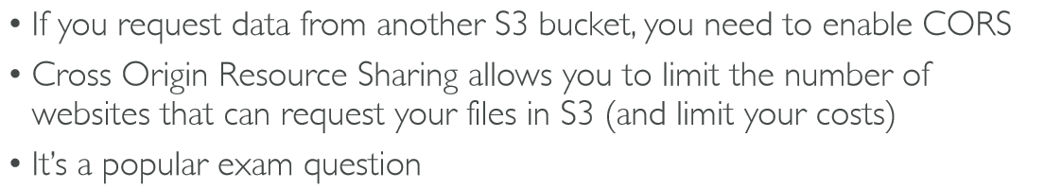
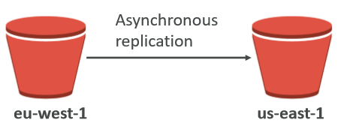
S3-Hosting
S3 can host static websites and have them accessible on the www
The website URL will be: • <bucket-name>.s3-website-<AWS-region>.amazonaws.com
If you get a 403 (Forbidden) error, make sure the bucket policy allows public reads
CORS
CRR
Must enable versioning (source and destination) Buckets must be in different AWS regions
Can be in different accounts
Copying is asynchronous
Must give proper IAM permissions to S3

Slide 8
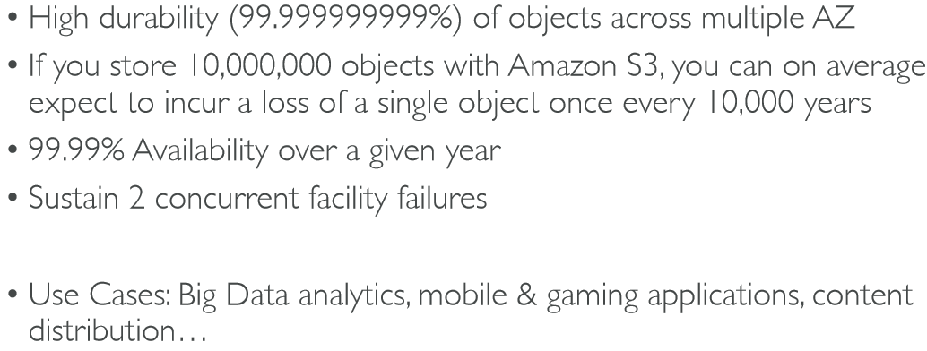
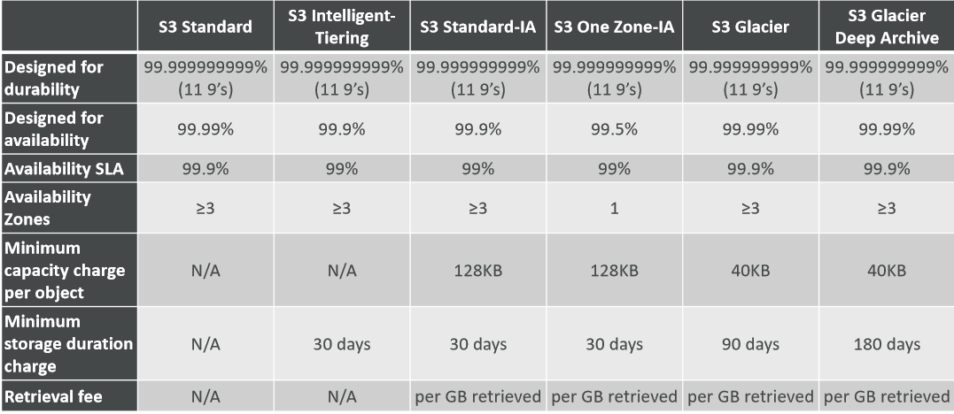
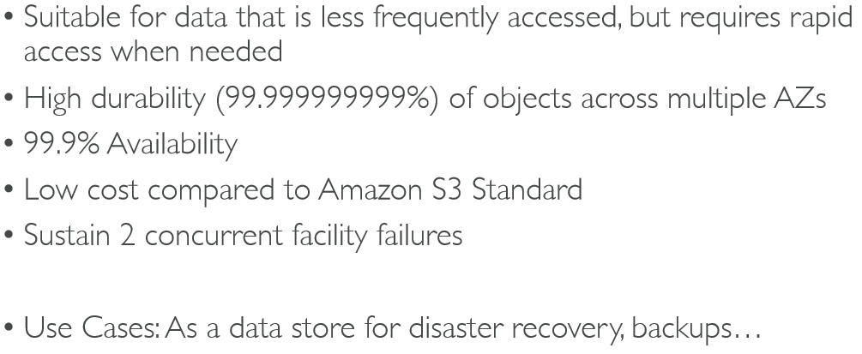
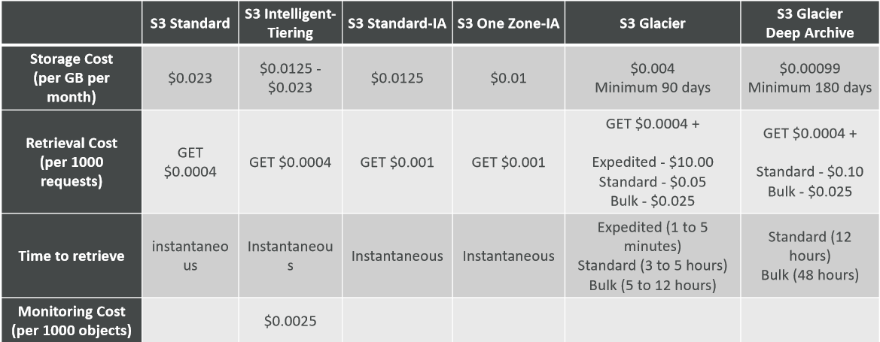
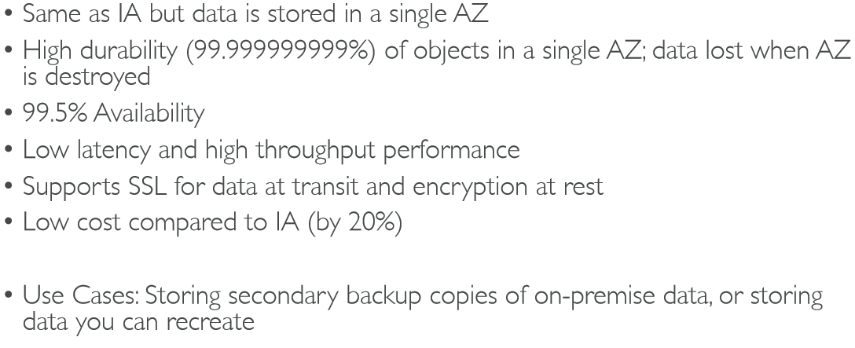
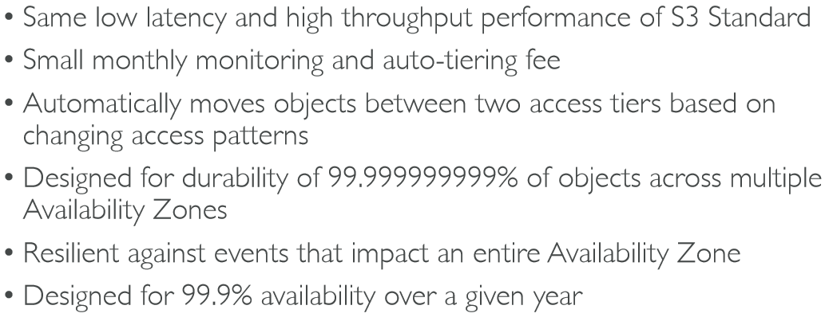
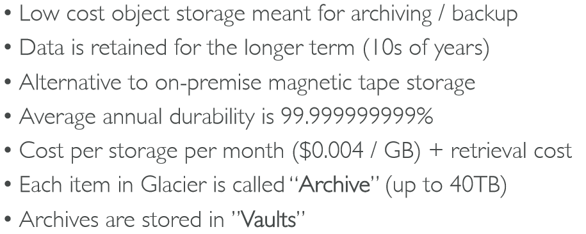
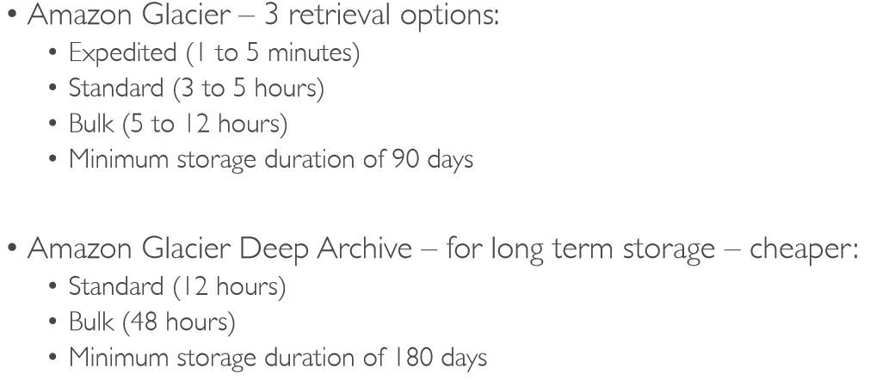
Storage tiers and Glacier
Types of Storage tiers
Comparison
Amazon S3 Standard -General Purpose
Amazon S3 Standard-Infrequent Access (IA)
Amazon S3 One Zone-Infrequent Access
Amazon S3 Intelligent Tiering
Amazon Glacier
Amazon Glacier and Glacier Deep Archive retrieval durations
Type Comparison
Cost Comparison

Slide 9
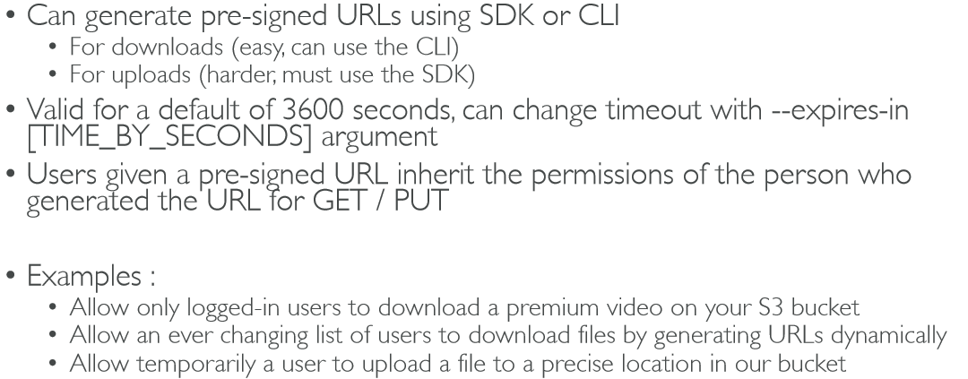
Pre-signed URL
You Tube Video

Slide 10
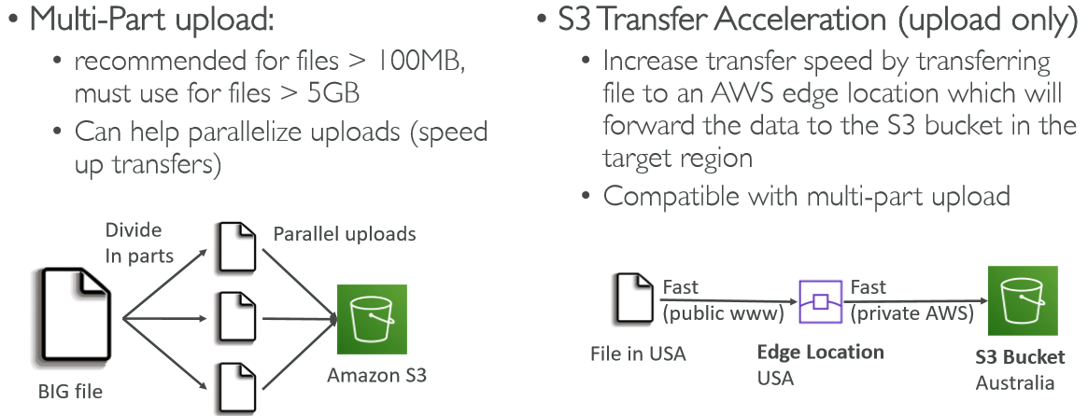
S3 Performance

Slide 11
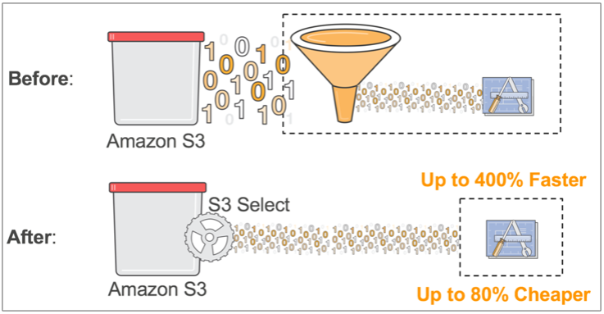
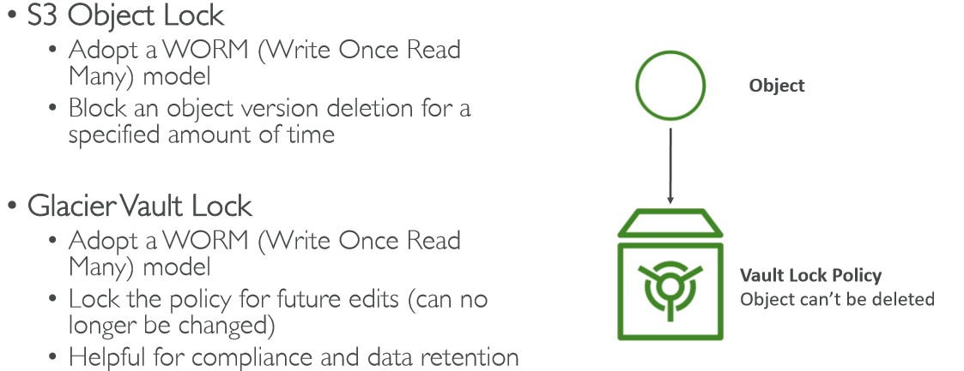
S3-Select and Glacier Select
Document
Object Lock & Glacier Vault Lock

Slide 12

Athena
-> Serverless service to perform analytics directly against S3 files
-> Uses SQL language to query the files
-> Has a JDBC / ODBC driver Charged per query and amount of data scanned
-> Supports CSV, JSON, ORC, Avro, and Parquet (built on Presto)
-> Use cases: Business intelligence / analytics / reporting, analyze & query VPC Flow Logs, ELB Logs, CloudTrail trails, etc...
-? Exam Tip: Analyze data directly on S3 => use Athena

