Slide 1
Welcome To The Course

Slide 2

Is Investing Monkey-Business?
Source: Eric Isselee, Getty Images

Slide 3


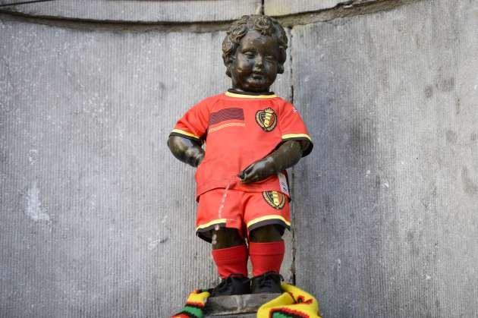
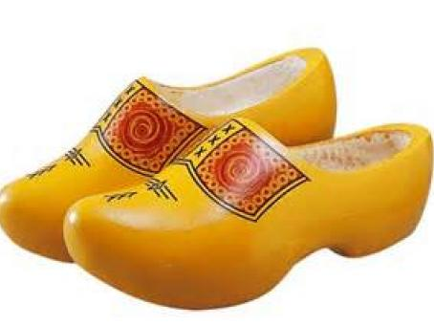
Who am I?
Professor of Finance
http://www.hln.be/hln/nl/9091/Time-out/article/detail/1807049/2014/03/07/Manneken-Pis-gekleed-in-nieuw-WK-shirt-Rode-Duivels.dhtml
http://vrouwenvannu.nl/nieuw-amsterdamveenoord/hinky-bangma-op-klompen-door-amerika

Slide 4
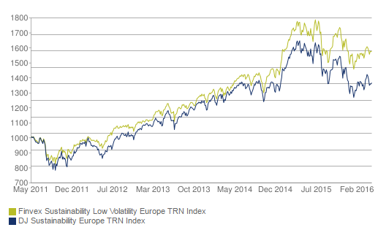

Who am I?
Advisor to investment companies about risk optimized investment: Winning by losing less.
http://www.finvex.com/

Slide 5
Simple Tricks
To avoid large losses:
Carefully select diversified portfolios
Screening based on liquidity analysis
Screening based on financial risk and performance analysis
Optimize portfolios under diversification constraints

Slide 6
Simple Tricks
To avoid large losses:
Carefully select diversified portfolios
Use backtesting and online performance monitoring
> library(PerformanceAnalytics)
> data(edhec)
> table.AnnualizedReturns(edhec)[,2:6]
Distressed Securities Emerging Markets Equity Market Neutral Event Driven Fixed Income Arbitrage
Annualized Return 0.0975 0.0936 0.0739 0.0932 0.0507
Annualized Std Dev 0.0636 0.1336 0.0312 0.0636 0.0491
Annualized Sharpe (Rf=0%) 1.5342 0.7006 2.3700 1.4660 1.0323

Slide 7
Simple Tricks
To avoid large losses:
Carefully select diversified portfolios
Use backtesting and online performance monitoring
Learn this by doing at DataCamp!

Slide 8
Course Overview
Ch. 1: Portfolio weights and returns
Ch. 2:
Portfolio performance evaluation
Ch. 3:
Drivers of performance
Ch. 4: Portfolio optimization

