Slide 1
Video 4: The non-normality of the return distribution

Slide 2
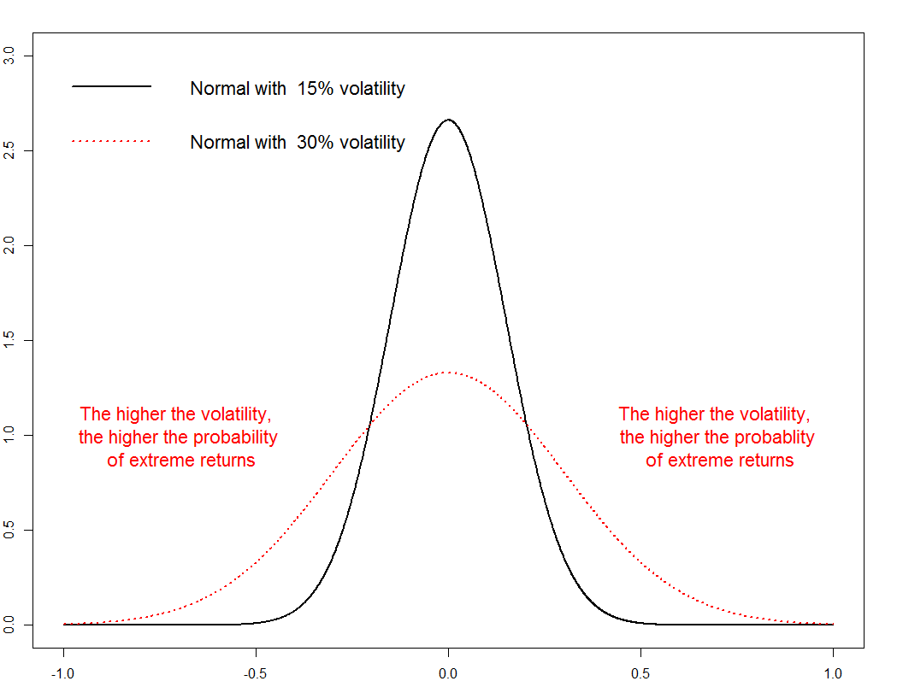
Volatility describes “normal” risk
Notes:
Up to now, we have been using the portfolio volatility as our measure of risk. Loosely speaking, the underlying assumption is that the portfolio return has a normal distribution and thus that its density function is bell-shaped. It is symmetric such that gains are equally likely as losses of the same magnitude.

Slide 3
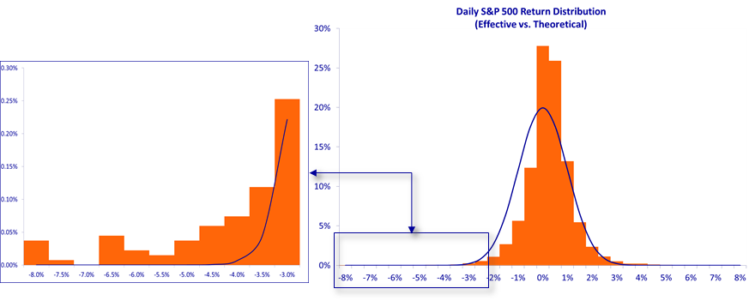
Non-normality of the return distribution
Notes:
For many financial assets, this assumption of a normal distribution is wrong. Their distribution tends to be skewed to left with tails that are fatter than those of a normal distribution.
As a consequence, when zooming in on the left tail of the histogram of financial returns, we often find that there are more extreme negative returns happening than is possible under a normal distribution.

Slide 4
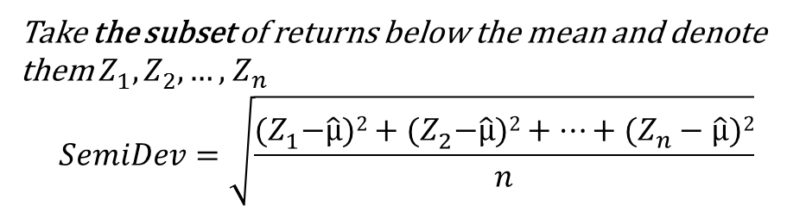
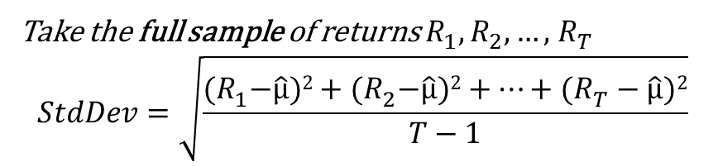
The portfolio return semideviation
Semideviation of portfolio returns
Standard deviation of portfolio returns
Take the full sample of returns $R_{1}^{},R_{2}^{},…,$ $R_{T}^{}$
$$StdDev=\sqrt{\frac{{(R}_{1}^{}−\hat{μ})2+{(R}_{2}^{}−\hat{μ})2+…\text{+} (R_{T}^{}−\hat{μ})2}{T−1}}$$
Take the subset of returns below the mean and denote them $Z_{1}^{},Z_{2}^{},…,$ $Z_{n}^{}$
$$SemiDev=\sqrt{\frac{{(Z}_{1}^{}−\hat{μ})2+{(Z}_{2}^{}−\hat{μ})2+…\text{+} (Z_{n}^{}−\hat{μ})2}{n}}$$
Notes:
When this happens, an investor is no longer satisfied with using only the standard deviation as the risk measure, but should be using also a downside risk measure that quantifies the risk of losing money. Such a downside risk measure focuses on the left side of the return distribution, instead of considering the complete distribution.
A straightforward way to turn the standard deviation into a downside risk measure is to remove the higher than average returns. We then obtain the so-called portfolio semideviation.
As can be seen on the slide, it is defined as the square root of the average variability of the lower than average returns around the mean.

Slide 5
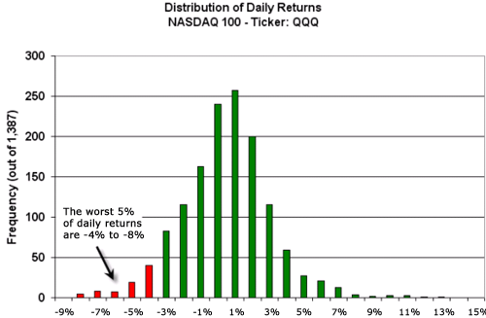
The portfolio return Value-at-Risk and Expected Shortfall
The 5% most extreme negative returns are between -4% and – 8%:
The 5% VaR is -4%: there is a 5% chance of an equally or more negative return
The 5% ES is around -5%: it is the average of all the 5% most extreme negative returns
Source: http://www.investopedia.com/articles/04/092904.asp
Notes:
Besides the semideviation, also the 5% portfolio value-at-risk and 5% expected shortfall are popular downside risk measures. They quantify the risk of the 5% most extreme losses.
To understand their definition, take a look again at the return distribution plot, where I indicate their value.
The 5% value-at-risk is the return that is so extremely negative that there is only a 5% chance of observing a return that is even more negative.
But how severe are those 5% most extreme losses? This question is answered by computing the average value of the 5% most negative returns. This number is called the 5% expected shortfall.

Slide 6
Shape of the distribution
Is it symmetric?
➔ Check the skewness
Are the tails fatter than those of the normal
➔ Check the excess kurtosis
Notes:
In terms of performance measures, we have thus seen the mean and volatility, as well as downside risk measures such as the semideviation and value at risk.
Typically, investors also report the skewness and excess kurtosis of their portfolio returns to indicate two types of non-normality in the return distribution, namely asymmetry and fat tails.

Slide 7
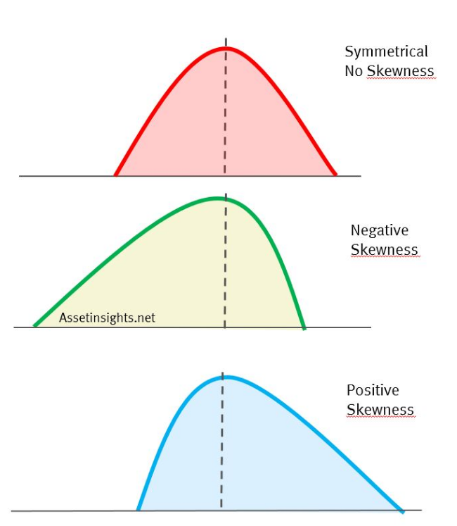
Skewness
Zero skewness: The return distribution is symmetric
Negative skewness: Large negative returns occur more often than large negative returns
Positive skewness: Large positive returns occur more often than large negative returns
Notes:
The skewness is designed such that it is approximately zero when the distribution is symmetric.
When the skewness is negative, it indicates that large negative returns occur more often than large positive returns.
A negative skewness thus corresponds to a distribution with a long left tail.
The opposite is true in case of a positive skewness. Then large positive returns are more likely than large negative returns, and the distribution has a long tail to the right.

Slide 8
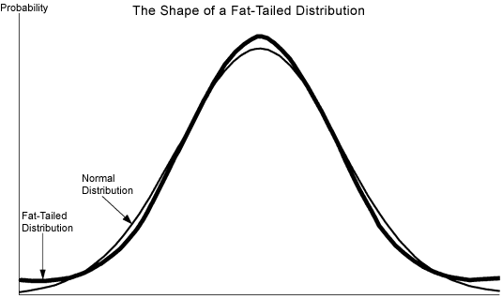
Excess kurtosis
The distribution is fat-tailed when the excess kurtosis > 0
Source: http://www.fattails.ca/distribution.html
Notes:
Besides skewness, also fat tails are a cause of non-normality. A distribution with fat tails is a distribution in which extremely large positive or negative returns occur more often than a normal distribution would predict.
A useful statistic to detect fat tails is the excess kurtosis. Its value is zero for the normal distribution. The larger the excess kurtosis, the fatter the tails are compared to the tails of a normal distribution.
***
Let’s do some exercises to get more insights about the non-normality of the S&P 500 portfolio returns.

