Slide 1
Video 1: Welcome to the course

Slide 2

Is investing a monkey-business?

Slide 3
About myself
Professor of finance, Vrije Universiteit Brussel and Amsterdam;
Inventor of statistical methodology for reliable financial decision
Publications in the Journal of Portfolio Management and Review of Finance, among others.
Contributor to the R packages PerformanceAnalytics, PortfolioAnalytics and highfrequency, among others.
Consultancy to investment firms.

Slide 4
The importance of risk management
Old Wall Street saying: “There are old traders and bold traders, but there are no old, bold traders.”
Investment success is achieved by “Winning by losing less”

Slide 5
Approaches to avoiding large losses
[1] Diversify investments: For most investments, there exists a well-diversified portfolio with a higher return and/or lower risk.

Slide 6
Approaches to avoiding large losses
[2] Quantify the consequences of investment decisions:
Monitor past performance;
Estimate the future reward and risk of the investment.

Slide 7
This course
Chapter 1
Chapter 2
Chapter 3
Chapter 4

Slide 8
Video 2: The investment decision in a portfolio context

Slide 9

Investing in the Coca Cola Company or PepsiCo?

Slide 10
Nobel prize lecture of Robert Engle: “to avoid all risks would be impossible; it might entail no flying, no driving, no walking. Even a bath could be dangerous. There are some risks we choose to take because the benefits from taking them exceed the possible costs. The central paradigm of finance is that must take risks to achieve rewards but not all risks are equally rewarded.

Slide 11
The power of diversification
Portfolio diversification reduces risk and/or increases reward.
REWARD
RISK

Slide 12
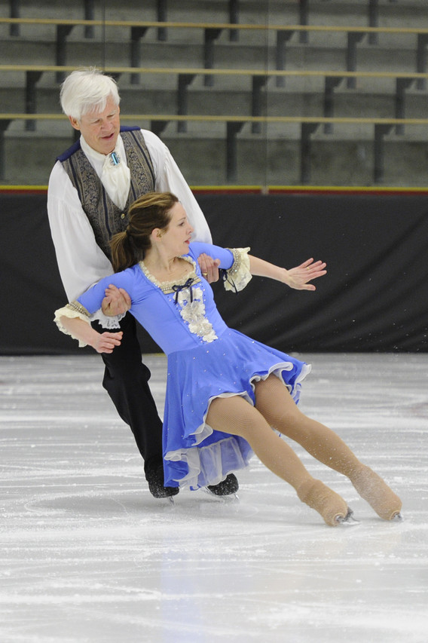
Nobel prize lecture of Robert Engle: “it is easily observed that to avoid all risks would be impossible; it might entail no flying, no driving, no walking, eating and drinking only healthy foods and never being touched by sunshine. Even a bath could be dangerous. There are some risks we choose to take because the benefits from taking them exceed the possible costs. Optimal behavior takes risks that are worthwhile.”

Slide 13
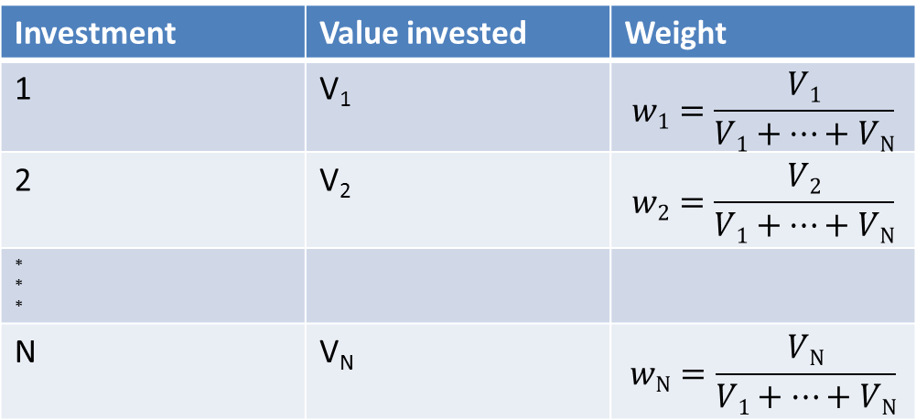
Portfolio weights
Investment | Value invested | Weight
1 | V₁ | $$w1=\frac{V1}{V1+…+VN}$$
2 | V₂ | $$w2=\frac{V2}{V1+…+VN}$$
* * *
N | V_{N} | $$wN=\frac{VN}{V1+…+VN}$$

Slide 14
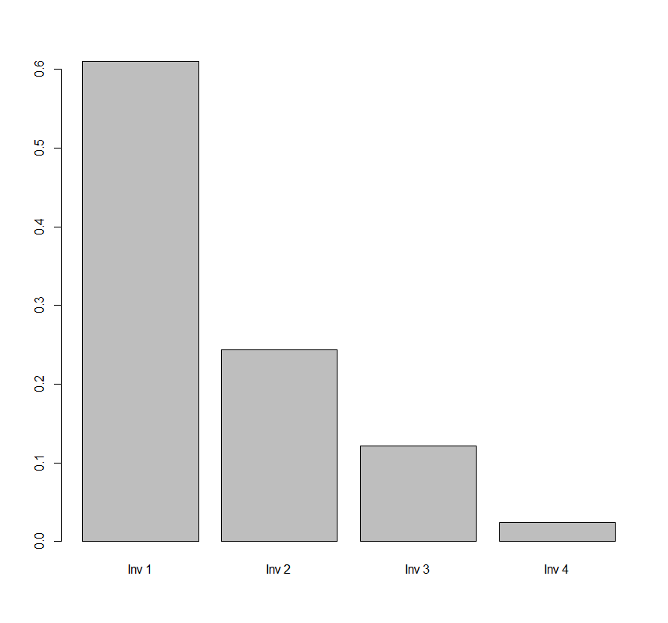
values <- c(500000, 200000, 100000, 20000)
names(values) <- c("Inv 1","Inv 2","Inv 3","Inv 4")
weights <- values/sum(values)
barplot(weights)

Slide 15
Descriptive analysis of weights shows the budget allocation.
Weights are the decision variable.
Examples of possible weight allocation decisions:
Speculation: Invest all your wealth in one single asset
Equal-weighting: Invest in all assets the same amount
Market capitalization based weighting: Set the weights of the assets relatively to their market value. Overweight large stocks, underweight small stocks
Low risk approach: Overweight the less volatile stocks
The small is beautifull investor: Overweight small stocks
The growth investor: Overweight assets with a high potential to increase their market value in the future.
The value investor: Overweight stocks with low price to earnings and price to book ratios.

Slide 16
Important for us …

Slide 17
Video 3: One-period portfolio returns are the weighted average of the individual returns

Slide 18
The investor decides on the portfolio weights
These weights determine the change in portfolio value.
Backward looking questions:
Forward looking questions:

Slide 19
Expressed in relative terms…

Slide 20
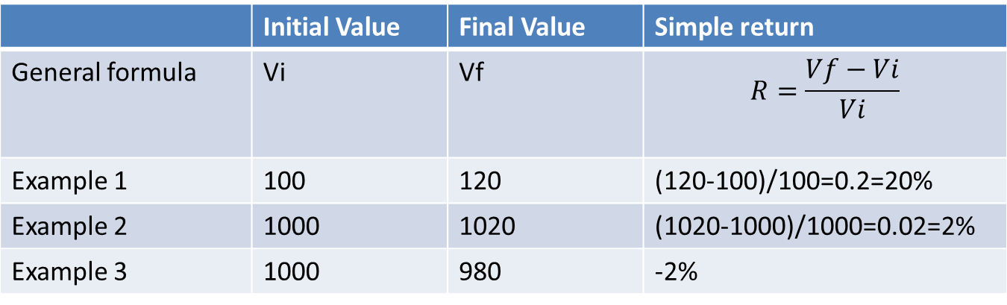
Simple returns over a one-period investment
 | Initial Value | Final Value | Simple return
General formula | Vi | Vf | $$R=\frac{Vf−Vi}{Vi}$$
Example 1 | 100 | 120 | (120-100)/100=0.2=20%
Example 2 | 1000 | 1020 | (1020-1000)/1000=0.02=2%
Example 3 | 1000 | 980 | -2%

Slide 21
The portfolio return is the change in portfolio value relative to the initial value:
PORTFOLIO RETURN = (FINAL PORTFOLIO VALUE-INTIAL PORTFOLIO VALUE)/INITIAL PORTFOLIO VALUE

Slide 22
This formula applies to any investment, and thus also for a portfolio:
Investment | Initial Value | Final Value | Return
1 | Vi₁ | VF₁
2 | Vi₂ | Vf₂
* * *
N | Vi_{N} | Vf_{N}
TOTAL | Vi = Vi₁+…+Vi_{N} | Vf = Vf₁+…+Vf_{N} | R = (Vf-Vi)/Vi

Slide 23
Disadvange…
Equivalence
PORTFOLIO RETURN
= (FINAL PORTFOLIO VALUE-INTIAL PORTFOLIO VALUE)/INITIAL PORTFOLIO VALUE
= weighted average return

Slide 24
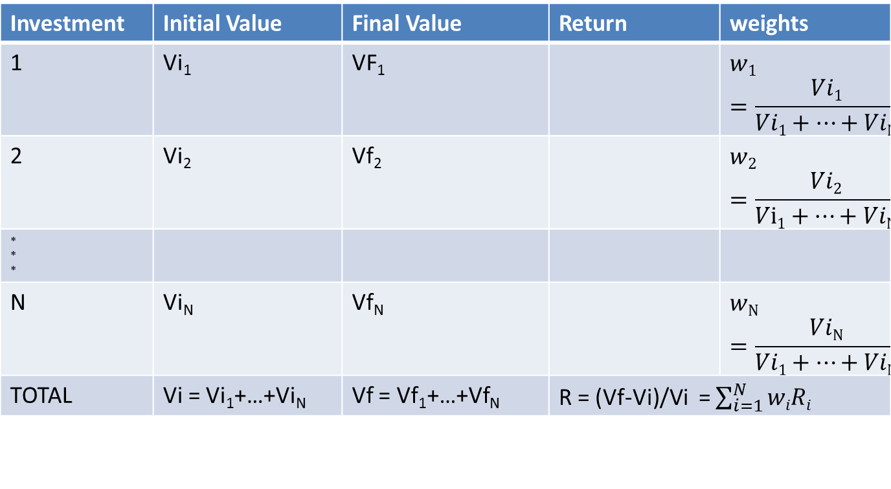
Magic
Investment | Initial Value | Final Value | Return | weights
1 | Vi₁ | VF₁ |  | $$w1=\frac{Vi1}{Vi1+…+ViN}$$
2 | Vi₂ | Vf₂ |  | $$w2=\frac{Vi2}{Vi1+…+ViN}$$
* * *
N | Vi_{N} | Vf_{N} |  | $$wN=\frac{ViN}{Vi1+…+ViN}$$
TOTAL | Vi = Vi₁+…+Vi_{N} | Vf = Vf₁+…+Vf_{N} | R = (Vf-Vi)/Vi = $\sum_{i=1}^{N}{wiRi}$

Slide 25
Simple example with 2 assets

Slide 26

Video 4: Multiperiod returns and sneak preview for the road ahead

Slide 27
We have seen single period returns of a portfolio with only a few investments
In practice:
Multi-period investments
Larger portfolios
Scalability is possible using the functionality of the R package PerformanceAnalytics
Illustration for the 30 DJIA stocks over 25 years with monthly rebalancing

Slide 28
First, multi-period returns

Slide 29
A common mismatch:
Returns are available at a daily, weekly or monthly frequency
The investment period is longer
Available (higher frequency) returns
Total multi-period return needed

Slide 30
Compounding formula
Initial value: Vi
Value after:
One period: Vi(1+R₁)
Two periods: Vi(1+R₁)(1+R₂)
…
K periods: Vi(1+R₁)(1+R₂)…(1+R_{K})
R₁
R₂
R₃
R_{K}

Slide 31
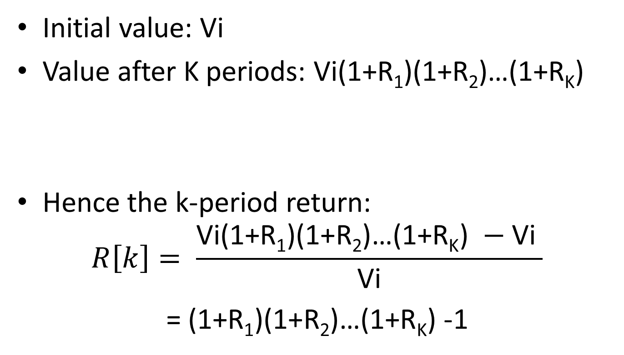
Multiperiod return
Initial value: Vi
Value after K periods: Vi(1+R₁)(1+R₂)…(1+R_{K})
Hence the k-period return:
$$R\left[k\right]= \frac{\text{Vi}\text{(1+}\text{R}\text{1}\text{)(1+}\text{R}\text{2}\text{)…(1+}\text{RK}\text{) }−\text{Vi} }{\text{Vi}}$$
= $\text{(1+}\text{R}\text{1}\text{)(1+}\text{R}\text{2}\text{)…(1+}\text{RK}\text{) −1}$

Slide 32
returns <- c( 0.05 , -0.01 , 0.03 , 0.02 , 0.01 ) cumprod(1+returns)
[1] 1.050000 1.039500 1.070685 1.092099 1.103020
tail(cumprod(1+returns),1)-1
[1] 0.1030197

Slide 33
Let us now consider a realistic portfolio of stocks, invested in 30 large US firms, namely the stocks included in the Dow Jones Industrial Average universe:
[show tickers]

Slide 34
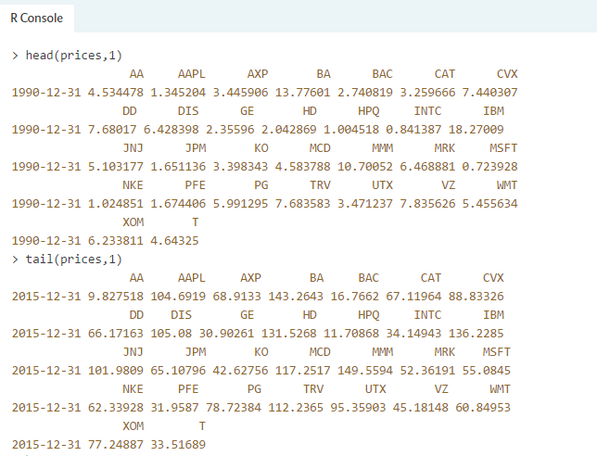
For those thirty stocks, the variable ‘prices’ provides us the end-of-month close adjusted prices over the period December 1990 till December 2015

Slide 35
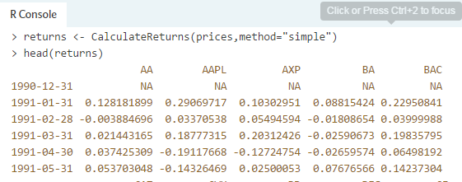
Returns

Slide 36
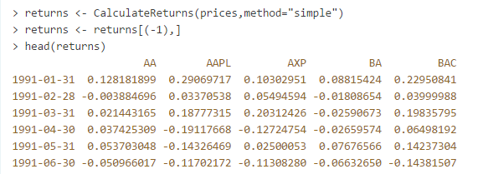
Returns

