Slide 1
The Portfolio Weights

Slide 2


Investment decision choices
There are two similar companies:
Do you invest in either of them based on a coin toss?
Source: ICMA Photos, Flickr

Slide 3
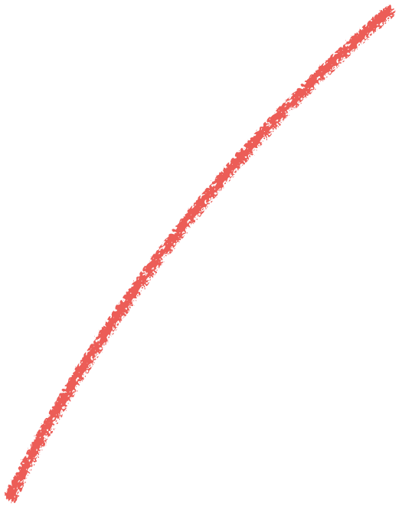

Betting vs diversification
Source: ICMA Photos, Flickr

Slide 4



Investment | Value Invested | Weight
1 | V1
2 | V2
N | VN
Wrong: should be: w₂
w_{N}

Slide 5
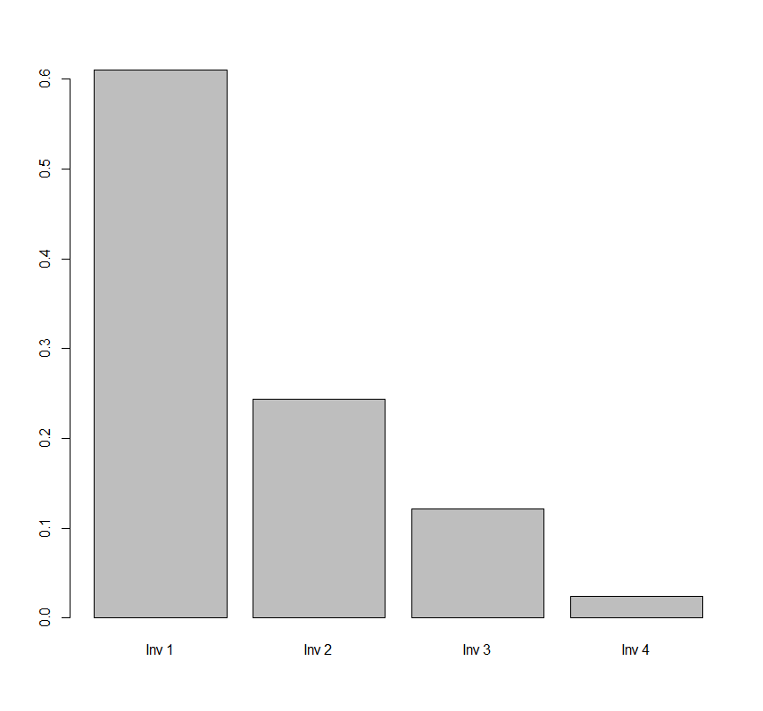
values <- c(500000, 200000, 100000, 20000)
names(values) <- c(“Inv 1”, “Inv 2”, “Inv 3”, “Inv 4”)
weights <- values/sum(values)
barplot(weights)

Slide 6
Allocation strategies
Allocation strategies
Optimize mean and variance
(Ch. 4)
Betting on
one asset
Equal-weighting
Market cap weighting

Slide 7
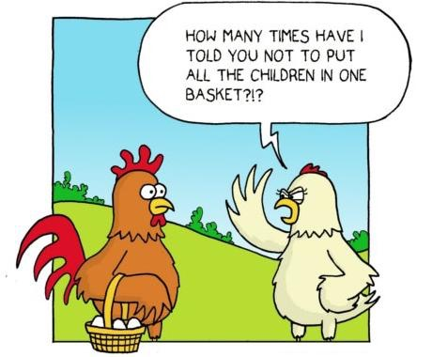
Source: http://www.falibo.com/vocabulary/idiom-dont-put-all-your-eggs-in-one/

