Slide 1
Welcome To The Course

Slide 2

Is Investing Monkey-Business?
Source: Eric Isselee, Getty Images

Slide 3


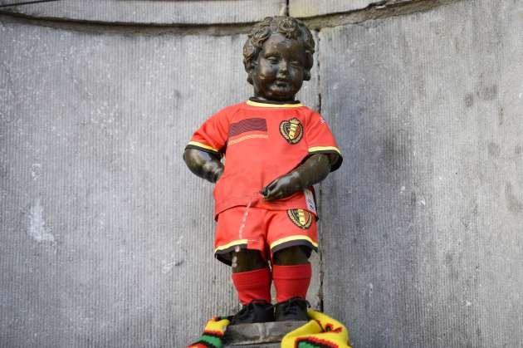
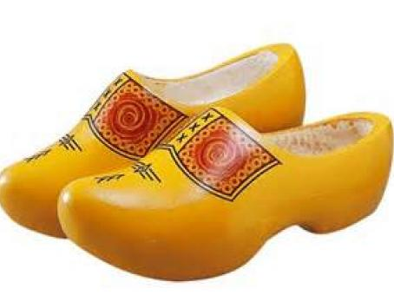
Who am I?
Professor of Finance
http://www.hln.be/hln/nl/9091/Time-out/article/detail/1807049/2014/03/07/Manneken-Pis-gekleed-in-nieuw-WK-shirt-Rode-Duivels.dhtml
http://vrouwenvannu.nl/nieuw-amsterdamveenoord/hinky-bangma-op-klompen-door-amerika

Slide 4
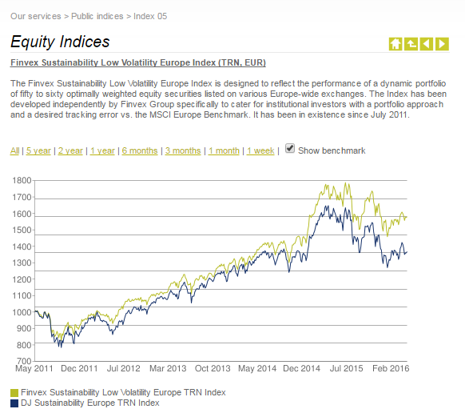
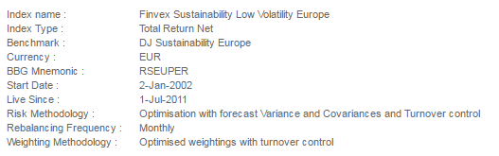
Who am I?
Professor of Finance
Advisor to investment companies
Expertise in portfolio management
Focus on risk management
http://www.finvex.com/

Slide 5
Simple Tricks
To avoid large losses:
Carefully select diversified portfolios
Screening based on liquidity analysis
Screening based on economic, social and environmental analysis
Screening based on financial risk and performance analysis
Optimize portfolios under diversification constraints

Slide 6
Simple Tricks
To avoid large losses:
Carefully select diversified portfolios
Use backtesting and online performance monitoring
> library(PerformanceAnalytics)
> data(edhec)
> table.AnnualizedReturns(edhec)[,2:6]
Distressed Securities Emerging Markets Equity Market Neutral Event Driven Fixed Income Arbitrage
Annualized Return 0.0975 0.0936 0.0739 0.0932 0.0507
Annualized Std Dev 0.0636 0.1336 0.0312 0.0636 0.0491
Annualized Sharpe (Rf=0%) 1.5342 0.7006 2.3700 1.4660 1.0323

Slide 7
Simple Tricks
To avoid large losses:
Carefully select diversified portfolios
Use backtesting and online performance monitoring
Learn this by doing at DataCamp!

Slide 8
Course Overview
Ch. 1: Portfolio Weights & Returns

Slide 9
Course Overview
Ch. 1: Portfolio Weights & Returns
Ch. 2: Portfolio Performance Evaluation

Slide 10
Course Overview
Ch. 1: Portfolio Weights & Returns
Ch. 2: Portfolio Performance Evaluation
Ch. 3: Drivers of Performance

Slide 11
Course Overview
Ch. 1: Portfolio Weights & Returns
Ch. 2: Portfolio Performance Evaluation
Ch. 3: Drivers of Performance
Ch. 4: Portfolio Optimization

