Slide 1
The Portfolio Weights

Slide 2

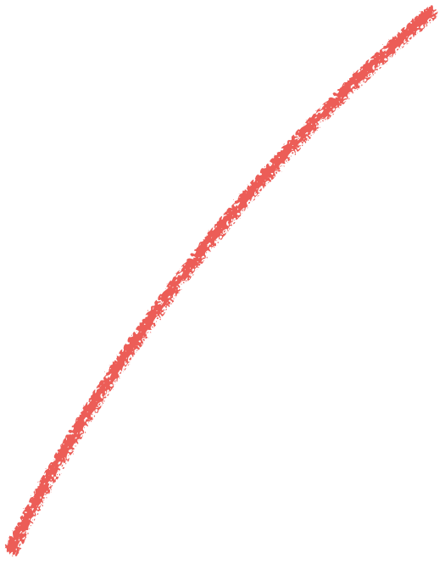


Scenario
There are two similar companies:
Do you invest in either of them based on a coin toss?
Source: ICMA Photos, Flickr

Slide 3



Investment | Value Invested | Weight
1 | V1
2 | V2
N | Vn

Slide 4
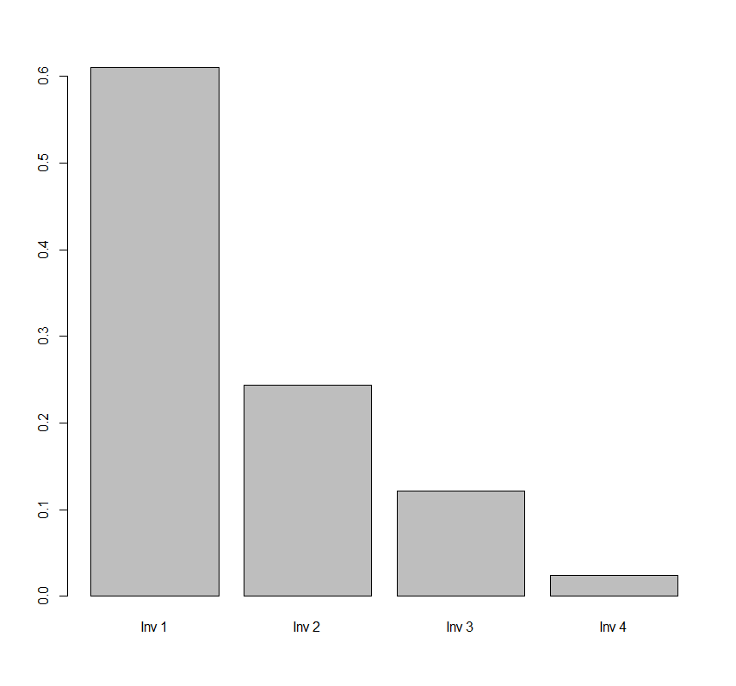
values <- c(500000, 200000, 100000, 20000)
names(values) <- c(“Inv 1”, “Inv 2”, “Inv 3”, “Inv 4”)
weights <- values/sum(values)
barplot(weights)

Slide 5
Allocation Strategies
Optimize mean and variance (Ch. 4)
Betting on one asset
Equal weighting of diversified set of assets
Market capitalization based on weighting

Slide 6
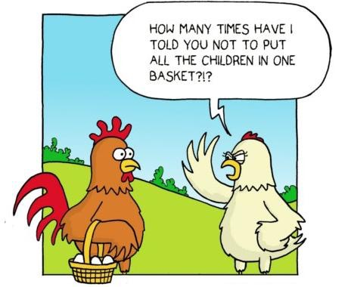
Source: http://www.falibo.com/vocabulary/idiom-dont-put-all-your-eggs-in-one/

