Slide 1

Exploring the Future: Trends and Applications of Artiﬁcial Intelligence

Slide 2
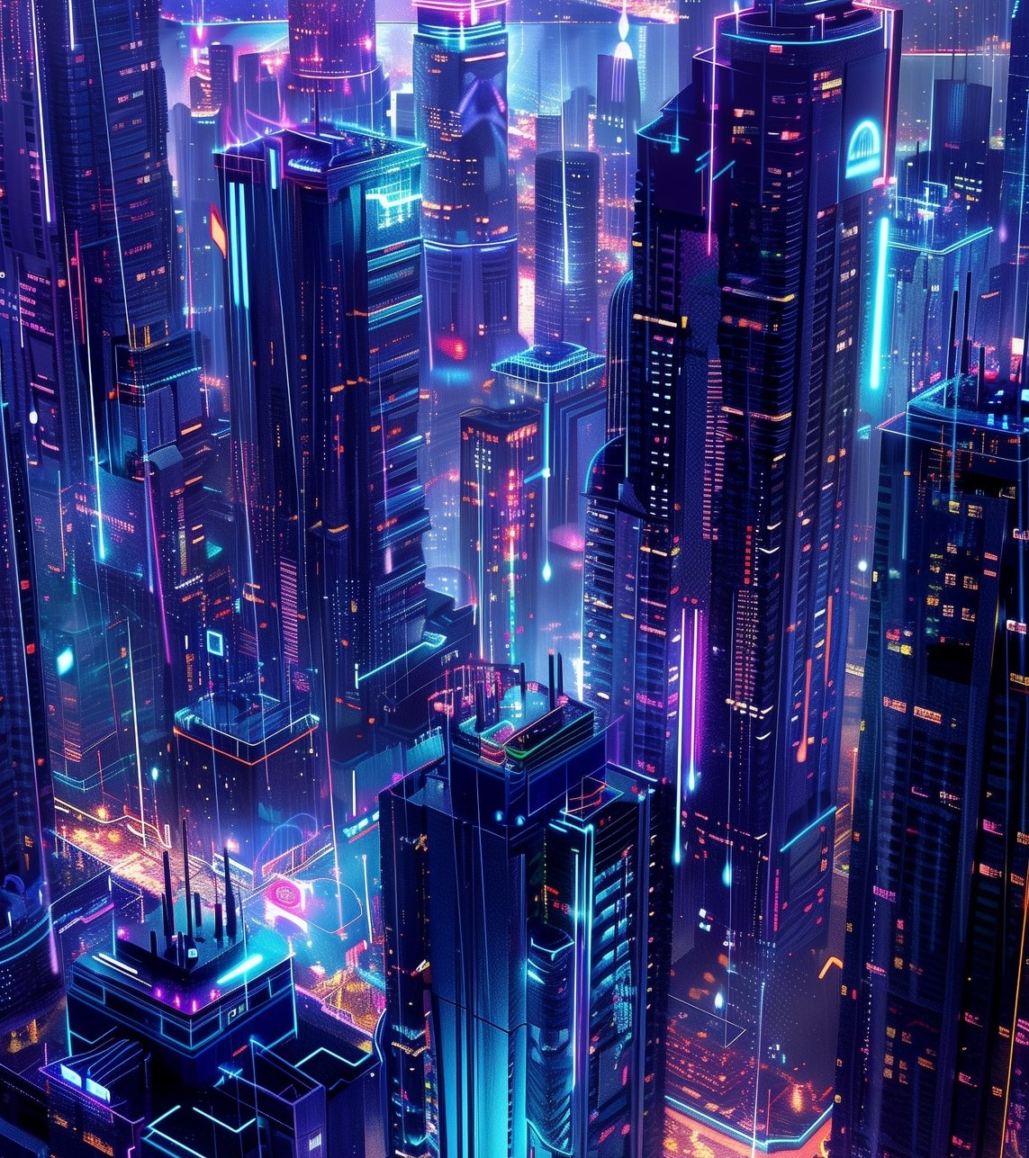


Introduction to AI Trends
is rapidly transforming various sectors. This presentation explores the
and
of AI that will shape our future. We will delve into its impact on industries, society, and our daily
lives.

Slide 3
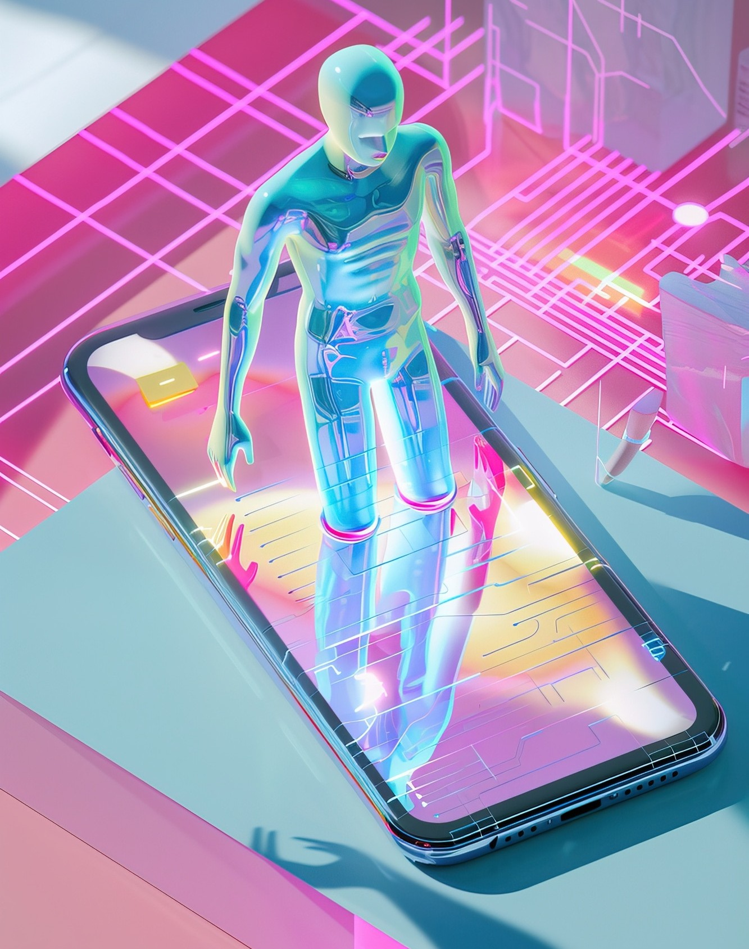



Current AI Landscape
The advancements in
is characterized by
,
, and .
These technologies are becoming integral in sectors such as healthcare, ﬁnance, and education, driving innovation and efﬁciency.

Slide 4





AI in Healthcare
AI is revolutionizing applications like
through
,
, and
. These innovations enhance patient care, reduce costs, and improve outcomes, making healthcare more efﬁcient and accessible.

Slide 5
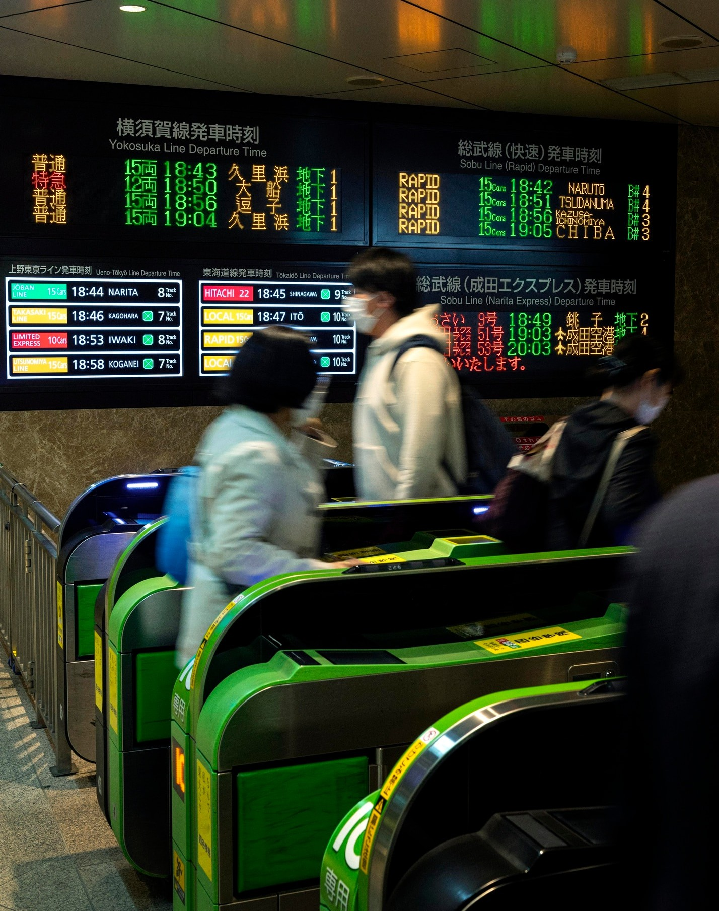






AI in Finance
In the
, AI is utilized for
, and
,
. These applications help institutions make data-driven decisions, enhance security,
and improve customer experiences.

Slide 6






Ethical Considerations
As AI continues to evolve,
become paramount.
Issues like , , and
must be addressed to ensure that AI technologies are developed and implemented responsibly.

Slide 7



AI in Customer Service
AI is enhancing through ,
and
,
. These
technologies improve customer interactions, streamline processes, and provide personalized support, leading to higher satisfaction levels.

Slide 8
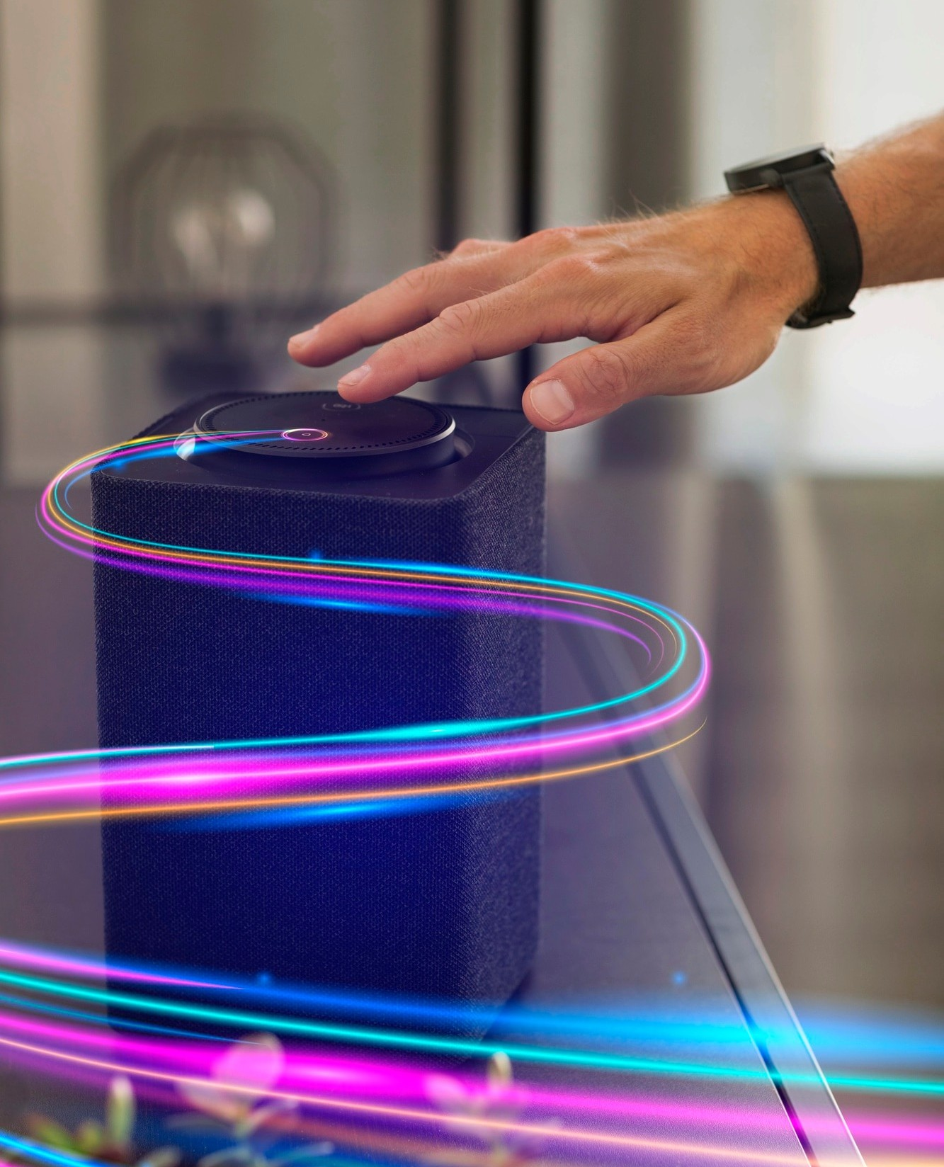



Future Trends in AI
Looking ahead, we can expect trends such as ,
, and
. These trends will further integrate AI into our lives, making it more accessible and understandable.

Slide 9
Conclusion
In conclusion, AI is poised to signiﬁcantly inﬂuence our future.
By understanding its trends and applications, we can better prepare for the changes it brings, ensuring a positive impact on society and the economy.

Slide 10
Thanks!
Do you have any questions? youremail@email.com
+91 620 421 838
www.yourwebsite.com @yourusername

