Slide 1
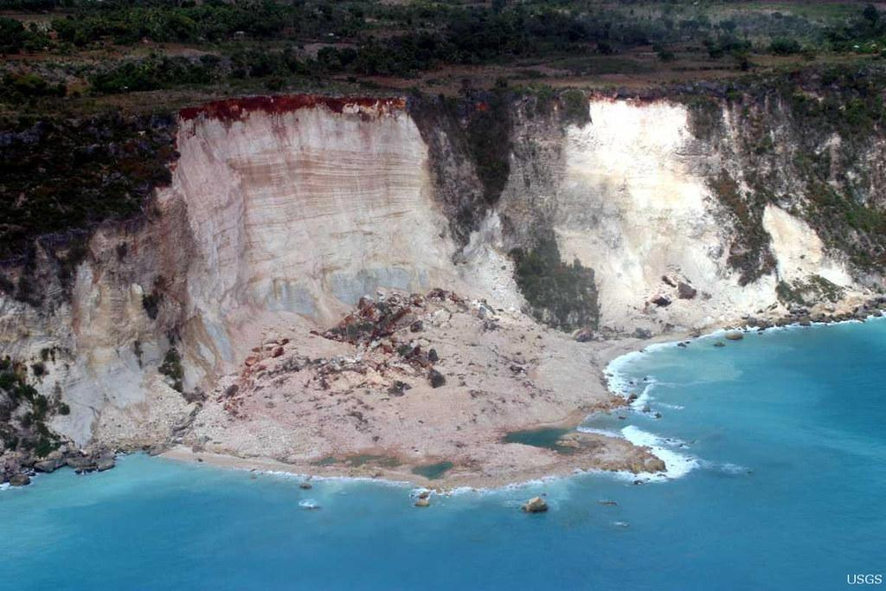
IDENTIFYING RISK
WITH SCIENCE
Predicting landslides with AI
Notes:
Wecome everyone, we would like to show our presentation about the identification of landslides risks using science and technology.

Slide 2
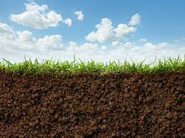
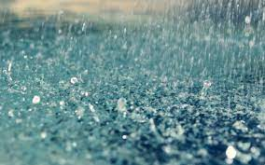
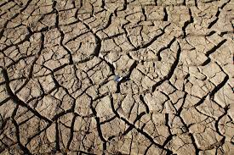
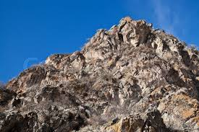
PROBLEM ANALYSIS
Slope degree → Soil moisture → Rainfall
Slope degree → Rocky terrain → Earthquake
Human behaviour
Vegetation → Reduced risk of landslides
Notes:
First of all we had to do a problem analysis, where we identified the causes of a landslide (with the help of the data already available of the past landslides) which were catacterized by many factor such as the terrain type, the natural fenomena and the human behavyour (in small percentage): more precicely we cocluded that to have a landslide must be there a slope degree between a certain range, and heavy rainfalls are more likely to have great impact combined with high soil moisture.
Rocky terrains seem to give away if there is a remarkable earthquake.
Vegetation helps to reduce the risk of landslides because the plants contribute to stabilize the terrain.
There is also a human impact for this issue but the data shows that is very low so we did not consider it.

Slide 3
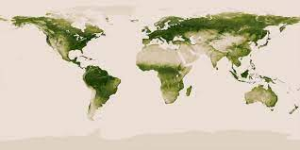
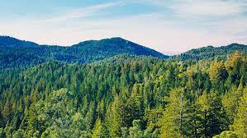
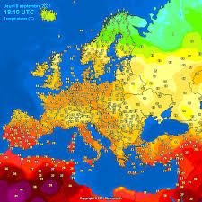
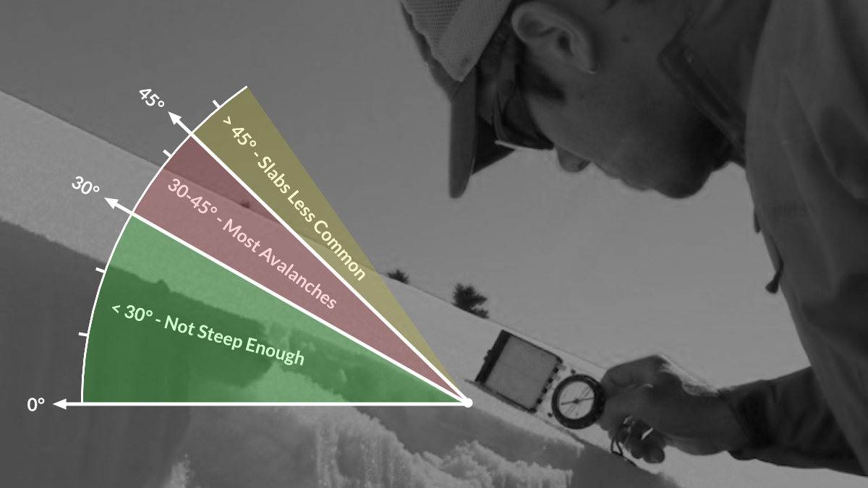
DATA GATHERING AND PROCESSING
Vegetation
Surface temperature
Rainfall
Terrain slope
Snow
Soil moisture
Notes:
We did a research in the net to find the data necessary to evaluate the risk in a specified area, so we gathered of vegetation, suface temperature, rainfall rate and grownd slope, we thought to use also soil moisture but we did not find enough data.
We combined all this factors to make a machin learnig model

Slide 4

MACHINE LEARNING MODEL
Deep Neural Network
Skewed dataset
Notes:
The team created a concept for a machine learning model which uses a binary classification method. Using data from the Cooperative Open Online Landslide Repository a dataframe of landslides was composed, using the previously obtained and processed data to fill the inputs. After creating other instances of events in which no landslide has happened, the positive events were oversampled, as to reduce the imbalance of the set, and for the training a weighted logistic loss function was used, as to further reduce the imbalance. This model, given as input the current vegetation index, the slope of the terrain, the temperature of it and the daily and cumulative rainfalls, will output a score between 0 and 1 that will show the confidence of an approaching landslide.

Slide 5
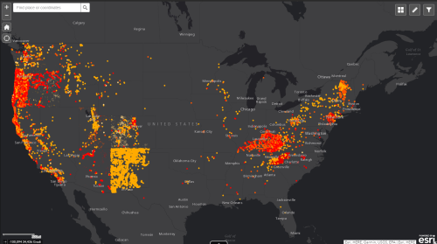
SHARING THE INFORMATION
Web API
Site
Application
Notes:
We want to share the indexes of risk and the other data such us past conditions of the grownd rainfall frequency and so on with the local cities via WEB API, and in the future with an Application, so it can be available to everyone and be easy to access

Slide 6
FUTURE DEVELOPMENTS
Adding more features (soil moisture, terrain type)
Generalization of the model
Mobile app
Notes:
This model can be developed in the future, adding more features such as soil moisture terrain type, the model can be generalized to more areas of the globe because we considered only a small location due to the big amount of data to compute in this 2 days.
We begin to share the information via a web site but in the future it can be usefull a mobile application.

Slide 7
RESOURCES
MODIS
ALOS
JAXA Global Rainfall Watch
Notes:
These are some of the attendible resources that we have found and used for our project and this is all
Thank you for your attention.

