Slide 1
Naturally Curly
Kate Hayes

Slide 2
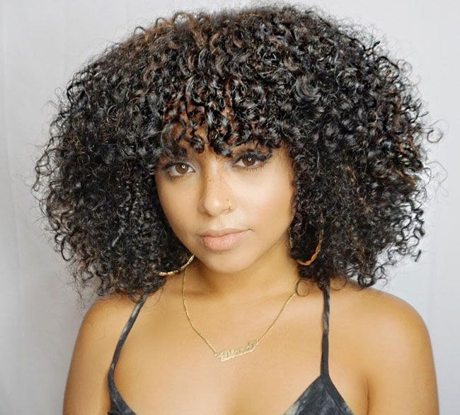
Who Cares About Curly Hair?
The global hair industry is worth 90 Billion dollars in 2019¹
Consumers want to know which products are right for their hair
Product Creators want to know how to market their products
https://diana-cdn.naturallycurly.com/Articles/91_curly-haircut-fringe-fro-bangs-650x586.jpg
1. https://www.statista.com/statistics/254608/global-hair-care-market-size/

Slide 3
Driving Question
Are curly hair characteristics and products able to predict each other?

Slide 4

“NaturallyCurly.com is the leading resource for the natural and textured hair community, giving every member a voice in a space seeing significant growth and change.”
Our Mission: Be the most trusted & engaging community for women with textured hair.
September 1998
The forum-turned-curly hair community offers helpful expert content, qualified user-generated product and stylist reviews, and direct digital access to popular products and emerging brands

Slide 5
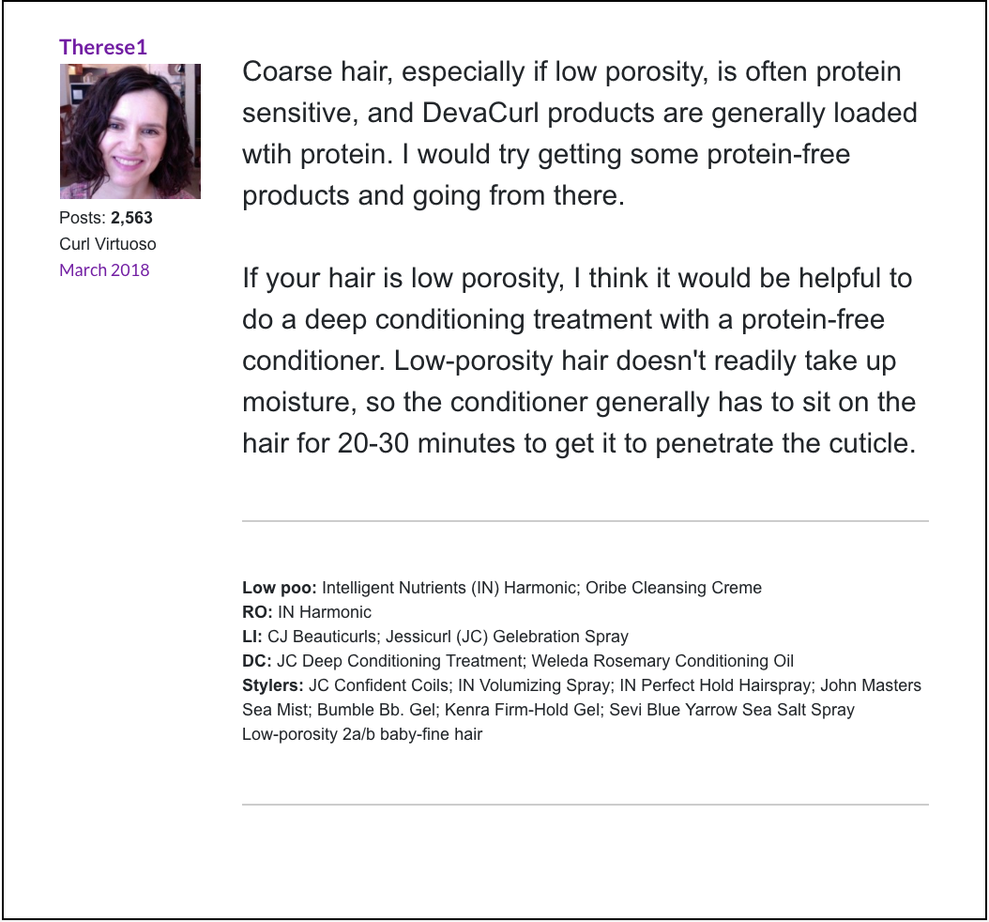
Naturally Curly Forum Signatures
[‘', "Molly didn't want her hair to look pretty- that was out of the question. She only wanted everyone to think she was a clever little girl and not to find fault with her. -George Eliot", "Mix of 3A and 3B\nWash: Recently changed to using low sulfate shampoos. I love it. My hair needs all residue removed to get any volume.\nConditioner: Kinky Curly Knot today\nStyler: AG Recoil (I have eliminated everything but AGRecoil. My hair has tons of volume and bounce.)\nIn high humidity: a dime/nickle size of gel lightly scrunched on the canopy. FINALLY I found a way that doesn't kill my hair volume.", 'password: wavy', '3b-3c, normal porosity\nShampoo: DevaCurl Nopoo \nCondition/Detangle: Giovanni Smooth As Silk \nLeave-in: the Giovanni or Mixed Chicks\nOnly When Needed: Jojoba Oil, ACV wash\n\n"If you want your life to change, you have to change some things in your life.":tongue3:\n']

Slide 6
Curl Characteristics
Curl Pattern
2a, 2b, 2c
3a, 3b, 3c
4a, 4b, 4c
Density
How much scalp is visible
thin, medium, thick
Porosity
How much water your hair holds
Low, normal, high
Texture
How rough is the hair
Fine, medium, coarse
https://img.buzzfeed.com/buzzfeed-static/static/2016-11/15/16/asset/buzzfeed-prod-fastlane01/sub-buzz-1964-1479245827-3.jpg?downsize=800:*&output-format=auto&output-quality=auto

Slide 7
Products
DevaCurl
Jessicurl
Suave
ASIAM
Cantu
Shea
Kinky Curly
Not Your Mothers Naturals
Herbal Essence
Garnier
www.pinterest.com%252Fbebabob73%252F%26psig%3DAOvVaw2Kms6lty88Qh0P872xlCkv%26ust%3D1567655446536827&psig=AOvVaw2Kms6lty88Qh0P872xlCkv&ust=1567655446536827

Slide 8
Challenges
Natural language is very messy
No uniform format
Not all curly hair relevant
Acronyms
Different phrases to mean the same thing
Inconsistent punctuation, spelling, and capitalization
Uneven class distributions
No obvious product dictionary
Order of words matters so a simple Bag of Words is insufficient

Slide 9
Approach
Heavy usage of regular expressions to clean the data up
Label and remove the four characteristics from each signature if present
Inspect various Ngrams for possible products
Perform TF-IDF on the products and use that as the feature and try to predict each characteristic category in return

Slide 10
Results
Models Used:
LinearSVC
LogisticRegression
MultinomialNB
RandomForestClassifier
Logistic Regression consistently outperforms other models and Multinomial Naïve Bayes is a close second
Texture was classified with about 74 % accuracy
Density was classified with about 58 % accuracy
Porosity was classified with about 45 % accuracy
Curl Pattern was classified with about 32 % accuracy

Slide 11
Conclusions & Future Work
All models for each characteristic that was attempting to be predicted performed better than random guessing
The product predictor text needs to be cleaned up more and non-relevant signatures discarded as well as all common acronyms
Upsampling or downsampling needs to be applied to even out class imbalances
Different scoring metrics can be examined as well for different insights into the data

Slide 12
Thank You For Your Time
Questions?

