Slide 1
Movie Reviews sentiment analysis
-

Slide 2
01
DataSet
Imdb Dataset

Slide 3
The dataset contains 50,000 reviews in total
Structure: Each data sample includes:
Source
25000 for Training and 25000 for testing
text(review)and label(negative(0) or positive(1))
Datasets Library

Slide 4
Pre-Processing
1-Tokenization: Using a tokenizer compatible with the chosen
LLM(distilbert-base-uncased)
2-Padding and Truncation:
Reviews were padded or truncated to a fixed length to enable efficient batch processing
3-Splitting

Slide 5
—
Model Name: distilbert-base-uncased

Slide 6
distilbert-base-uncased
Architecture: DistilBERT is a lighter and faster version of BERT (Bidirectional Encoder Representations from Transformers
Capabilities:Trained on a large corpus of English text (same as BERT: BookCorpus and English Wikipedia).
Pre-trained using a masked language modeling (MLM) objective — predicting masked words from context.

Slide 7
distilbert-base-uncased
r=8: Rank of the low-rank matrices.
lora_alpha=16: Scaling factor.
lora_dropout=0.05: Dropout applied during adaptation.
task_type="SEQ_CLS": LoRA is applied for sequence classification.
LoRA was applied to the distilbert-base-uncased model using the PEFT library .
Low-rank dimension (r) was set to 16. This controls the size of the added trainable matrices.

Slide 8
Metrics
- Accuracy: Proportion of correct predictions over total samples.
F1 Score (weighted): Balances precision and recall, accounts for class imbalance.
Precision (weighted): How many selected items are relevant.
Recall (weighted): How many relevant items were selected.
All metrics use weighted averaging to handle imbalanced sentiment classes (e.g., more positive reviews than negative).
The result before finetuning (without Lora):

Slide 9
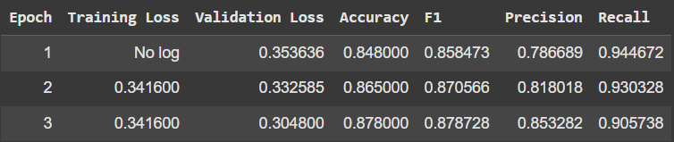
Metrics
- Accuracy: Proportion of correct predictions over total samples.
F1 Score (weighted): Balances precision and recall, accounts for class imbalance.
Precision (weighted): How many selected items are relevant.
Recall (weighted): How many relevant items were selected.
All metrics use weighted averaging to handle imbalanced sentiment classes (e.g., more positive reviews than negative).
The result after fine tuning (with Lora):

Slide 10
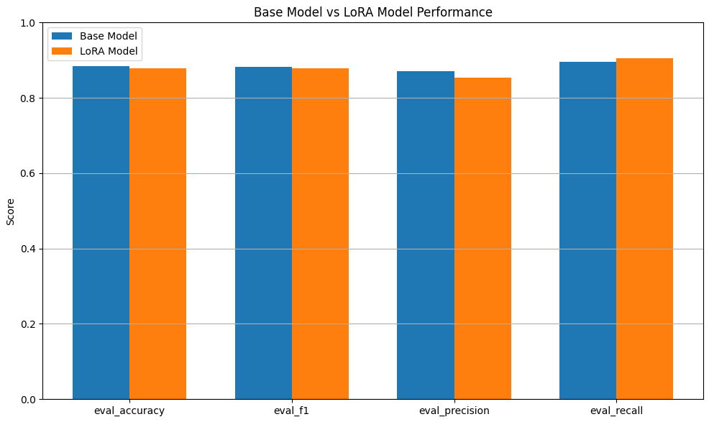
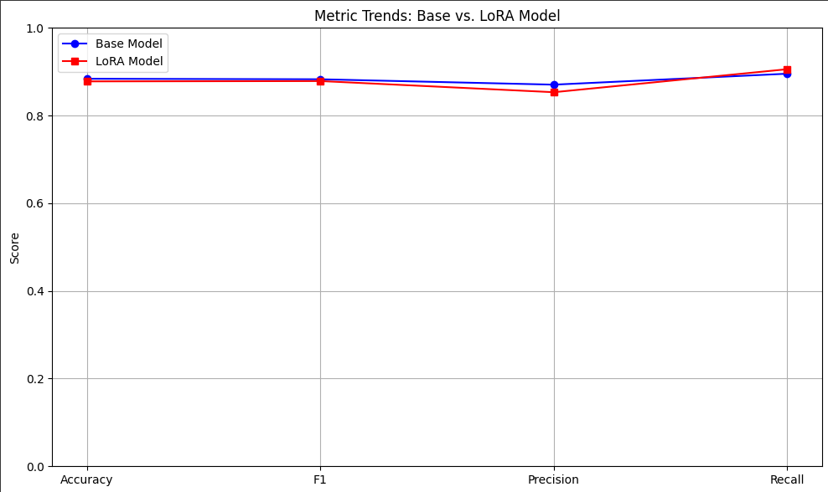
Base Model(without Lora) Vs Lora Model

Slide 11
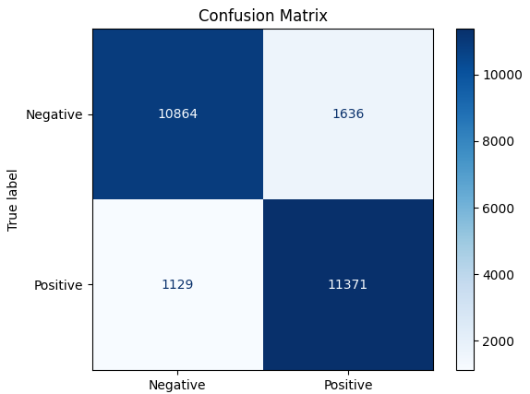
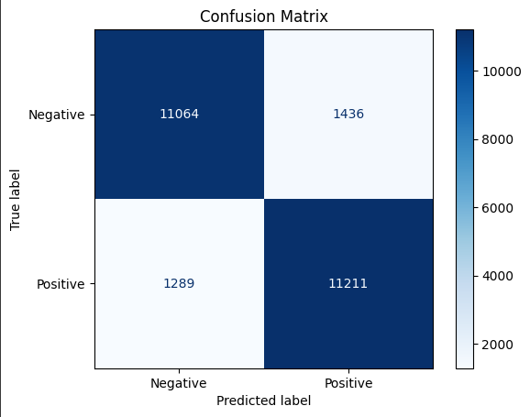
Base Model(without Lora) Vs Lora Model
With Lora
Without Lora

Slide 12
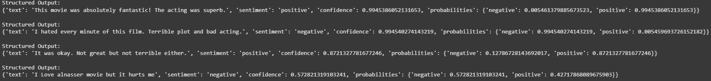
The results.

Slide 13
Thanks!
Please keep this slide for attribution

