Slide 1
Personalized Healthcare System!
theDfaulters
NIT Rourkela

Slide 2
Overview
The healthcare industry produces a large amount of “raw health-care data” daily that can be used to extract information for predicting disease that can happen to a patient in future while using the treatment history and health data. These data will be later used for effective decision making for patient’s health. This area has a very high scope of improvements by using informative data in healthcare starting from disease predictions, suggestions of drugs etc.

Slide 3
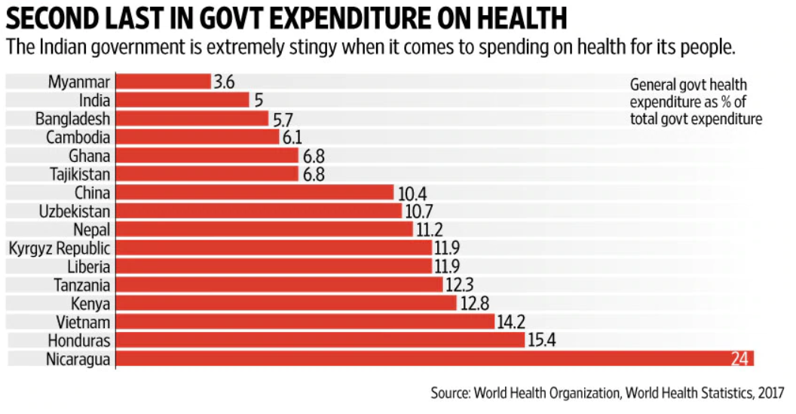

Slide 4
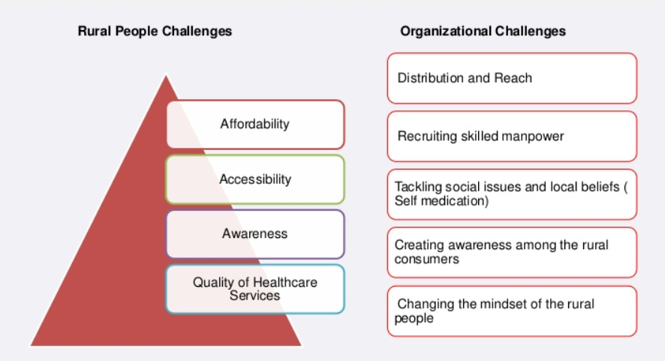
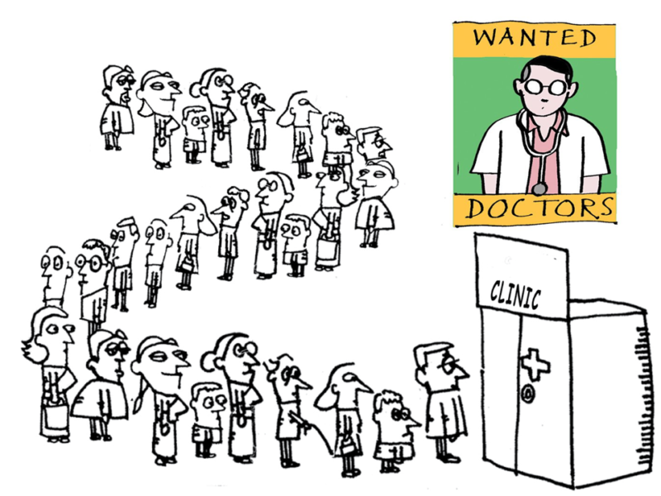

Slide 5

PROPOSED METHODOLOGY
DATA
EXTRACTION
Pre-Processing
Entity
Extractions
Bi-Directional
LSTM
Knowledge
Graphs
Patients’ Side
Doctors’ Side
FUSION
(SOFTWARE)

Slide 6
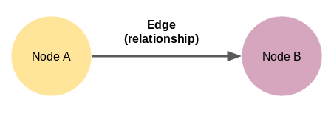
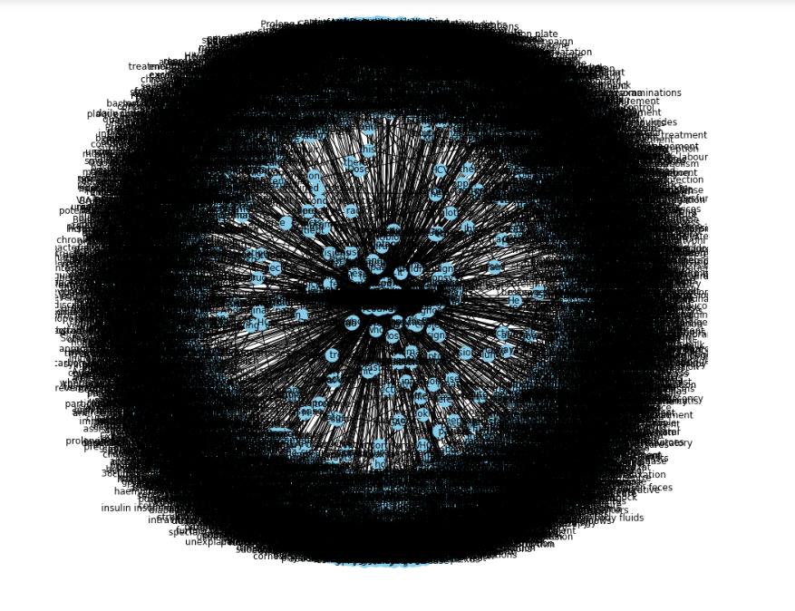
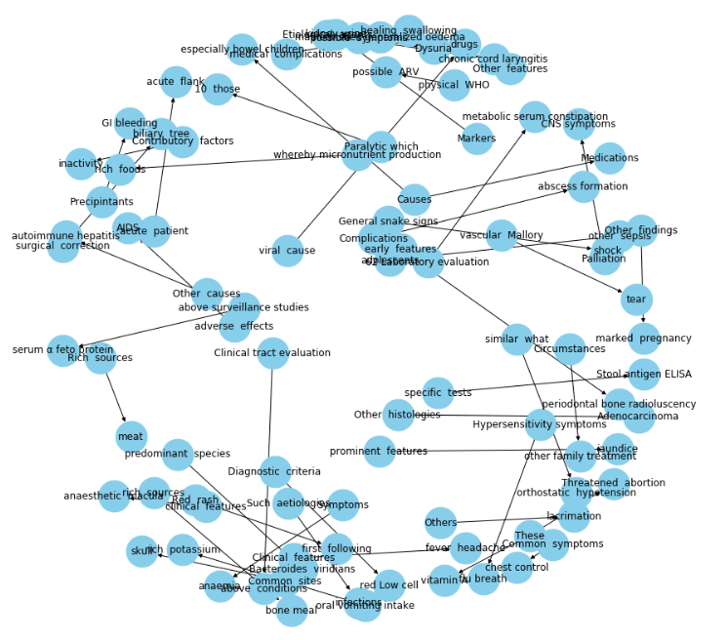
Knowledge Graph!

Slide 7
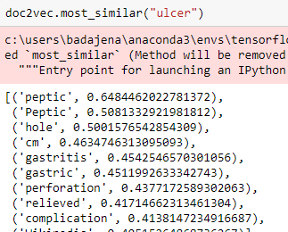
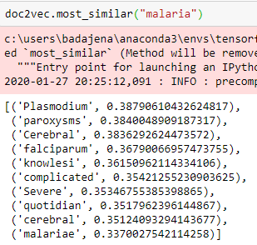


WordEmbedding

Slide 8
USE OF KNOWLEDGE GRAPH
DATA
EXTRACTION
OLD KNOWLEDGE GRAPH
(PATIENT’S HISTORY)
NEW DIAGNOSIS
f(x)
f(y)
FUSED KNOWLEDGE GRAPH
f(x, y)

Slide 9
WORKFLOW OF DBMS AND NEURAL NETWORKS
DATA
(WIKIPEDIA)
WEB SCRAPPING
PREDICTION OF DISEASES
BI-DIRECTIONAL LSTM
TOKENIZATION
EMBEDDING & LABELING
RECOMMENDATION OF DOCTORS AND MEDICINES

Slide 10
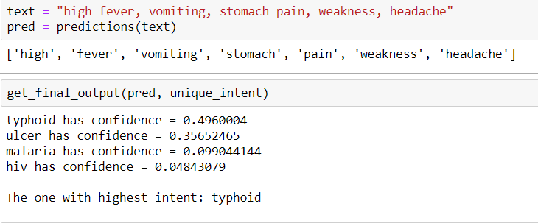
MODEL OUTPUT

Slide 11
SWOT ANALYSIS
STRENGTH
Highly scalable, affordable and adaptable
Simple UI for better user experience
WEAKNESS
Need of Internet Connections
OPPORTUNITY
The availability of huge raw medical data
Ease of productization
THREATS
Yet to achieve full accuracy
Well established competitors
Lack of investments

Slide 12
Scope of Improvements
Proper standardized well processed datasets can help in better diagnosis
Data Augmentation

Slide 13

theDfaulters
Debaprasad Badajena
Jagannath Pandit
Rahul Sasmal
Abhishek Jaiswal

