Slide 1

Using RStudio to Visualize Variation in Bahamas Fish Density
Elizabeth Ortiz

Slide 2
Monitoring of Reef Fish Communities can Indicate Coral Reef Health Status
Benefits Of Studying Fish Communities
Disturbances in habitat
Water quality
Predator abundance
Fisheries management
Identify areas of high biodiversity and species richness

Slide 3
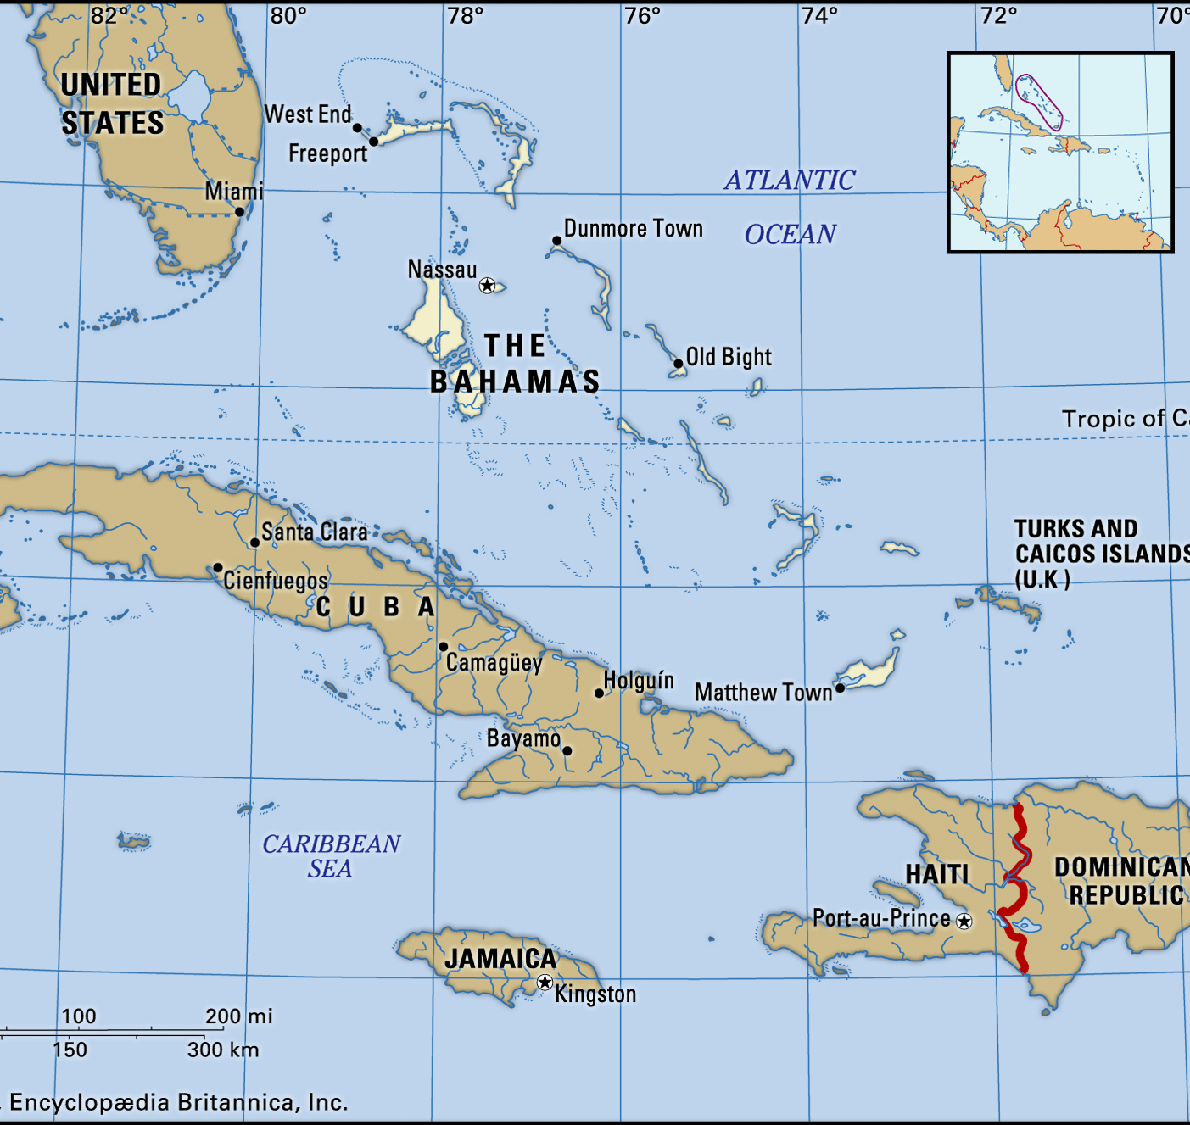
Do fish populations exhibit dynamic variations within the coral reefs of the Bahamas?

Slide 4
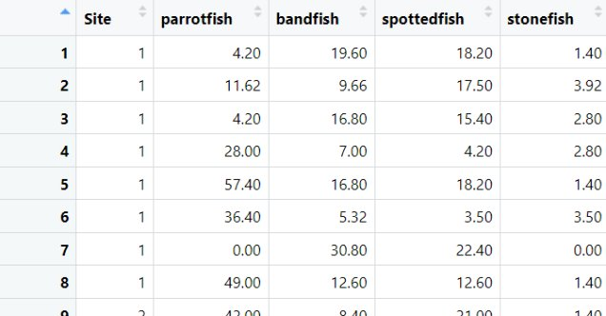
Fish density of the most abundant species

Slide 5
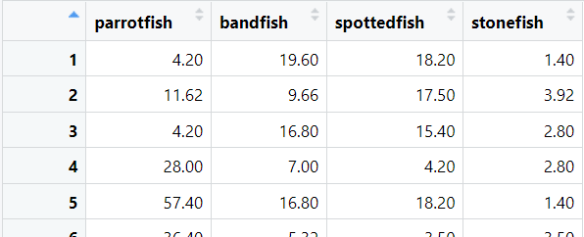
Create a data file with ONLY the dependent variables.
dependents<-mydata[,2:5]
View(dependents)

Slide 6
Convert to z-scores to standardize the variables
scaled.data<-scale(dependents, scale=TRUE, center=TRUE)
Run the PCA
PCAmodel<-princomp(scaled.data, cor=FALSE)
*The variable were converted to z-scores -> use covariance matrix (cor=FALSE)

Slide 7
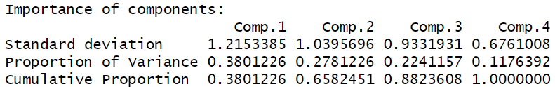
summary(PCAmodel)
Standard Deviation:
Comp.1 has more variance in the data
Proportion of Variance:
Comp.1 explains 38.01%, Comp.2 explains 27.81%, Comp.1 explains 22.41%, Comp.2 explains 11.76%
Cumulative Proportion:
All the variance is explained by the fourth component.

Slide 8
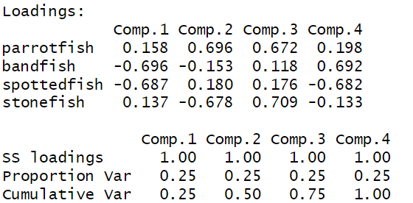
loadings(PCAmodel)
Parrotfish high loading Comp.2 -> strong (+) association
Bandfish high loading Comp.1 -> strong (-) association
Spottedfish high loading Comp.1 -> strong (-) association
Stonefish high loading Comp.3 -> strong (+) association

Slide 9
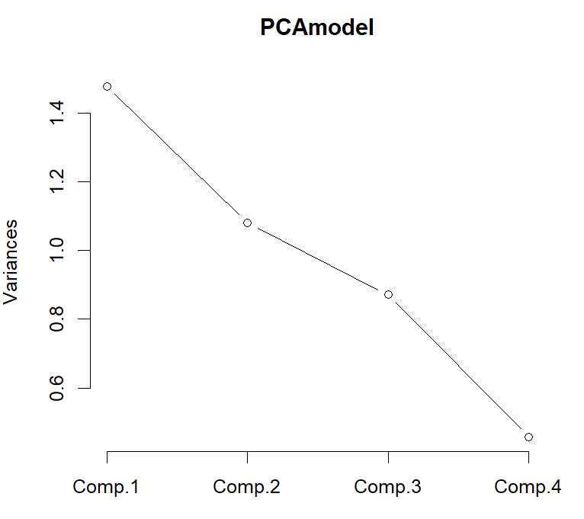
plot(PCAmodel, type="lines")

Slide 10
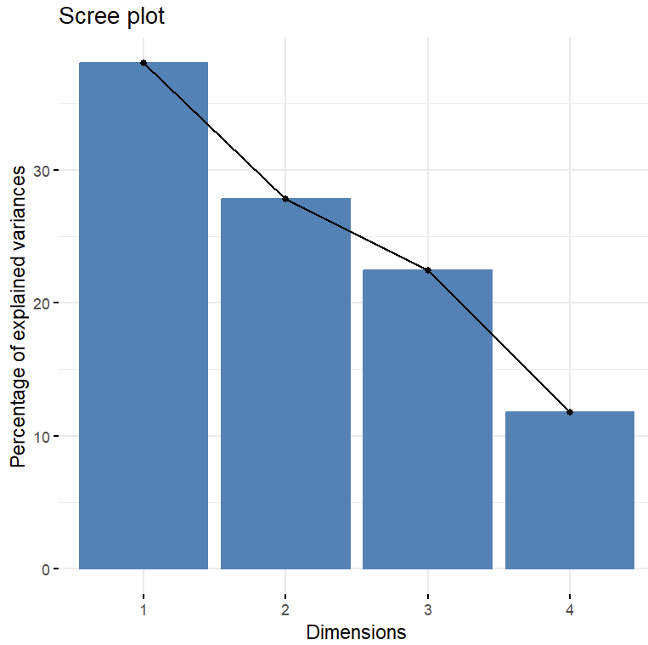
Scree plot
library(factoextra)
fviz_eig(PCAmodel)

Slide 11
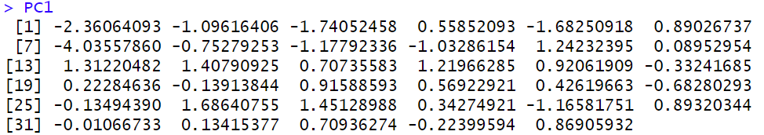
Are there significant differences between fish communities?
Principal components for each individual
PCAmodel$scores
PC1<-PCAmodel$scores[,1]
PC1

Slide 12
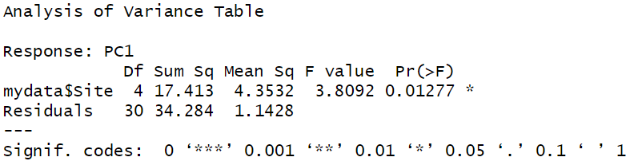
model1<-lm(PC1~mydata$Site)
anova(model1)
Statistically significant principal component 1 ... there are differences in PC1 scores among the different sites studied

Slide 13
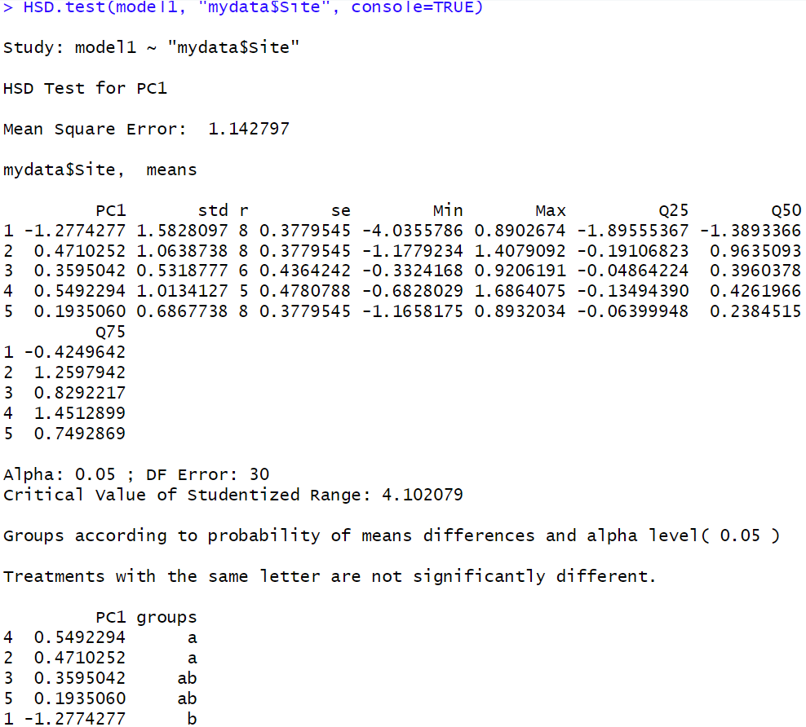
Post-hoc tests- Identify specific differences between sites in terms of their PC1 mean scores
library(agricolae)
HSD.test(model1, "mydata$Site", console=TRUE)
Sites with the same letter are not significantly different
Sites in Group "a" have significantly higher PC1 means compared to Group "b".

Slide 14
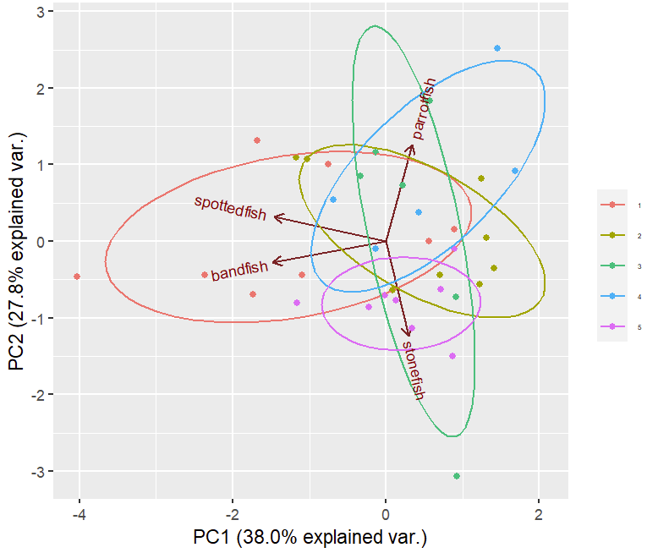
mydata$Site <- factor(mydata$Site)
library(ggbiplot)
ggbiplot(PCAmodel, obs.scale=1, var.scale=1, groups=mydata$Site, ellipse=TRUE, varname.size=3, varname.adjust=1.2, circle=FALSE) + scale_color_discrete(name='') + geom_point (aes(colour=factor(mydata$Site)), size = 1) + theme(legend.direction = 'vertical', legend.position='right', legend.text=element_text(size=4))
Parrotfish high loading Comp.2 -> strong (+) association​
Bandfish high loading Comp.1 -> strong (-) association​
Spottedfish high loading Comp.1 -> strong (-) association​
Stonefish high loading Comp.3 -> strong (+) association​

Slide 15
Do fish populations exhibit dynamic variations within the coral reefs of the Bahamas?
Yes, the fish communities differ among sites.

Slide 16
References
Burt, April J., et al. “Integration of Population Genetics with Oceanographic Models Reveals Strong Connectivity among Coral Reefs across Seychelles.” Scientific Reports, vol. 14, Mar. 2024, p. 4936. PubMed Central, https://doi.org/10.1038/s41598-024-55459-x.
Chapman S, Schenk P, Kazan K, Manners J. Using biplots to interpret gene expression patterns in plants. Bioinformatics. 2002 Jan;18(1):202-4. doi: 10.1093/bioinformatics/18.1.202. PMID: 11836233.
Leong C, Haszard JJ, Heath AM, Tannock GW, Lawley B, Cameron SL, Szymlek-Gay EA, Gray AR, Taylor BJ, Galland BC, Lawrence JA, Otal A, Hughes A, Taylor RW. Using compositional principal component analysis to describe children's gut microbiota in relation to diet and body composition. Am J Clin Nutr. 2020 Jan 1;111(1):70-78. doi: 10.1093/ajcn/nqz270. PMID: 31711093.
Lim SB, Tan SJ, Lim WT, Lim CT. A merged lung cancer transcriptome dataset for clinical predictive modeling. Sci Data. 2018 Jul 24;5:180136. doi: 10.1038/sdata.2018.136. PMID: 30040079; PMCID: PMC6057440.
Song Y, Yao S, Li X, Wang T, Jiang X, Bolan N, Warren CR, Northen TR, Chang SX. Soil metabolomics: Deciphering underground metabolic webs in terrestrial ecosystems. Eco Environ Health. 2024 Mar 20;3(2):227-237. doi: 10.1016/j.eehl.2024.03.001. PMID: 38680731; PMCID: PMC11047296.
Zhang, Yiwei, et al. “Adjustment for Population Stratification via Principal Components in Association Analysis of Rare Variants.” Genetic Epidemiology, vol. 37, no. 1, Jan. 2013, pp. 99–109. PubMed, https://doi.org/10.1002/gepi.21691.

