Slide 1

11.1 组会分享
汇报人：张硕

Slide 2


CONTENTS
01
Image Caption Survey
02
Panoptic Segmentation Survey

Slide 3

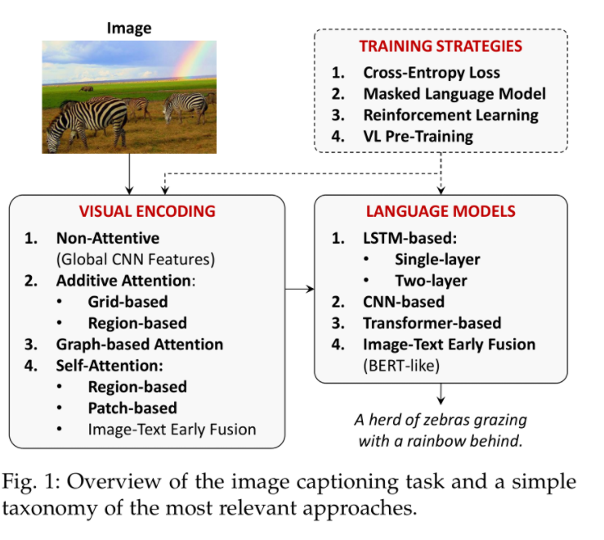
Cap

Slide 4
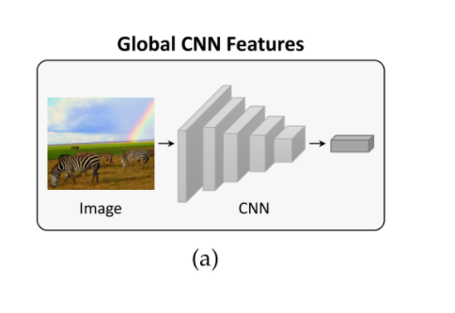
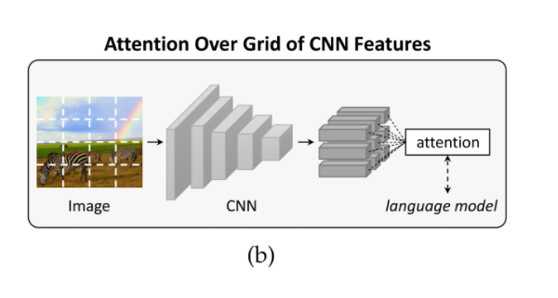
Visual Endoing
Additive attention VS Transformer
Grid（top-down） VS Region（bottom-up）

Slide 5
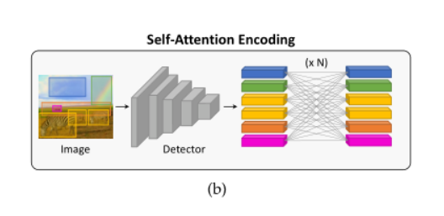
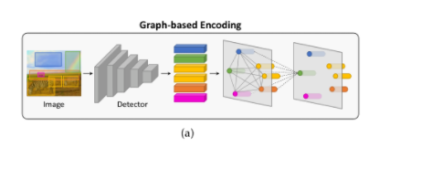
Visual Endoing

Slide 6
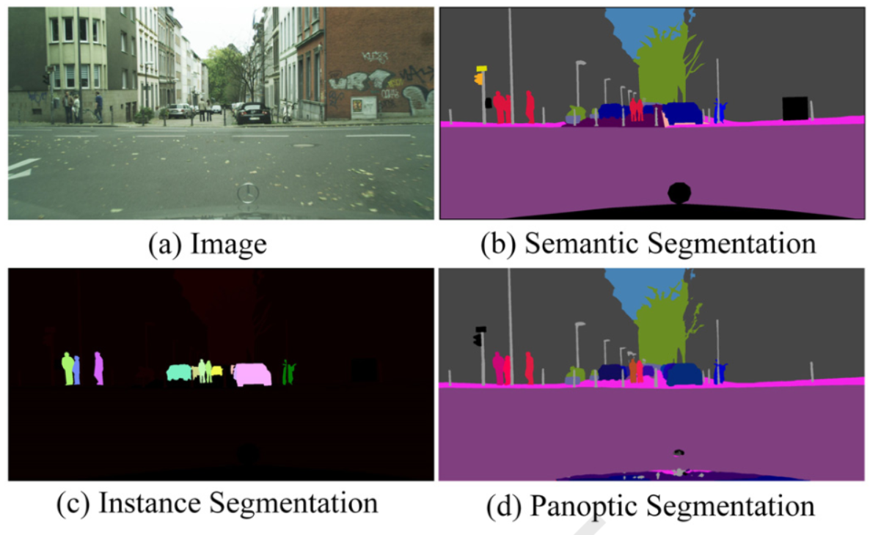
Panoptic Segmentation
Stuff
Thing
Panoptic Segmentation
Semantic Segmentation
Instance Segmentation

Slide 7
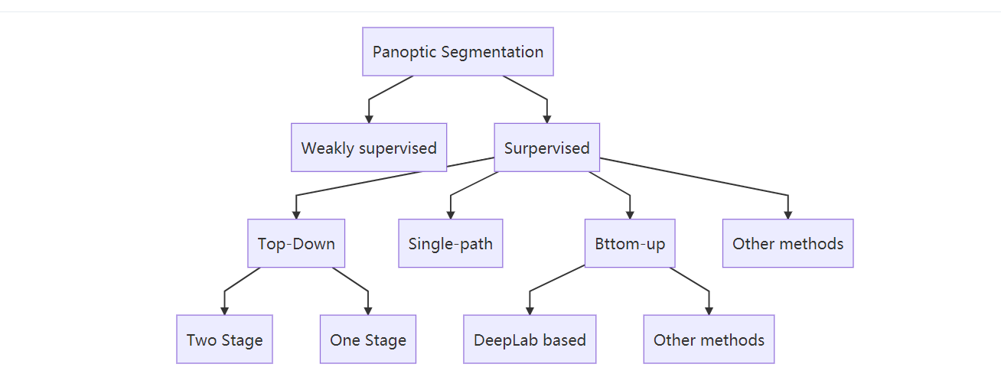
Terminology
Top-Down
Bottom-Up

Slide 8
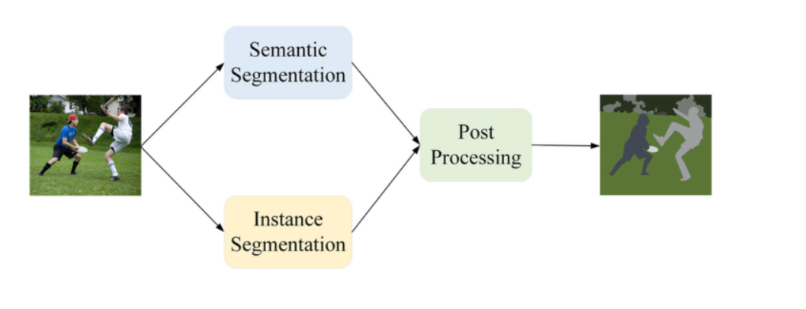
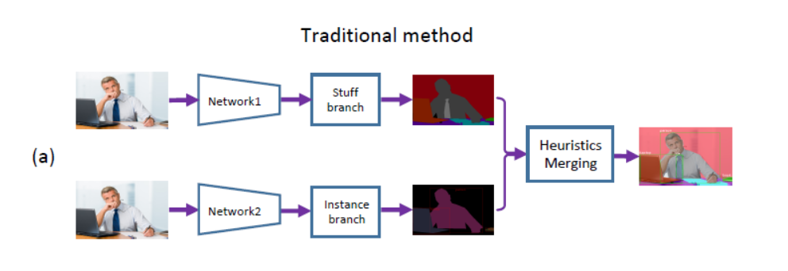
Top-Down（two stages）

Slide 9
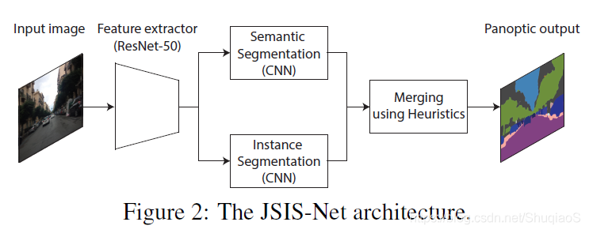
Improvements on the network framework

Slide 10
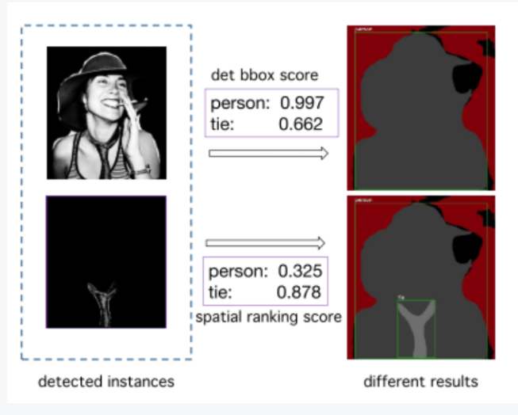
Overlapping occlusion

Slide 11
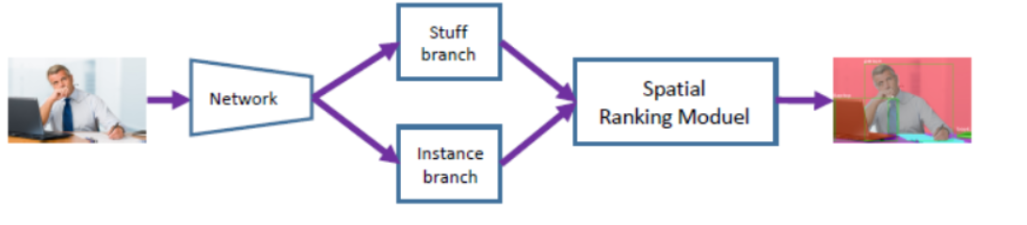
Improvements on the network framework
OANet：
OCFusion：by learning the binary relationship Occlude(Mi, M j)
SOGNet: describes the overlapping relation as a scene overlapping graph with directed edges

Slide 12
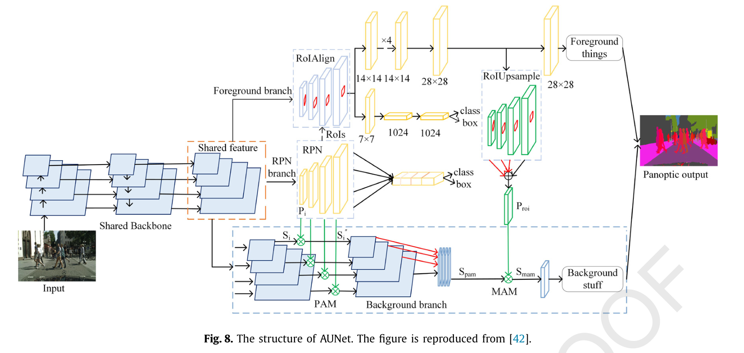
using information exchange module

Slide 13
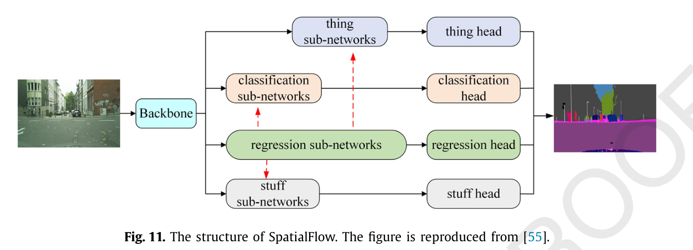
Top-Down(one-stage)

Slide 14
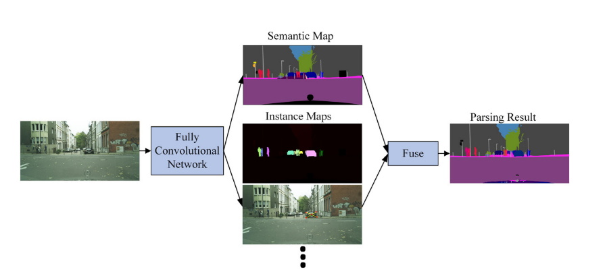
Bottom-up methods
DeeperLab

Slide 15
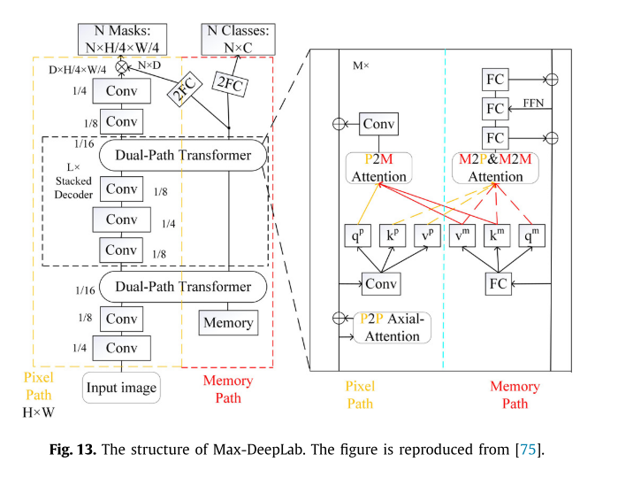
Methods based on the transformer

Slide 16
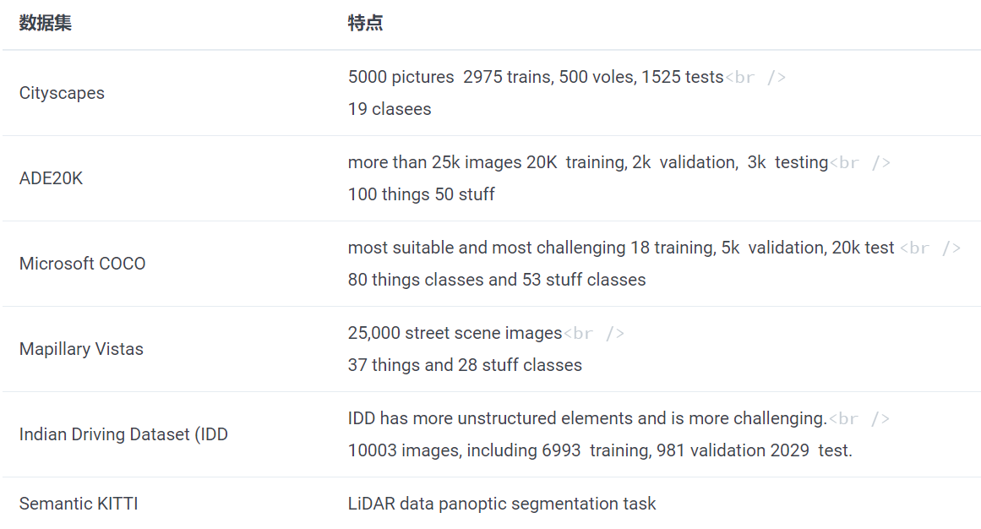
Datasets
最常用：COCO, Cityscapes, and Mapillary Vistas

Slide 17
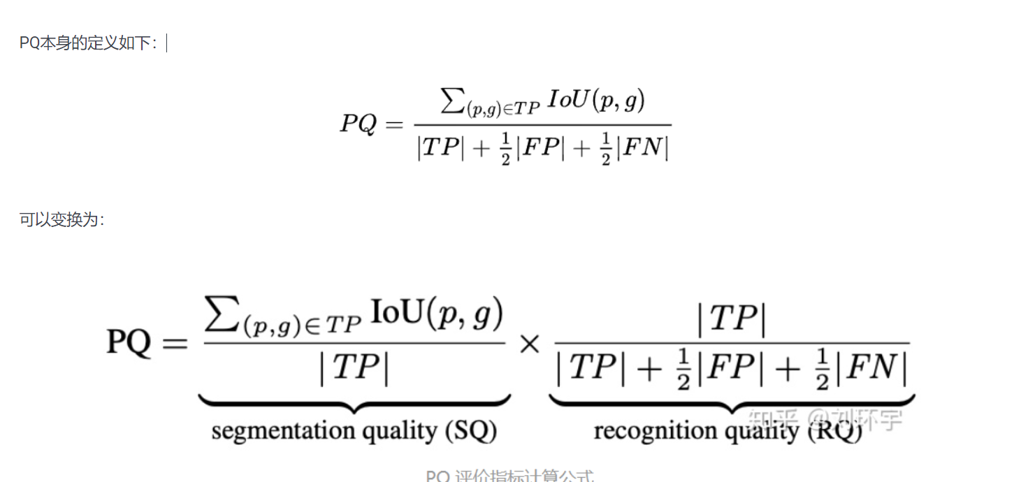
Metric

Slide 18
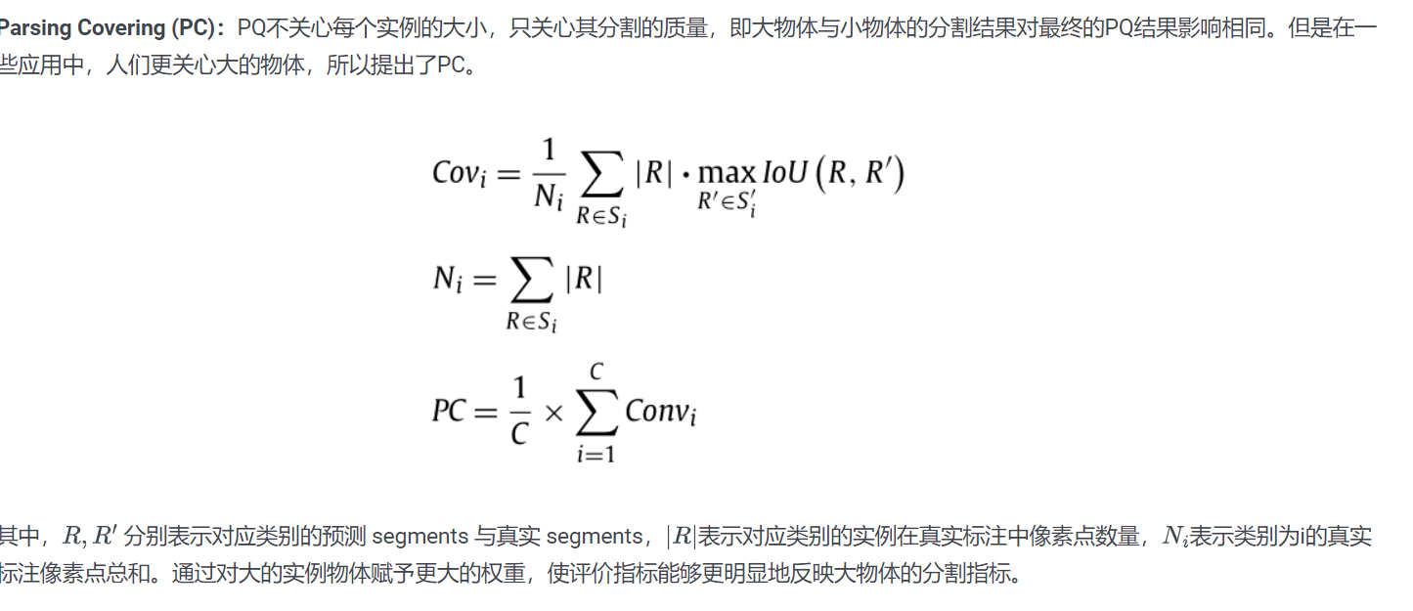
Metric

Slide 19
Challenges and trends
Conflicts
Balance between speed and accuracy
Segmentation capability when facing adverse conditions
Post-process
One stage
Bottom-up top-down
One path

Slide 20
References
Li, X. and D. Chen (2021). "A survey on Deep Learning-based Panoptic Segmentation." Digital Signal Processing: 103283.
Stefanini, M., et al. (2021). "From Show to Tell: A Survey on Image Captioning." arXiv preprint arXiv:2107.06912.

Slide 21
Thank You

