Slide 1


Occluded Face Recognition
End2End Occluded Face Recognition by Masking Corrupted Features
Zhixin Cao
Xi’an Jiaotong University
2021-12

Slide 2
Contents
01.
OFR & MFR & PFR
02.
Methods to deal with occlusion
03.
Model :FROM

Slide 3
01
OFR & MFR & PFR

Slide 4

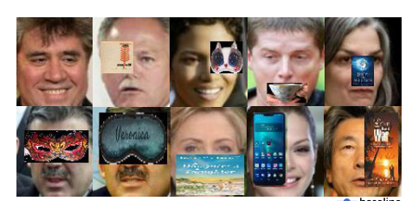
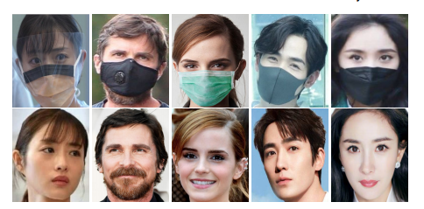
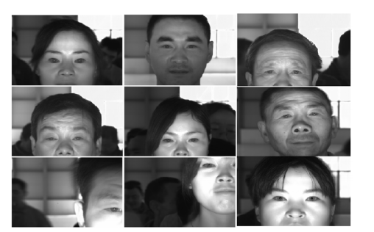
01
OFR & MFR & PFR
OFR：occluded face recognition
MFR：masked face recognition
PFR：partial face recognition

Slide 5
02
Methods to deal with occlusion

Slide 6
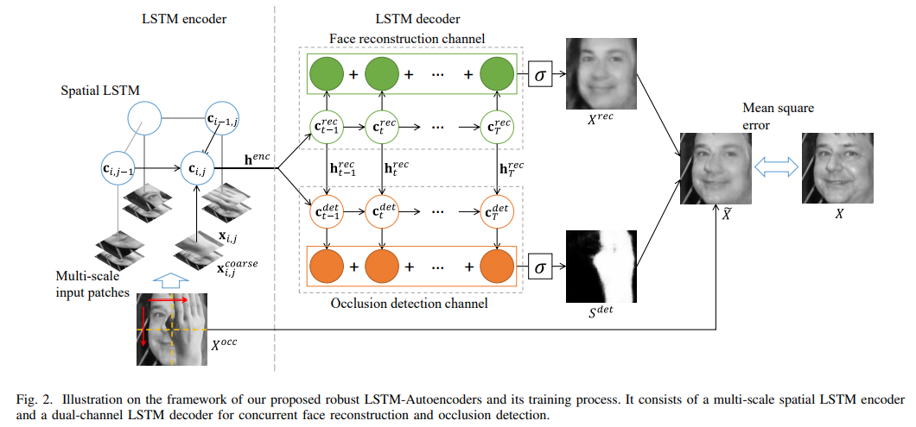
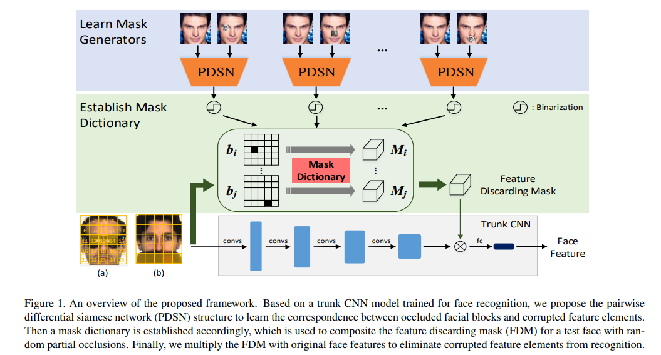
02
Methods to deal with occlusion
1. recovering
2.removing

Slide 7
03
FROM
（face recognition with occlusion masks)

Slide 8
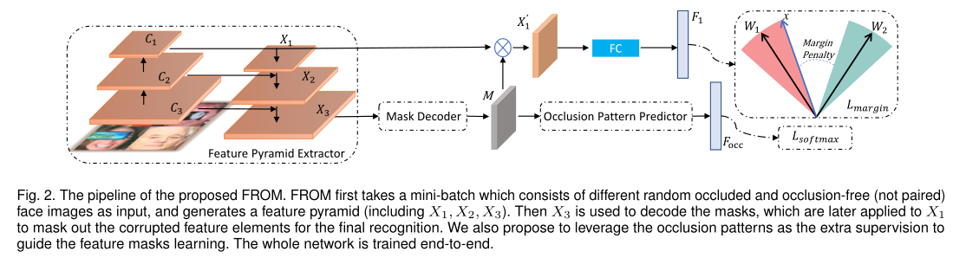
03
FROM（face recognition with occlusion masks)
End2End Occluded Face Recognition by Masking Corrupted Features | IEEE Journals & Magazine | IEEE Xplore

Slide 9

03
feature pyramid extractor

Slide 10
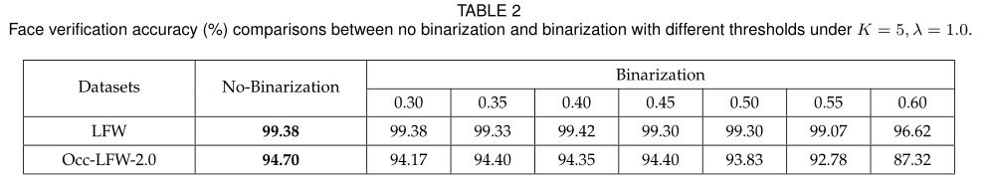
03
mask decoder
Soft mask
VS
hard mask

Slide 11
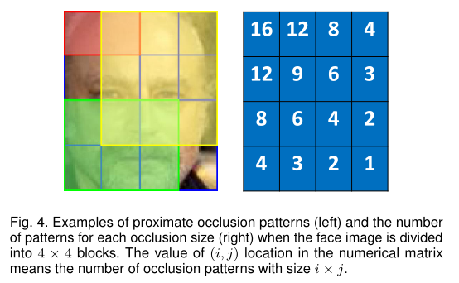
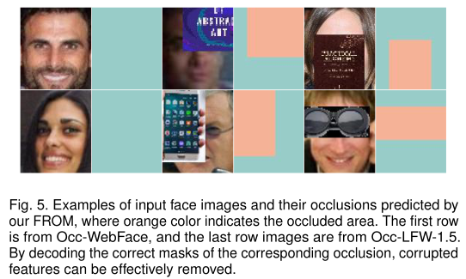
03
occlusion pattern predictor

Slide 12

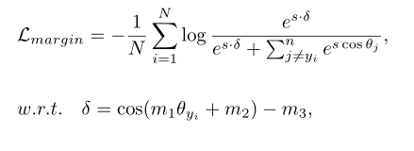


03
loss

Slide 13
04
Reference

Slide 14
04
Reference
[1] Ding F , Peng P , Huang Y , et al. Masked Face Recognition with Latent Part Detection[C]// MM '20: The 28th ACM International Conference on Multimedia. ACM, 2020.
[2] Qiu H , Gong D , Li Z , et al. End2End Occluded Face Recognition by Masking Corrupted Features[J]. IEEE Transactions on Pattern Analysis and Machine Intelligence, 2021, PP(99):1-1.
https://www.cnblogs.com/sdu20112013/p/11050746.html

Slide 15
Thank you
Zhixin Cao
Xi’an Jiaotong University

