Slide 1
Generative Adversarial Networks (GAN)
Speaker: Guanyu Hu
School of Computer Science and Technology
Xi'an Jiaotong University

Slide 2
Outline
Generative Model
What Are Generative Models
Types of Deep Generative Models
Generative Adversarial Networks (GAN)
Discriminator
Generator
BCE Cost Function
Training GANs
Notes:
95720

Slide 3

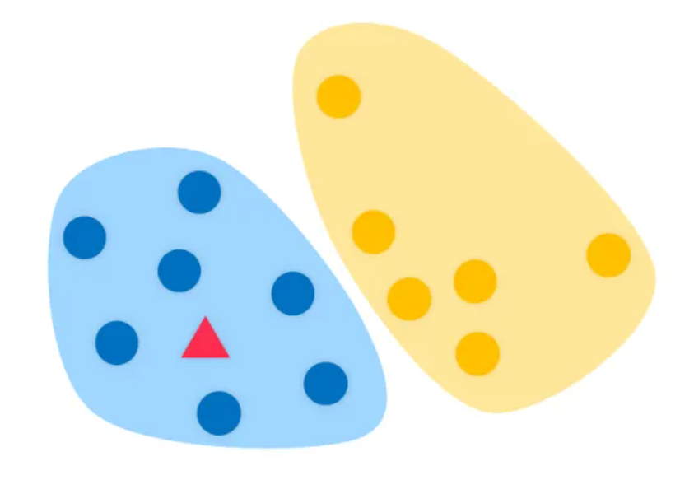
What Are Generative Models
VS.
Discriminative Models
Generative Models
Notes:
目的：一开始都是用于分类的监督模型
首先我们看看 Discriminative Model 是怎么进行分类的

Slide 4
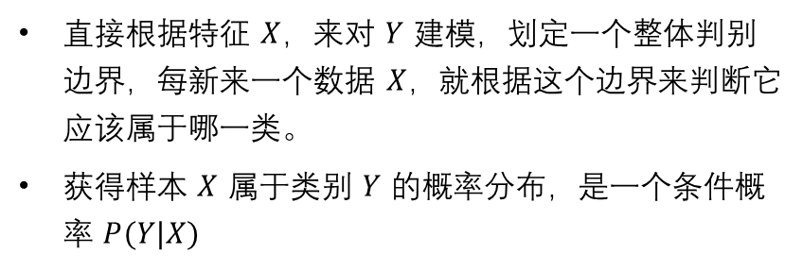
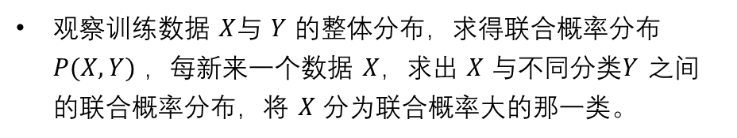
What Are Generative Models
Discriminative Models
Generative Models
How:
How:
直接根据特征 $X$，来对 $Y$ 建模，划定一个整体判别边界，每新来一个数据 $X$，就根据这个边界来判断它应该属于哪一类。
获得样本 $X$ 属于类别 $Y$ 的概率分布，是一个条件概率 $P(Y|X)$
观察训练数据 $X$与 $Y$ 的整体分布，求得联合概率分布 $P(X,Y)$ ，每新来一个数据 $X$，求出 $X$ 与不同分类$Y$ 之间的联合概率分布，将 $X$ 分为联合概率大的那一类。
Goal:
给定一组 feature $X$ 计算出与不同分类的联合概率 $P(X,Y)$
Goal:
Methods:
给定一组 feature $X$ 来判定它是属于哪个分类 $Y$ 的
朴素贝叶斯方法，隐马尔可夫模型

Slide 5
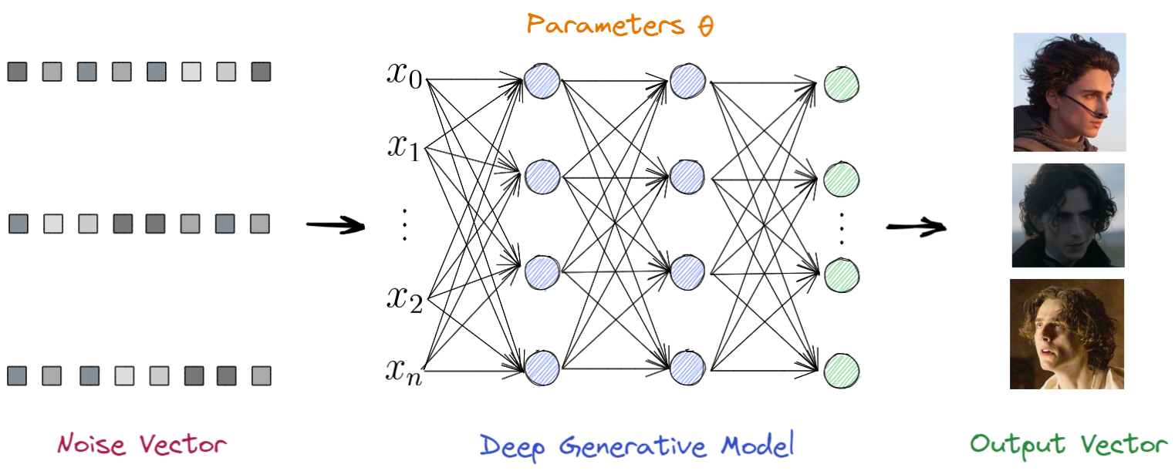
What Are Generative Models
Take some random input represented by the noise
From these inputs, to generate a set of features $X$ that look like a realistic representation of class $Y$
Notes:
后来大家发现 Generative Model 的原理可以用来进行生成
他是怎么做的呢，比如我们想生成甜茶的脸
取一些由噪声 Vector 表示的随机输入，经过我们的生成模型，能够生成一组vector，每一个生成的vector都是甜茶的脸

Slide 6
Outline
Generative Model
What Are Generative Models
Types of Deep Generative Models
Generative Adversarial Networks (GAN)
Discriminator
Generator
BCE Cost Function
Training GANs

Slide 7
Outline
Generative Model
What Are Generative Models
Types of Deep Generative Models
Generative Adversarial Networks (GAN)
Discriminator
Generator
BCE Cost Function
Training GANs

Slide 8
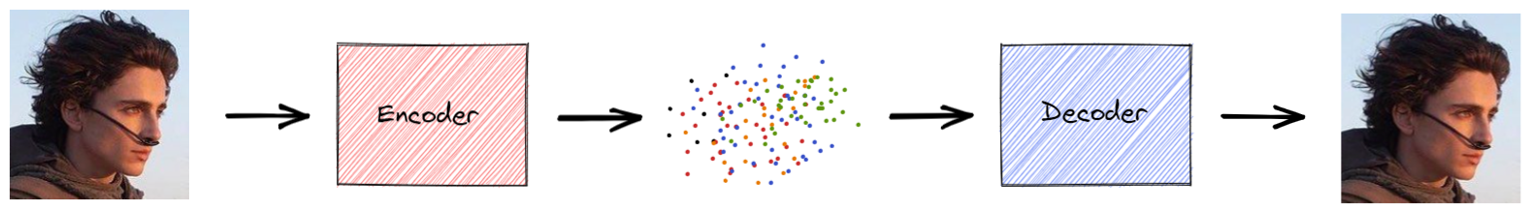
Types of Deep Generative Models
Variational Autoencoders (VAE)
Notes:
变分自编码器
首先通过向encoder输入真实的图像来学习，encoder的目的是找到一种在Latent Space中表示图像的方法
接下来，将latent representation通过解码器，重构出编码器之前看到的真实图像

Slide 9
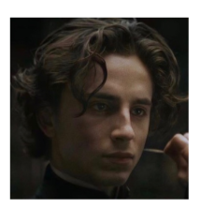
Types of Deep Generative Models
Autoencoders (VAE)
Variational
Notes:
变分自编码器
在训练完成后 去掉 encoder, 我们可以从隐空间中随机选择一个点，decoder 就可以生成逼真的图片

Slide 10
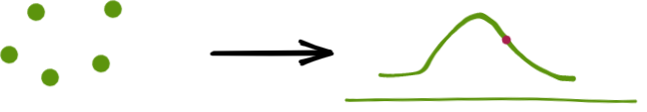
Types of Deep Generative Models
Variational
Notes:
这个点应该怎么选？
这时候变分自编码器中的 这个变分就起到作用了。
给整个模型注入一些噪音, encoder 没有将图片在隐空间中编码为一个点, 实际上是**将图像编码到整个分布上**
然后对该分布上的一个点进行采样，以输入 decoder 从而生成一个真实的图像。

Slide 11
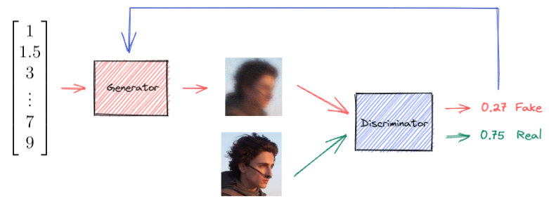
Types of Deep Generative Models
Generative Adversarial Networks (GAN)
Notes:
由两个模型组成：一个判别器和一个生成器，它们通常是由神经网络构成的。

Slide 12
Outline
Generative Model
What Are Generative Models
Types of Deep Generative Models
Generative Adversarial Networks (GAN)
Discriminator
Generator
BCE Cost Function
Training GANs

Slide 13
Outline
Generative Model
What Are Generative Models
Types of Deep Generative Models
Generative Adversarial Networks (GAN)
Discriminator
Generator
BCE Cost Function
Training GANs

Slide 14
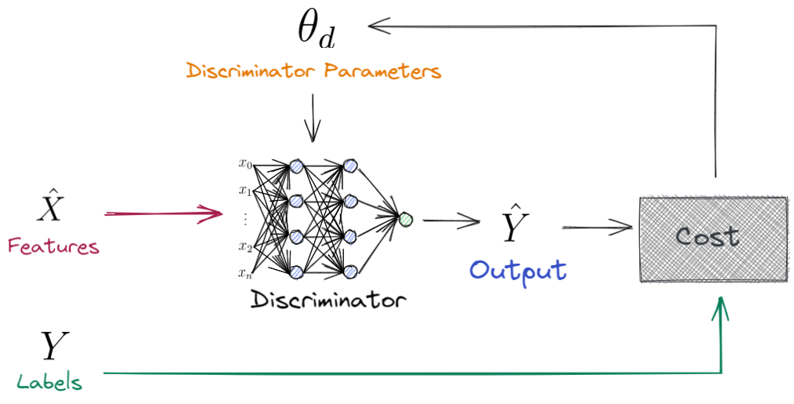
Generative Adversarial Networks (GAN)
Discriminator
for Classification
Notes:
首先我们来看 Discriminator 在用于 classification 的时候是怎么做的，
神经网络的输出是一个分类
他是在不停的更新自己

Slide 15
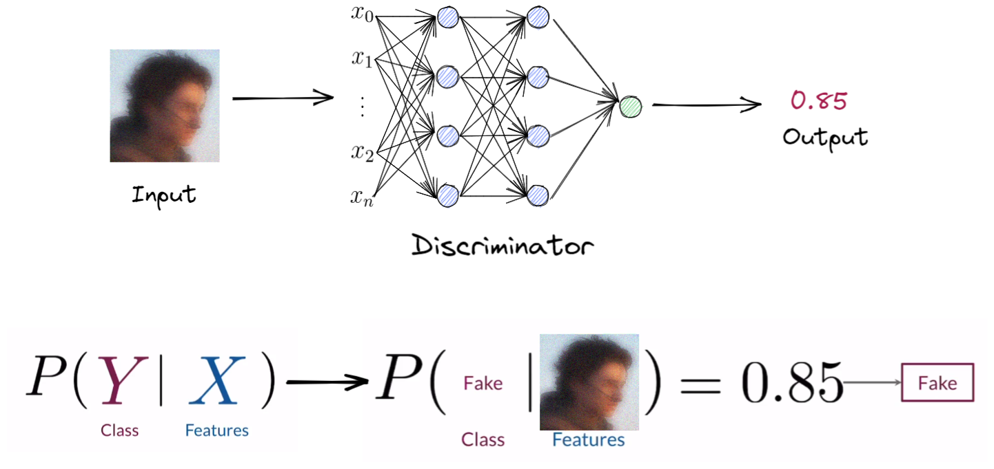
Generative Adversarial Networks (GAN)
Discriminator
for Generation
Notes:
接下来我们来看 Discriminator 在Gan 中是怎么帮助 Generator 工作的，
这里神经网络的输出是一个 真实程度
他是在不停地进行判别生成图片的真实性，而没有更新！

Slide 16
Outline
Generative Model
What Are Generative Models
Types of Deep Generative Models
Generative Adversarial Networks (GAN)
Discriminator
Generator
BCE Cost Function
Training GANs

Slide 17
Outline
Generative Model
What Are Generative Models
Types of Deep Generative Models
Generative Adversarial Networks (GAN)
Discriminator
Generator
BCE Cost Function
Training GANs

Slide 18
Generative Adversarial Networks (GAN)
Generator
Notes:
Generator 的目的是给定一个 noise vector 去生成甜茶
Noise vector 每个值
这里的神经网络输出的不是分类，而是图片中每个像素点的值
Output 的维度应该与图片的大小一致

Slide 19
Outline
Generative Model
What Are Generative Models
Types of Deep Generative Models
Generative Adversarial Networks (GAN)
Discriminator
Generator
BCE Cost Function
Training GANs

Slide 20
Outline
Generative Model
What Are Generative Models
Types of Deep Generative Models
Generative Adversarial Networks (GAN)
Discriminator
Generator
BCE Cost Function
Training GANs

Slide 21
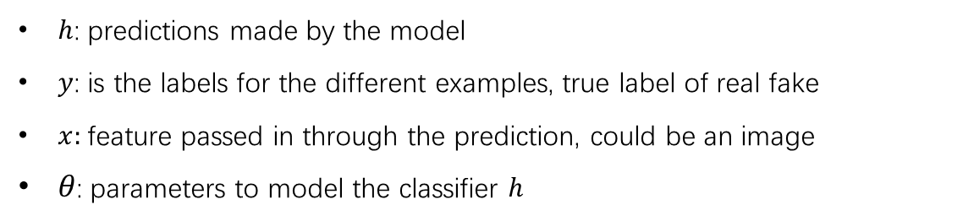
Generative Adversarial Networks (GAN)
Binary Cross Entropy function Cost Function
$h$: predictions made by the model
$y$: is the labels for the different examples, true label of real fake
$x:$feature passed in through the prediction, could be an image
$θ$: parameters to model the classifier $h$

Slide 22
Outline
Generative Model
What Are Generative Models
Types of Deep Generative Models
Generative Adversarial Networks (GAN)
Discriminator
Generator
BCE Cost Function
Training GANs

Slide 23
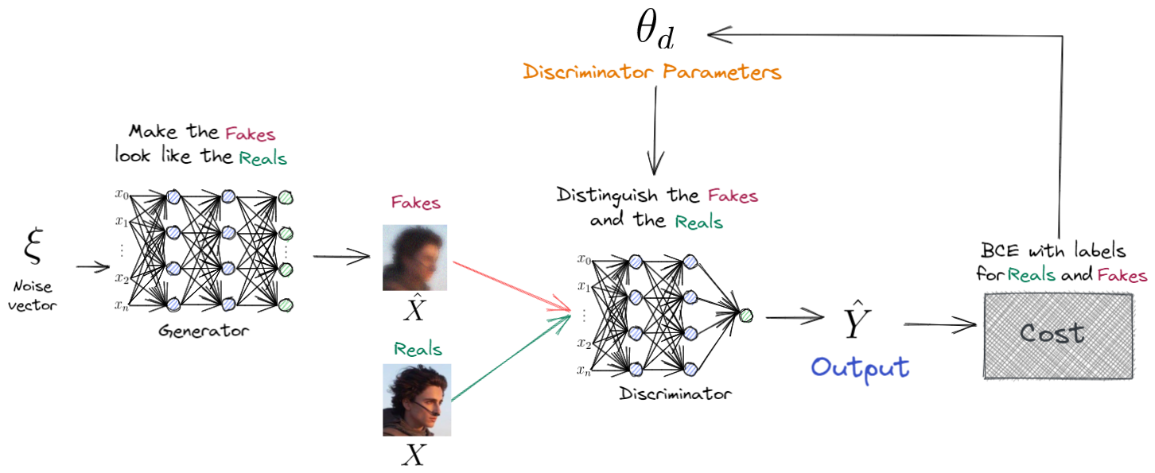
Generative Adversarial Networks (GAN)
Training Discriminator

Slide 24
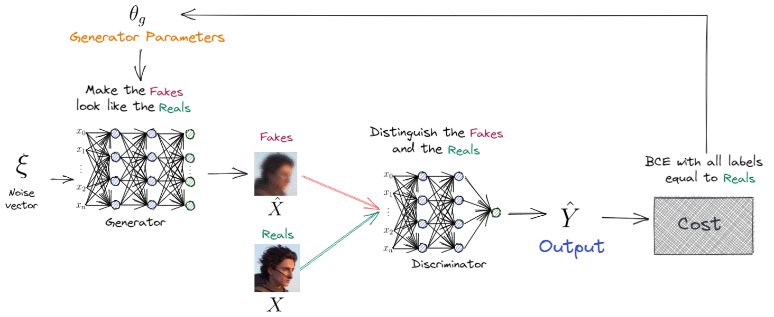
Generative Adversarial Networks (GAN)
Training Generator

Slide 25
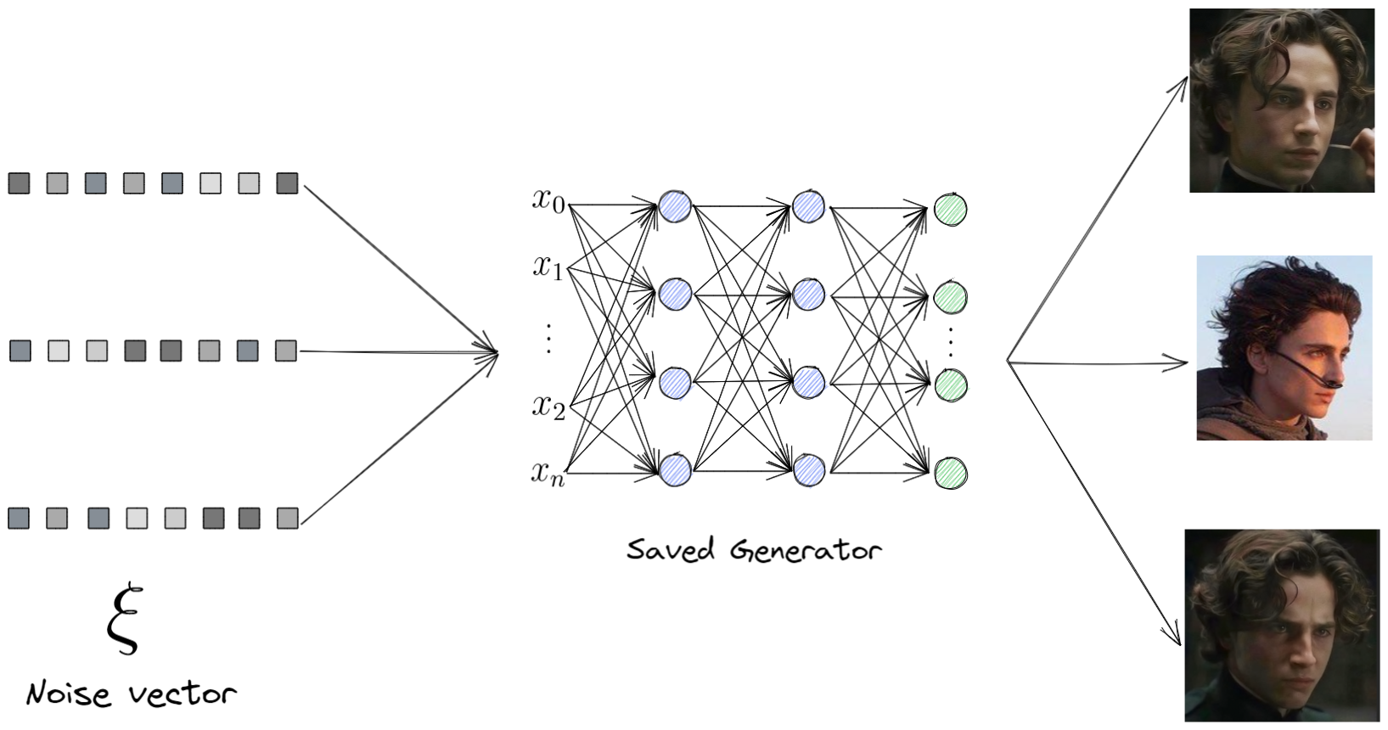
Generative Adversarial Networks (GAN)
Use Saved Model

