Slide 1

Masked Autoencoders Are Scalable Vision Learners
张硕
12.2

Slide 2


CONTENTS
01
Transformer
02
ViT
03
Masked Autoencoders

Slide 3

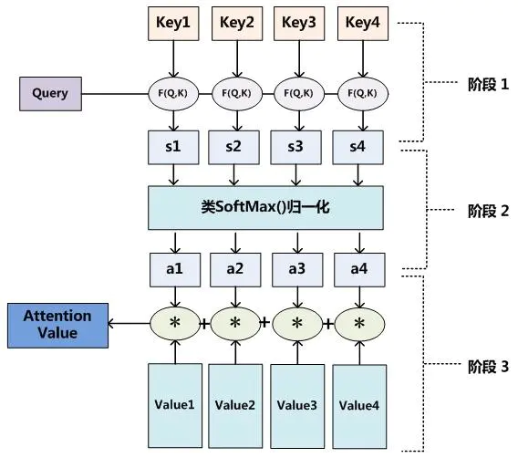
Attention

Slide 4
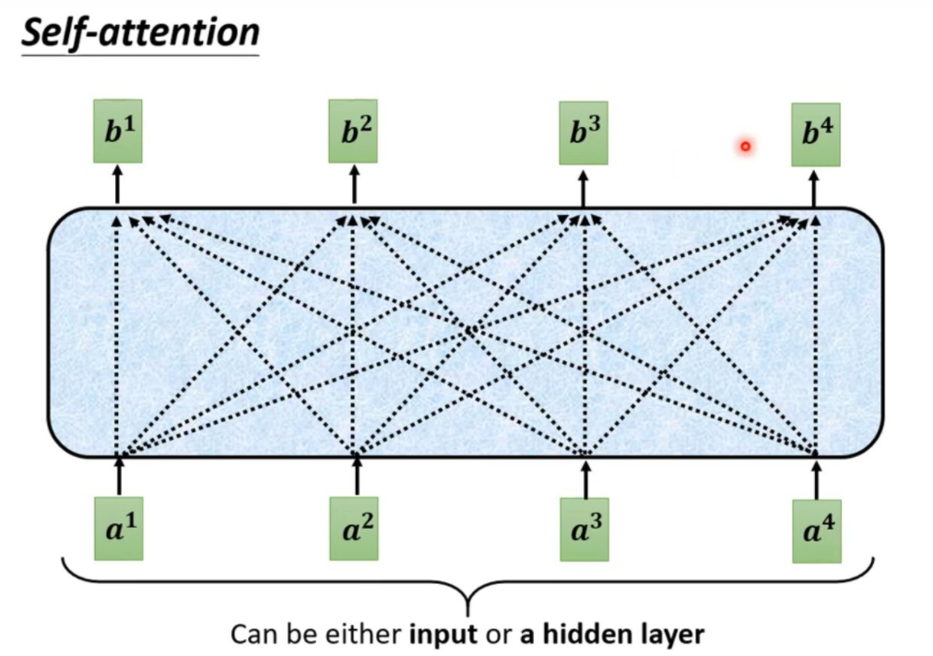
Self-attention

Slide 5
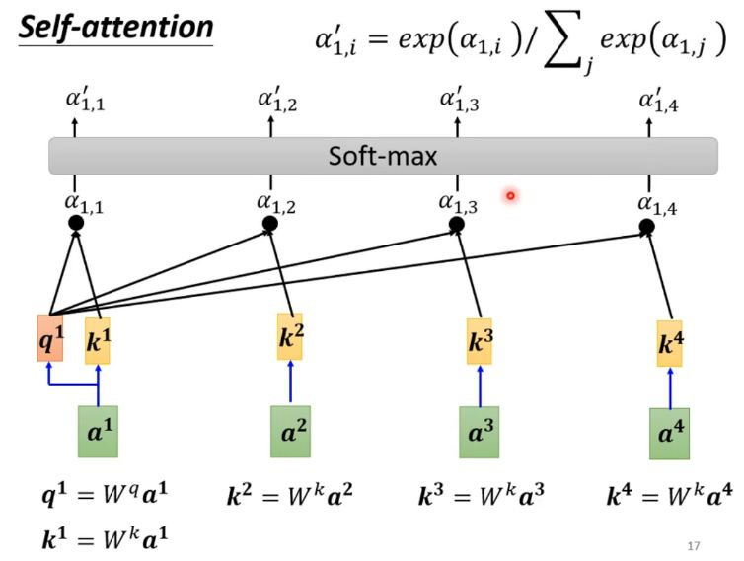
Self-attention

Slide 6
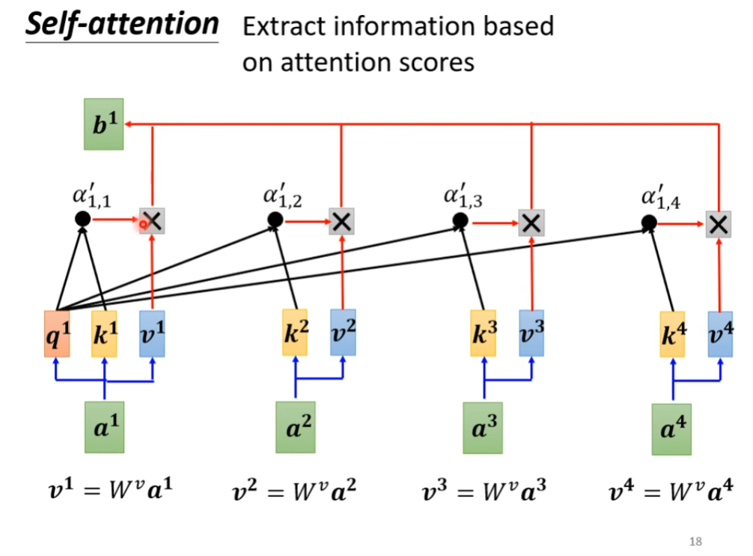
Self-attention

Slide 7
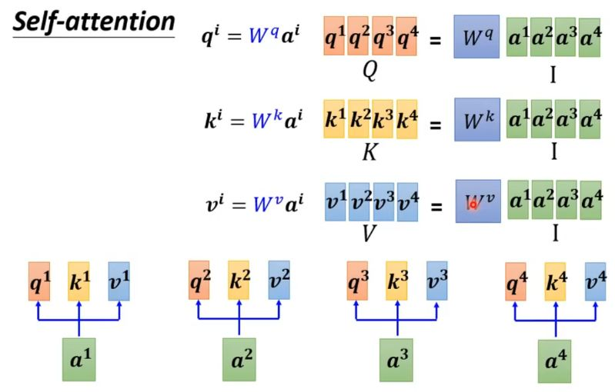
Self-attention

Slide 8
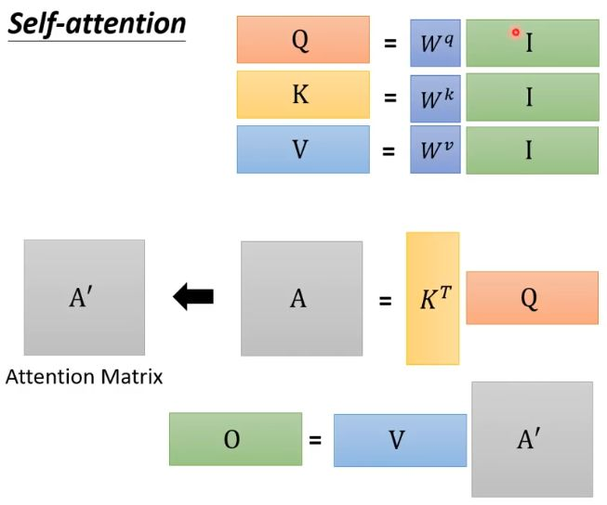
Self-attention

Slide 9
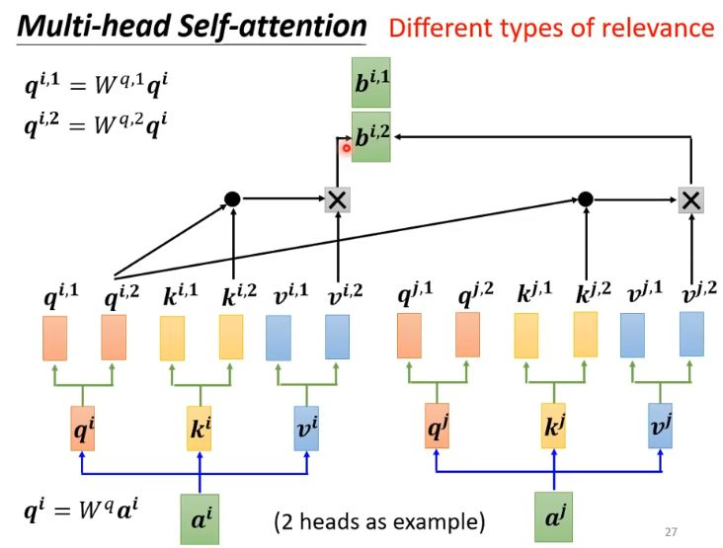
Multi-head

Slide 10
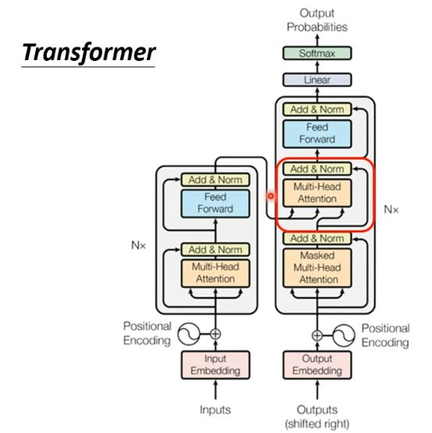
Transformer

Slide 11
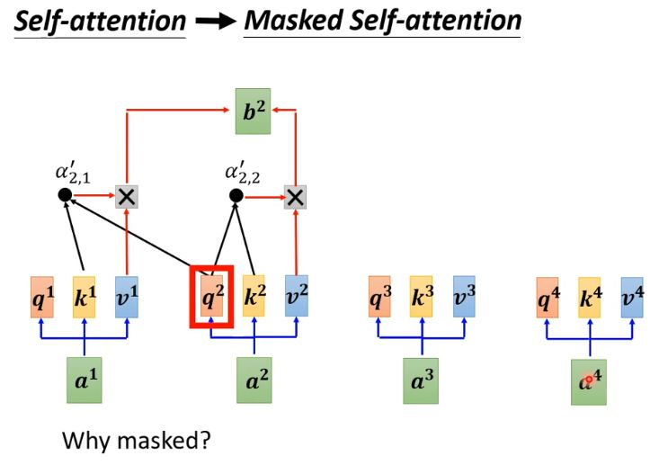
Maked Self-attention

Slide 12
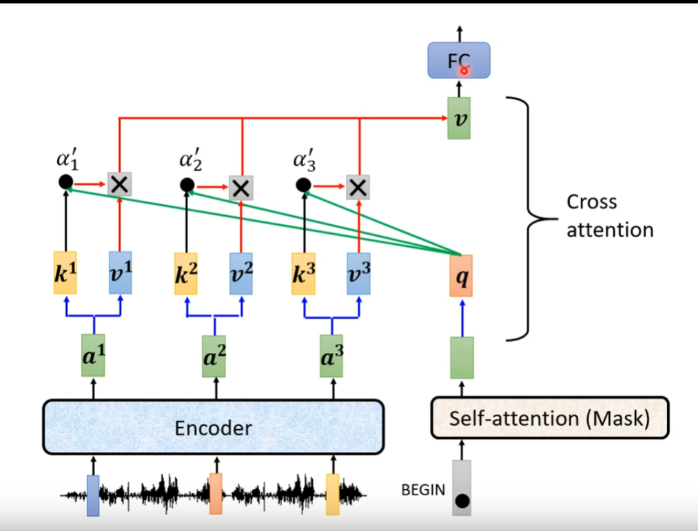
Cross attention

Slide 13
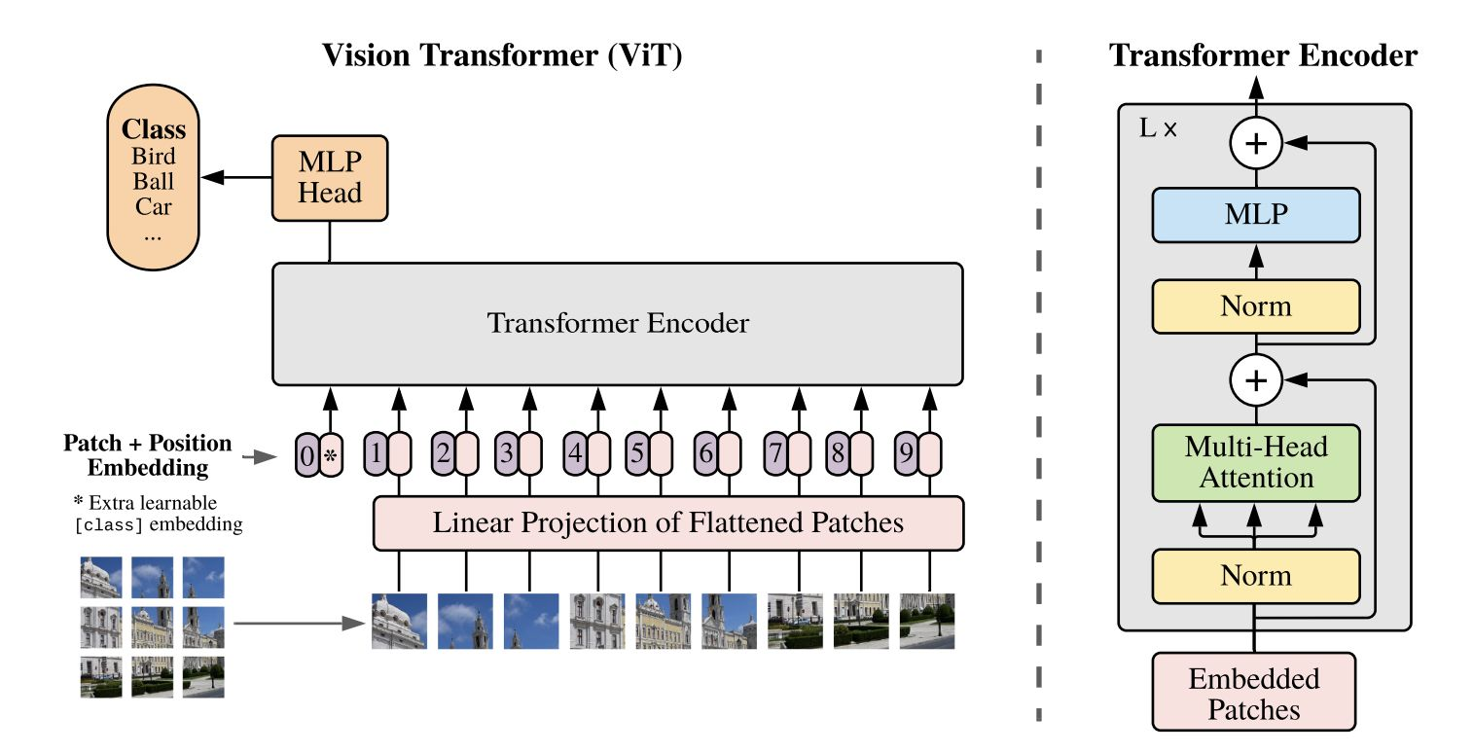
ViT

Slide 14
Architecture
Masked Autoencoders Are Scalable Vision Learners
Inspiration：
Masked autoencoding of BERT
What makes masked autoencoding different between vision and language?
Architecture
Information density
Decoder
Two Cores：
A high proportion of the input image
An asymmetric encoder-decoder architecture

Slide 15
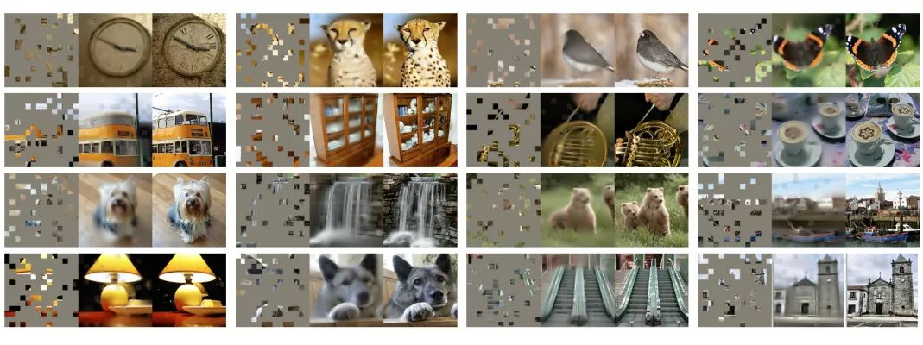
High proportion
For each triplet, we show the masked image (left), our MAE reconstruction (middle), and the ground-truth (right). The masking ratio is 80%, leaving only 39 out of 196 patches.

Slide 16
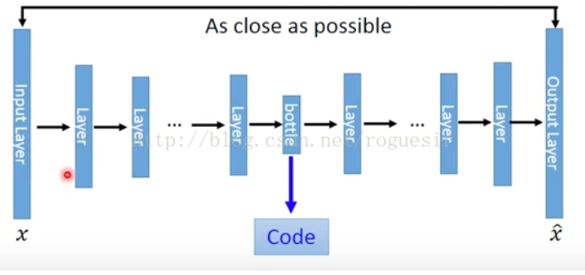
AutoEncoders

Slide 17
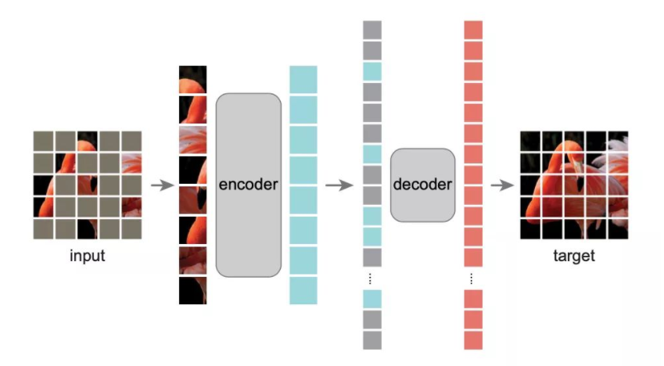
Asymmetric autoEncoders
Encoder
input: without masked patches, only 25% of image.
Decoder:
input: encoded visible patches, and
mask tokens.
Reconstruction target: predicting the pixel values for each masked patch.
loss function:
mean squared error (MSE) between the reconstructed and original images in the pixel space. We compute the loss only on masked patches

Slide 18
References
台大李宏毅机器学习：self-attention和Transformer
https://www.bilibili.com/video/BV1Xp4y1b7ih?p=4
Transformer讲解
https://zhuanlan.zhihu.com/p/376286459
ViT讲解
https://zhuanlan.zhihu.com/p/355541661
An Image is Worth 16x16 Words: Transformers for Image Recognition at Scale
https://arxiv.org/abs/2010.11929
Masked Autoencoders Are Scalable Vision Learners
https://arxiv.org/pdf/2111.06377.pdf
MAE为什么能成功
https://zhuanlan.zhihu.com/p/438910751

Slide 19
Thank You

