Slide 1

Talking Head
Yixin Song
2021-10-21

Slide 2
Content
1. Definition
2. Key Points
3. Datasets
4. Evaluation
5. Others

Slide 3
1
Definition

Slide 4
What dose Talking Head Generation do
Given a driver (audio, video, text), the input can be consistent with any person's facial features.

Slide 5
2
Key Points

Slide 6
The key points of Talking Head Generation
Identify Preserving
Visual Quality
Lip Synchronization
Natural-spontaneous Motion

Slide 7
3
Datasets

Slide 8
without Head Movement
GRID dataset (Cooke 2006)
There are 33 speakers, front-facing the camera and each uttering 1000 short phrases, containing six words randomly chosen from a limited dictionary (51 words). All the sentences are spoken with neutral emotion without any noticeable head movements.
TCD-TIMID dataset (Harte and Gillen 2015)
Consists of high-quality audio and video footage of 62 speakers reading a total of 6913 phonetically rich sentences without apparent head movement. The video footage is recorded from two angles: straight on and 30◦

Slide 9
without Head Movement
3. MODALITY dataset (Czyzewski et al. 2017)
Provides facial depth information for further analysis by using the Time-of-Flight camera. The employed camera model is SoftKinetic DepthSense 325, which delivers the depth data at 60 frames per second with a spatial resolution of 320 × 240 pixels. Besides depth recordings, the 3D data can be retrieved owing to stereo RGB cameras recordings available in the corpus. 2. LRW dataset (Chung and Zisserman 2016)
4. LRW dataset (Chung and Zisserman 2016)
Consists of 500 different words spoken by hundreds of different speakers in the wild. There is a significant variation of head pose across this dataset from some videos where a single speaker is talking directly at the camera, to panel debate where the speakers look at each other, leading to some videos with extreme head poses.

Slide 10
with Spontaneous Motions
1. CREMA-D dataset (Cao et al. 2014)
91 actors coming from a variety of different age groups and races utter 12 sentences. Different from other datasets, each sentence in CREMA-D is acted out by the actors multiple times with different emotions and intensities with natural head movement
2. RAVDESS dataset (Livingstone et al. 2018) and MSP-IMPROV dataset (Busso et al. 2016)
involve creating stimulus with conflicting emotional content conveyed through speech and facial expression.

Slide 11
with Spontaneous Motions
3. Faceforensics++ dataset (Rossler et al. 2019)
Contains 1000 videos of news briefing from different reporters. The speakers in the videos are facing the camera with moderate and natural head movements.
4. ObamaSet (Suwajanakorn et al. 2017)
Consists of an abundance of video footage from President Barack Obama’s weekly presidential addresses, spanning a period of eight years. His head pose changes when he speaks while keeping his persona consistent. Because of those characteristics, ObamaSet is a suitable dataset to study the high-quality talking-head generation for a specific subject.

Slide 12
with Apparent Movement
1. VoxCeleb1 (Nagrani et al. 2017) and VoxCeleb2 (Chung et al. 2018) datasets
Contain over one million utterances from over 6,000 speakers, extracted from videos uploaded to YouTube. The speakers span a wide range of different accents, professions, ethnicities, and ages.
Videos included in the datasets are shot in a large number of challenging visual and auditory environments, with variations in lighting, image quality, pose (including profiles), and motion blur. These include speeches given to large audiences, interviews from quiet indoor studios, outdoor stadiums and red carpets, excerpts from professionally shot multimedia, and even homemade videos shot on hand-held devices. Audio segments present in the datasets are degraded with background chatter, laughter, overlapping speech, and varying room acoustics.

Slide 13
with Apparent Movement
2. The LRS3-TED dataset (Afouras et al. 2018 )
A large-scale dataset for audio-visual speech recognition tasks, which contains word-level alignment between the subtitle and the audio signal.
3. MELD dataset (Poria et al. 2018)
Contains about 13,000 utterances from 1,433 dialogues from the TV-series Friends, which are annotated with emotion and sentiment labels.

Slide 14
4
Evaluation

Slide 15
with Apparent Movement
Identify Preserving -- Face detect
Visual Quality – SSIM/PSNR/FID/CPBD
Lip Synchronization -- Landmark Distance / Sync Net
Natural-spontaneous Motion -- User study

Slide 16
5
Others

Slide 17
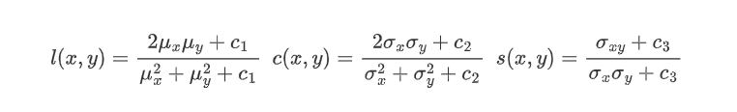


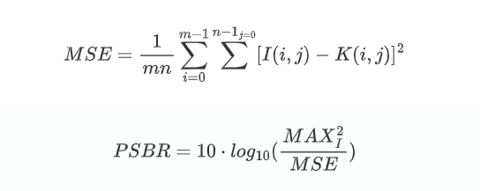
SSIM and PSNR

Slide 18
CPBD cumulative probability blur detection
A non reference quantitative index evaluation factor for image sharpening. It is defined based on the cumulative probability of fuzzy detection and is a classification method.
FID Frechet Inception Distance score
Measure the quality and diversity of generated images to evaluate different Gan models.
Ablation Study
An ablation study typically refers to removing some “feature” of the model or algorithm, and seeing how that affects performance.

Slide 19
Thanks
Yixin Song
2021-10-21

