Slide 1


Transfer Learning
--- Domain Adaptation
Jie Wei
Xi’an Jiaotong University
2021-10

Slide 2
Contents
1
Transfer Learning
2
Domain Adaptation
3
Paper Share
4
References
Notes:
The speech consists of three parts:

Slide 3

01
Transfer Learning

Slide 4
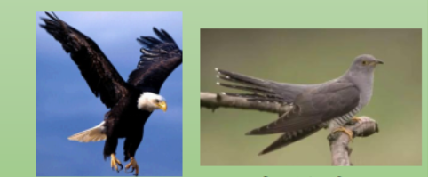
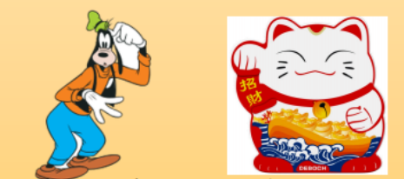


1.1 Background
Why?
Labelled Data
Specific Model
What?
Transfer learning (TL): focuses on storing knowledge gained while solving one problem and applying it to a different but related problem.
Notes:
将某个领域或任务上学习到的知识或模式应用到不同但相关的领域或问题中。
监督学习需要大量的标注数据，标注数据是一项枯燥无味且花费巨大的任务
一个模型也往往难以满足每个人的个性化需求，这就需要在不同人之间做模型的适配。

Slide 5
1.1 Background
Task: the model needs to do
image recognition & sentiment analysis
Domain: a specific domain (dataset)
book review & movie review
Source Domain
not directly related to the task
Target Domain
specific and related to the task
Notes:
可以理解为某个时刻的某个特定领域，比如书本评论和电视剧评论可以看作是两个不同的
任务 就是要做的事情，比如情感分析和实体识别就是两个不同的task
Source domain 可以是任何你可以获取到的数据集
Target domain : 特定的，你要解决问题的数据集

Slide 6
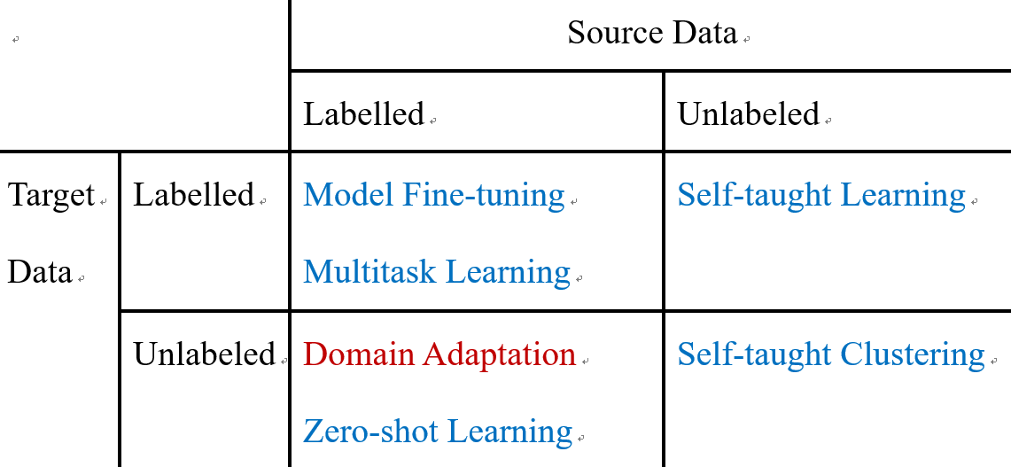
1.2 Classification
Notes:
Model fine-tuning : 加载预训练参数； 固定部分参数不训练，使用target data训练其他参数； or全部参数都进行优化
Multitask learning：将不同的任务放在一起，共用中间层捕捉共性，具体任务层分开训练，以提升多个任务的效果
Zero-shot learning：源域中从没有出现的类别，出现在目标域中
主流的两种方式： 不直接进行分类，使用属性来表示每个class，然后查表确定class
Image和Attribute进行embedding，投影到一个space， 然后两个vector更接近

Slide 7
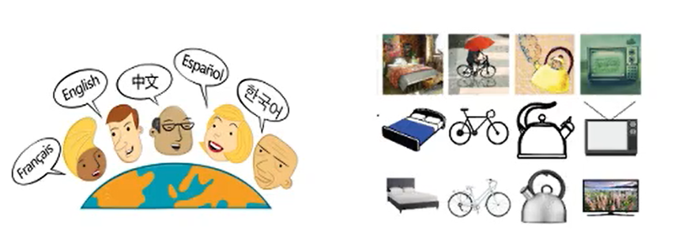
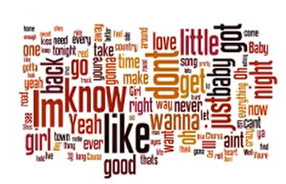
1.3 Application
Visual:
Image Classification
Audio:
Speech Recognition
Text:
Text Translation
… …

Slide 8
02
Domain Adaptation

Slide 9



2.1 Problem
Training
Data
mismatch
Testing
Data
99.5%
57.5%
Domain shift: Training and testing data have different distributions.

Slide 10
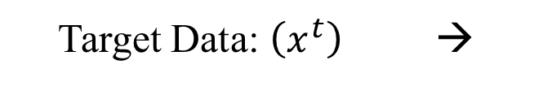
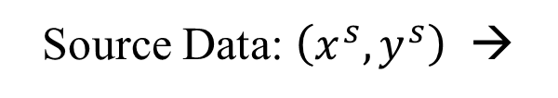
2.2 Task Description
Source Data: $\left(x^{s},y^{s}\right)$ →
Training Data
Target Data: $\left(x^{t}\right)$ →
Testing Data
Object: use these data to help the source domain training model more robust

Slide 11




2.3 Basic Idea
Learn to ignore domain feature
image
Feature Extractor
Label
Predictor
“4”
Source
(labeled)
blue points
Target
(unlabeled)
red points
Notes:
实际上识别过程可以分为两部分：1.抽取特征（如得到一个4096维的向量），2.分类（到底是1，2，3···）
那么我们就可以通过feature区分，如果用feature区分不出来是来自哪个Domain的（同时还要保证能分出来1,2,3……），就说明说明成功了

Slide 12



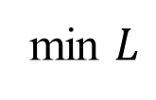

2.4 Domain Adversarial
Not only cheat the domain classifier, but satisfy label predictor
$$\min{(L−L_{d})}$$
Feature Extractor
Label
Predictor
“4”
$$L$$
Generator
min $L$
$$\min{ L_{d} }$$
Domain Classifier: Learn to classify source or target data
Feature Extractor: Learn to “fool” domain classifier
Label Predictor: Learn to improve the main task performance
$$L_{d}$$
Domain
Classifier
Source 0
Target 1
Discriminator
Notes:
如何让source和target的特征无法区分呢， 借鉴对抗学习的思想
我们训练一个domain classifier， 以feature 为输入的二元分类器，其任务是判断这个feature是来自source还是target的
此时， feature extractor 任务是欺骗domain classifier
但如果，feature extractor对所有输入都是输出相同结果，那模型也没有什么用

Slide 13
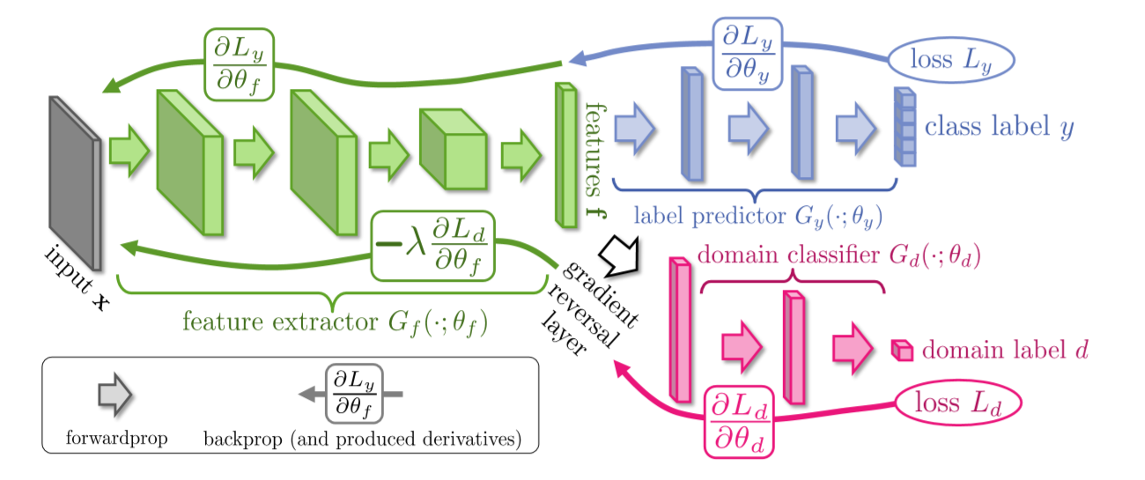
2.5 Training
Y Ganin, Lempitsky V. Unsupervised Domain Adaptation by Backpropagation[C]. ICML, 2015.
Notes:
​ 在反向传播更新参数的过程中，梯度下降是最小化loss function，而特征提取器任务是最大化label分类准确率但最小化域分类准确率，因此要最大化域判别器loss fuction。
因此，论文提出在域分类器和特征提取器中间有一个梯度反转层（Gradient reversal layer），在粉色部分的参数向Ld减小的方向优化，绿色部分的梯度向Ld增大的方向优化，用一个优化器就实现了两部分有不一样的优化目标，形成对抗的关系。
具体的：GRL就是将传到本层的误差乘以一个负数（-​），这样就会使得GRL前后的网络其训练目标相反，以实现对抗的效果。
​

Slide 14
03
Paper Share

Slide 15
3.1 Task
Paper:
Gao Y , Liu J X , Wang L , et al. Domain-Adversarial Autoencoder with Attention Based Feature Level Fusion for Speech Emotion Recognition[C]. ICASSP 2021 - 2021 IEEE International Conference on Acoustics, Speech and Signal Processing (ICASSP). IEEE, 2021.
Task:
Speech Emotion Recognition
Motivate:
Insufficient training data → pre-train a model and transfer knowledge
Mismatch between domains → domain-adversarial training

Slide 16
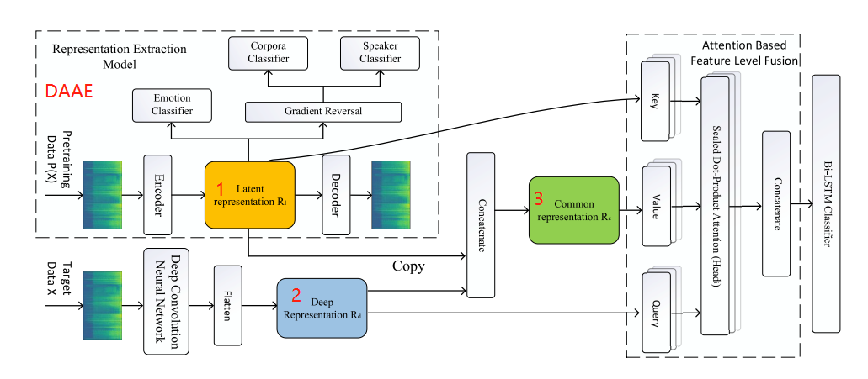
3.2 Proposed Model
Three parts:
Domain-adversarial autoencoder
Deep CNN
Multi-head attention-based feature fusion

Slide 17
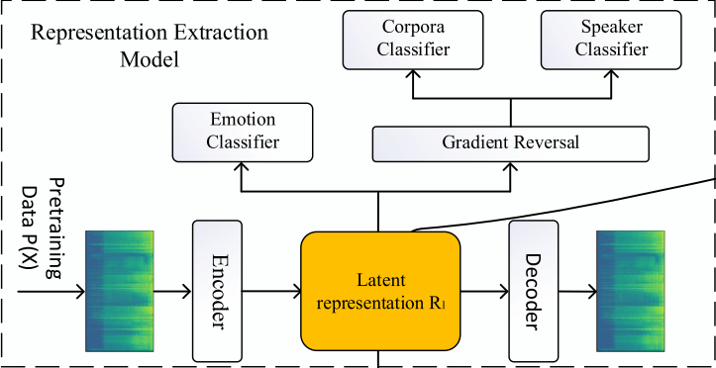
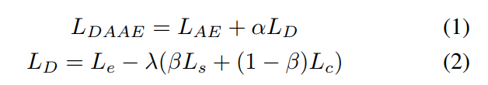
3.2 Proposed Model
a pretrained convolutional autoencoder
a domain adversarial neural network
Training Stage:
pre-training
Fine-tune (feature extraction)
SAVEE, EMO-DB, EmoV-DB
IEMOCAP
Loss Function:

Slide 18
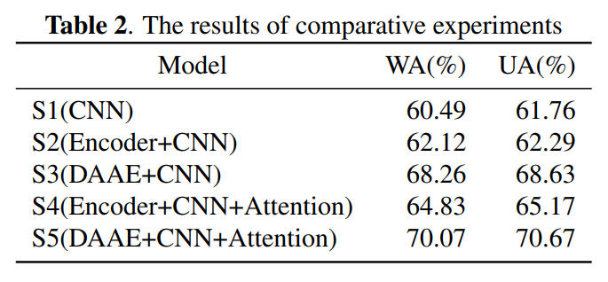
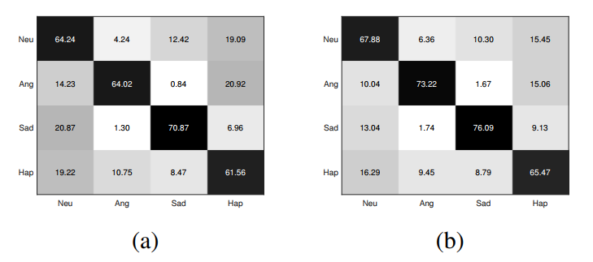
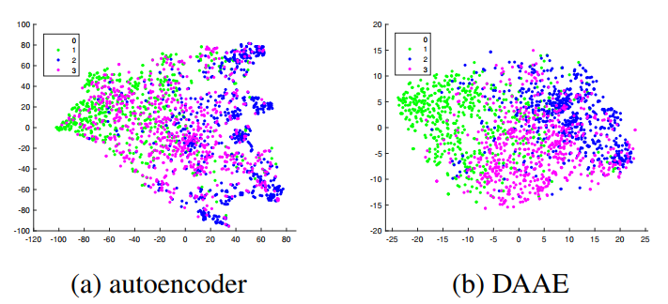
3.2 Experiments

Slide 19
04
References

Slide 20
4 References
Paper:
[1] Y Ganin, Lempitsky V. Unsupervised Domain Adaptation by Backpropagation[C]. ICML, 2015.
[2] Gao Y , Liu J X , Wang L , et al. Domain-Adversarial Autoencoder with Attention Based Feature Level Fusion for Speech Emotion Recognition[C]. ICASSP, 2021.
Video:
https://www.bilibili.com/video/BV1JE411g7XF?p=83
https://www.bilibili.com/video/BV1Wv411h7kN?p=71
https://www.bilibili.com/video/BV1T7411R75a?spm_id_from=333.999.0.0
Blog:
http://blog.itpub.net/69942346/viewspace-2654034/
https://blog.csdn.net/dakenz/article/details/85954548
Github:
https://github.com/jindongwang/transferlearning
https://github.com/jvanvugt/pytorch-domain-adaptation

Slide 21
Thank you for watching!
weijie_xjtu@stu.xjtu.edu.cn

