Slide 1


Sequence Model
Jie Wei
Xi’an Jiaotong University
2021-11

Slide 2
Contents
1
Recurrent Neural Network
2
Sequence-to-sequence Learning
3
Attention Mechanism
4
Transformer
5
References

Slide 3

01
Recurrent Neural Network

Slide 4

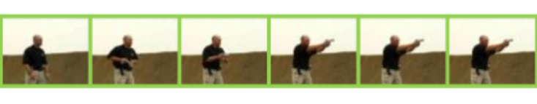
1.1 Background
Examples of sequence data
Text Sentence
XJTU is a C9 League university located in Xi’an.
Audio
Video
Why RNN?
Temporal relationship learning → Contextual information

Slide 5
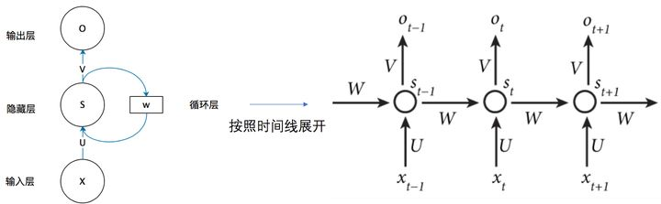
1.2 RNN Structure
X: input
S: hidden-layer output
O: output-layer output
U: input → hidden weight matrix
W: t-1 hidden → t hidden weight matrix
V: hidden → output weight matrix

Slide 6
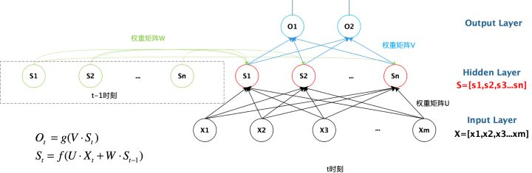
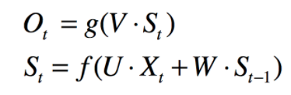
1.2 RNN Structure
Formula:

Slide 7
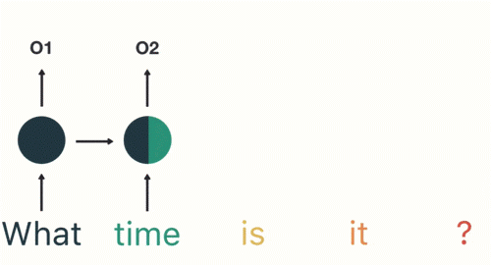
1.3 Variants
Disadvantages:
Gradient vanishing problems.
It cannot process very lengthy sequences.
LSTM & GRU:
only preserves important and relevant information

Slide 8
02
Sequence-to-sequence Learning

Slide 9
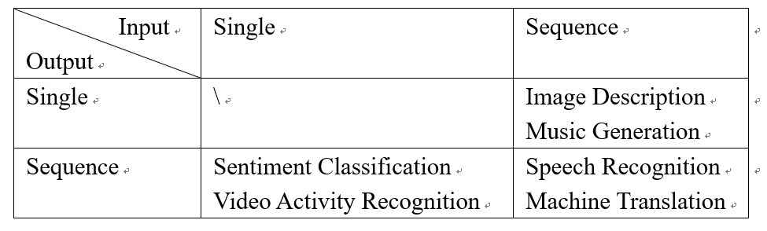
2.1 Task
Analysis and Recognition
Analysis and Generation
RNN exist problem:
the length of output remains the same as input sequence

Slide 10
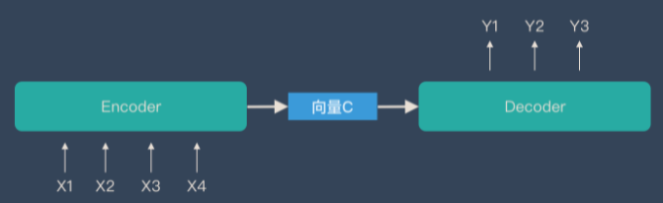
2.2 Seq2seq
Input: a sequence
Output: a sequence
** The length of the input and output sequences is variable
Encoder & Decoder
Encoder: a sequence → context vector
Decoder: context vector → a sequence

Slide 11
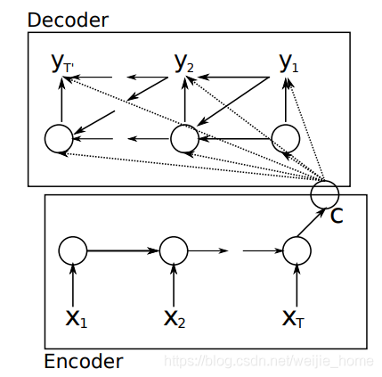
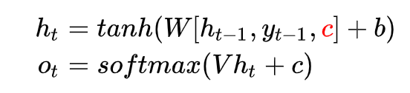

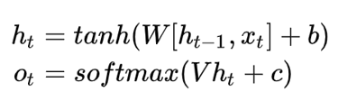

2.2 Seq2seq
Cho RNN Encoder-Decoder [1]
[1] https://arxiv.org/pdf/1406.1078.pdf

Slide 12
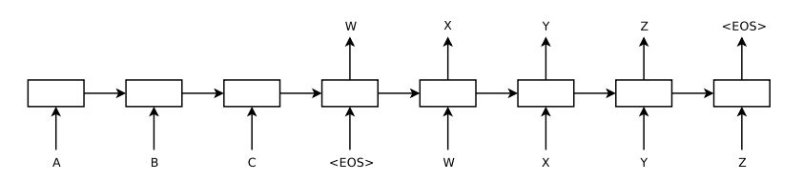


2.2 Seq2seq
Sutskever Encoder-Decoder [1]
Encoder:
Decoder:
[1] https://arxiv.org/pdf/1409.3215.pdf

Slide 13
03
Attention Mechanism

Slide 14
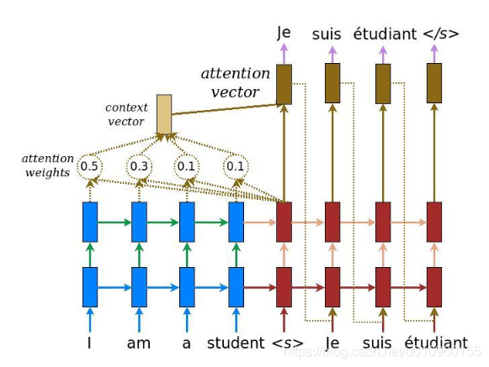
3.1 Motivation
Leverage the complete information from Encoder
Same scene, different people with different attention

Slide 15
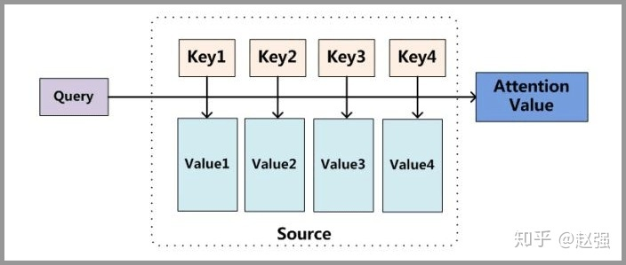
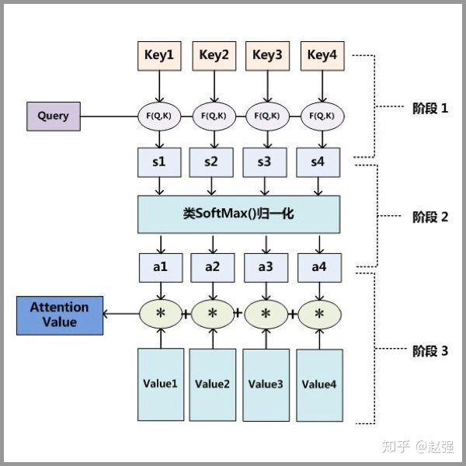
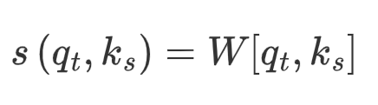
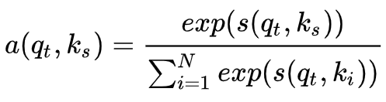
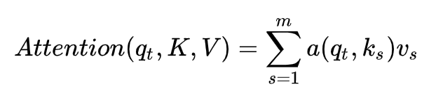
3.2 Principle
Key
Value
Query

Slide 16
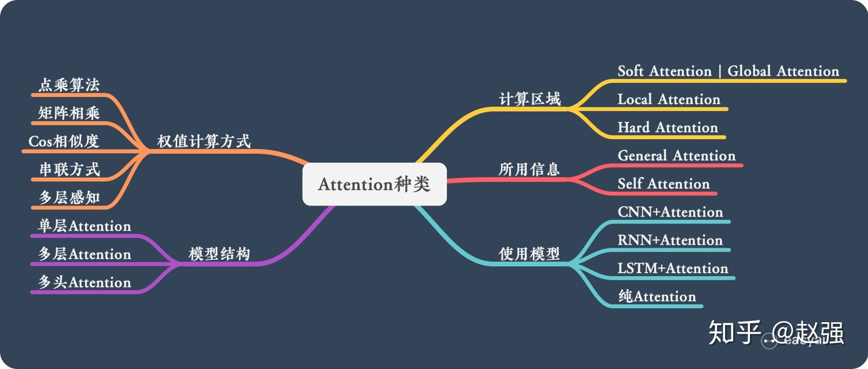
3.3 Category

Slide 17
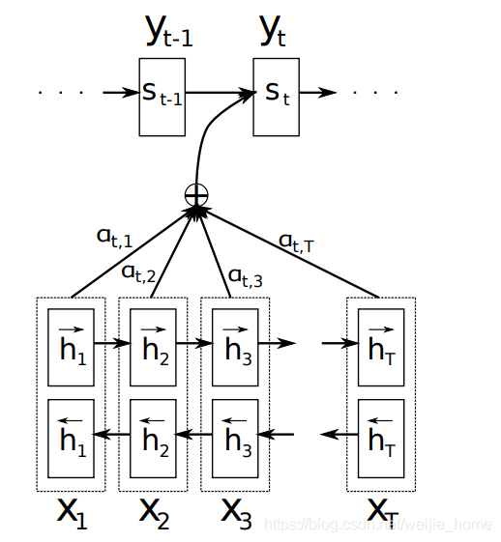
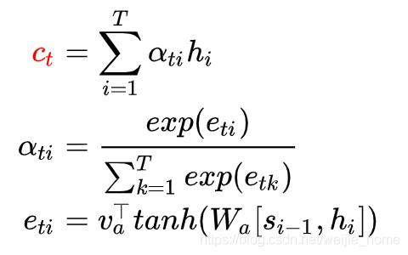
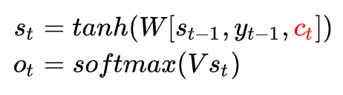
3.4 Bahdanau Attention
1) Context vector
2) Hidden layer parameters

Slide 18
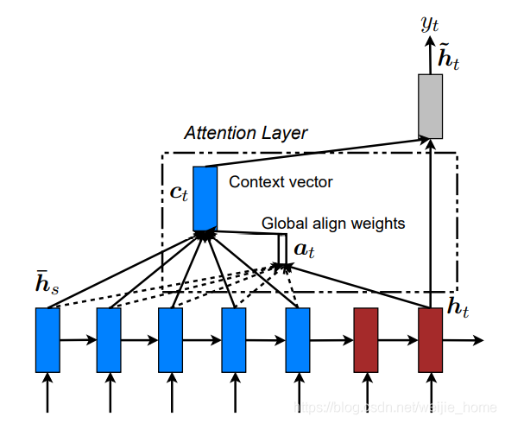

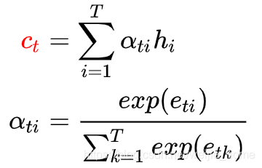

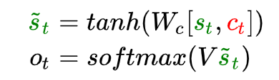
3.5 Luong Attention
1) Hidden layer parameters
2) Context vector
3) Hidden layer parameters

Slide 19
04
Transformer

Slide 20
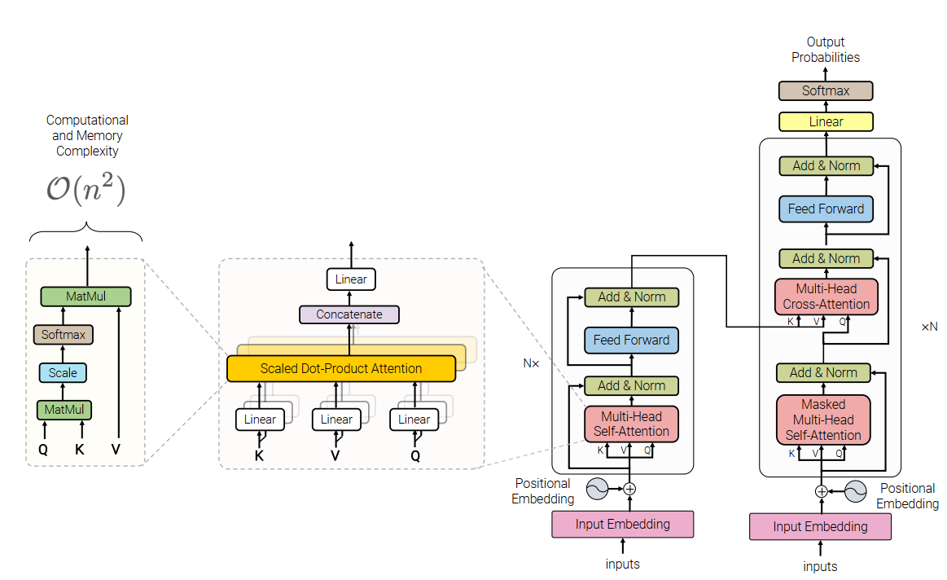
4.1 Structure
Self-Attention
Cross-Attention

Slide 21
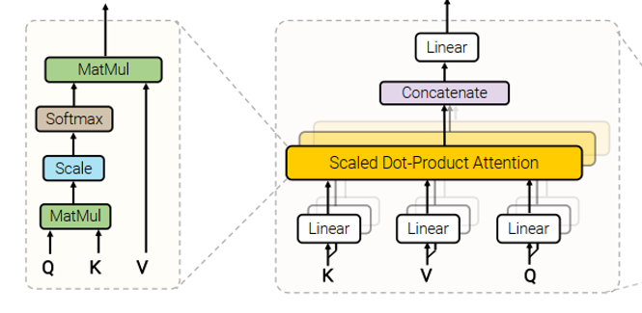
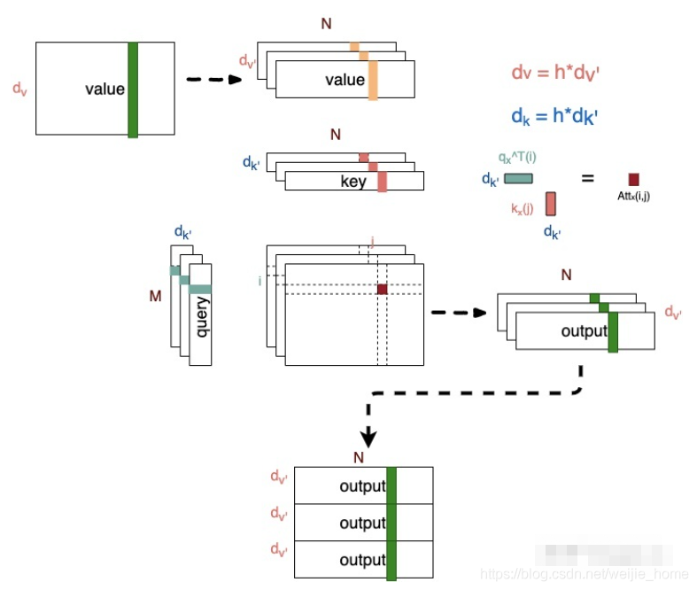

4.2 Multi-Head Attention
Multi-head attention allows the model to jointly attend to information from different representation subspaces at different positions.

Slide 22
05
References

Slide 23
5 References
Paper:
[1] Cho K, Van Merriënboer B, Gulcehre C, et al. Learning phrase representations using RNN encoder-decoder for statistical machine translation[J]. arXiv preprint arXiv:1406.1078, 2014.
[2] Sutskever I, Vinyals O, Le Q V. Sequence to sequence learning with neural networks[C]//Advances in neural information processing systems. 2014: 3104-3112.
[3] Bahdanau D, Cho K, Bengio Y. Neural machine translation by jointly learning to align and translate[J]. arXiv preprint arXiv:1409.0473, 2014.
[4] Luong M T, Pham H, Manning C D. Effective approaches to attention-based neural machine translation[J]. arXiv preprint arXiv:1508.04025, 2015.
[5] Vaswani A, Shazeer N, Parmar N, et al. Attention is all you need[C]//Advances in neural information processing systems. 2017: 5998-6008.
Blog:
https://zhuanlan.zhihu.com/p/30844905
https://easyai.tech/ai-definition/rnn/
https://blog.csdn.net/weijie_home/article/details/116407137
Github:
https://github.com/pprp/awesome-attention-mechanism-in-cv

Slide 24
Thank you for watching!
weijie_xjtu@stu.xjtu.edu.cn

