Slide 1
Education for long-term prediction code
Theoretical Background on Hydrodynamics
Theoretical Background on Long term analyses
Overall work flow
Application of long term prediction

Slide 2
Theoretical Background on Hydrodynamics

Slide 3






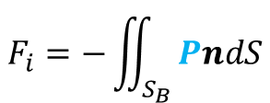



Potential flow theory (AQWA)
Boundary condition
Sea bed ($S_{H}$)
$$\frac{∂Ω}{∂z}=0$$
Body surface ($S_{B}$)
$$\frac{∂Ω}{∂n}=U∙n+ω∙(r×n)$$
Free surface ($S_{F}$)
$$\frac{∂^{2}Ω}{∂^{2}t}+g\frac{∂Ω}{∂z}=0$$
Governing equation (Continuity condition )
$$∇^{2}Ω=\frac{∂^{2}Ω}{∂x^{2}}+\frac{∂^{2}Ω}{∂y^{2}}+\frac{∂^{2}Ω}{∂z^{2}}=0$$
$$Ω(x,y,z)$$
Note:
Wave frequencies and heading angles change free surface boundary condition
$$P=ρ(\frac{∂Ω}{∂t}+\frac{1}{2}{\left|∇Ω\right|}^{2}+gz)$$
Bernoulli equation
$$F_{i}=−\iint_{S_{B}}{PndS}$$
Hydrodynamic forces

Slide 4
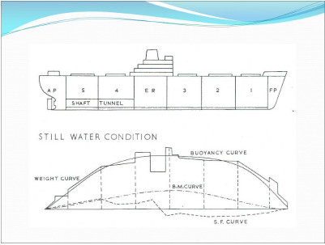
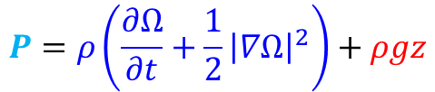
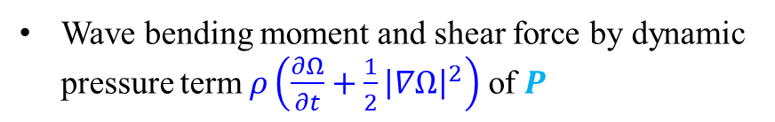
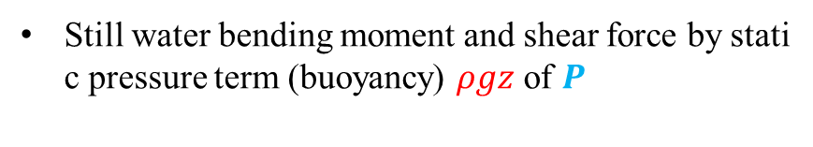
Wave bending moment and shear force calculation (AQWA)
$$P=ρ\left(\frac{∂Ω}{∂t}+\frac{1}{2}{\left|∇Ω\right|}^{2}\right)+ρgz$$
Bernoulli equation
Still water bending moment and shear force by static pressure term (buoyancy) $ρgz$ of $P$
Wave bending moment and shear force by dynamic pressure term $ρ\left(\frac{∂Ω}{∂t}+\frac{1}{2}{\left|∇Ω\right|}^{2}\right)$ of $P$

Slide 5
Theoretical Background on Long term analyses

Slide 6

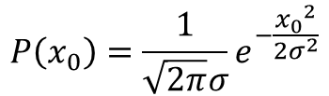
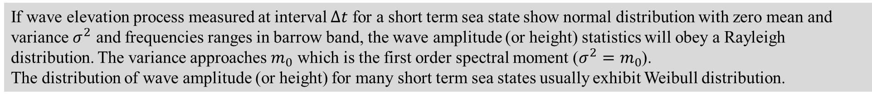


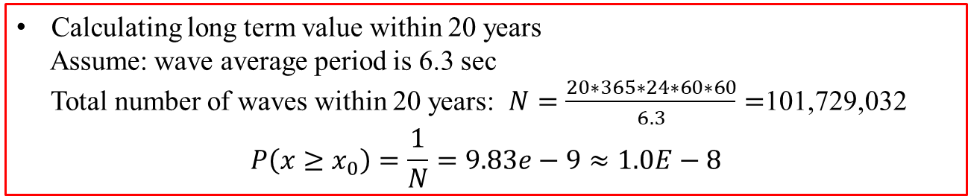

Procedure of Long Term Prediction
Weibull PDF
PDF
$$P\left(x_{0}\right)=\frac{1}{\sqrt{2π}σ}e^{−\frac{{x_{0}}^{2}}{2σ^{2}}}$$
CDF
EPF
Weibull CDF
$$x_{0}$$
$$P\left(x≤x_{0}\right)=1−e^{−\frac{{x_{0}}^{2}}{2σ^{2}}}$$
Calculating long term value within 20 years
Assume: wave average period is 6.3 sec
Total number of waves within 20 years: $N=\frac{20∗365∗24∗60∗60}{6.3}=$101,729,032
$$P\left(x≥x_{0}\right)=\frac{1}{N}=9.83e−9≈1.0E−8$$
Weibull EDF
$$P\left(x≥x_{0}\right)=e^{−\frac{{x_{0}}^{2}}{2σ^{2}}}$$
If wave elevation process measured at interval $Δt$ for a short term sea state show normal distribution with zero mean and variance $σ^{2}$ and frequencies ranges in barrow band, the wave amplitude (or height) statistics will obey a Rayleigh distribution. The variance approaches $m_{0}$ which is the first order spectral moment ($σ^{2}=m_{0}$).
The distribution of wave amplitude (or height) for many short term sea states usually exhibit Weibull distribution.
$$σ^{2}=m_{0}$$

Slide 7
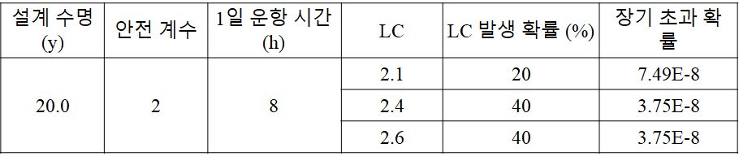
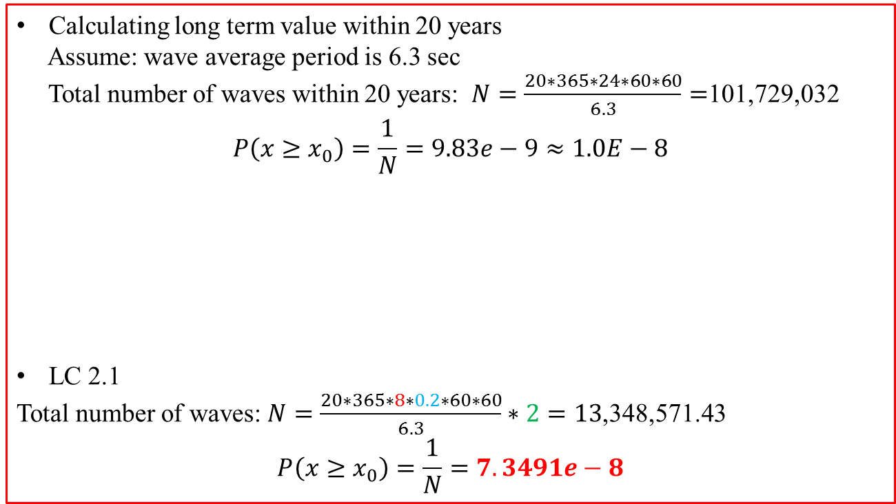
Calculating long term value within 20 years
Assume: wave average period is 6.3 sec
Total number of waves within 20 years: $N=\frac{20∗365∗24∗60∗60}{6.3}=$101,729,032
$$P\left(x≥x_{0}\right)=\frac{1}{N}=9.83e−9≈1.0E−8$$
LC 2.1
Total number of waves: $N=\frac{20∗365∗8∗0.2∗60∗60}{6.3}∗2=13$,348,571.43
$$P\left(x≥x_{0}\right)=\frac{1}{N}=7.3491e−8$$

Slide 8

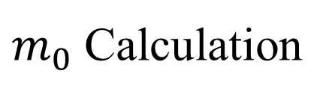


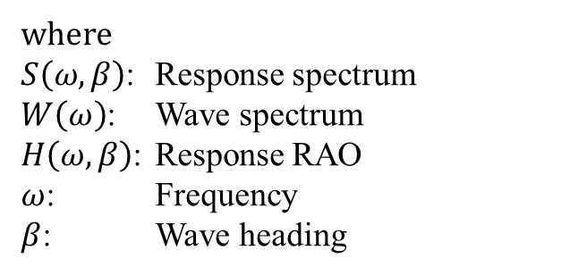


$m_{0}$ Calculation
$$m_{0}=\int_{0}^{∞}{ω^{0}S\left(ω,β\right)dω}$$
$β$: Wave heading is constant
$$S\left(ω,β\right)={H\left(ω,β\right)}^{2}×W\left(ω\right)$$
where
$S\left(ω,β\right)$: Response spectrum
$W\left(ω\right)$: Wave spectrum
$H\left(ω,β\right)$: Response RAO
$ω$: Frequency
$β$: Wave heading
$$×$$
$$m_{0}$$

Slide 9

$$m_{0}(β)$$
Wave heading 0 with probability of 0.1
$$S\left(ω,β=0\right)={H\left(ω,0\right)}^{2}×W\left(Hs=13, Tz=0.5\right)$$
$$m_{0}^{′}=m_{0}\left(0\right)×0.1+m_{0}\left(30\right)×0.12+ ∙∙∙ +m_{0}\left(180\right)×0.1$$
Wave heading 30 with probability of 0.12
.
.
.
.
.
Wave heading 180 with probability of 0.1

Slide 10
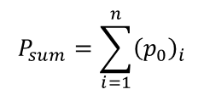




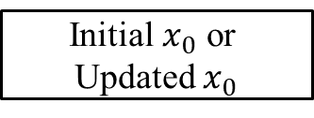

Long Term Value Calculation
Spectral moment considering wave heading ($m_{0}^{′}$)
Probability of each sea state ($p_{i}$)
Initial $x_{0}$ or Updated $x_{0}$
$${\left(p_{0}\right)}_{i}=e^{−\frac{{x_{0}}^{2}}{2m_{0}^{′}}}×p_{i}$$
Update $x_{0}$
$$P_{sum}=\sum_{i=1}^{n}{{\left(p_{0}\right)}_{i}}$$
$$\frac{ABS\left(x_{0}\left(P_{sum}>{10}^{−8}\right)−x_{0}\left(P_{sum}<{10}^{−8}\right)\right)}{x_{0}\left(P_{sum}<{10}^{−8}\right)}<tol$$
No
Yes
Take $x_{0}$

Slide 11
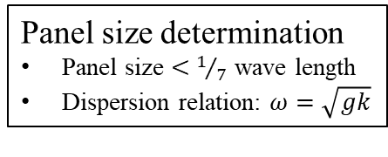
Overall work flow
Environmental condition
Panel modelling in HyperMesh
Import IGES file
Wave headings
Surface edit
Sea states
wave frequencies
Panel size determination
Panel size $<$ $1/7$ wave length
Dispersion relation: $ω=\sqrt{gk}$
Panel generation
ABAQUS input file generation
Transform to AQWA input file (In-house code)
Free surface boundary determination
Mass information edit
Center of mass
Mass & Inertia mass
Gravity & water density
Boundary condition edit
Wave headings
Wave frequencies
Water depth
Data check execution of AQWA
Mass verification
Damping modelling
Running AQWA simulation
Long term calculation code
(in-house code)
Output files
(*.lis: motion & acceleration; *.PTA: Wave bending & shear)

