Slide 1
FACE MASK DETECTION WITH MACHINE LEARNING
(Major Project )
Presented By:-
Anmol A. Khadse
(AI Intern ,Meta Scifror Technology)

Slide 2
INTRODUCTION
Project Objective: The objective of this project is to develop a machine learning model to accurately detect whether individuals are wearing face masks in images. This is particularly relevant in public health scenarios where mask-wearing compliance is essential.
Approach: We utilize machine learning models, particularly Convolutional Neural Networks (CNNs), to classify images as "masked" or "unmasked." The focus is on processing the images, building a robust model, and evaluating its performance.

Slide 3
PROBLEM STATEMENT
Context:
The dataset includes images labeled as "with_mask" and "without_mask." The images vary in lighting, angles, and background conditions.
Goal:
The goal is to build a model that can accurately classify images into these two categories to support public health monitoring.
Importance:
Accurate face mask detection can help in ensuring compliance with public health guidelines, reducing the spread of infections in community settings.

Slide 4
Dataset overview
Features:
Images: The dataset contains images labeled as "with_mask" and "without_mask.“
Labels: Binary labels (0 for "without_mask" and 1 for "with_mask").
Dataset Size:
Dataset includes images, with approximately equal distribution between the two classes.

Slide 5
TECHNOLOGY USED
Programming Language:
Python: Used for data manipulation, model building, and evaluation.
Libraries:
TensorFlow/Keras: For building and training the CNN model.
OpenCV: For image processing tasks.
Matplotlib & Seaborn: For data visualization.
Development Environment:
Google Colab: A cloud-based environment providing access to GPUs, used for model training and evaluation.

Slide 6
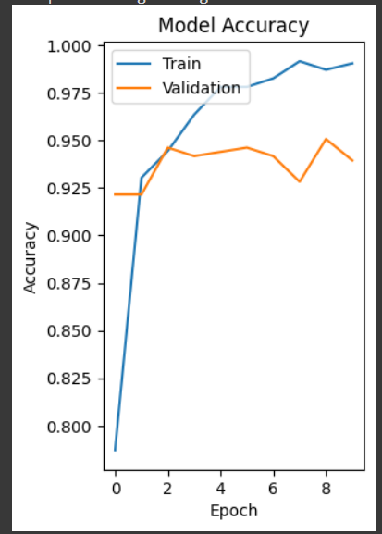
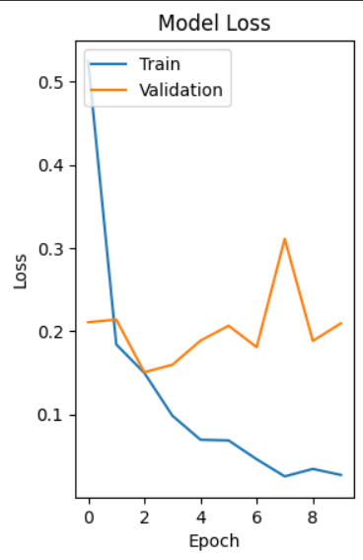
Data visualization

Slide 7
Data preprocessing
Handling Image Sizes:
All images are resized to 128x128 pixels to ensure uniform input size for the CNN model.
Normalization:
Pixel values are normalized to a range of [0, 1].
Data Split:
The dataset is divided into training (80%) and testing (20%) sets.

Slide 8
Model training and evaluation
CNN Model:
A Convolutional Neural Network (CNN) was selected for image classification, consisting of convolutional layers, pooling layers, and fully connected layers.
Training:
The model was trained on the training dataset with validation on the test dataset over 10 epochs.
Evaluation Metrics:
Accuracy, Precision, Recall, F1-Score, and Confusion Matrix were used to evaluate the model’s performance.

Slide 9
MODEL ARCHITECTURE
Model Type: Convolutional Neural Network (CNN)
Layers:
Convolutional Layers
Pooling Layers
Fully Connected Layers
Activation Functions: ReLU and Sigmoid

Slide 10
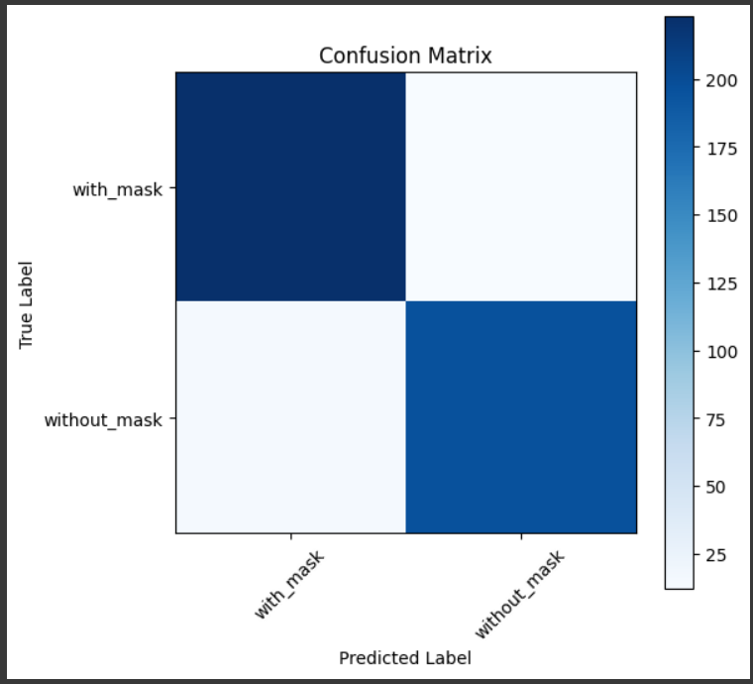
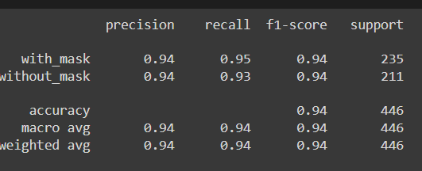
Result comparison
Model Performance:
Accuracy:94%
Confusion Matrix:

Slide 11
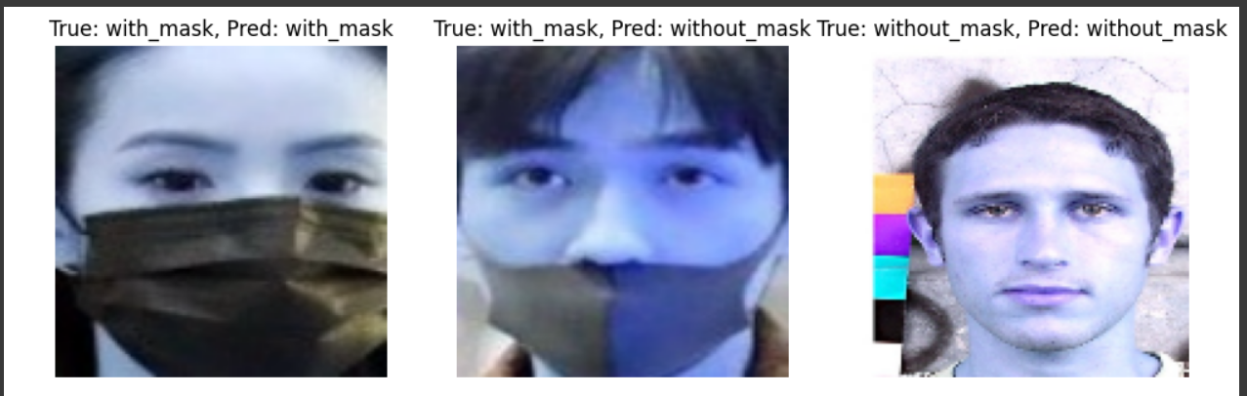
conclusion
The CNN model demonstrated a strong ability to classify images into "with_mask" and "without_mask" categories. The model achieved high accuracy, making it a viable tool for public health monitoring.

Slide 12
Thank you

