Slide 1
Titanic Survival Prediction Project
(Predicting Survival Outcomes Using Machine Learning)
Presented by:
Anmol A. Khadse
(AI Intern, Meta Scifor Technologies)

Slide 2
Introduction
Objective: The Titanic Survival Prediction project aims to predict whether a passenger on the Titanic would survive the disaster based on various features such as age, sex, passenger class, and more.
Approach: We employ machine learning models to build a predictive system and evaluate their effectiveness using accuracy, confusion matrix, and classification reports.

Slide 3
Problem Statement
The Titanic Problem is based on the sinking of the ‘Unsinkable’ ship Titanic in early 1912. It gives you information about multiple people like their ages, sexes, sibling counts, embarkment points, and whether or not they survived the disaster. Based on these features, you have to predict if an arbitrary passenger on Titanic would survive the sinking or not.

Slide 4
Dataset Overview
Features: The dataset contains various features of passengers such as:
Survived (0 = No, 1 = Yes)
Pclass (Passenger Class)
Sex
Age
SibSp (Number of Siblings/Spouses Aboard)
Parch (Number of Parents/Children Aboard)
Fare
Embarked (Port of Embarkation: C = Cherbourg, Q = Queenstown, S = Southampton)
Dataset Size: 891 Rows And 12 Columns

Slide 5
Technology Used
Programming Language:
Python: Used for data manipulation, model building, and evaluation.
Libraries:
Pandas: For data loading, preprocessing, and manipulation.
Scikit-learn: For model building, training, evaluation, and hyperparameter tuning.
Matplotlib & Seaborn: For data visualization.
Development Environment:
Google Colab: A cloud-based environment for running code and accessing powerful computational resources.

Slide 6
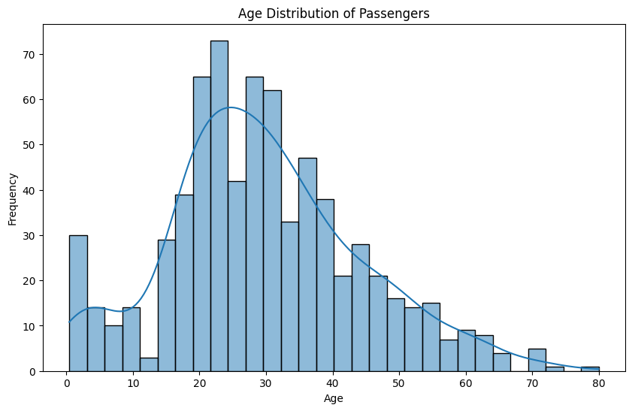
Data Visualization

Slide 7
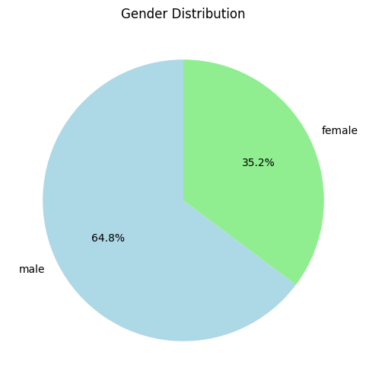

Slide 8
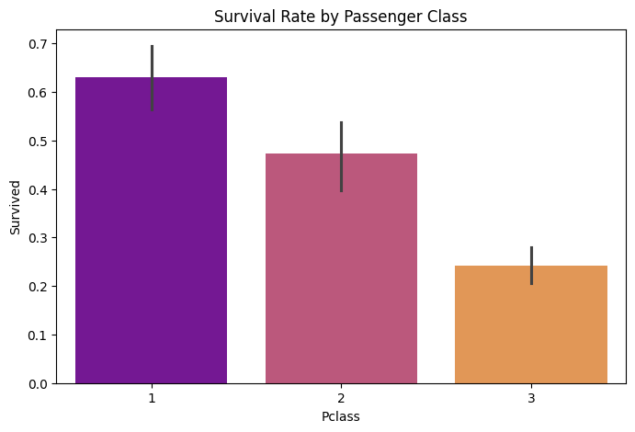
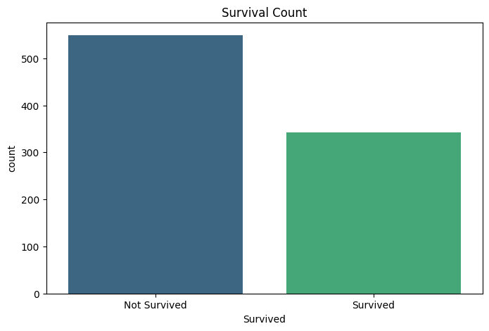

Slide 9
Data Preprocessing
Handling Missing Values: Filled missing values in Age and Embarked columns; dropped Cabin due to excessive missing data.
Encoding Categorical Variables: Converted Sex and Embarked into numerical values using Label Encoding.
Feature Scaling: Applied StandardScaler to normalize the features like Age and Fare.
Data Split: Divided the dataset into training (70%) and testing (30%) sets.

Slide 10
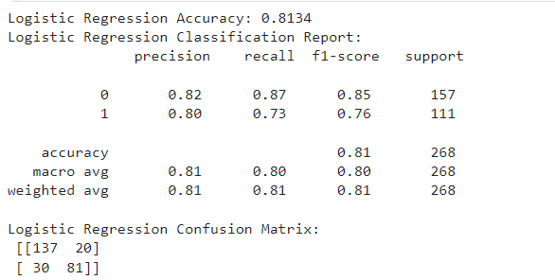
Model Training & Evaluation
Logistic Regression
Accuracy: 81.34%
Performance: High precision and recall, especially in predicting survival outcomes.
Confusion Matrix: Strong ability to differentiate between survivors and non-survivors.

Slide 11
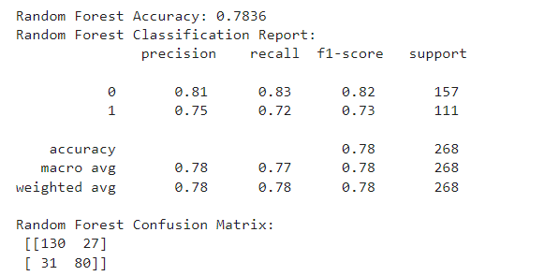
Random Forest
Accuracy: 78.36%
Performance: Balanced precision and recall, slightly lower than Logistic Regression.
Confusion Matrix: Shows some misclassification, particularly with borderline cases.

Slide 12
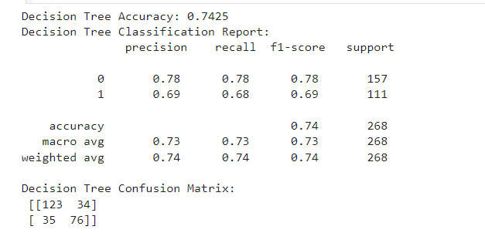
Decision Tree
Accuracy: 74.25%
Performance: Lower accuracy, indicating potential overfitting.
Confusion Matrix: More misclassification errors compared to other models.

Slide 13
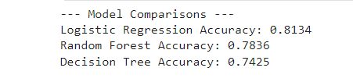
Results Comparison
Model Comparison: Accuracy, Precision, Recall for all three models.
Best Model: Logistic Regression with 81.34% accuracy.
Conclusion: Logistic Regression is the most reliable model for predicting survival outcomes.

Slide 14
Conclusion
Summary: This project highlights the importance of data preprocessing, model selection, and evaluation in predicting survival outcomes on the Titanic.
Best Model: Logistic Regression is recommended as the best model due to its consistent performance across all metrics.

Slide 15
Thank you

