Slide 1
LOAN APPLICATION STATUS PREDICTION
(Mini Project 1)
Presented By:-
Anmol A. Khadse
(AI Intern ,Meta Scifror Technology)

Slide 2
INTRODUCTION
Project Objective: The objective of this project is to predict whether a loan application will be approved based on various applicant details such as income, credit history, loan amount, and more.
Approach: We utilize machine learning models to analyze the dataset and build predictive models. The focus is on understanding how different factors influence the likelihood of loan approval.
Models Used: We applied Logistic Regression, Random Forest, and Decision Tree classifiers to make predictions.

Slide 3
PROBLEM STATEMENT
Context: The dataset includes details of applicants who have applied for a loan. The features provided include credit history, income, loan amount, and other demographic details.
Goal: The goal is to build a model that predicts whether a loan application will be approved based on the provided features.
Importance: Accurately predicting loan approval can help financial institutions make better lending decisions, reduce risk, and improve customer service.

Slide 4
Dataset overview
Features: Loan_ID, Gender, Married, Dependents, Education, Self_Employed, ApplicantIncome, CoapplicantIncome, LoanAmount, Loan_Amount_Term, Credit_History, Property_Area.
Target Variable: Loan_Status (Approved/Not Approved).
Dataset Size: Dataset includes 614 Rows and 13 Columns

Slide 5
TECHNOLOGY USED
Programming Language:
Python: The primary language used for data manipulation, model building, and evaluation.
Libraries:
Pandas: For data loading, preprocessing, and manipulation.
Scikit-learn: Used for model building, training, evaluation, and hyperparameter tuning.
Matplotlib & Seaborn: Employed for data visualization, providing insights into the data distribution and feature relationships.
Development Environment:
Google Colab: A cloud-based development environment that allows for easy collaboration, GPU access, and running complex computations.

Slide 6
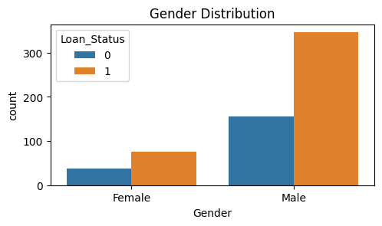
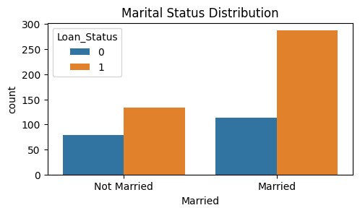
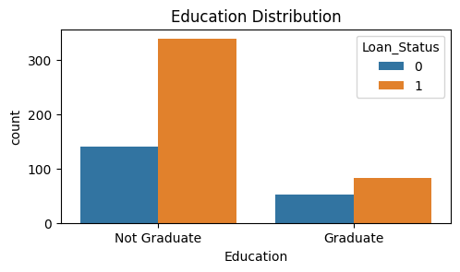
Data visualization

Slide 7
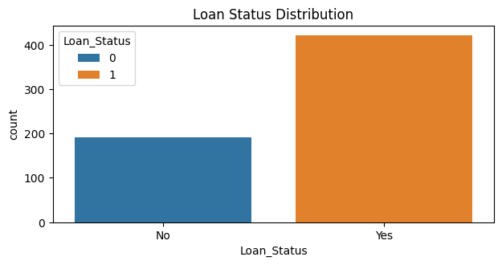
Overall loan distribution

Slide 8
Data preprocessing
Handling Missing Values:
Categorical columns (e.g., Gender, Married) were filled with the mode (most frequent value).
Numerical columns (e.g., LoanAmount, Loan_Amount_Term) were filled with the median to handle missing data.
Encoding Categorical Variables:
Label Encoding was applied to convert categorical features like Gender, Married, Education, and Property_Area into numerical form.
Feature Engineering:
Created a new feature TotalIncome by combining Applicant Income and Coapplicant Income to better represent the financial capacity of the applicant. of the applicant.
Feature Scaling:
Applied StandardScaler to normalize features such as sLoan Amount and Total Income, ensuring all features are on similar scale. Dataset Split:
The dataset was divided into training (70%) and testing (30%) sets to evaluate model performance on unseen data.

Slide 9
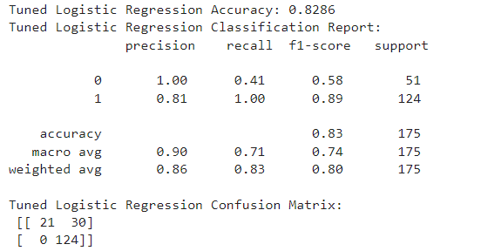
Model training and evaluation
Logistic Regression:
Accuracy: Achieved 82.86% accuracy.
Performance: High precision and recall, especially for correctly identifying approved loans.
Confusion Matrix: Showed a strong ability to differentiate between approved and not approved loans.

Slide 10
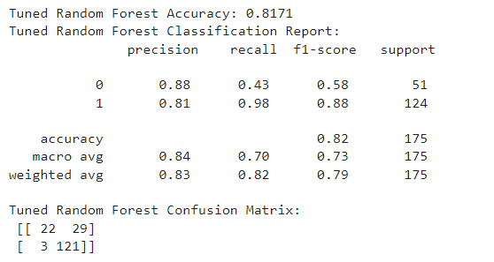
Random Forest:
Accuracy: Achieved 81.71% accuracy.
Performance: Provided balanced precision and recall but slightly lower than Logistic Regression.
Confusion Matrix: Some misclassification, particularly with borderline cases.

Slide 11
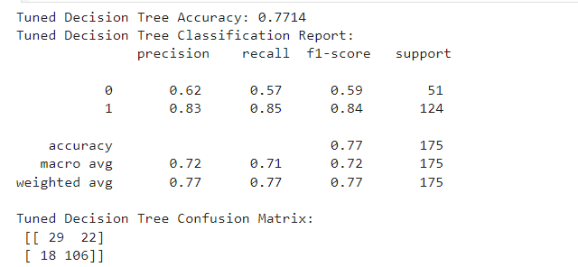
Decision Tree:
Accuracy: Achieved 77.14% accuracy.
Performance: Lower performance, indicating potential overfitting, especially with small feature sets.
Confusion Matrix: Showed more misclassification errors compared to other models.

Slide 12

Result comparison
Model Comparison: Accuracy, Precision, Recall for all three models.
Best Model: Logistic Regression with 82.86% accuracy.
Conclusion: Logistic Regression is the most reliable model for predicting loan approval.

Slide 13
conclusion
This project highlights the importance of preprocessing, model selection, and evaluation in achieving accurate predictions.
Logistic Regression is recommended as the best model for loan approval prediction due to its consistent performance across all metrics.

Slide 14
Thank you

