Slide 1

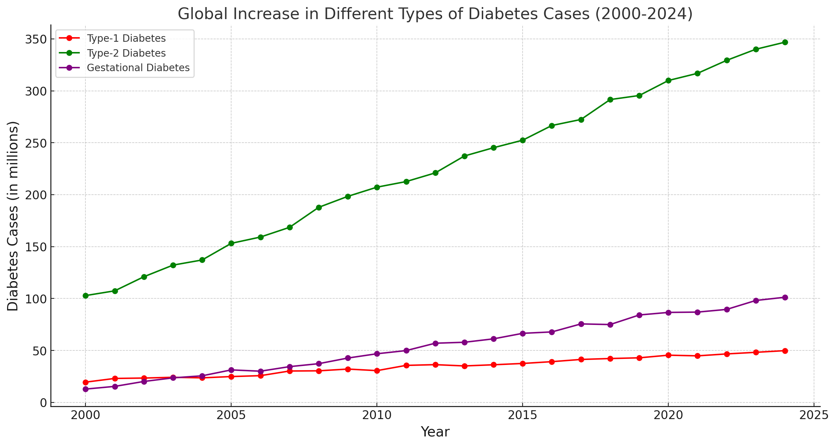
REAL TIME AI POWERED HEALTH COACH FOR DIABETES
DATA DIVERS (Ashna Ali, Sai Kiran Basetty, Sreevardhan Reddy Soma, Venkata Sai Veeramalla)
School of Science and Engineering-University of Missouri Kansas City
Introduction
Methodology
Workflow
Future Work
Diabetes is a growing global health concern, with Type-2 diabetes and gestational diabetes becoming increasingly prevalent. These conditions, if not diagnosed and managed early, can lead to severe complications such as cardiovascular diseases, neuropathy, and kidney failure. This project focuses on developing an AI-driven predictive model to enhance early diagnosis and intervention for diabetes, including pre-diabetes, Type-2 diabetes, and gestational diabetes. Leveraging artificial intelligence, the project will utilize a combination of demographic data, lifestyle factors, and biometric measurements to build an effective and user-friendly tool. By incorporating machine learning techniques, such as Gradient Boosting Classifiers, and advanced deep learning architectures, including LSTM networks, the model aims to provide high accuracy and reliability in predictions.
The main objective is to create an accessible AI solution capable of early diabetes detection and personalized health guidance for individuals at risk. This approach has the potential to support early medical interventions, leading to better patient outcomes, reduced healthcare costs, and a significant positive impact on diabetes management and prevention strategies worldwide.
Add your information, graphs, and images to this section.
Workflow
Dataset/Database
Feature extraction
Preprocessing
Fitting models on data
Diabetes prediction
Patient Compliance and Data Quality: Data quality and patient compliance are major challenges in healthcare. Patients may forget to log their meals or exercise activities, which can impact prediction accuracy. Future improvements should focus on integrating automatic data collection tools, such as wearable devices that track physical activity and dietary logs using smart cameras, to improve the quality and completeness of data.
Scalability for Real-time Data Handling: A common problem in real-world applications is scaling the solution to accommodate multiple users at once, especially when dealing with real-time data. Future improvements should focus on developing a scalable backend infrastructure capable of handling simultaneous data streams from numerous users without compromising performance.
User Engagement and Behavior Analysis: Use real-time data to engage users and analyze their behavior patterns. For example, tracking whether users follow recommendations and providing real-time feedback can help in maintaining better glycemic control. Future work should focus on creating a feedback loop that motivates users to adhere to healthy habits.
Data Privacy and Security: Handling real-time health data comes with privacy and security concerns. Future improvements should involve the integration of encryption protocols and secure authentication mechanisms to ensure that users' real-time data is kept confidential and safe from breaches.
Results
Conclusion
Types of classification
Recommendations
Evaluation
Training/Validation Accuracy Curves for CGM, Male and Female models
Classification Reports: Precision, Recall, F1-Score
Testing of LLM
Screenshot of app
Methodology
Data collection/preprocessing:
Collected Data related to Male & Female diabetes data across the different popular platforms like Kaggle, GitHub repos. For CGM we used existing data set for type-2 diabetes to Simulate the entire CGM data for each categorical prediction.
Model Building and Selection:
Approach to the problem by using the ML/DL Algorithms like XG Boost for male & female data with Accuracy 90% & 89%, LSTM for CGM data with Accuracy 91%. LLM for recommendation after the predicted result to user.
Why 3 models:
In ML/DL each has its impact in dealing with certain types of data. We created Three Distinct models for male and female for their characteristics (only female can get Gestational Diabetes) and dedicated model for CGM data that only works for time series data . This allows each model to specialize in its specific tasks leading to more efficient and accurate diabetes prediction.
(placeholder for comparative analysis btwn models)
Reference
Add your information, graphs, and images to this section.

