Slide 1
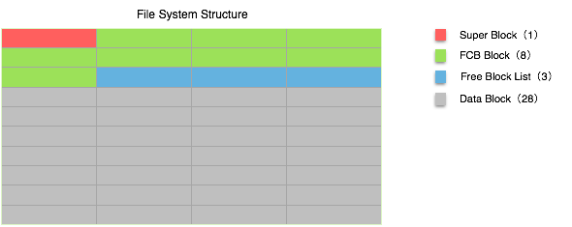
/*super block, store the information of the filesystem*/
typedef struct supb{
int full;//if the file system is full.
int size;//DATA_BLOCK_NUMBER
int filenum;// total file number stored in the file system
int freeblock;//free data block number
char name[FILENAME_LENGTH];//name of the file system(file name stored in your local disk)
} sb_t;

Slide 2
/*FCB of each file stored in the filesystem*/
typedef struct fcb {
char not_free;//if the fcb block is free
int start;// the start block of the file
int end;//the end block of the file
int size;// size of the file(Byte)
long timep;(timestamp that the file was put into the file system)
char name[FILENAME_LENGTH];//name of the file
} fcb_t;
typedef struct mpfs {
sb_t sb[1];//the super block
fcb_t fb[FILE_NUMBER];//the fcb block list
int next[DATA_BLOCK_NUMBER];// the free data block list
} pfs_t;

