Slide 1

AK8PO - OxObstacles
Jan Dluho3

Slide 2
Game idea
Idea was to create Maze with multiple obstacles.
Main goal is to get from start to finish to continue to the next leve

Slide 3
Gameplay objects
Player object – Main character
Wall object – Object that is creating a maze
Spinner object – Object that is spinning and making it difficult for player to pass by
Dropper object – An object that fall from the sky out of the nowhere
Roller object – An object that fall from the sky like a avalanche

Slide 4
Game scripts
Mover – implementing logic for moving the player
ObjectHit – implementing logic when player hit any object in the game then it turn red and score is added
Scorer – implementing score couner
Spinner – defining the rotation of the spinner
Dropper – defining the logic when in certain time objects should be dropped into the game
Game – defining the main shortcuts to exit the game by ESC

Slide 5
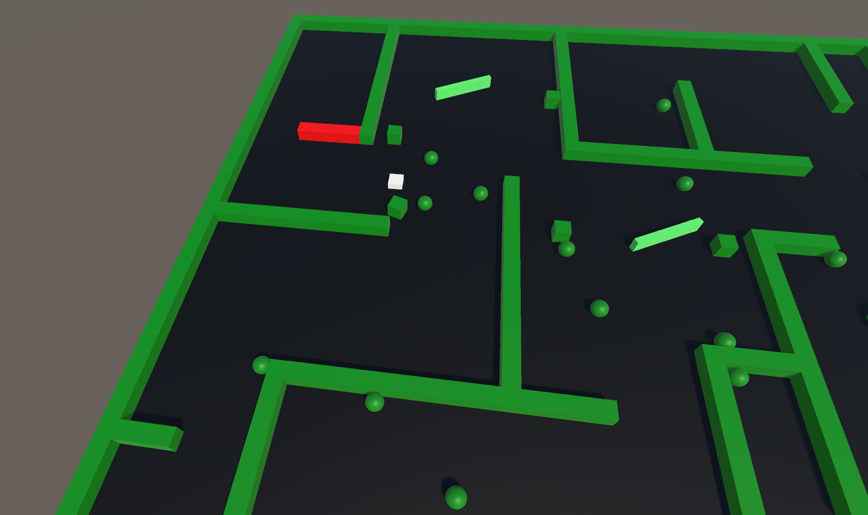
Game

Slide 6
Components used
CinemachineVirtualCamer
BoxCollider
Rigidbody
MeshCollider
SphereCollider

Slide 7
Thank you ….
If you have any questions please … dont ☺

