Slide 1
FINAL YEAR PROJECT DEFENCE
Enhancing Web-Based Recruitment for Efficient Candidate Selection Through Resume Screening
Searchera — an AI-assisted recruitment portal for HORAI Labs
RYAN MASHETI
SCT221-C004-0507/2022
Supervisor: Mr. Vincent Omwoma
Jomo Kenyatta University of Agriculture and Technology
School of Computing and Information Technology · B.Sc. Information Technology · August 2026

Slide 2
Presentation Outline
01
Introduction
background · problem · objectives
02
Literature Review
e-recruitment & AI screening
03
Research Methodology
design · SDLC · requirements
04
System Analysis & Design
architecture · data · pipeline
05
Implementation
stack · features · ranking engine
06
Evaluation & Results
testing · KPIs · bias monitoring
07
Conclusion & Recommendations
findings · limits · next steps
Searchera · Final Year Project
1

Slide 3
CHAPTER 1 · INTRODUCTION
Background
Recruitment is a core talent-acquisition function; digital transformation moved it from paper to the web.
E-recruitment widened reach — employers now receive hundreds to thousands of applications per role.
The persistent bottleneck is initial screening and shortlisting of candidates.
Manual review cannot scale with application volume, so time, cost and quality all suffer.
250–500
applications per corporate job posting
Bottleneck
Screening & shortlisting
the step that cannot scale manually
Searchera · Final Year Project
2

Slide 4
CHAPTER 1 · INTRODUCTION
Problem Statement
High application volume makes manual resume screening slow, time-consuming and inconsistent.
Recruiters fall back on keyword scans and quick visual checks — qualified candidates are missed.
Manual evaluation is prone to unconscious bias — confirmation, affinity, halo and anchoring.
Existing ATS tools handle administration, not intelligent evaluation; AI platforms are costly for SMEs.
Net effect: delayed hiring, higher costs, vacant roles and reduced fairness.
Searchera · Final Year Project
3

Slide 5
CHAPTER 1 · INTRODUCTION
Objectives
General objective Develop, implement and evaluate an AI-enhanced web recruitment system that improves the efficiency, accuracy and fairness of candidate screening.
Analysis & Research
Analyse existing systems and select suitable AI / NLP techniques for resume analysis.
Design
Design a scalable architecture integrating recruitment with AI-driven resume evaluation.
Implementation
Implement the system with a candidate-ranking algorithm and intuitive UI for seekers and recruiters.
Testing & Evaluation
Validate screening against manual methods and produce documentation and training materials.
Searchera · Final Year Project
4

Slide 6
CHAPTER 1 · INTRODUCTION
Significance & Scope
WHY IT MATTERS
IN SCOPE
Solves a universal operational problem across industries and organisation sizes.
Adds empirical evidence on AI/NLP in HR — a relatively underexplored area.
Supports fairer, less-biased hiring and the future-of-work shift to automation.
Full workflow: job posting → application → AI analysis → ranking.
Serves both job seekers and recruiters via a responsive web platform.
OUT OF SCOPE
No video interviews, personality or psychometric assessments.
No credential verification; no third-party job-board integration.
Text-based analysis only — visual resume design is not scored.
Searchera · Final Year Project
5

Slide 7
CHAPTER 2 · LITERATURE REVIEW
E-Recruitment Evolution
Traditional: newspapers, agencies — manual, slow, geographically limited (Barber, 1998).
1990s–2000s: job boards (Monster, CareerBuilder), then Applicant Tracking Systems (Parry & Tyson, 2008).
Today: integrated e-recruitment with analytics, mobile and automation.
AI in HR: recruitment is the most common AI use-case (Tambe et al., 2019).
Paper & print
Job boards
ATS platforms
AI screening
pre-1990
1995
2000s
today
The shift
From reach to volume —
then from volume to intelligence
Searchera · Final Year Project
6

Slide 8
CHAPTER 2 · LITERATURE REVIEW
AI & NLP for Resume Analysis
NER & parsing
Named-entity recognition extracts names, skills, dates and qualifications from unstructured resumes.
Semantic matching
Word embeddings recognise equivalence — “Python developer” ≈ “Python programmer”.
ML ranking
Supervised classifiers and ensembles rank candidates (Singh & Sharma, 2020).
Key risk
Model quality depends on training-data diversity; biased data can amplify discrimination.
Searchera · Final Year Project
7

Slide 9
CHAPTER 2 · LITERATURE REVIEW
Existing Solutions & the Gap
EXISTING TOOLS
THE GAP THIS PROJECT FILLS
LinkedIn Talent — sourcing and recommendation, not full screening.
HireVue — AI video interviews; validity and bias concerns.
Pymetrics — gamified assessments; not resume screening.
Textio — optimises job descriptions, not screening.
No single affordable platform combines full ATS with validated AI screening.
Explainability is under-addressed — most tools are “black boxes”.
Bias auditing is often missing from commercial tools.
SMEs are priced out of advanced platforms.
Searchera · Final Year Project
8

Slide 10
CHAPTER 3 · RESEARCH METHODOLOGY
Research Design
Mixed-methods: quantitative (screening accuracy, time, ranking consistency) + qualitative (user feedback).
Pragmatic paradigm — practical outcomes and problem-solving first.
Systematic flow: requirements → design → development → testing → evaluation.
Each stage informs the next; findings feed back into refinement.
QUANTITATIVE
Screening accuracy · processing time · ranking consistency
QUALITATIVE
User experience · trust · adoption factors
Searchera · Final Year Project
9

Slide 11
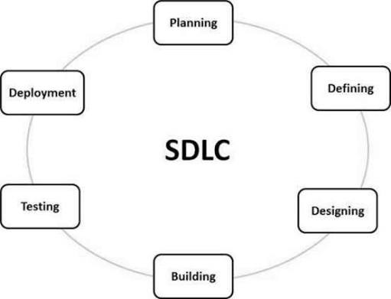
CHAPTER 3 · RESEARCH METHODOLOGY
Development Approach
Agile / Scrum methodology with two-week sprints and iterative refinement.
16-week plan across six phases — analysis → design → development → testing → deployment → evaluation.
Iteration: results feed back to tune the AI model and database.
Implementation phases (from project plan)
Searchera · Final Year Project
10

Slide 12
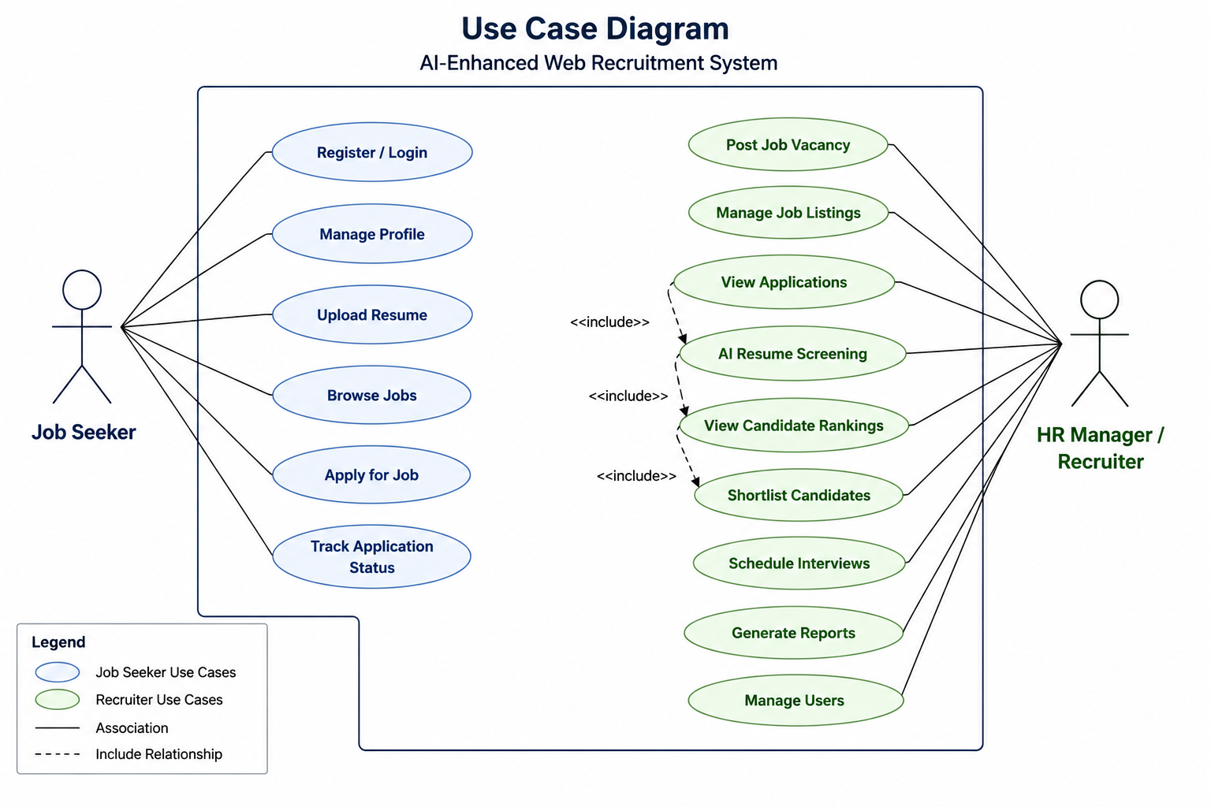
CHAPTER 3 · RESEARCH METHODOLOGY
Requirements & Use Cases
FUNCTIONAL
Accounts (seeker / recruiter / admin) · job posting
Resume upload + AI parsing · screening & ranking
Application tracking · notifications · reporting · search
NON-FUNCTIONAL
Screening ≤10s · UI load ≤3s
Security: HTTPS, bcrypt, RBAC (OWASP Top 10)
Privacy: DPA 2019 · availability 99.5% · WCAG 2.1 AA
Searchera · Final Year Project
Use case diagram
11

Slide 13
CHAPTER 3 · RESEARCH METHODOLOGY
Data Collection & Evaluation
Primary: structured interviews, questionnaires, observation of workflows.
Secondary: literature and security reports on existing platforms.
Comparative: same resumes screened manually vs AI, against an expert gold standard.
Statistical tests (t-tests, correlation) establish significance.
ETHICS
Informed consent
Confidentiality & anonymity
Voluntary participation
Departmental approval
Objectivity & data integrity
Searchera · Final Year Project
12

Slide 14
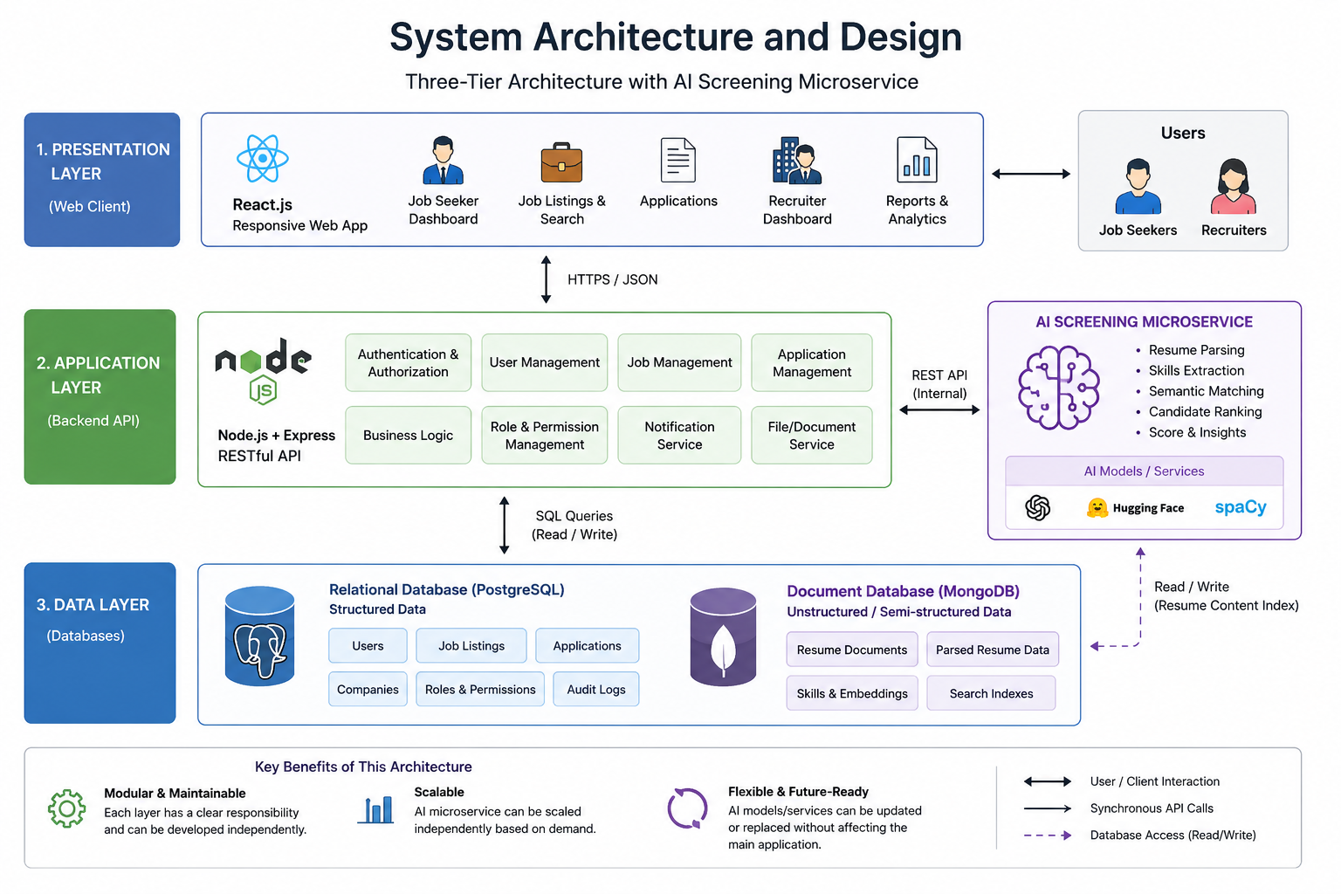
CHAPTER 4 · SYSTEM ANALYSIS & DESIGN
System Architecture
Three-tier web application, with a screening module layered in.
Presentation — React single-page app (seeker + recruiter UIs).
Application — Node.js / Express REST API (auth, business logic).
Data — SQLite via sql.js (WASM), persisted to file.
AI screening — OpenAI (gpt-4o-mini) with a deterministic heuristic fallback.
System architecture diagram
Searchera · Final Year Project
13

Slide 15
CHAPTER 4 · SYSTEM ANALYSIS & DESIGN
Database Design
users
accounts · roles (Seeker / Employer / Admin)
companies
employer profiles, industry, ratings
jobs
postings: title, description, type, salary, deadline
applications
status · match_score · fit_tier · screening_json
cvs
uploaded file + AI analysis_json
notifications
user alerts · read state
interview_sessions
questions · answers · score
SQLite (sql.js / WASM) · bcrypt password hashing · schema normalised with foreign keys
Searchera · Final Year Project
14

Slide 16
CHAPTER 4 · SYSTEM ANALYSIS & DESIGN
AI Screening Pipeline
1
2
3
4
5
CV ingestion
Skill extraction
Scoring
Ranking
Explainability
PDF / DOCX / TXT
upload & text extraction
Job requirements +
candidate profile / CV
Heuristic overlap,
OpenAI enhancement
Match score 0–100
+ 5 fit tiers
Strengths · gaps ·
skill-match matrix
Dual-mode: heuristic scoring always runs — the LLM refines it when an API key is configured.
FIT TIERS
Excellent ≥85 · Strong ≥70 · Moderate ≥55 · Weak ≥40 · Poor <40
Searchera · Final Year Project
15

Slide 17
CHAPTER 5 · IMPLEMENTATION
Technology Stack
Frontend
React 19 · Vite 7 · Tailwind CSS 4 · React Router 7 · lucide-react
Backend
Node.js 20 · Express 5 · JWT + bcrypt · multer uploads
Data
SQLite via sql.js (WASM) — persisted to searchera.sqlite
AI
OpenAI gpt-4o-mini (optional Grok) + deterministic heuristic fallback
Parsing
pdf-parse for PDF CV text extraction
Searchera · Final Year Project
Runs without an API key — screening falls back to local heuristics, so the demo works fully offline.
16

Slide 18
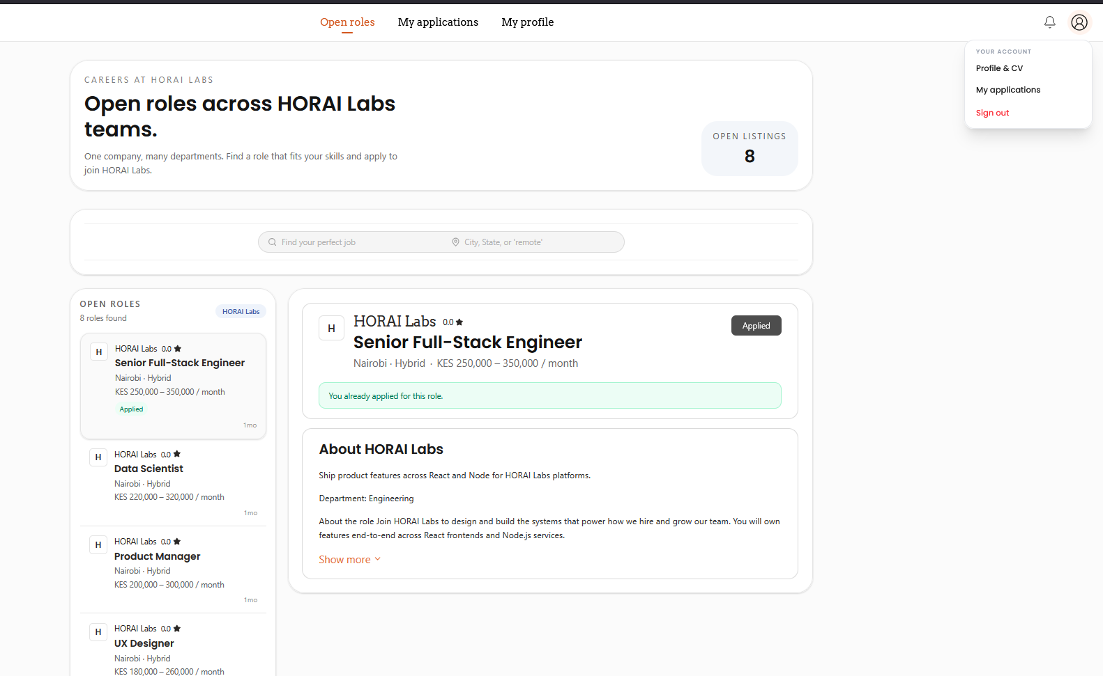
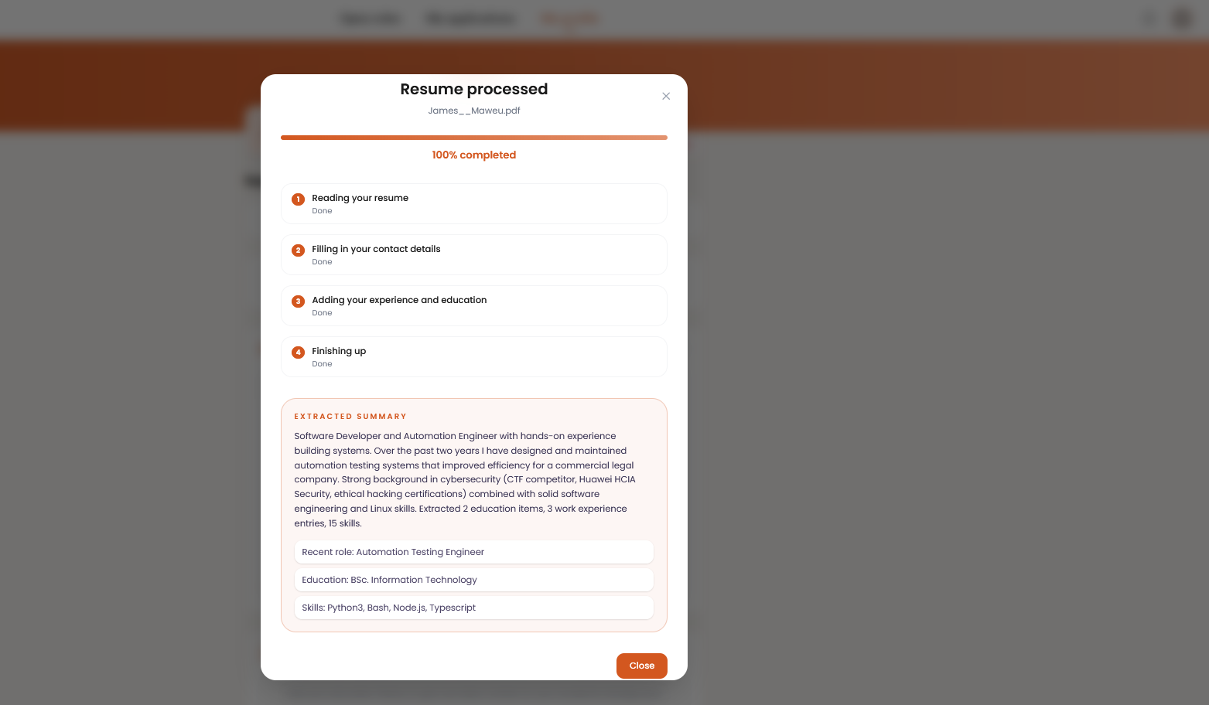
CHAPTER 5 · IMPLEMENTATION
Job Seeker Portal
Browse and search jobs with filters; view details and apply.
Profile + CV upload with AI parsing (auto-fills headline, skills, experience).
Track application status and receive notifications.
Job listings & search
Resume upload & AI parse
Searchera · Final Year Project
17

Slide 19
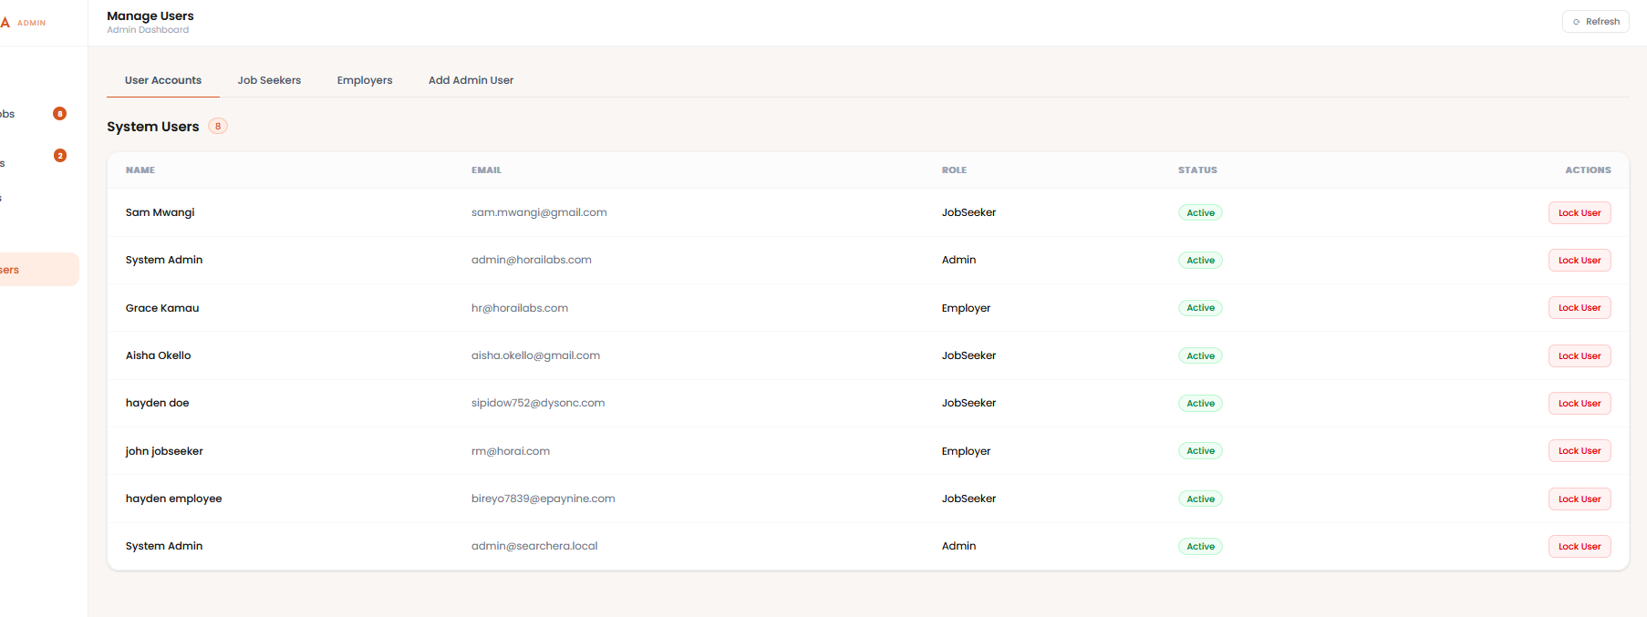
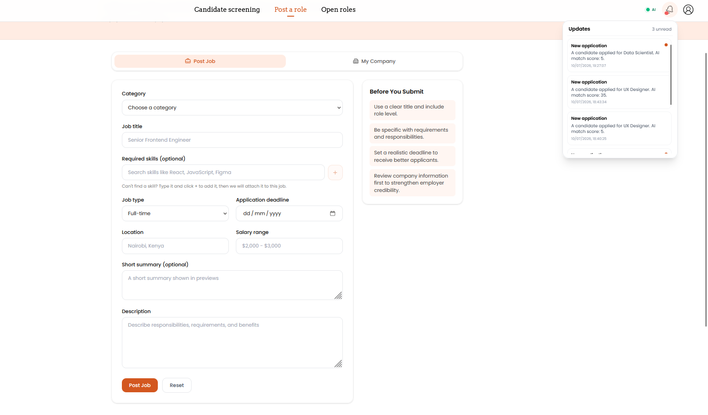
CHAPTER 5 · IMPLEMENTATION
Employer & Admin Desk
Post and manage jobs; review applications end-to-end.
Ranked shortlist with match scores, tiers and explanations.
Accept / reject with comments; notifications to candidates.
Admin: user management, analytics, system oversight.
Admin dashboard
Job posting form
Searchera · Final Year Project
18

Slide 20
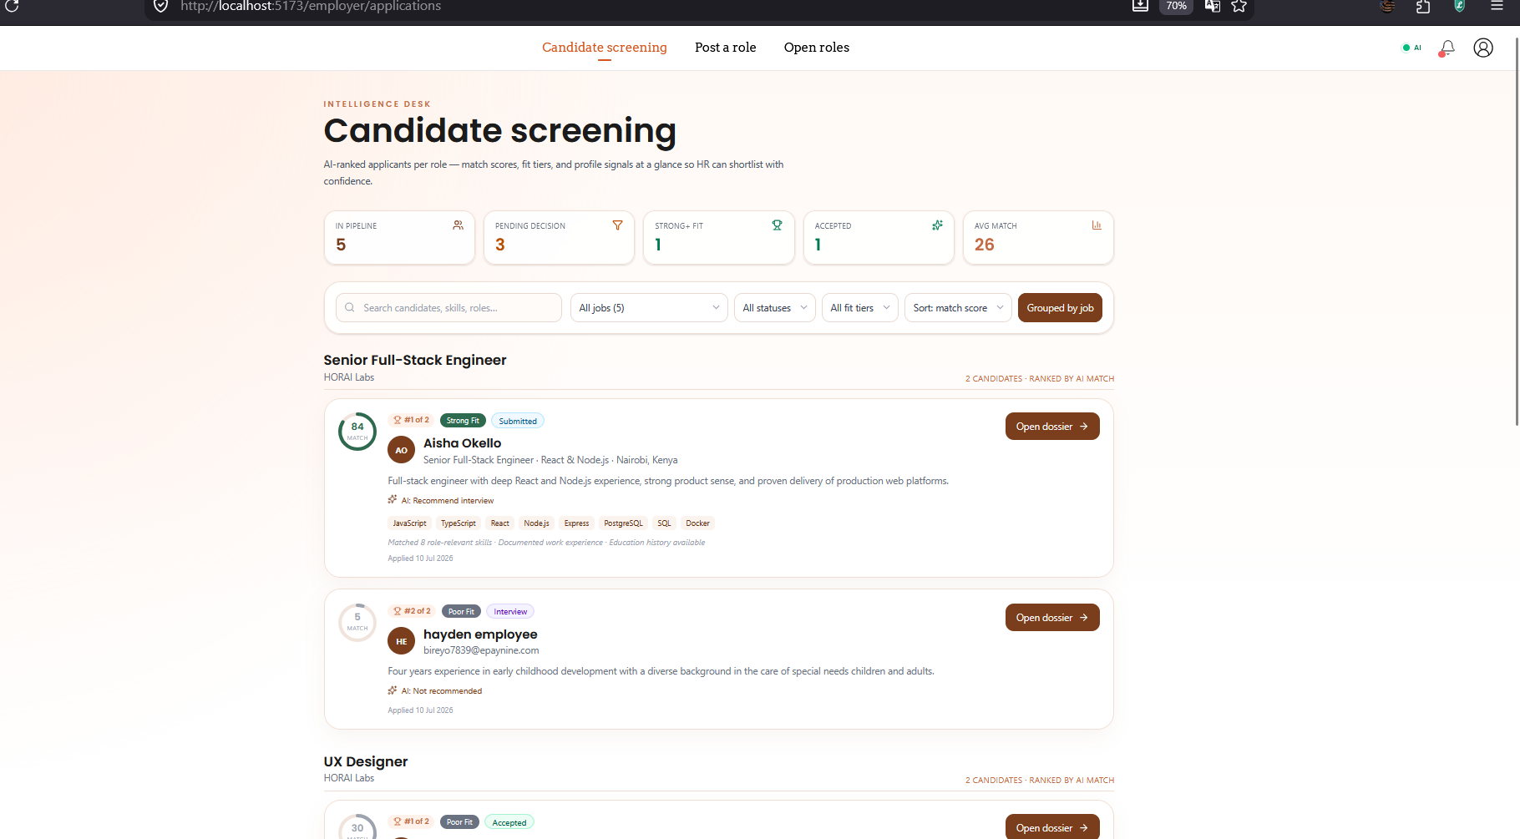
CHAPTER 5 · IMPLEMENTATION
AI Screening & Ranking
Deterministic heuristic always runs: skill-overlap scoring + profile completeness.
OpenAI enhances when configured — fair, specific, concise scoring.
Output: match score 0–100, fit tier, recommendation, strengths and gaps.
AI-ranked candidate shortlist
Searchera · Final Year Project
19

Slide 21
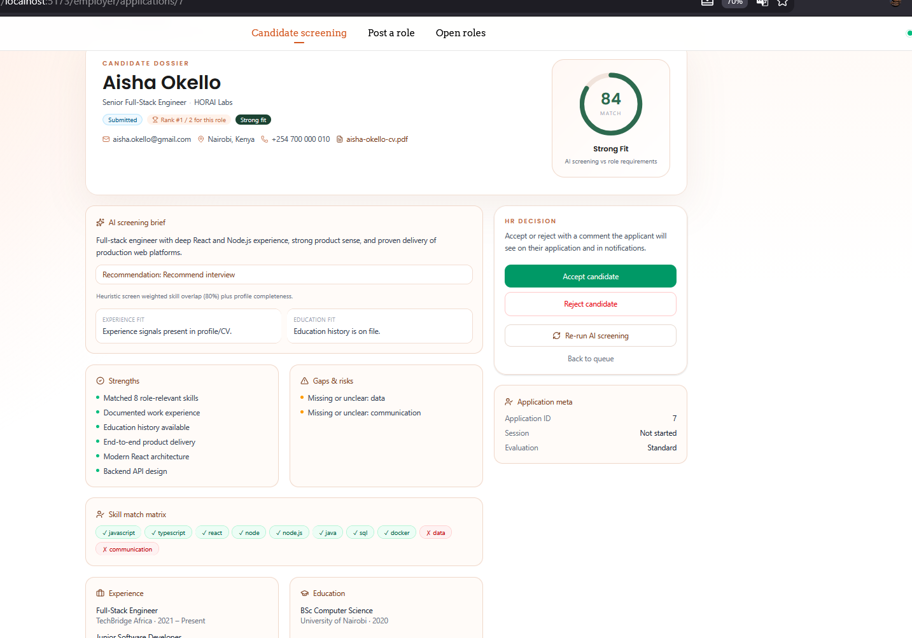
CHAPTER 5 · IMPLEMENTATION
Explainable Screening
Every ranking is justified: strengths, gaps and a per-skill match matrix.
Recruiters see which requirements are met vs not met.
Reasoning + experience/education fit — supports audit and compliance.
Transparency builds trust in AI-assisted decisions.
Explainability detail view
Searchera · Final Year Project
20

Slide 22
CHAPTER 6 · EVALUATION & RESULTS
Testing Strategy
Unit
Modules in isolation — resume parser, scorer, auth.
Integration
API ↔ screening service; data flows between tiers.
System
End-to-end scenarios against the requirements spec.
UAT
Recruiters and seekers validate real-world workflows.
AI validation
Precision, recall, F1 vs human expert judgement.
Searchera · Final Year Project
21

Slide 23
CHAPTER 6 · EVALUATION & RESULTS
Key Performance Indicators
Screening time reduction
60% decrease
before vs after implementation
Candidate ranking accuracy
85% precision
recruiter feedback on top-10
Resume parsing accuracy
90% extraction
manual verification of fields
False positive rate
< 15%
high-ranked candidates rejected
User satisfaction
4.0 / 5.0
post-usage Likert survey
System uptime
99.5%
monitoring dashboard
Targets defined in the project plan — to be measured during UAT and comparative evaluation.
Searchera · Final Year Project
22

Slide 24
CHAPTER 6 · EVALUATION & RESULTS
Bias Monitoring & Fairness
Analyse screening outcomes across demographic groups to detect disparities.
Audit training data for historical bias and mitigate it.
Provide transparent explanations so humans can review and correct.
Refine the NLP pipeline when mis-parsing or bias is discovered.
DESIGN PRINCIPLE
AI ranks on
qualifications —
not demographics.
Searchera · Final Year Project
23

Slide 25
CHAPTER 7 · CONCLUSION & RECOMMENDATIONS
Conclusion
Delivered a working AI-assisted recruitment portal — Searchera.
Automates the full loop: CV upload → parsing → screening → explainable ranking.
Dual-mode AI (OpenAI + heuristic) keeps it affordable and usable offline.
Directly targets the screening bottleneck, unconscious bias and SME accessibility.
Automated
Explainable
Affordable
screening end-to-end
every ranking decision
runs offline / no key
Searchera · Final Year Project
24

Slide 26
CHAPTER 7 · CONCLUSION & RECOMMENDATIONS
Limitations
Quantitative UAT results are pending — KPI targets are defined, not yet measured.
SQLite (sql.js) used instead of the proposed PostgreSQL — fine for demo / single-node scale.
Heuristic fallback is not deep NLP (no fine-tuned transformer); deep analysis needs the API key.
No credential verification; English-only text analysis.
No third-party job-board or social-media integrations.
Searchera · Final Year Project
25

Slide 27
CHAPTER 7 · CONCLUSION & RECOMMENDATIONS
Recommendations
01
Integrate external job boards (LinkedIn, BrighterMonday, Fuzu).
02
Add resume and credential verification.
03
Introduce video interviews and psychometrics.
04
Continuous model learning from recruiter decisions.
05
Multilingual NLP (e.g. Swahili).
06
Strengthened bias auditing and fairness metrics.
07
Companion mobile application.
08
Predictive analytics for hiring outcomes.
Searchera · Final Year Project
26

Slide 28
Thank You
Questions & Discussion
Enhancing Web-Based Recruitment for Efficient Candidate Selection Through Resume Screening
Ryan Masheti · SCT221-C004-0507/2022 · JKUAT SCIT

