Slide 1
Dictionary
L9,10 and 11

Slide 2
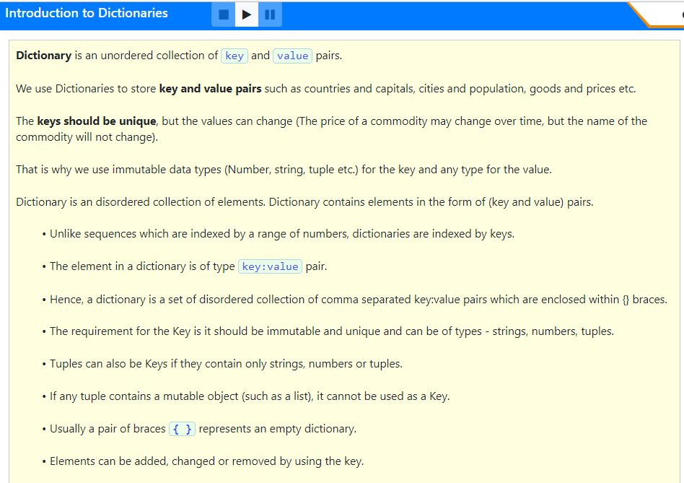

Slide 3
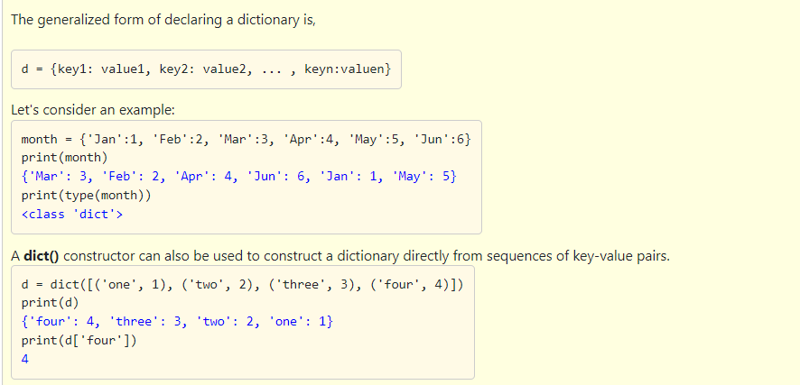

Slide 4
Which of the following option is correct?
The keys in a dictionary can be mutable.
The values in a dictionary have to be immutable.
A dictionary is collection of disordered elements and each element is in the form a Key and a Value pair.
A tuple can be a key, if they only contain strings, numbers and lists.
The dict() function is used to construct a dictionary.
1,2,3
3 and 4
3 and 5
4 and 5

Slide 5
Which of the following option is correct?
The keys in a dictionary can be mutable.
The values in a dictionary have to be immutable.
A dictionary is collection of disordered elements and each element is in the form a Key and a Value pair.
A tuple can be a key, if they only contain strings, numbers and lists.
The dict() function is used to construct a dictionary.
1,2,3
3 and 4
3 and 5
4 and 5

Slide 6
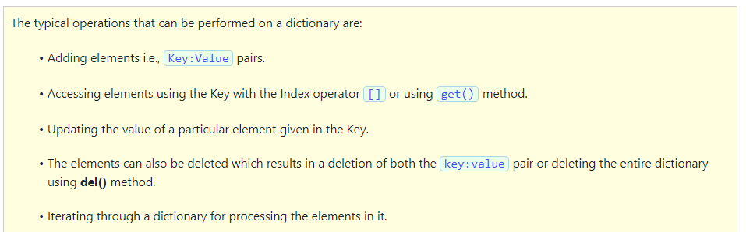

Slide 7
Which of the following option is correct?
The elements in a dictionary can be either keys or values but not both.
The indexing operator [] is used to access a key using the value as the parameter inside the indexing operator.
A value in a dictionary can be updated using the indexing operator along with the key.
A For loop is used to iterate the elements of a dictionary.
Deleting an element in a dictionary only deletes the value but not the key.
1,2,3
3 and 4
4 and 5
2 and 3

Slide 8
Which of the following option is correct?
The elements in a dictionary can be either keys or values but not both.
The indexing operator [] is used to access a key using the value as the parameter inside the indexing operator.
A value in a dictionary can be updated using the indexing operator along with the key.
A For loop is used to iterate the elements of a dictionary.
Deleting an element in a dictionary only deletes the value but not the key.
1,2,3
3 and 4
4 and 5
2 and 3

Slide 9
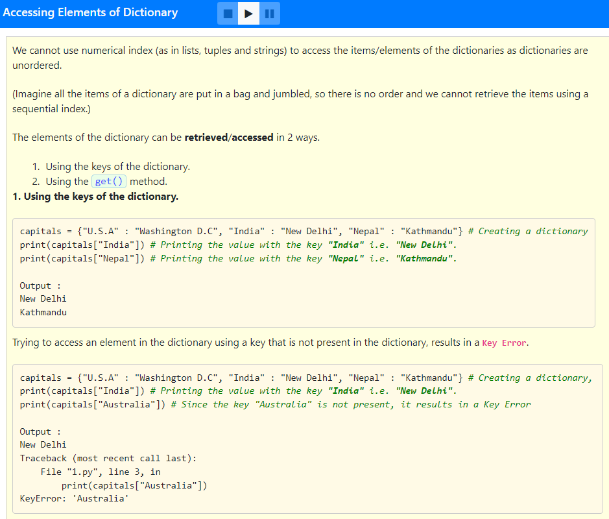

Slide 10
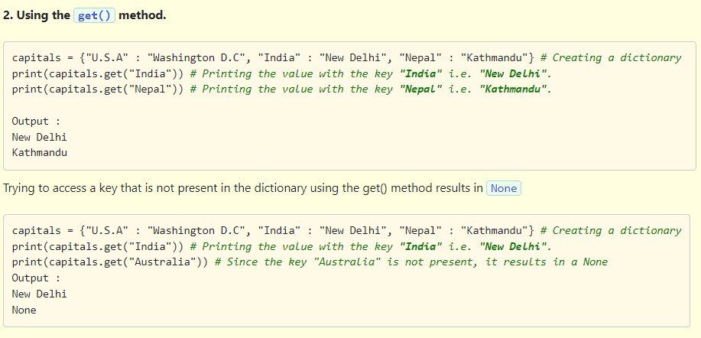

Slide 11
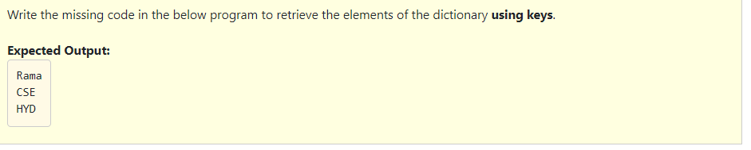
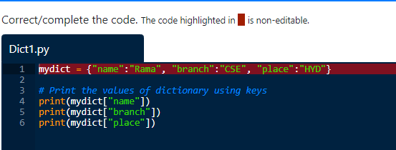

Slide 12
mydict = {"name":"Rama", "branch":"CSE", "place":"HYD"}
print(mydict['name'])
print(mydict['branch'])
print(mydict['place'])

Slide 13
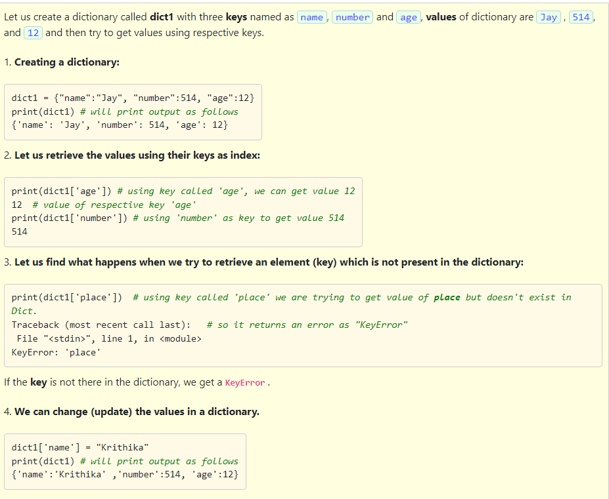

Slide 14
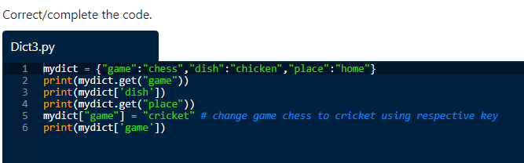
Identify the errors in below program and correct the program:

Slide 15
Solution(Correct Code):
mydict = {"game":"chess","dish":"chicken","place":"home"}
print(mydict.get('game'))
print(mydict['dish'])
print(mydict.get('place'))
mydict['game'] = "cricket"
print(mydict['game'])

Slide 16
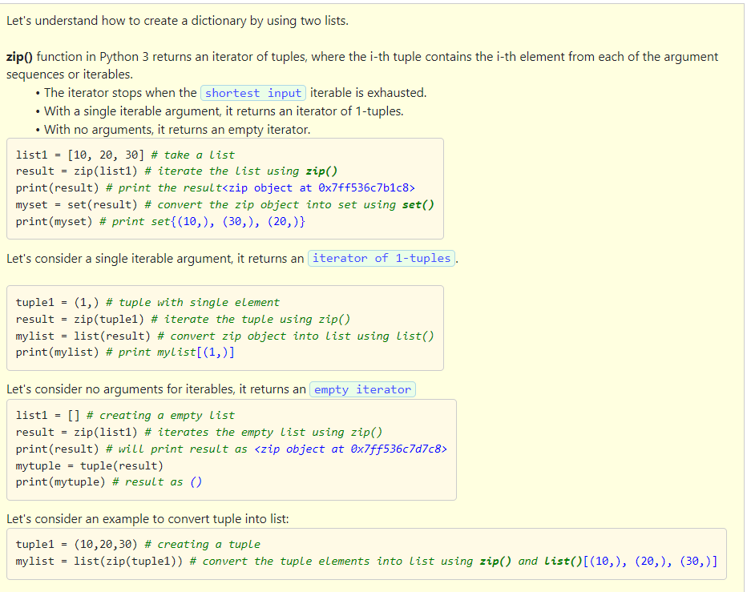

Slide 17
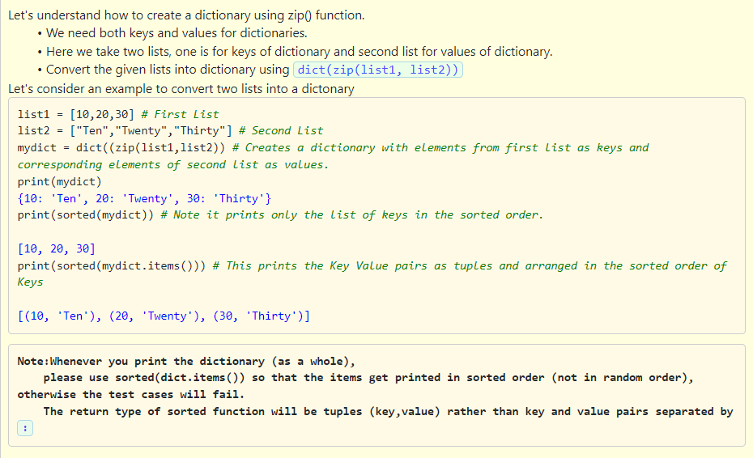

Slide 18
Which of the following option is correct?
In Python 3 zip() function returns an iterator of tuples true or false?
If there is no arguments zip() function returns an empty iterator.
While creating dictionaries we need only keys.
sorted(dict.items()) function prints the arguments in sorted order.
1,2 and 3
2 and 4
1,2 and 4
3 and 4

Slide 19
Which of the following option is correct?
In Python 3 zip() function returns an iterator of tuples true or false?
If there is no arguments zip() function returns an empty iterator.
While creating dictionaries we need only keys.
sorted(dict.items()) function prints the arguments in sorted order.
1,2 and 3
2 and 4
1,2 and 4
3 and 4

Slide 20
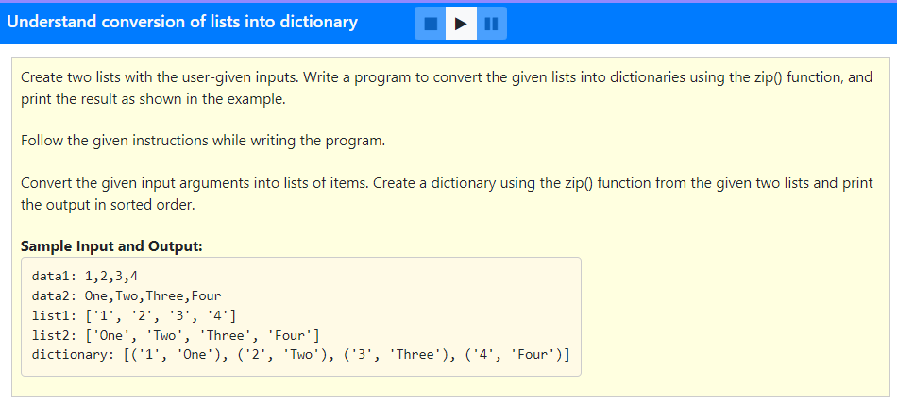

Slide 21
data1 = input("data1: ")
data2 = input("data2: ")
list1 = data1.split(",")
list2 = data2.split(",")
mydict = dict(zip(list1, list2))
print("list1:", list1)
print("list2:", list2)
print("dictionary:", sorted(mydict.items()))

Slide 22
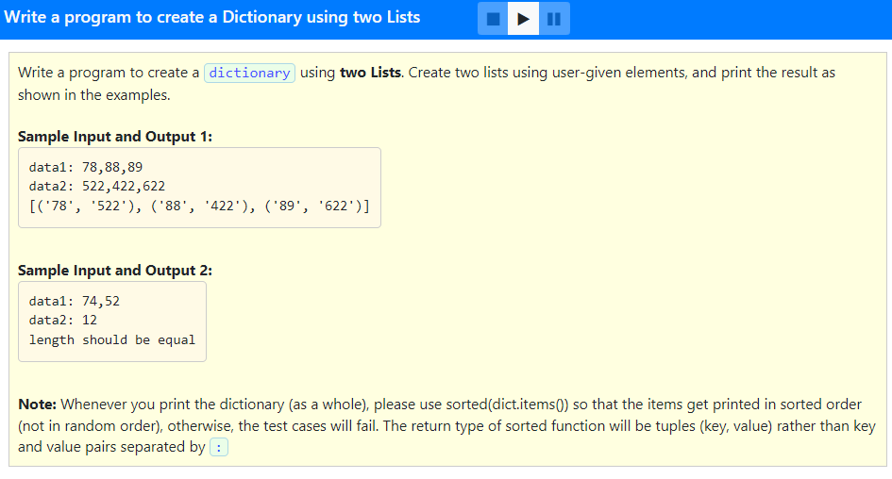

Slide 23
#Program to create a dictionary from 2 lists
data1 = input("data1: ")
data2 = input("data2: ")
L1 = data1.split(",")
L2 = data2.split(",")
d1 = {}
if(len(L1) == len(L2)):
for i in range(len(L1)):
d1[L1[i]] = L2[i]
print(sorted(d1.items()))
else:
print("length should be equal")

Slide 24
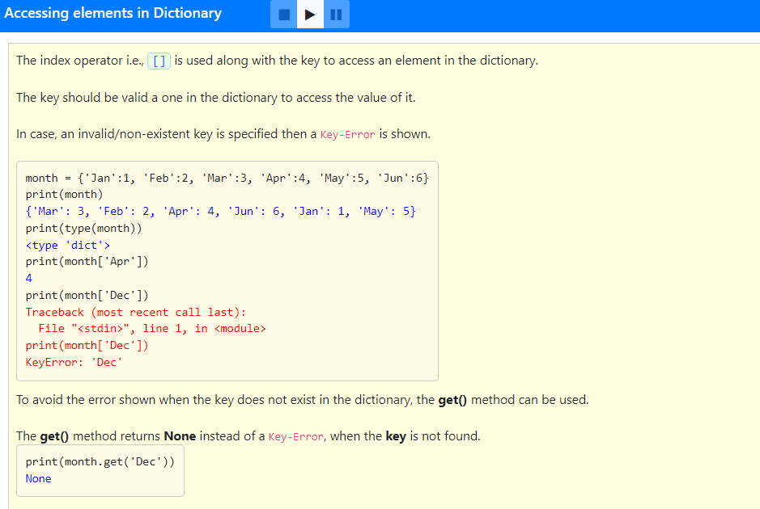

Slide 25
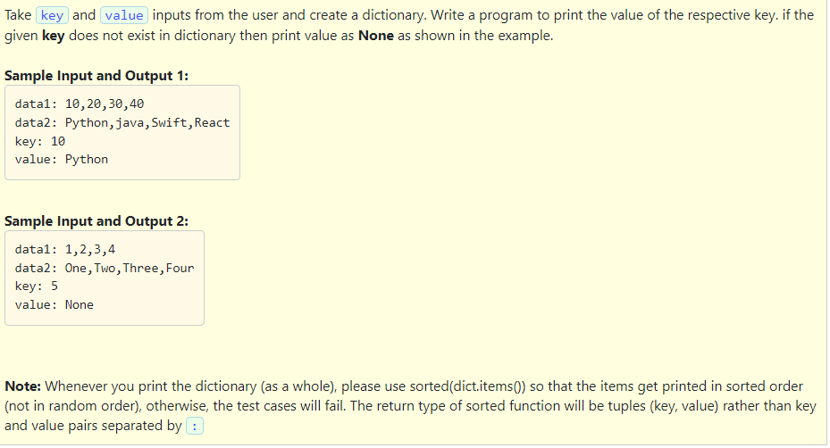

Slide 26
data1 = input("data1: ")
data2 = input("data2: ")
list1 = data1.split(",")
list2 = data2.split(",")
dict1 = dict(zip(list1, list2))
key = input("key: ")
if key in dict1:
print("value:", dict1[key])
else:
print("value:", dict1.get(key,"None"))

Slide 27
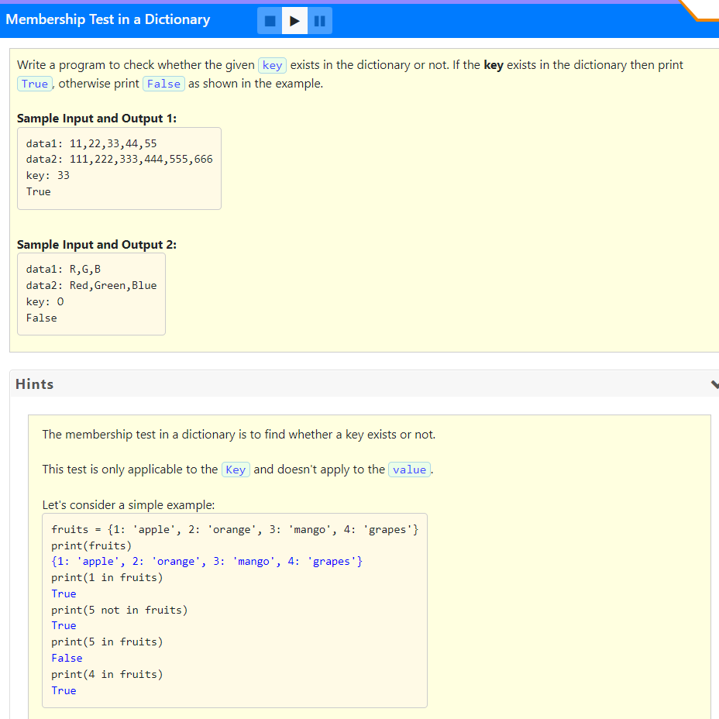

Slide 28
data1 = input("data1: ")
data2 = input("data2: ")
list1 = data1.split(",")
list2 = data2.split(",")
dict1 = dict(zip(list1, list2))
key = input("key: ")
#print("Dictionary:", sorted(dict1.items()))
if key in dict1:
print("True")
else:
print("False")

Slide 29
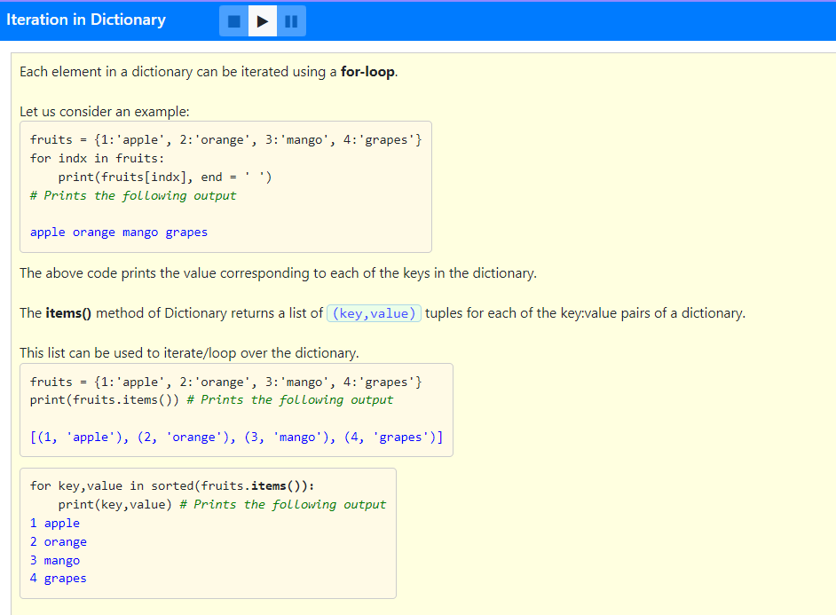

Slide 30
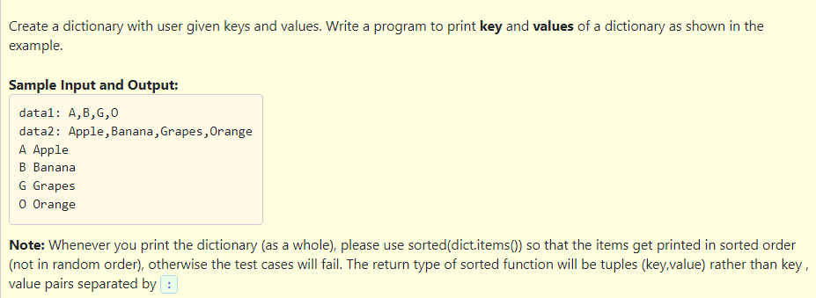

Slide 31
data1 = input("data1: ")
data2 = input("data2: ")
list1 = data1.split(",")
list2 = data2.split(",")
dict1 = dict(zip(list1, list2))
for key, value in sorted(dict1.items()):
print(key, value)

Slide 32
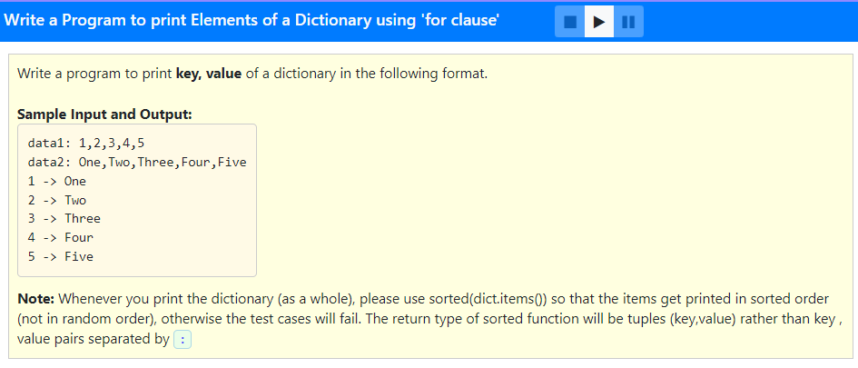

Slide 33
data1 = input("data1: ")
data2 = input("data2: ")
list1 = data1.split(",")
list2 = data2.split(",")
dict1 = dict(zip(list1, list2))
for key, value in sorted(dict1.items()):
print(key, '->', value)

Slide 34
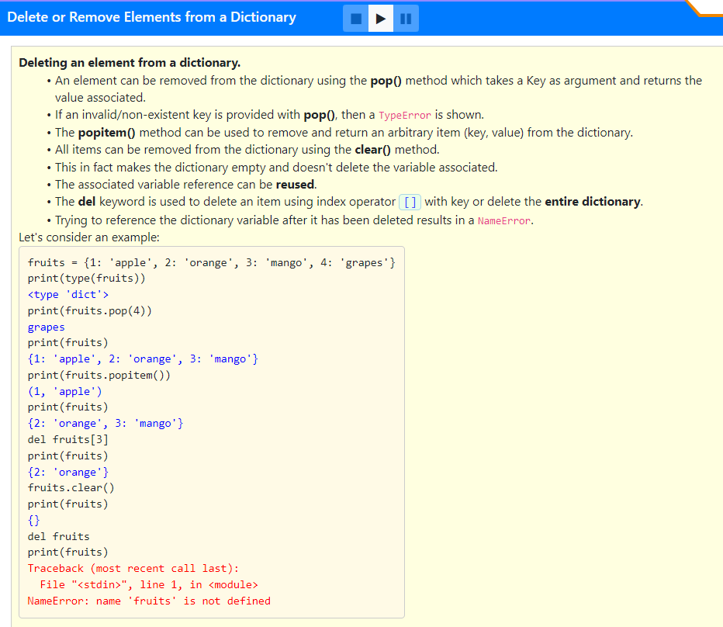

Slide 35
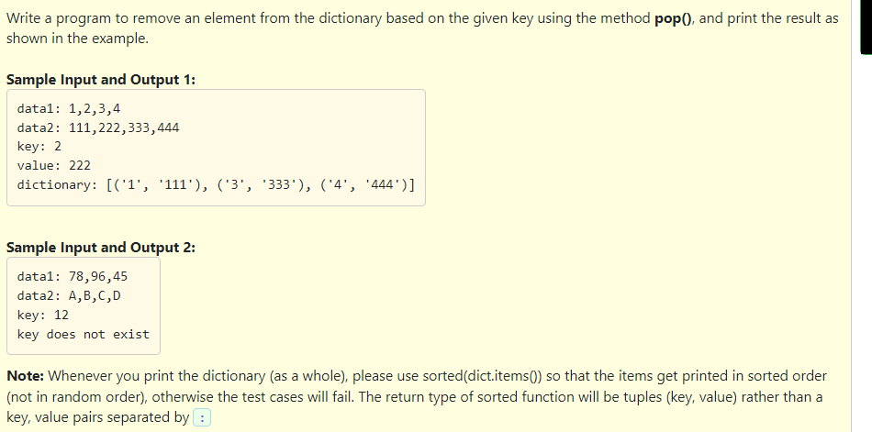

Slide 36
Solution:
data1 = input("data1: ")
data2 = input("data2: ")
list1 = data1.split(",")
list2 = data2.split(",")
dict1 = dict(zip(list1, list2))
key = input("key: ")
if key in dict1:
print("value:", dict1.pop(key))
sorted_dict = sorted(dict1.items())
print("dictionary:", sorted_dict)
else:
print("key does not exist")

Slide 37
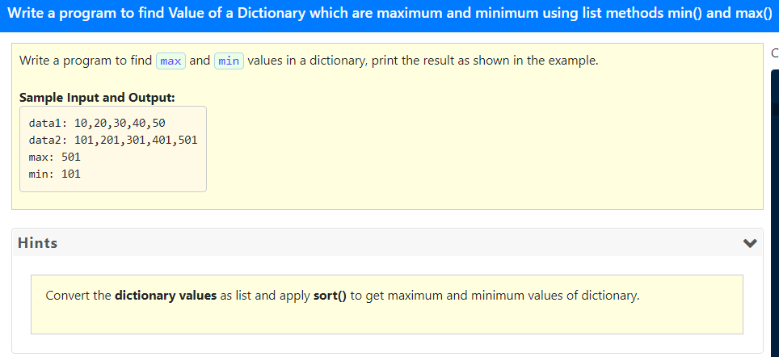
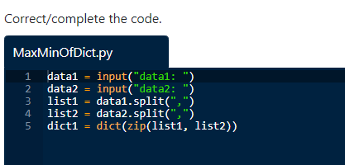

Slide 38
data1 = input("data1: ")
data2 = input("data2: ")
list1 = data1.split(",")
list2 = data2.split(",")
dict1 = dict(zip(list1, list2))
l1 = []
for key in dict1:
l1.append(dict1[key])
l1.sort()
print("max:", l1[-1])
print("min:", l1[0])

Slide 39
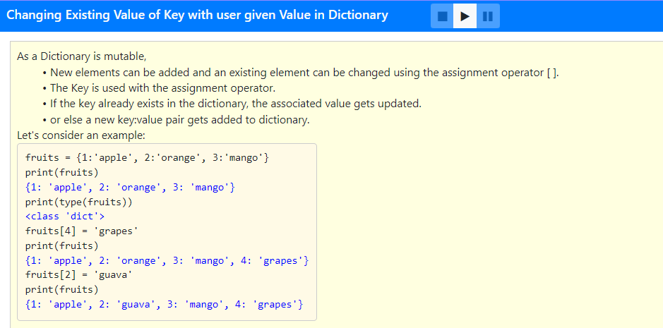

Slide 40
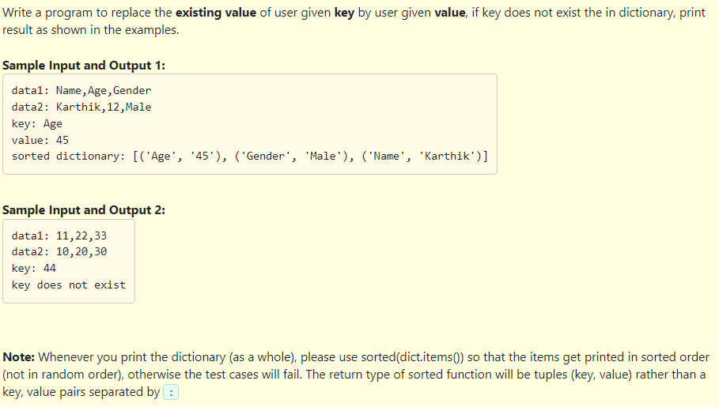

Slide 41
data1 = input("data1: ")
data2 = input("data2: ")
list1 = data1.split(",")
list2 = data2.split(",")
dict1 = dict(zip(list1, list2))
key = input("key: ")
if key in dict1:
val = input("value: ")
dict1[key] = val
print("sorted dictionary:", sorted(dict1.items()))
else:
print("key does not exist")

Slide 42
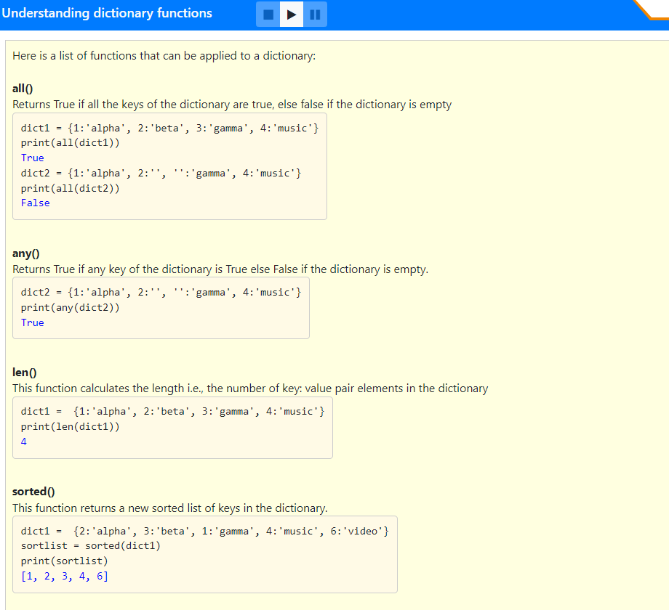

Slide 43
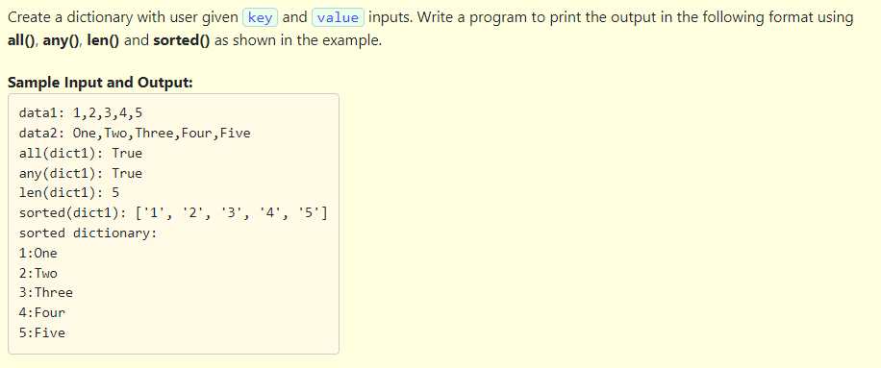

Slide 44
data1 = input("data1: ")
data2 = input("data2: ")
list1 = data1.split(",")
list2 = data2.split(",")
dict1 = dict(zip(list1, list2))
print("all(dict1):", all(dict1))
print("any(dict1):", any(dict1))
print("len(dict1):", len(dict1))
print("sorted(dict1):", sorted(dict1))
print("key,value of dictionary: ")
for key in sorted(dict1):
print("%s:%s" %(key, dict1[key]))

Slide 45
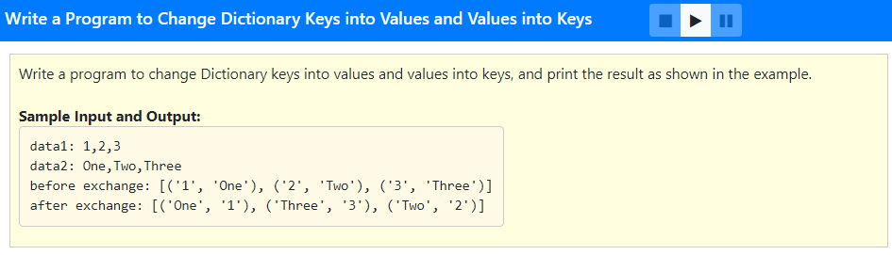

Slide 46
data1 = input("data1: ")
data2 = input("data2: ")
list1 = data1.split(",")
list2 = data2.split(",")
dict1 = dict(zip(list1, list2))
d3 = dict()
for key in dict1:
d3[dict1[key]] = key
print("before exchange:", sorted(dict1.items()))
print("after exchange:", sorted(d3.items()))

Slide 47
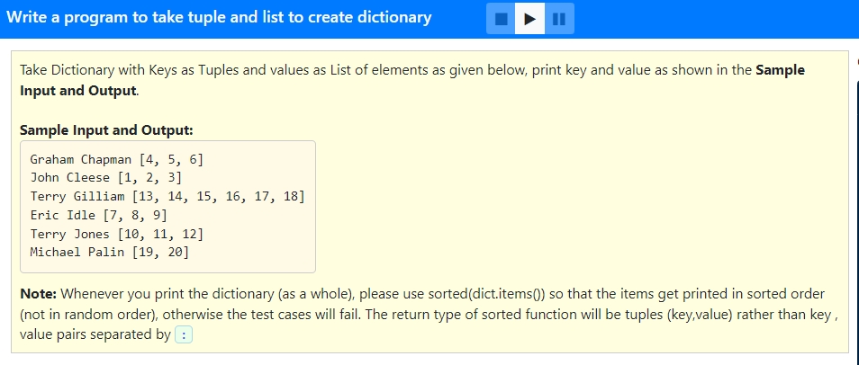
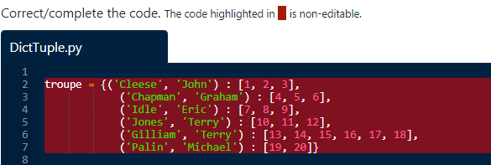

Slide 48
troupe = {('Cleese', 'John') : [1, 2, 3],
('Chapman', 'Graham') : [4, 5, 6],
('Idle', 'Eric') : [7, 8, 9],
('Jones', 'Terry') : [10, 11, 12],
('Gilliam', 'Terry') : [13, 14, 15, 16, 17, 18],
('Palin', 'Michael') : [19, 20]}
for last, first in sorted(troupe): # for key in dict
print (first, last, troupe[last, first])

Slide 49
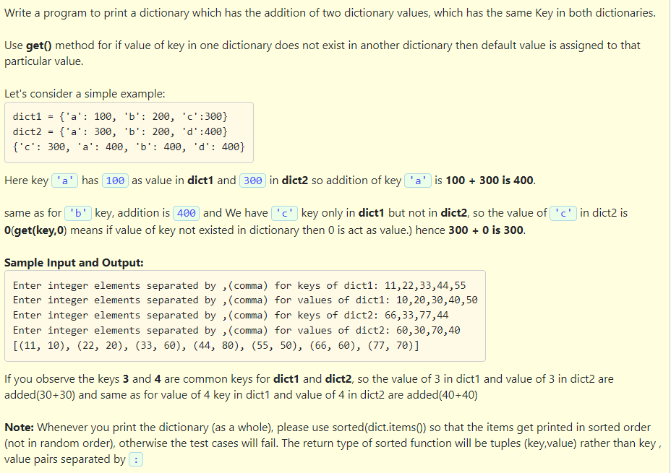

Slide 50
#Program to combine two dictionaries
data1 = input("Enter integer elements separated by ,(comma) for keys of dict1: ")
data2 = input("Enter integer elements separated by ,(comma) for values of dict1: ")
list1 = data1.split(",")
list2 = data2.split(",")
for i in range(len(list1)):
list1[i] = int(list1[i])
for i in range(len(list2)):
list2[i] = int(list2[i])
dict1 = dict(zip(list1, list2))
data3 = input("Enter integer elements separated by ,(comma) for keys of dict2: ")
data4 = input("Enter integer elements separated by ,(comma) for values of dict2: ")
list3 = data3.split(",")
list4 = data4.split(",")
for i in range(len(list3)):
list3[i] = int(list3[i])
for i in range(len(list4)):
list4[i] = int(list4[i])
dict2 = dict(zip(list3, list4))
dict3 = {}
for key in (list(dict1.keys()) + list(dict2.keys())):
dict3[key] = dict1.get(key, 0) + dict2.get(key, 0)
print(sorted(dict3.items()))

Slide 51
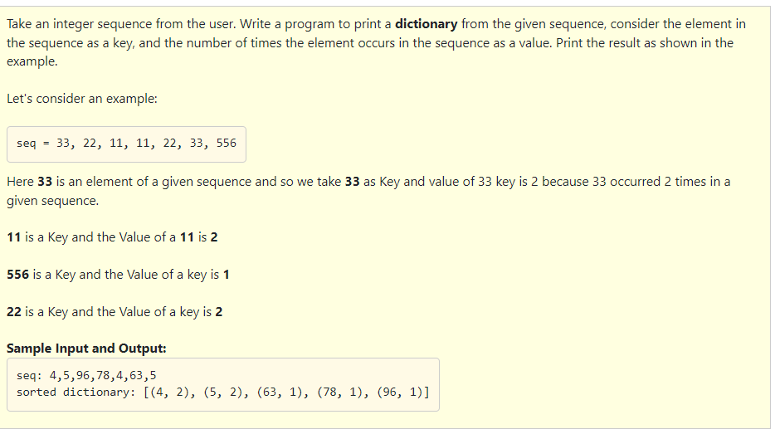

Slide 52
#Program to create dictionary of items and occurences
seq = input("seq: ")
list1 = seq.split(",")
for i in range(len(list1)):
list1[i] = int(list1[i])
tuple1 = tuple(list1)
d = dict()
for element in tuple1:
if element not in d:
d[element] = 1
else:
d[element] += 1
print("sorted dictionary:", sorted(d.items()))

Slide 53
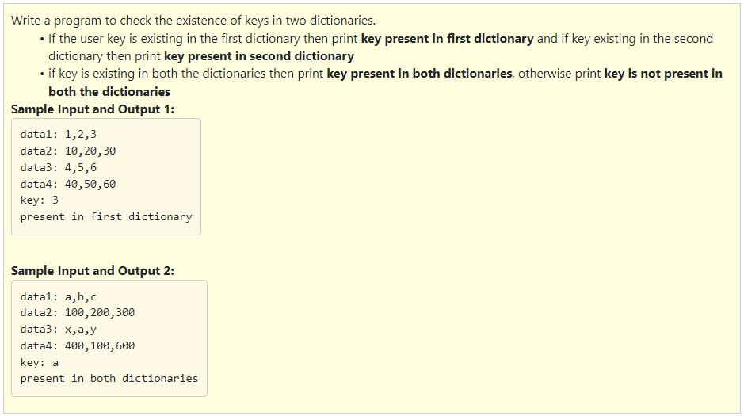

Slide 54
#Program to check the existence of a key in 2 dictionaries
data1 = input("data1: ")
data2 = input("data2: ")
list1 = data1.split(",")
list2 = data2.split(",")
dict1 = dict(zip(list1, list2))
data3 = input("data3: ")
data4 = input("data4: ")
list3 = data3.split(",")
list4 = data4.split(",")
dict2 = dict(zip(list3, list4))
kv = input("key: ")
if(kv in dict1.keys() and kv in dict2.keys()):
print("key present in both dictionaries")
elif(kv in dict1.keys()):
print("key present in first dictionary")
elif(kv in dict2.keys()):
print("key present in second dictionary")
else:
print("key is not present")

Slide 55
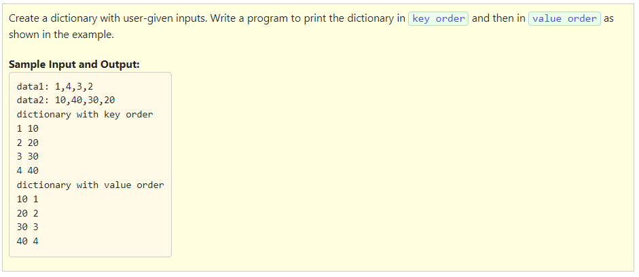

Slide 56
a = input("data1: ")
b = input("data2: ")
a = a.split(',')
b = b.split(',')
d = dict(zip(a,b))
print("dictionary with key order")
for key,value in sorted(d.items()):
print(key,value)
f = dict(zip(b,a))
print("dictionary with value order")
for key,value in sorted(f.items()):
print(key,value)

Slide 57
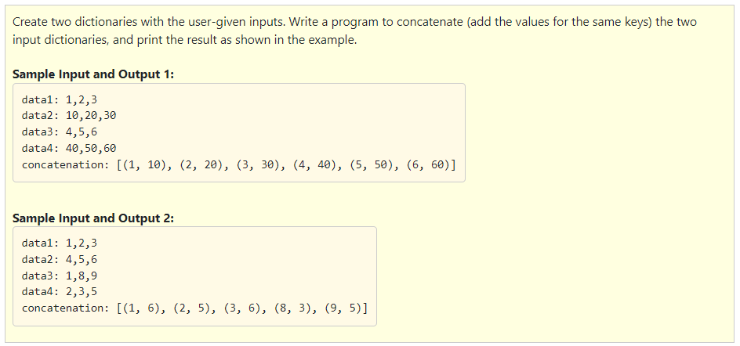

Slide 58
data1 = input("data1: ")
data2 = input("data2: ")
list1 = data1.split(",")
list2 = data2.split(",")
for i in range(len(list1)):
list1[i] = int(list1[i])
for i in range(len(list2)):
list2[i] = int(list2[i])
dict1 = dict(zip(list1, list2))
data3 = input("data3: ")
data4 = input("data4: ")
list3 = data3.split(",")
list4 = data4.split(",")
for i in range(len(list3)):
list3[i] = int(list3[i])
for i in range(len(list4)):
list4[i] = int(list4[i])
dict2 = dict(zip(list3, list4))
dicr = {}
for key in (list(dict1.keys()) + list(dict2.keys())):
x = dict1.get(key, 0)
y = dict2.get(key, 0)
dicr[key] = x + y
print("concatenation:", sorted(dicr.items()))

Slide 59
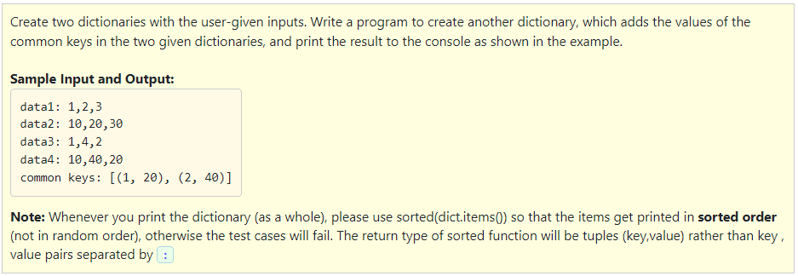

Slide 60
#Program to combine common items of two dictionaries
data1 = input("data1: ")
data2 = input("data2: ")
list1 = data1.split(",")
list2 = data2.split(",")
for i in range(len(list1)):
list1[i] = int(list1[i])
for i in range(len(list2)):
list2[i] = int(list2[i])
dict1 = dict(zip(list1, list2))
data3 = input("data3: ")
data4 = input("data4: ")
list3 = data3.split(",")
list4 = data4.split(",")
for i in range(len(list3)):
list3[i] = int(list3[i])
for i in range(len(list4)):
list4[i] = int(list4[i])
dict2 = dict(zip(list3, list4))
dict3 = {}
keys1 = list(dict1.keys())
keys2 = list(dict2.keys())
for x, y in [(x, y) for x in keys1 for y in keys2]:
if x == y:
dict3[x] = dict1[x] + dict2[y]
print("common keys:", sorted(dict3.items()))

Slide 61
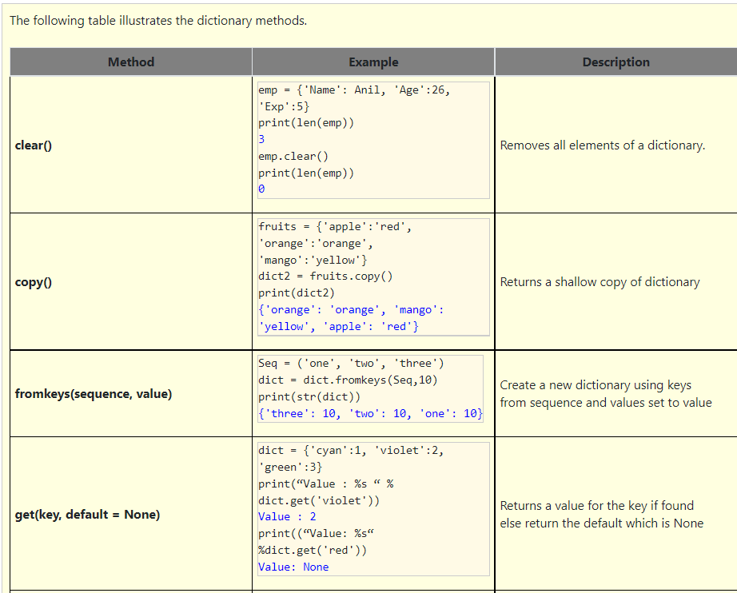
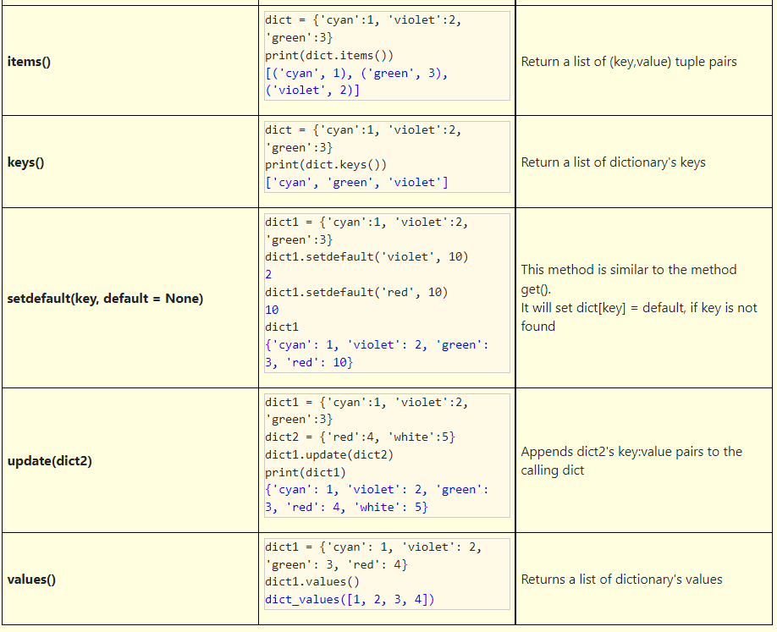

Slide 62
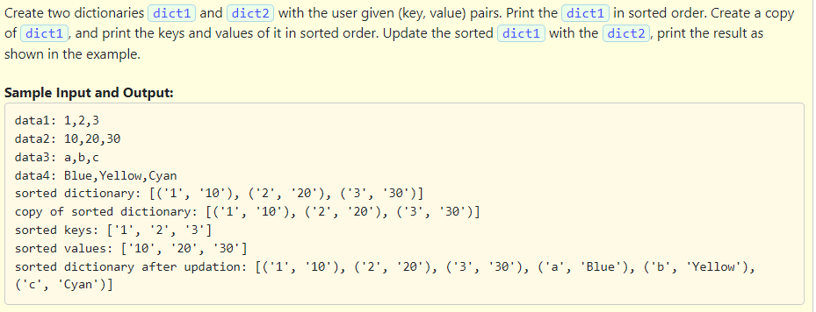

Slide 63
data1 = input("data1: ")
data2 = input("data2: ")
list1 = data1.split(",")
list2 = data2.split(",")
dict1 = dict(zip(list1, list2))
data3 = input("data3: ")
data4 = input("data4: ")
list3 = data3.split(",")
list4 = data4.split(",")
dict2 = dict(zip(list3, list4))
print("sorted dictionary:", sorted(dict1.items()))
copy_dict = dict1.copy()
print("copy of sorted dictionary:", sorted(copy_dict.items()))
print("sorted keys of dictionary:", sorted(dict1.keys()))
print("sorted values of dictionary:", sorted(dict1.values()))
dict1.update(dict2)
print("sorted dictionary after updation:", sorted(dict1.items()))

Slide 64
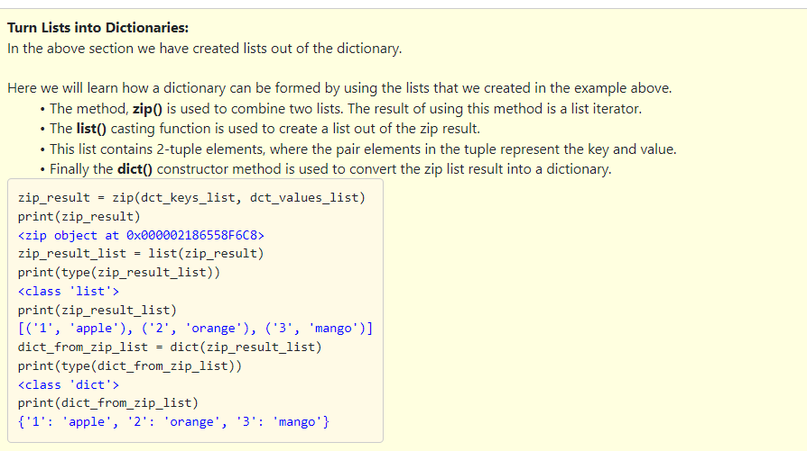

Slide 65
#Understand and retype the code below to learn how a dictionary is formed by using lists.
dct = {'1':'apple', '2':'orange', '3':'mango', '4':'banana'}
print("dct_keys = dct.keys()")
dct_keys = dct.keys()
print("dct_values = dct.values()")
dct_values = dct.values()
print("dct_keys_list = list(dct_keys)")
dct_keys_list = list(dct_keys)
print("dct_values_list = list(dct_values)")
dct_values_list = list(dct_values)
print("dct_keys_list =", sorted(dct_keys_list))
print("dct_values_list =", sorted(dct_values_list))
print("Combining both the keys and values list using zip");
print("zip(dct_keys_list, dct_values_list)")
zip_result = zip(dct_keys_list, dct_values_list)
print("Creating a list out of the zip result using list function")
zip_result_list = list(zip_result)
print("zip_result_list =", sorted(zip_result_list))
print("Finally creating the dictionary from the zip result list")
dict2 = dict(zip_result_list)
print("dict2 =", sorted(dict2.items()))

Slide 66
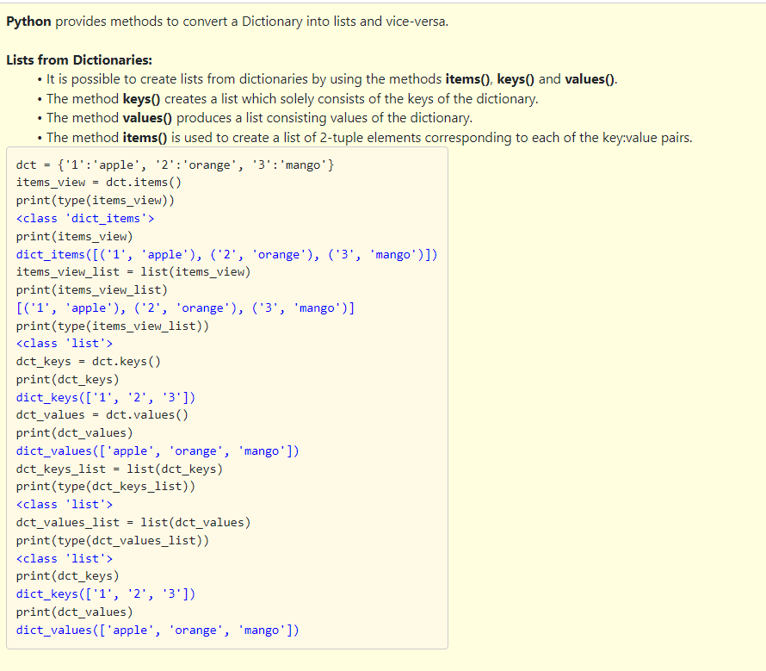

Slide 67
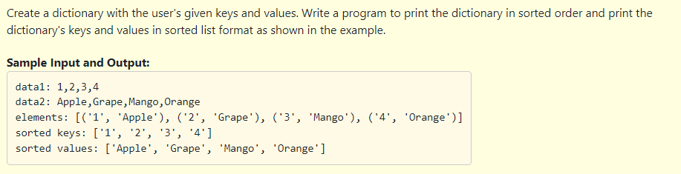

Slide 68
data1 = input("data1: ")
data2 = input("data2: ")
list1 = data1.split(",")
list2 = data2.split(",")
dct = dict(zip(list1, list2))
items_view = sorted(dct.items())
print("elements:", (list(items_view)))
print("sorted keys:", sorted(list(dct.keys())))
print("sorted values:", sorted(list(dct.values())))

