Slide 1
L11,12
Mathematical functions, Trigonometric functions, Random functions, Mathematical constants

Slide 2
Mathematical functions(Math module)
Number-throretic and representation functions:
floor(),fmod(),ceil(),fabs(),factorial(),gcd(),trunc()
Power and Logarithmic functions:
exp(),log(),log10(),pow(),sqrt()
Trignometric functions:
sin(x),cos(x),tan(x),hypot(x,y)
Angular conversion functions:
degree(), radians()
Mathmatical contants
pi,e,tau,inf

Slide 3
floor():Rounds a number down to the nearest integer
ceil():Rounds a number up to the nearest integer
fabs():Returns the absolute value of a number
factorial():Returns the factorial of a number
gcd():Returns the greatest common divisor of two integers
trunc():Returns the truncated integer parts of a number
exp():Returns E raised to the power of x
log():Returns the natural logarithm of a number, or the logarithm of number to base
log10():Returns the base-10 logarithm of x
pow():Returns the value of x to the power of y
sqrt():Returns the square root of a number

Slide 4
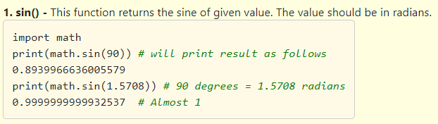
Trigonometric functions
Trigonometry is very useful in real Life.
Python provide us Trigonometric functions to perform trigonometric operations.
All the trigonometric functions are available in math module.
We have to import math module to use trigonometric functions.

Slide 5
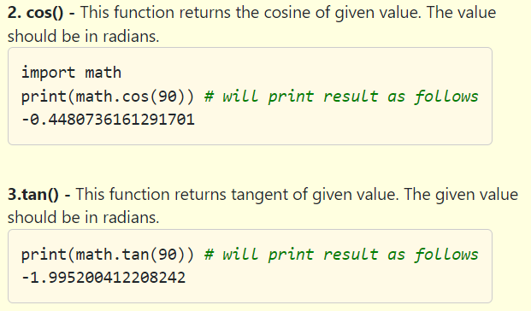

Slide 6
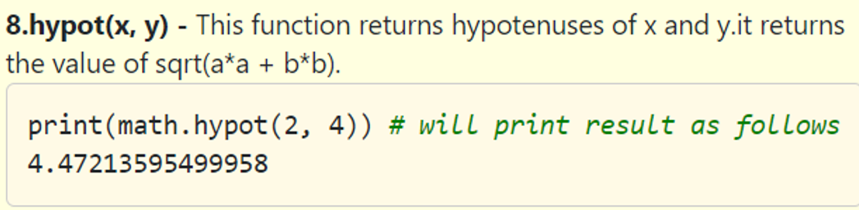
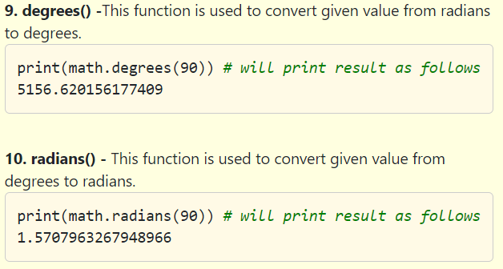

Slide 7
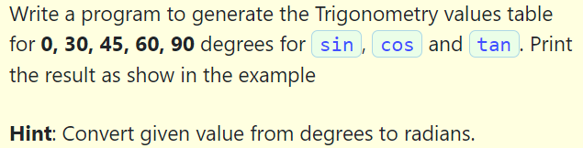
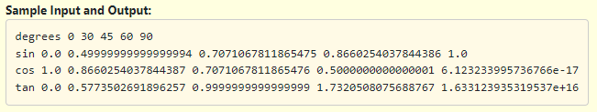

Slide 8
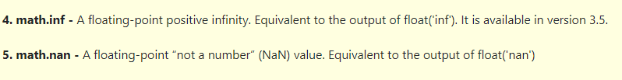
Mathematical Constants
Python provides five mathematical constants in math module which are
1. math.pi - The mathematical constant π = 3.141592…, to available precision.
2. math.e - The mathematical constant e = 2.718281…, to available precision.
3. math.tau -The mathematical constant τ = 6.283185…, to available precision. Tau is a circle constant equal to 2π. It is available in version 3.6

Slide 9
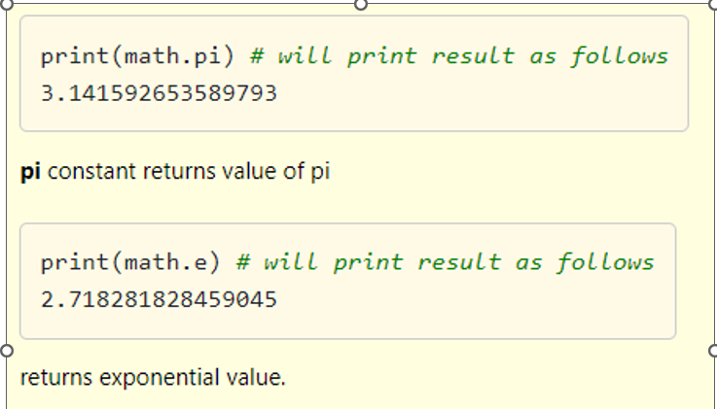

Slide 10
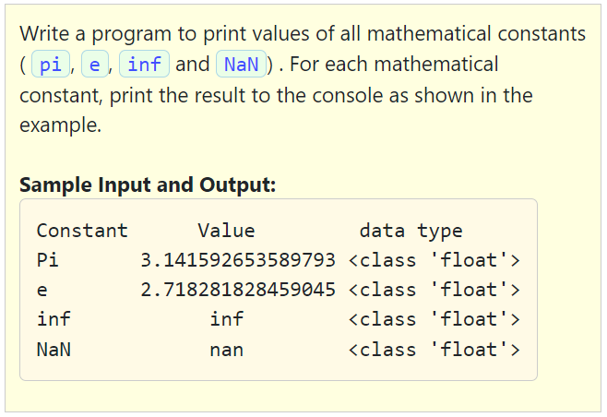

Slide 11
Miscellaneous functions(not in math)
min():Returns the smallest item in an iterable
max():Returns the largest item in an iterable
abs():Returns the absolute value of a number
pow():Returns the value of x to the power of y[Available inside/ and outside math module both]
round():Rounds a number

Slide 12
Random Number Functions

Slide 13
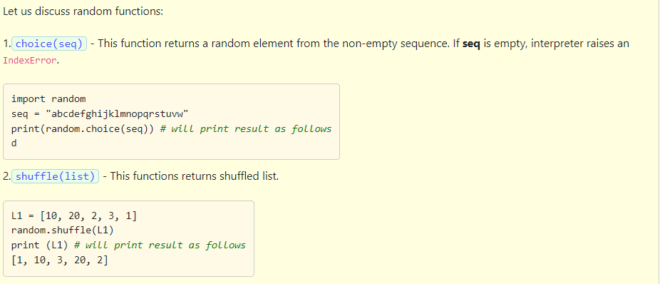
Python provides us random number functions. We use these random numbers in areas like research, games, cryptography, simulation and other applications.
We have to import random module to use random functions.

Slide 14
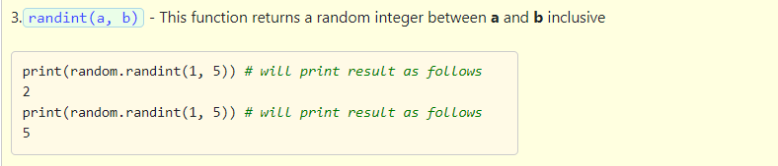
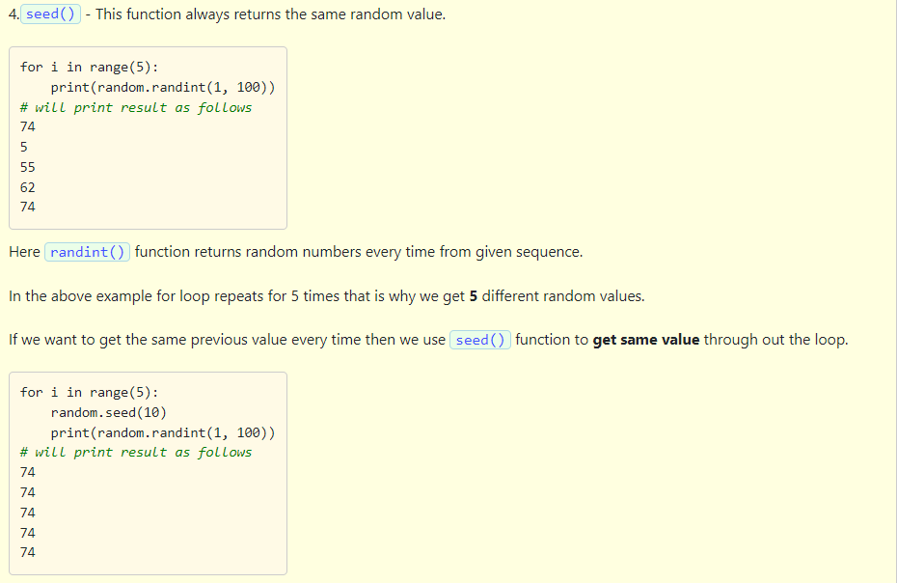

Slide 15
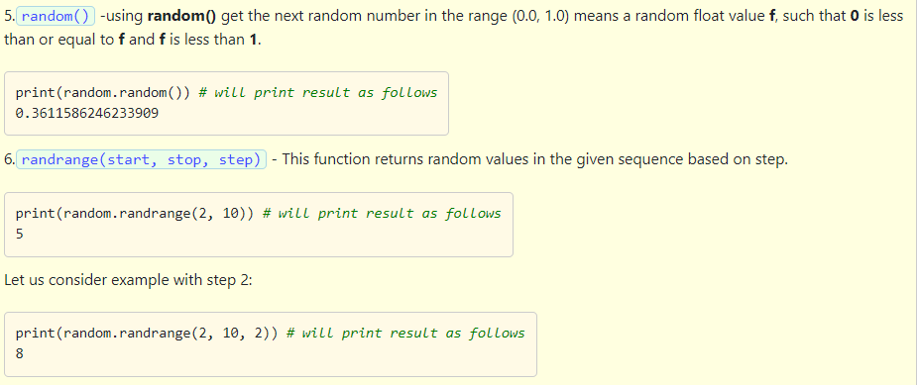

Slide 16
Which of the following options are Correct?
1.random() function returns random values between 0.0 and 1.0 only.
2. If we are not specifying step in randrange(), interpreter raises an Error.
3. using shuffle() function we can reshuffle the tuple.
1,2
2,3
3
1

Slide 17
Which of the following options are Correct?
1.random() function returns random values between 0.0 and 1.0 only.
2. If we are not specifying step in randrange(), interpreter raises an Error.
3. using shuffle() function we can reshuffle the tuple.
1,2
2,3
3
1

