Slide 1
L1,2,3
UNIT-3

Slide 2
A program is written to solve a simple/complex problem. Generally, a program solving simple problem is very easy to understand and also to identify mistakes, if any, in them.
The steps involved in the programs that solve large complex problems are huge and have thousands of lines of code and become difficult to understand. So, large programs are subdivided into a number of smaller programs called subprograms.
Some times, we need to write a particular block of code that needs to be executed more than once in our program. An error in one such block may introduce many errors in the program. This block of code can be grouped as a subprogram. Such subprograms specify one or more actions to be performed for the larger program. These subprograms are called functions.
Most programming languages provide this feature called functions , where we need to declare and define a group of statements once and that can be called and used whenever required. This saves both time and effort. So, we can define a Function as a self-contained block of statements that specifies one or more actions to be performed.
The main reasons for using functions are:
To improve the readability of code.
Improves the re-usability of the code, same function can be used in any program rather than writing the same code.
debugging of the code would be easier if you use functions (errors are easy to be traced).
reduces the size of the code, duplicate set of statements are replaced by function calls.

Slide 3
Which of the following option is correct?
1. A function is defined once but called many number of times.
2. Function is a block of statements to do one or more tasks.
3. By writing different functions in a program, increases the length of the code.
1 only
2 only
1 and 2
1 and 3

Slide 4
Which of the following option is correct?
1. A function is defined once but called many number of times.
2. Function is a block of statements to do one or more tasks.
3. By writing different functions in a program, increases the length of the code.
1 only
2 only
1 and 2
1 and 3

Slide 5
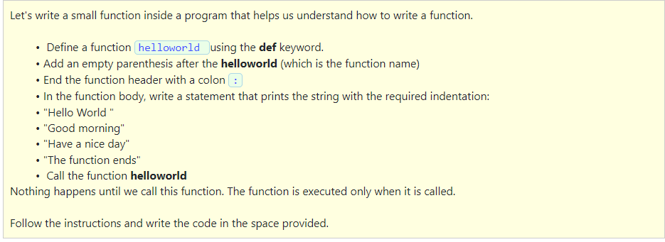
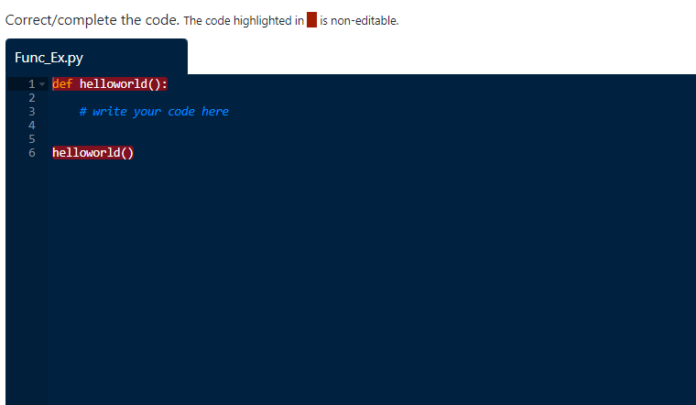

Slide 6
Solution:
def helloworld():
print("Hello World")
print("Good morning")
print("Have a nice day")
print("The function ends")
helloworld()

Slide 7
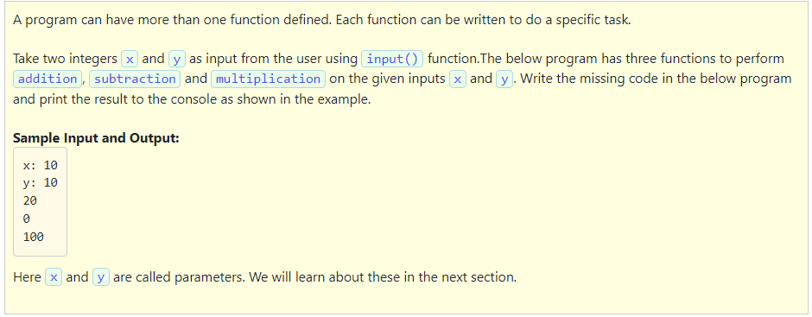
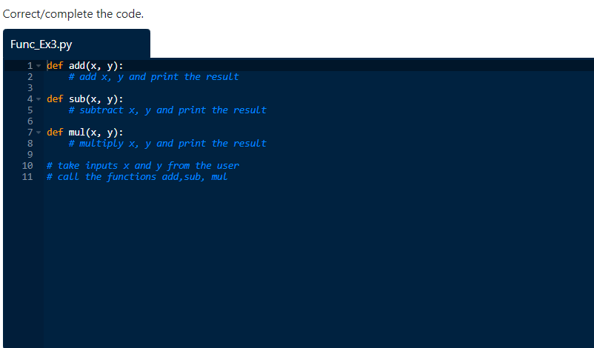

Slide 8
Solution:
def add(x, y):
print(x+y)
def sub(x, y):
print(x-y)
def mul(x, y):
print(x*y)
x=int(input("x: "))
y=int(input("y: "))
add(x,y)
sub(x,y)
mul(x,y)

Slide 9
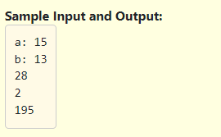
Calling a function:
Till now we have just defined the functions. It means they are just written and have never been used. To use a function (to execute the statements in the function), we need to call the function. A function is called by using the function name in the main program.
Example:
Write a program to know how to call a function in Python.
Take two integer parameters a and b as input from the user using input() function. Define three functions with names add, sub and mul to perform addition, subtraction and multiplication on the given two parameters respectively, print the result as shown in the example.

Slide 10
Solution:
# write your code here
def add(a,b):
print(a+b)
def sub(a,b):
print(a-b)
def mul(a,b):
print(a*b)
a=int(input("a: "))
b=int(input("b: "))
add(a,b)
sub(a,b)
mul(a,b)

Slide 11
Docstring
A comment that occurs in the first line of the function body after the colon(:) is known as Docstring.
Let's understand the features of docstrings:
It is called the Docstring.
It is a string written between triple quotes """ """.
It can have multiple lines.
This string is available in the program as a __doc__ attribute.
This is a very good practice when you write code and add a docstring to the function.

Slide 12
Which of the following is the correct option?
1. A comment that occurs in the first line of the function body after the colon(:) is known as Docstring
2. This docstring is available in the program as a __doc__ attribute.
3. A docstring should have only one line.
4. A docstring is written between triple quotes ""“
1,2,3
1,2 and 4
2 and 4
3 and 4

Slide 13
Which of the following is the correct option?
1. A comment that occurs in the first line of the function body after the colon(:) is known as Docstring
2. This docstring is available in the program as a __doc__ attribute.
3. A docstring should have only one line.
4. A docstring is written between triple quotes ""“
1,2,3
1,2 and 4
2 and 4
3 and 4

Slide 14
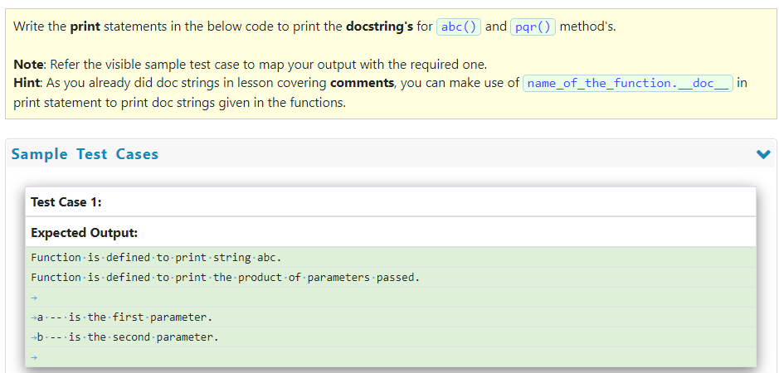
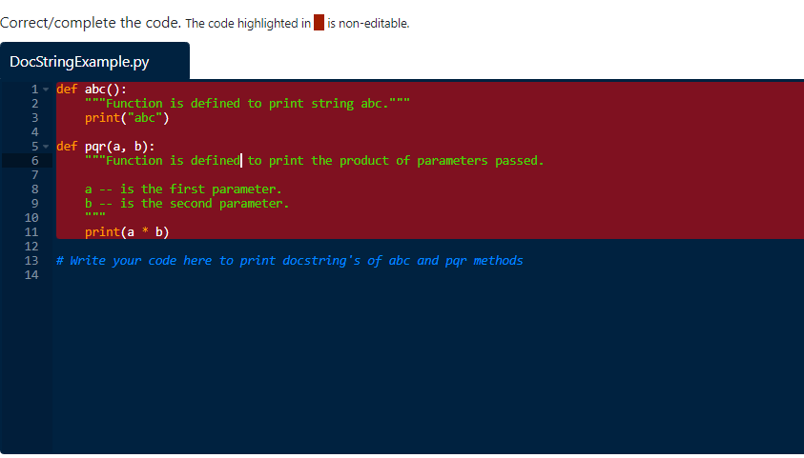

Slide 15

Solution:
def abc():
"""Function is defined to print string abc."""
print("abc")
def pqr(a, b):
"""Function is defined to print the product of parameters passed.
a -- is the first parameter.
b -- is the second parameter.
"""
print(a * b)
# Write your code here to print docstring's of abc and pqr methods
print(abc.__doc__)
print(pqr.__doc__)

Slide 16
Return statement in a function :
The return statement is used to quit a function it is executing and to pass the control back to the statement from where it was called. The syntax of the return statement is as below:
return [expression_list / value]
Features of the return statement:
The return statement can have an expression that gets evaluated and the value is returned or a value directly can be returned.
If there is no expression in the statement then the function will return None.
If the function does not have a return statement as we have done a few functions in previous examples, then the function will return None.
Multiple values can be returned by a Python function

Slide 17
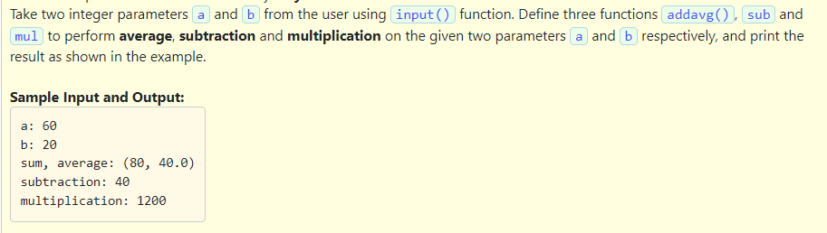

Slide 18
Solution:
def addavg(a,b):
sum1=a+b
avg=sum1/2
return sum1,avg
def sub(a,b):
return a-b
def mul(a,b):
return a*b
a=int(input("a: "))
b=int(input("b: "))
r1,r2=addavg(a,b)
print("sum, average: ({}, {})".format(r1,r2))
print("subtraction:",sub(a,b))
print("multiplication:",mul(a,b))

Slide 19
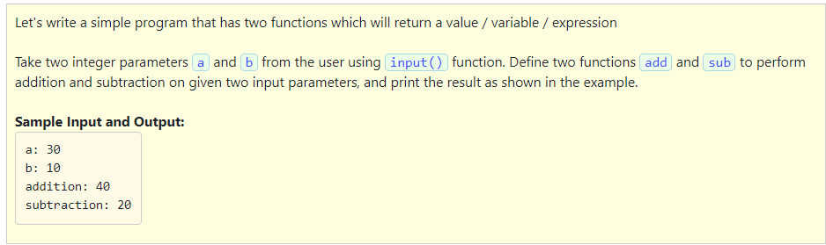

Slide 20
Solution:
def add(a,b):
return a+b
def sub(a,b):
return a-b
a=int(input("a: "))
b=int(input("b: "))
print("addition:",add(a,b))
print("subtraction:",sub(a,b))
Lesson-1 completes here

Slide 21
ARGUMENT
An argument is an expression which is passed to a function by its caller, in order for the function to perform its task.
It is an expression in the comma-separated list bound by the parentheses in a function call expression. Arguments are local to the particular function.
These variables are placed in the function declaration and function call.
These arguments are defined in the calling function.
PARAMETER
Parameters are variables defined in the function to receive the arguments.
Parameters are those defined in the function definition.
Parameters are available only with in the specified function and parameters belong to the called function.
Parameters are the local variables to the function.
The Parameters occupy memory only when the function execution starts and are destroyed when the function execution completes.

Slide 22
Select the correct statements given below:
1. An argument is an expression which is passed to a function by its caller, in order for the function to perform its task.
2. Arguments are local to the particular function.
3. Parameters are available only with in the specified function and parameters belong to the called function.
4. Parameters occupy memory through out the program execution.
1 and 2
1,2 and 3
2 and 3
1 and 3

Slide 23
Select the correct statements given below:
1. An argument is an expression which is passed to a function by its caller, in order for the function to perform its task.
2. Arguments are local to the particular function.
3. Parameters are available only with in the specified function and parameters belong to the called function.
4. Parameters occupy memory through out the program execution.
1 and 2
1,2 and 3
2 and 3
1 and 3

Slide 24
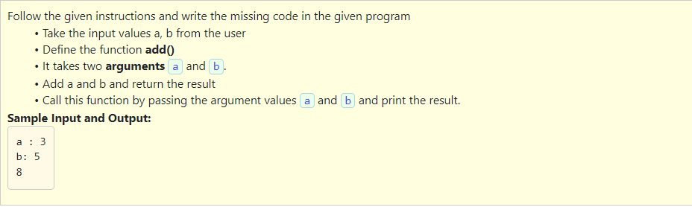
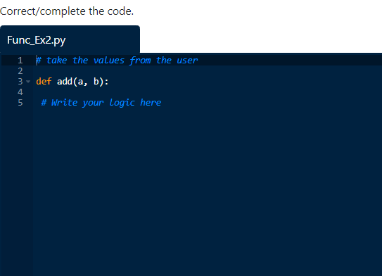

Slide 25
Solution:
a=int(input("a: "))
b=int(input("b: "))
def add(a, b):
return a+b
print(add(a,b))

Slide 26
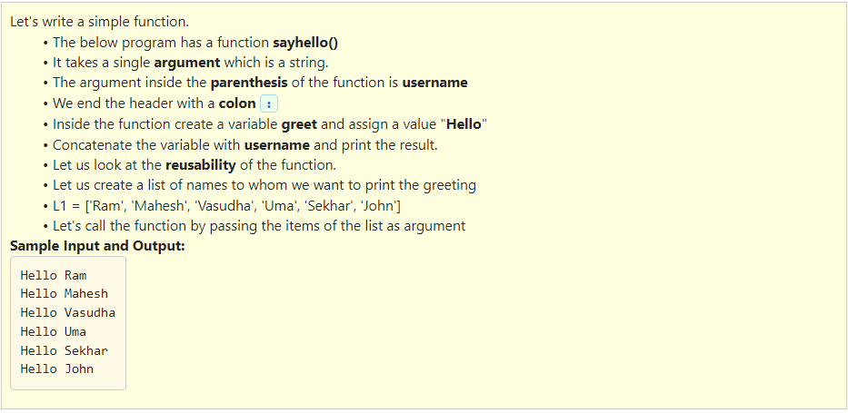
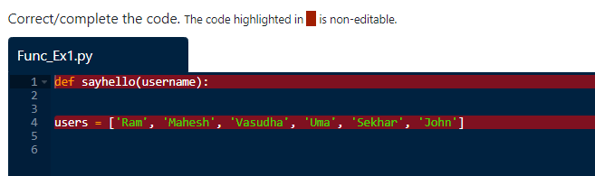

Slide 27
Solution:
def sayhello(username):
greet="Hello"
print(greet+" "+username)
users = ['Ram', 'Mahesh', 'Vasudha', 'Uma', 'Sekhar', 'John']
for i in users:
sayhello(i)

Slide 28
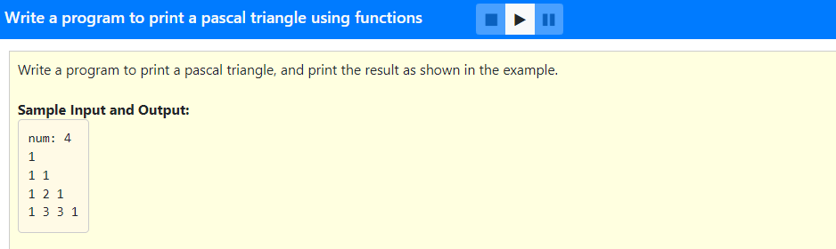
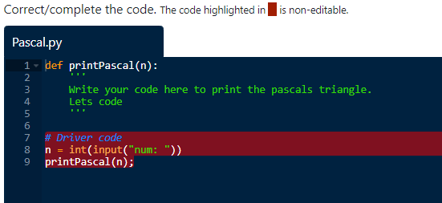
Solution:

Slide 29
Solution:
def printPascal(n):
for line in range(1, n + 1):
C = 1; # used to represent C(line, i)
for i in range(1, line + 1):
print(C, end = " ");
C = int(C * (line - i) / i);
print();
# Driver code
n = int(input("num: "))
printPascal(n);

Slide 30
Keyword arguments
Whenever a function is called with some arguments, the arguments passed get assigned to the parameters of the function and the function uses these parameter values inside the body of the function.
Example:
Let's look at a function which takes two arguments name and age and prints whether the person can apply for voter id or not, voter_id(name, age).
The first parameter is name which is a string and the second parameter is age which is an integer. Whenever we call this function, the first argument should be name and the second argument should be age.
We cannot call this function with the first argument as age and second argument as name.
These are called Positional arguments. Readers must examine the documentation to understand what the arguments mean, especially if there are many arguments. To avoid this problem, we use keyword arguments.

Slide 31
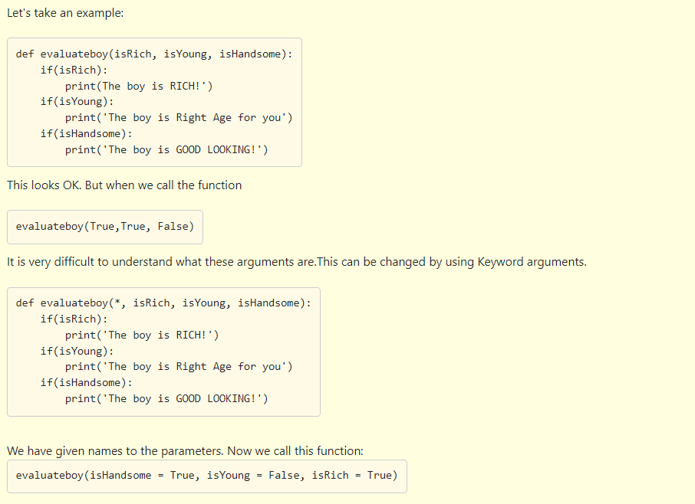
Notice the sequence in which the arguments are passed.
They are not in the same sequence as they are in the function definition.
This passing of arguments in any order by passing the names and assigning them to the right parameters is called keyword arguments.
Keyword arguments simply augment to Python’s core philosophy that “readability counts”.

Slide 32
Select all the correct statements given below.
1. When the values are passed, as arguments to the function in any order and these values get assigned, these arguments are called keyword arguments.
2. Calling the function add(a = 10,b = 20) or by add(10, 20) produce the same result.
3. Calling the function add(b = 20, a = 10) or by add(10, 20) do not produce the same result.
1 and 2
2 and 3
1 and 3
1 only

Slide 33
Select all the correct statements given below.
1. When the values are passed, as arguments to the function in any order and these values get assigned, these arguments are called keyword arguments.
2. Calling the function add(a = 10,b = 20) or by add(10, 20) produce the same result.
3. Calling the function add(b = 20, a = 10) or by add(10, 20) do not produce the same result.
1 and 2
2 and 3
1 and 3
1 only

Slide 34
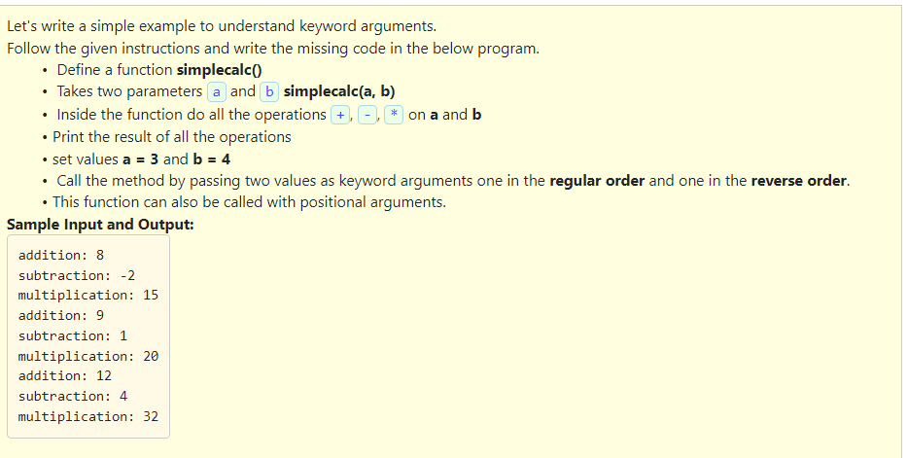
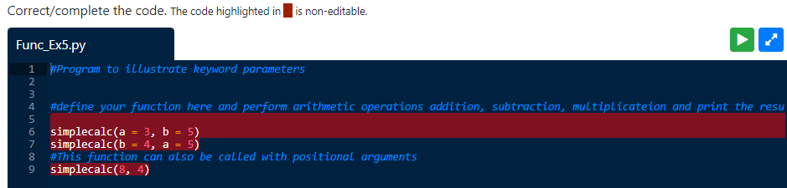

Slide 35
Solution:
#Program to illustrate keyword parameters
#define your function here and perform arithmetic operations addition, subtraction, multiplicateion and print the result.
def simplecalc(a,b):
print("addition:",a+b)
print("subtraction:",a-b)
print("multiplication:",a*b)
simplecalc(a = 3, b = 5)
simplecalc(b = 4, a = 5)
#This function can also be called with positional arguments
simplecalc(8, 4)

Slide 36
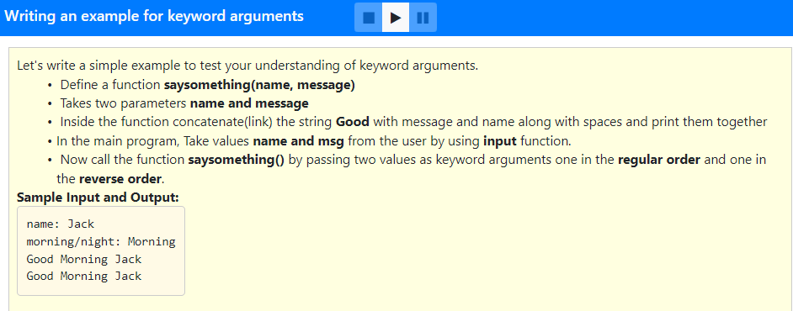

Slide 37
Solution:
def saysomething(name,message):
print("Good"+" "+message+" "+name)
n=input("name: ")
m=input("morning/night: ")
saysomething(name=n,message=m)
saysomething(message=m,name=n)

Slide 38
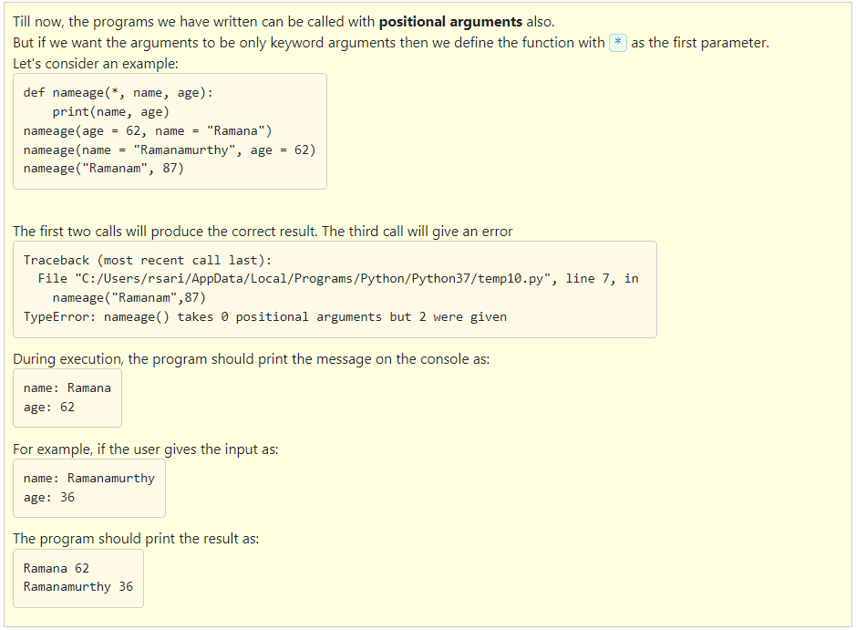

Slide 39
Solution:
def nameage(*, name, age):
print(name, age)
n=input("name: ")
a=int(input("age: "))
nameage(age = a, name = n)
nameage(name = n, age = a)
Note: This syntax will make sure we can pass only keyword arguments, but not positional arguments
Lesson 2 ends here..

Slide 40
Default arguments
Function arguments can have default values.
A default value can be provided to an argument by the use of assignment operator (=). The default value is assigned only when no value is passed for that argument.
In case of passing a value for the parameter that has the default value, the default value is replaced with the passed value.
Any number of arguments in any function can have default value.

Slide 41
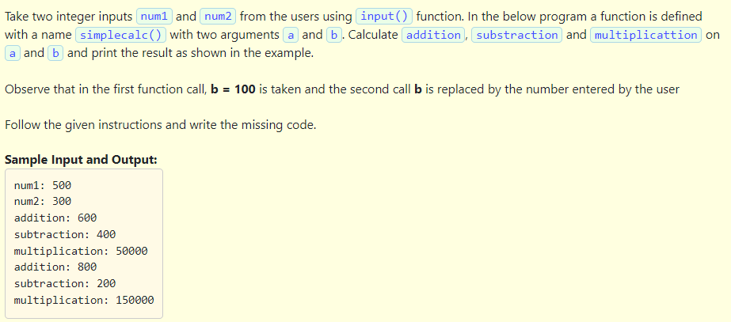
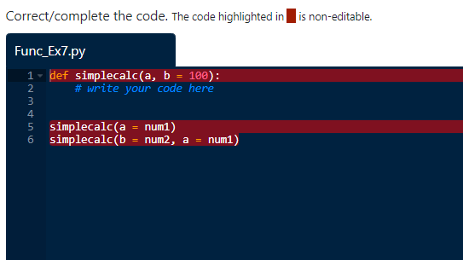

Slide 42
Solution:
def simplecalc(a, b = 100):
# write your code here
print("addition:",a+b)
print("subtraction:",a-b)
print("multiplication:",a*b)
num1=int(input("num1: "))
num2=int(input("num2: "))
simplecalc(a = num1)
simplecalc(b = num2, a = num1)

Slide 43
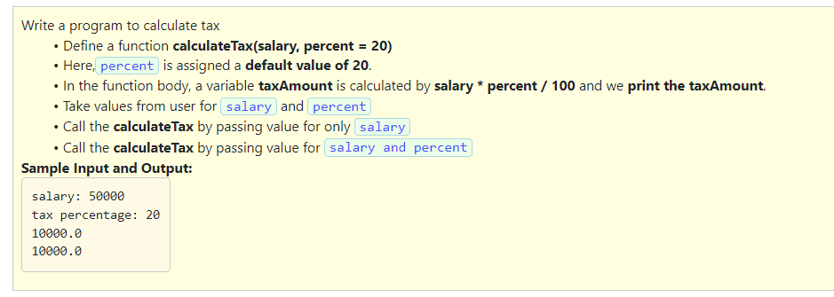

Slide 44
Solution:
def calculateTax(salary,percent=20):
taxAmount=(salary*percent)/100
print(taxAmount)
salary=int(input("salary: "))
percent=float(input("tax percentage: "))
calculateTax(salary)
calculateTax(salary,percent)

Slide 45
Important points on default arguments.
Function arguments can have default values in Python.
A default value can be provided to an argument by using assignment operator (=).
The default value is assigned only when no value is passed for that argument.
In case of passing a value for the parameter that has the default value, the default value is replaced with the passed value.
Any number of arguments in a function can have a default value.
But once we have a default argument, all the arguments to its right must also have default values.
This means Non-default arguments cannot follow default arguments.

Slide 46
Which of the following is the correct option?
1. Function arguments can have default values in Python.
2. The default value is assigned even when a value is passed for that argument.
3. Any number of arguments in a function can have a default values.
4. non-default arguments cannot follow default arguments.
1,2 and 3
1 and 2
1,3 and 4
All options are correct

Slide 47
Which of the following is the correct option?
1. Function arguments can have default values in Python.
2. The default value is assigned even when a value is passed for that argument.
3. Any number of arguments in a function can have a default values.
4. non-default arguments cannot follow default arguments.
1,2 and 3
1 and 2
1,3 and 4
All options are correct

Slide 48
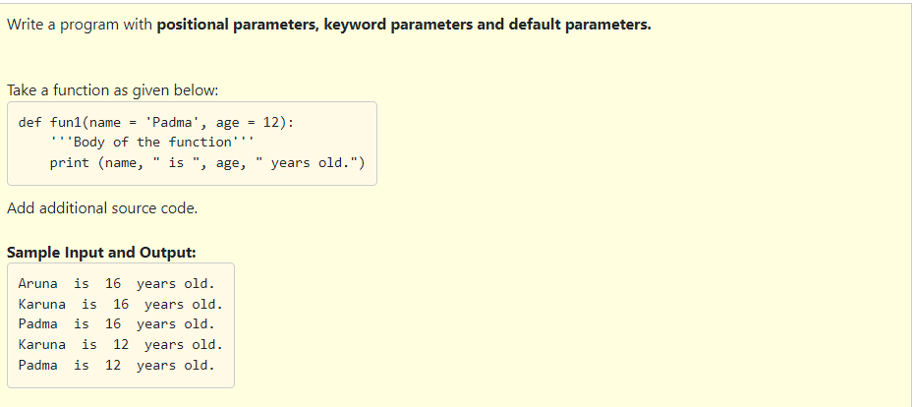

Slide 49
Solution:
def fun1(name = 'Padma',age = 12):
'''Body of the function'''
print (name,"is",age, "years old.")
fun1('Aruna', 16) #Call 1 -- positional parameters
fun1(age = 16, name = 'Karuna’) #Call 2 -- Keyword parameters
fun1(age = 16) #Call 3 -- Name is default
fun1(name = 'Karuna') #Call 4 -- Age is default
fun1() #Call 5 -- Name and Age are default

Slide 50
Arbitrary/Variable length arguments :
In some cases, the user may not have an idea of the correct number of arguments that will be passed into a function During of execution.
This kind of scenario can be dealt with a function being defined for an arbitrary number of arguments and then called.
This is done by using an asterisk (*) in the function definition, where we use this before the parameter name to specify that these type of arguments can be many.
The function body should be written in such a way to handle these arguments.
The syntax for specifying arbitrary number of arguments are
def fun_name( * args)

Slide 51
Which of the following is the correct option?
1. If the correct number of arguments that will be passed to a function at the time of execution is not known , we can use function with arbitrary arguments.
2. Arbitrary arguments. is specified by using an asterisk (*) in the function definition before the parameter name.
3. Arbitrary/Variable length arguments are two different functionalities.
1 and 2
2 and 3
1 only
1,2 and 3

Slide 52
Which of the following is the correct option?
1. If the correct number of arguments that will be passed to a function at the time of execution is not known , we can use function with arbitrary arguments.
2. Arbitrary arguments. is specified by using an asterisk (*) in the function definition before the parameter name.
3. Arbitrary/Variable length arguments are two different functionalities.
1 and 2
2 and 3
1 only
1,2 and 3

Slide 53
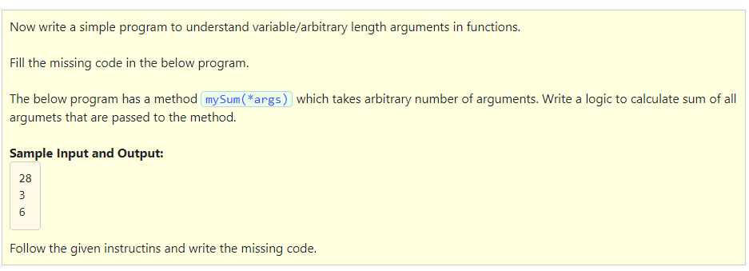
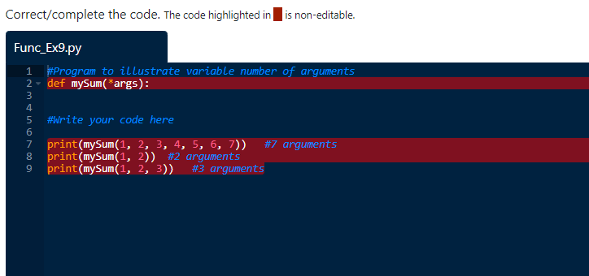

Slide 54
Solution:
#Program to illustrate variable number of arguments
def mySum(*args):
sum1 = 0
for i in args:
sum1 = sum1 + i
return(sum1)
print(mySum(1, 2, 3, 4, 5, 6, 7)) #7 arguments
print(mySum(1, 2)) #2 arguments
print(mySum(1, 2, 3)) #3 arguments

Slide 55
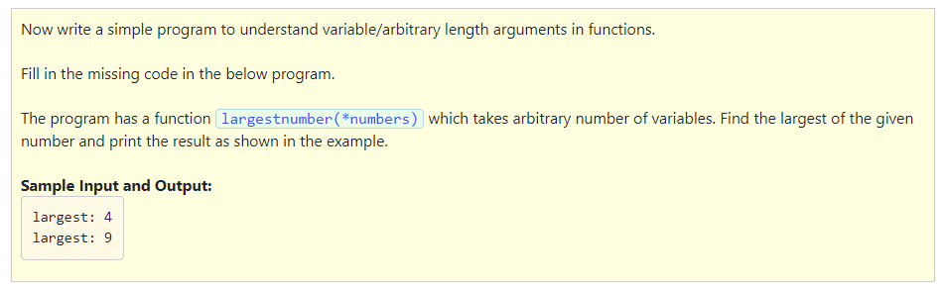
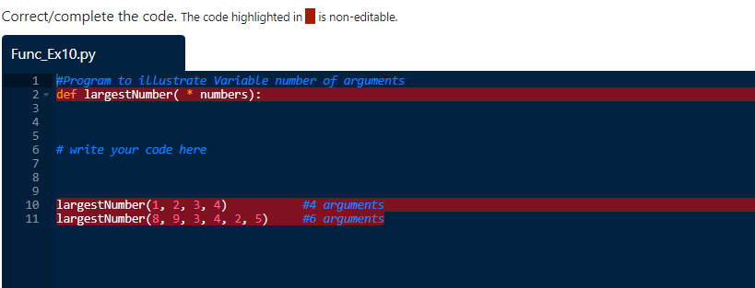

Slide 56
Solution:
#Program to illustrate Variable number of arguments
def largestNumber( * numbers):
m = numbers[0]
for num in numbers:
if num > m:
m = num
print("largest:",m)
# write your code here
largestNumber(1, 2, 3, 4) #4 arguments
largestNumber(8, 9, 3, 4, 2, 5) #6 arguments
Lesson-3 ends here..

