Slide 1
L7-Recursion

Slide 2
A function is called recursive if a statement within the body of the function calls the same function. This is also known as circular definition or self-reference.
There is a distinct difference between the normal and recursive functions.
A normal function will be invoked by another function.
A recursive function is invoked by itself directly or indirectly as long as the given condition is satisfied.
Recursive functions are useful while constructing the data structures like stacks, queues, linked lists and trees.
Every recursive function must satisfy the following two criteria or properties.
Base criteria: There must be at least one base criteria or condition in recursion process, such that, when this condition is met the function stops calling itself recursively.
Recursive step: It is called a well defined recursive function if the recursive calls progress in such a way that each time a recursive call is made, it comes closer to the base criteria.
A recursive function which satisfies the above two properties is said to be a well defined recursive function.

Slide 3
Recursion function calls can be classified into the below two types: When a function calls itself directly, it is called a direct recursion. In such cases only one function is involved, which calls itself until the given condition is met.
In indirect recursion or circular recursion two or more functions can be involved, where the recursive call be initiated by one of the intermediary functions.
For example: fun1 calls fun2, fun 2 calls fun3, and fun3 calls fun1. While using recursion, programmers need to be careful to define an exit condition from the function, otherwise the calls might result into an infinite loop.
Recursive functions are useful to solve many mathematical problems(calculating factorial, generating Fibonacci series, etc.)
Advantages of recursion:
The recursive functions are more readable, writable and maintainable, because the code is smaller and clearer.
Recursive functions are almost always much shorter than their iterative counterparts.
Certain problems are a lot more difficult to do without recursion.
Note: Recursive functions, in most cases, are more expensive than the iterative counter parts. For Fibonacci number, recursion is very expensive, because you call the function twice every time.

Slide 4
Some of the important points to remember when writing a program involving recursion process:
It is essential for a function to call itself, otherwise recursion will not take place.
Only user defined functions can be involved in the recursion. Library function cannot be involved in recursion because their source code cannot be viewed.
To stop the recursive function it is necessary to base the recursion on test condition and proper terminating statement.
new memory is allocated to all the local variables of the recursive functions with the same name during recursion.
All the recursive calls are pushed onto the stack until the terminating condition is detected when it is executed.
When the terminating condition is detected, the recursive calls stored in the stack are popped and executed. The last call is executed first then second, then third and so on. This may cause stack overflow, if the call depth is too high (>16000 in general)

Slide 5
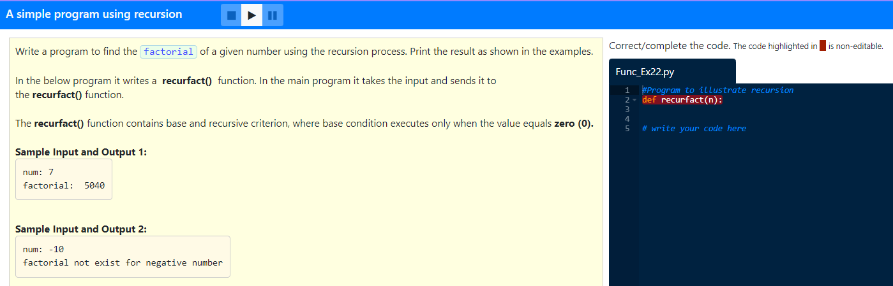

Slide 6
Solution:
#Program to illustrate recursion
def recurfact(n):
if n == 1 or n == 0:
return 1
else:
return n * recurfact(n - 1)
num = int(input("num: "))
if num < 0:
print("factorial not exist for negative number")
else:
print("factorial:", recurfact(num))

Slide 7
WAP to find the sum of all numbers from 1 to n using recursion
Solution:
def recursum(n):
if n ==1 or n==0:
return n
else:
return n + recursum(n - 1)
n = int(input("Enter n: "))
if n < 0:
print("Enter positive number")
else:
print("Sum is:", recursum(n))

Slide 8
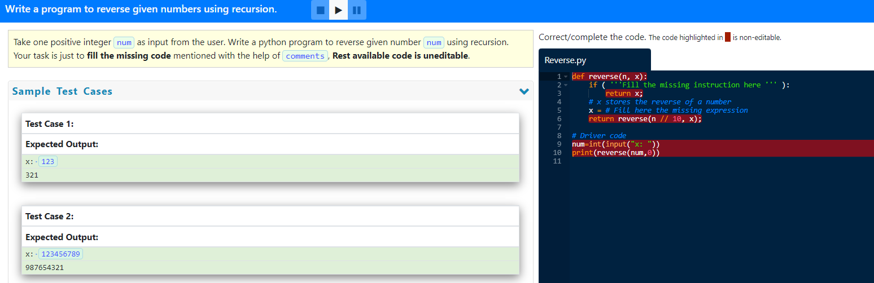

Slide 9
Solution:
def reverse(n, x):
if (n == 0):
return x;
# stores the reverse of a number
x = (x * 10) + (n % 10);
return reverse(n // 10, x);
num=int(input("x: "))
print(reverse(num,0))

Slide 10
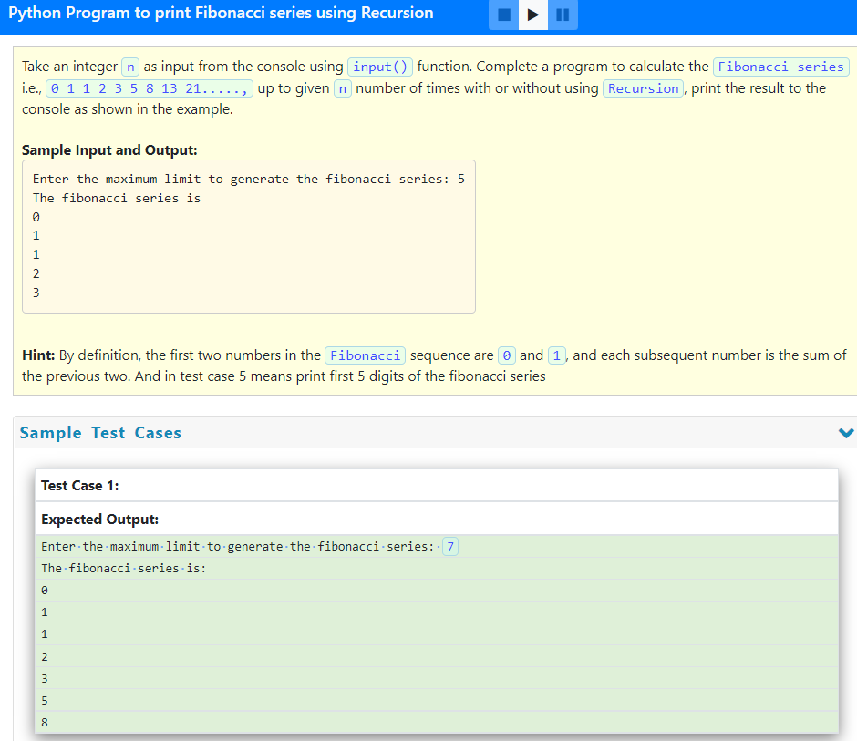

Slide 11
Solution:
def fibb(n):
if (n <= 1):
return n
else:
return (fibb(n - 1) + fibb(n - 2))
n = int(input("Enter the maximum limit to generate the fibonacci series: "))
print("The fibonacci series is:")
for i in range(0, n):
print(fibb(i))

