Slide 1
Web Scrapping using RegEx

Slide 2
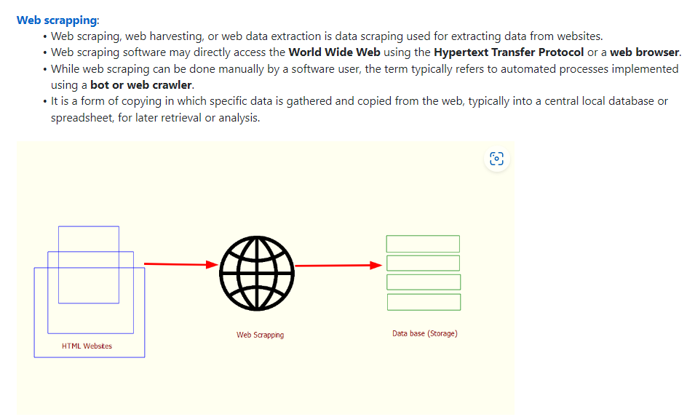

Slide 3
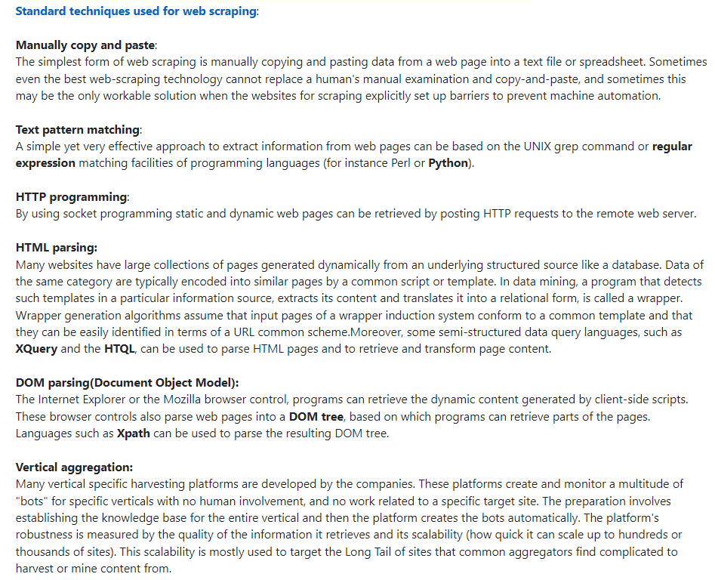

Slide 4
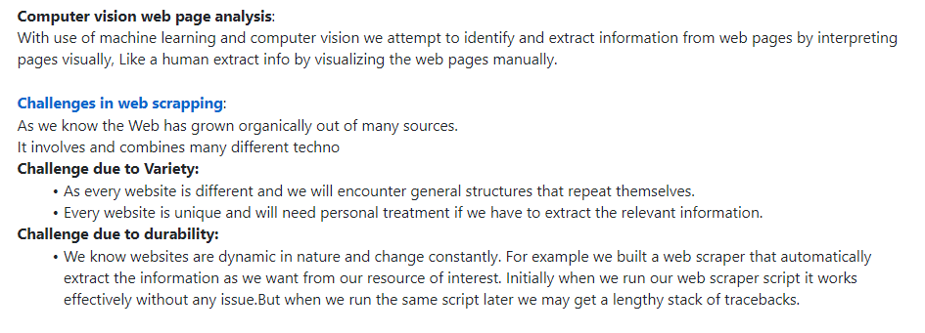

Slide 5
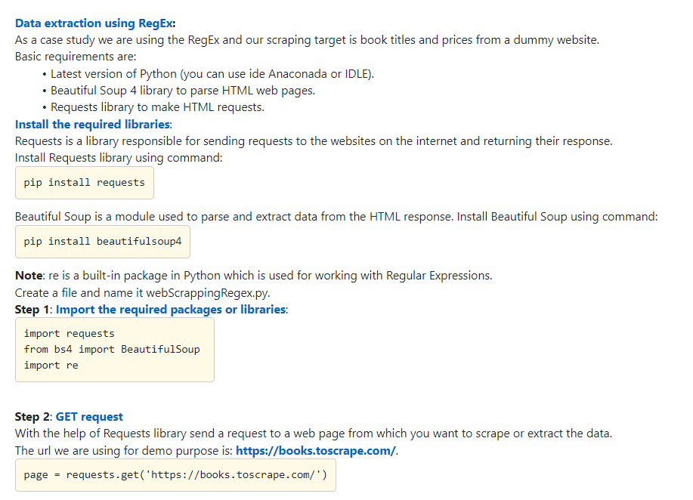

Slide 6
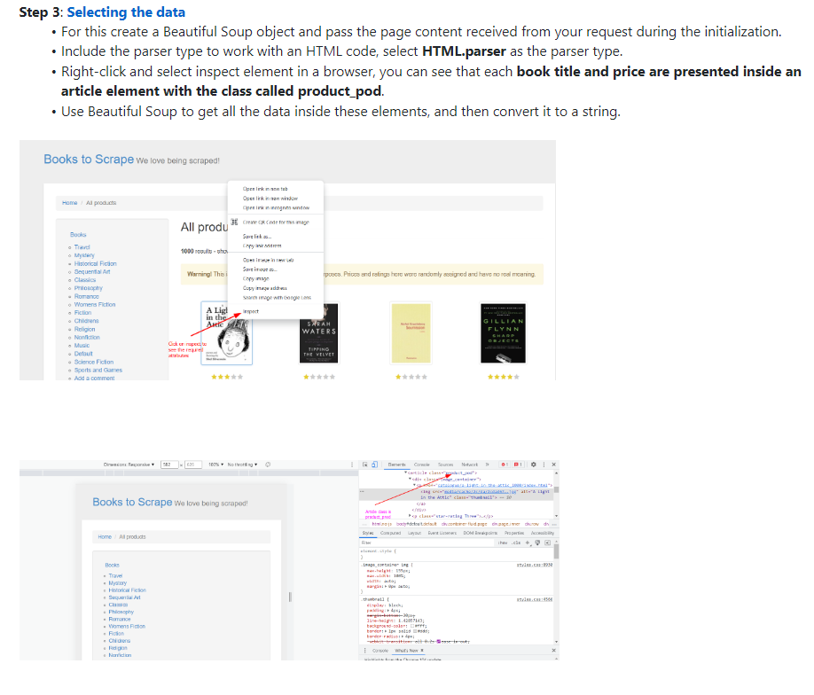
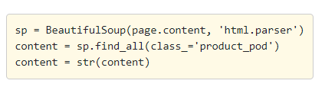

Slide 7
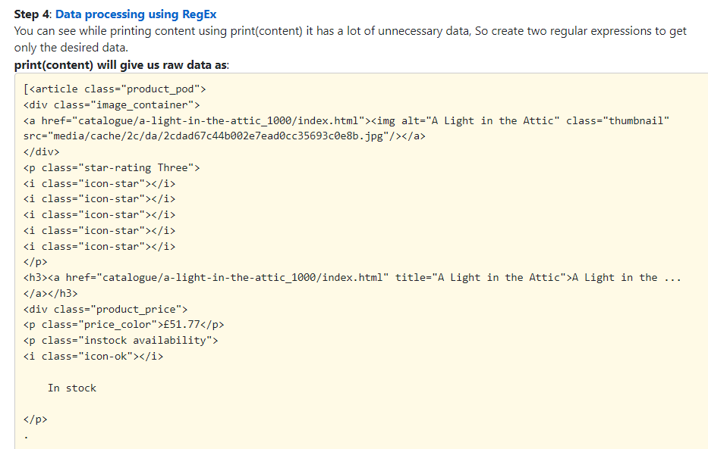

Slide 8
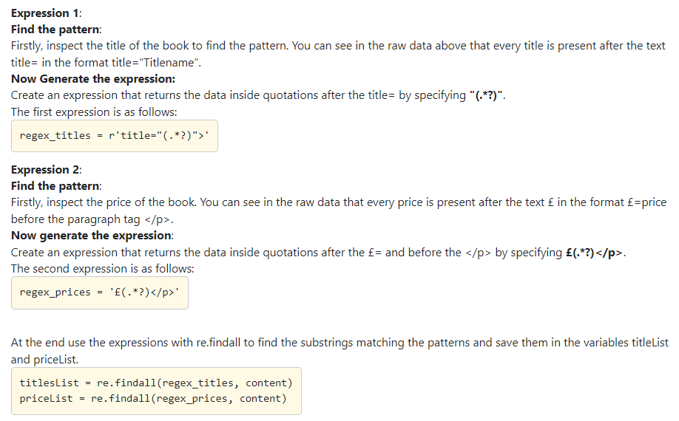

Slide 9
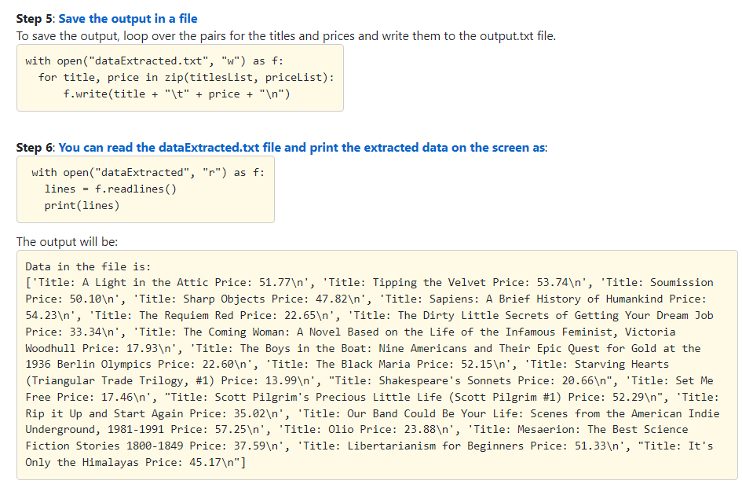

Slide 10
import requests from bs4 import BeautifulSoup import re page = requests.get('https://books.toscrape.com/') sp = BeautifulSoup(page.content, 'html.parser') content = sp.find_all(class_='product_pod') content = str(content) #print(content) regex_titles = r'title="(.*?)">' regex_prices = '£(.*?)</p>' titlesList = re.findall(regex_titles, content) priceList = re.findall(regex_prices, content) f=open("dataExtracted.txt", "w") for title, price in zip(titlesList, priceList): f.write(title + "\t" + price + "\n") f=open("dataExtracted.txt", "r") lines = f.readlines() print(lines)

