Slide 1
LOG SPLITTING MACHINE DESIGN

Slide 2
INTRODUCTION
Log splitting machine plays a crucial role in transforming raw logs into usable firewood and other wood products. This machine eliminates the use of manual labour to split logs thereby increasing the efficiency of splitting logs.
The machine uses an electric motor as its source of power. The shaft from the motor is connected to a pulley system which drives a speed reduction gear system and in turn driving the wood chopping system.
The logs are fed into the machine through log holding frame

Slide 3
Design calculations
Calculation of the length of pulley belt.
Motor pulley- 120mm
Gearbox pulley- 200mm
Center distance- 164.92mm
Lenth of open belt L=2C+(π​/2)(D1​+D2​)+((D2​−D1​)^2​/4C)
Where; D1= Diameter of the small pulley
D2= Diameter of larger pulley
C= center distance
L=2(164.92) + ((3.142(120+200)/2) + ((200-120)^2/4(164.92))
L = 842.19mm

Slide 4
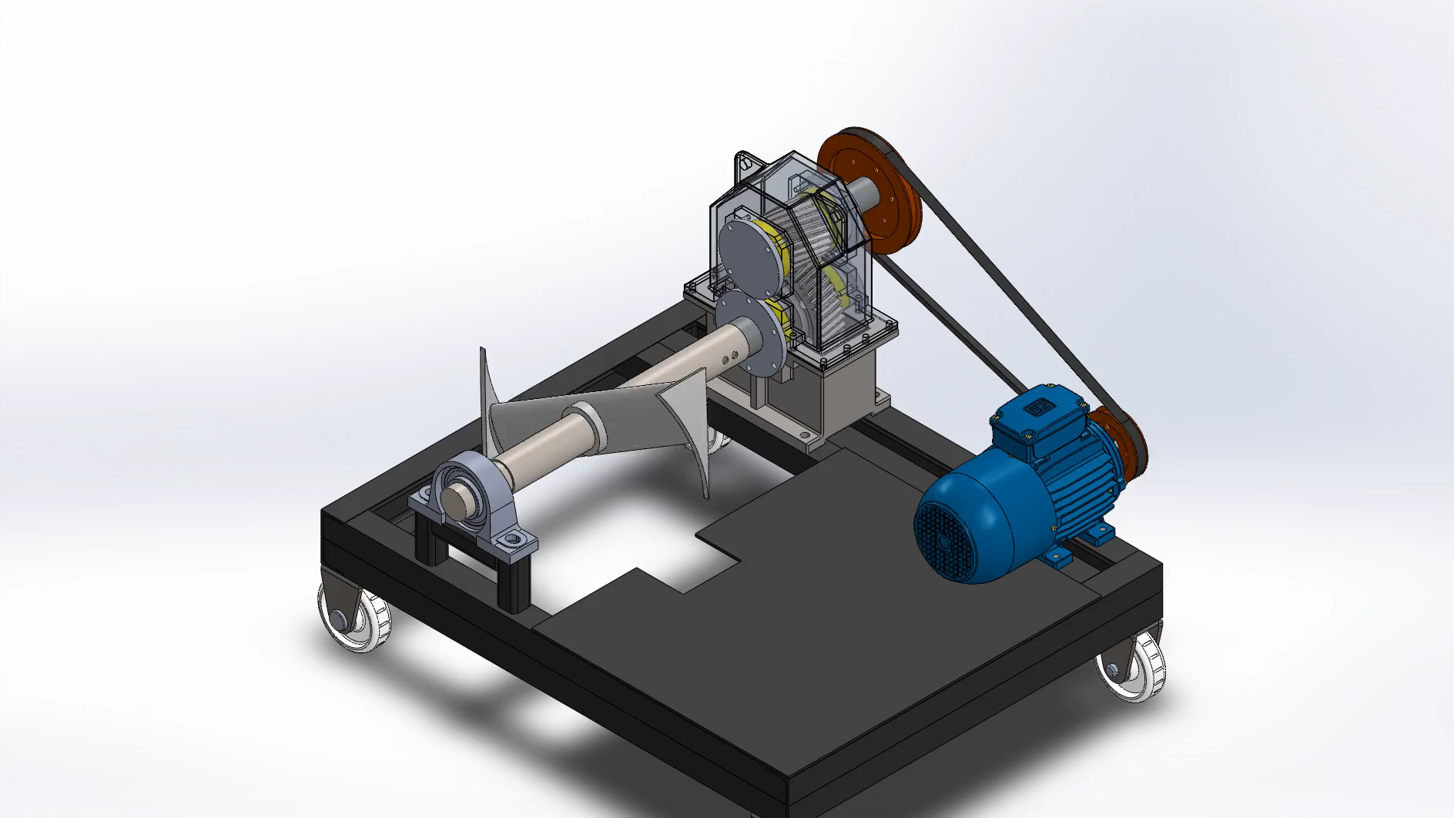
Assembly and exploded view

Slide 5
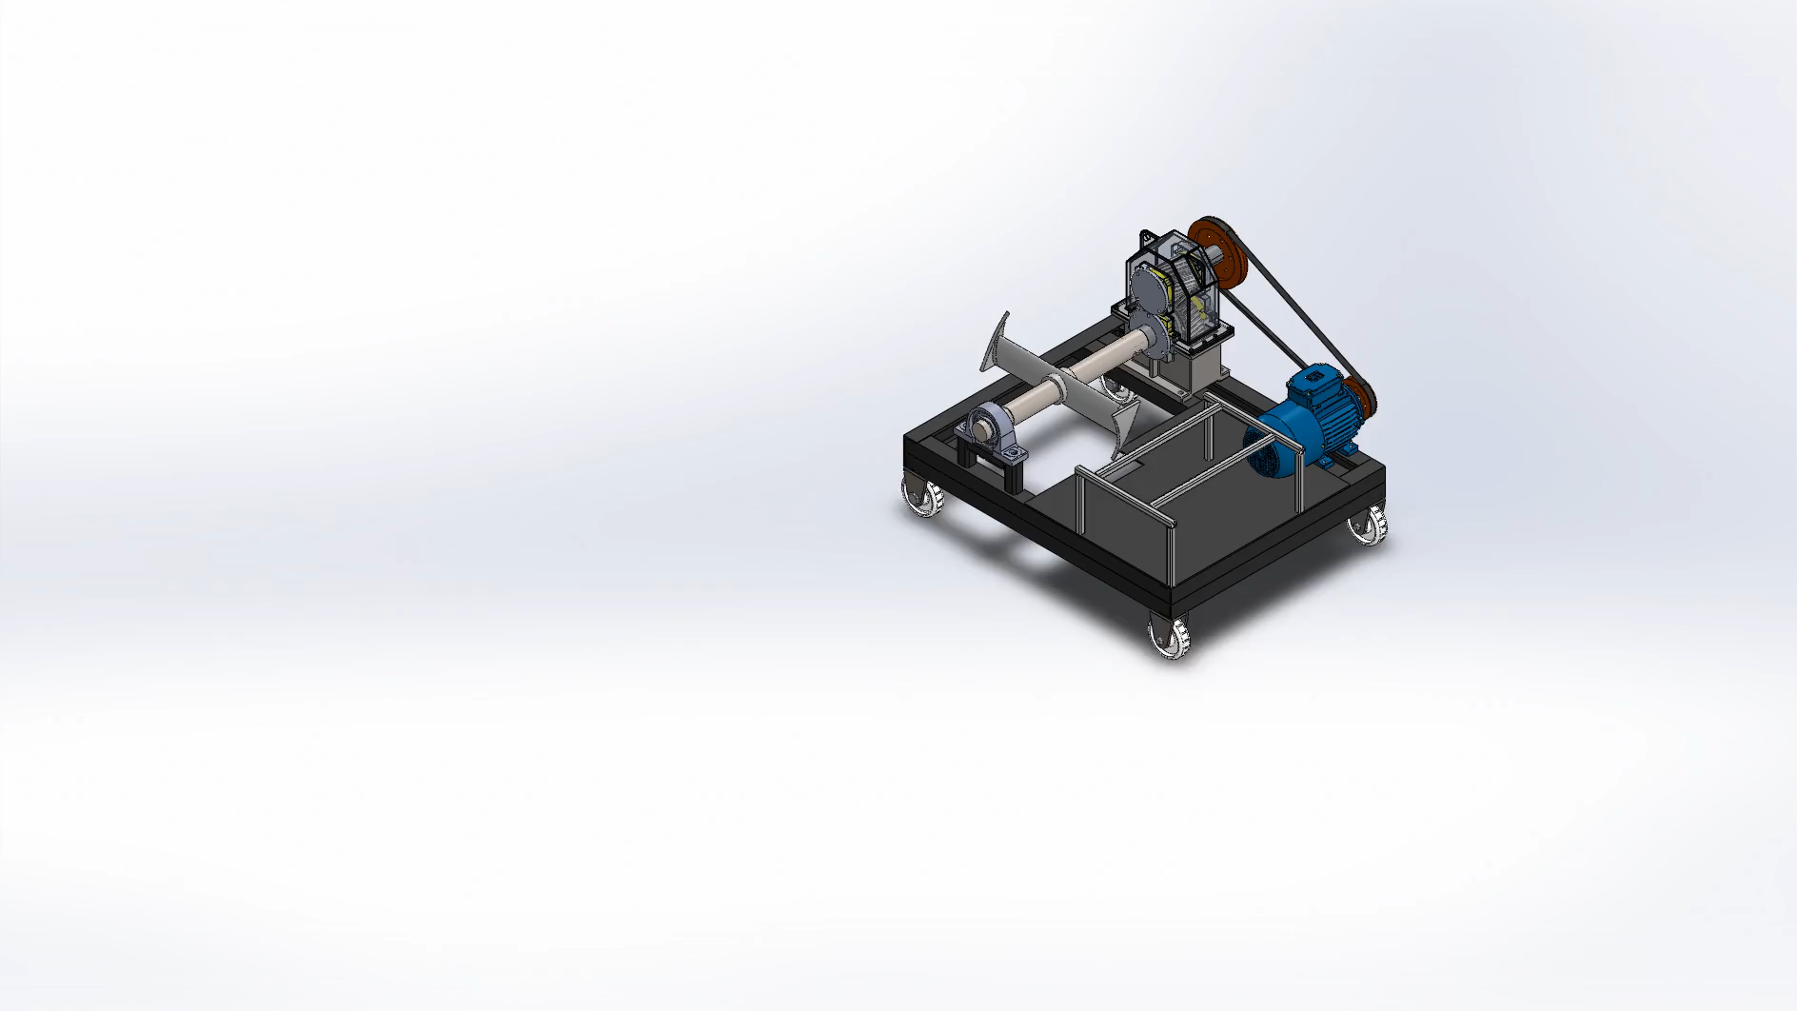

Slide 6
Budget of the machine
Component | Amount
10 horsepower motor | 28,000 Kenyan shillings
2m by 1m mild steel sheet and 30mm by 30mm square hollow pipe | 39,000 Kenyan shillings
Four rollers with holders | 2000 Kenyan shillings - all
U- profile beam – 6 metres | 18, 000 Kenyan shillings
Pulley system and helical gears | 12,000 Kenyan shillings
Total | 99,000 Kenyan shillings

Slide 7
Group Members
Victor chonga E023-01-1091/2020
Munene Victor E023-01-1131/2020
Waithaka Samuel E023-01-1137/2020
Obadiah mwema

