Slide 1
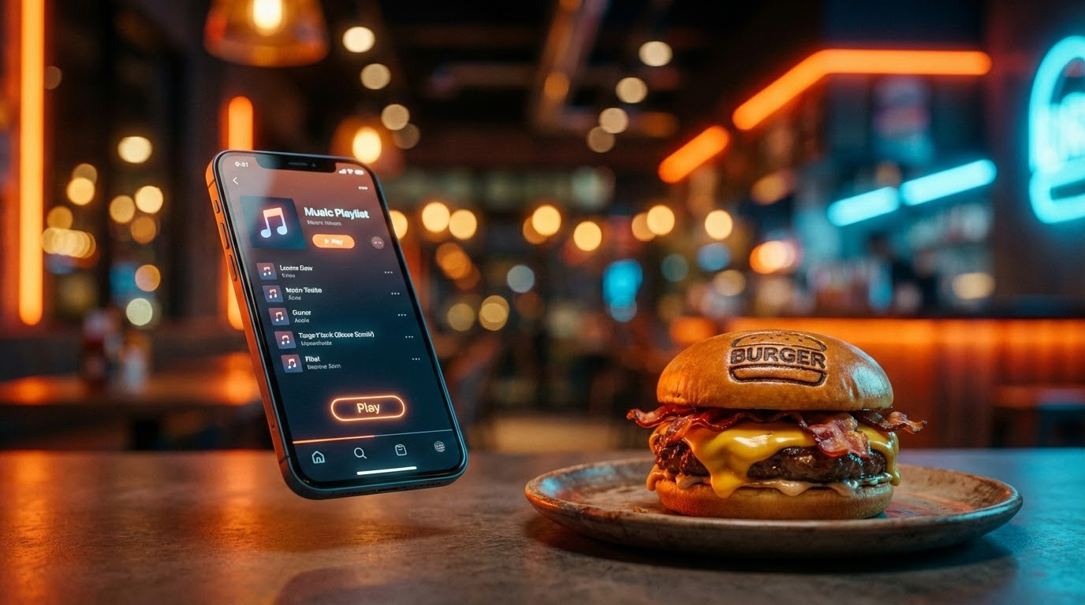
CrowdTune
The World’s First Social Jukebox Super App for Dining.
CrowdTune
Sirasit Sachdev
Confidential & Proprietary Material of Tech Care Academy. Do Not Distribute.

Slide 2
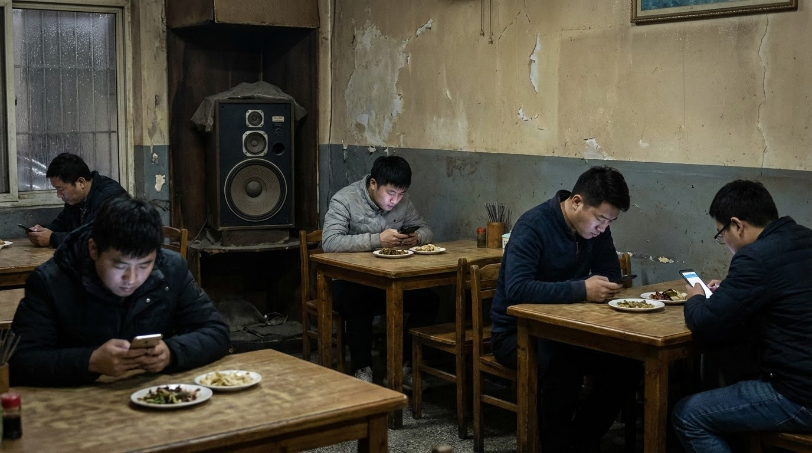
Silent is Boring
Traditional dining lacks interaction.
Customers are isolated, and the atmosphere is static.
CrowdTune
Sirasit Sachdev
Confidential & Proprietary Material of Tech Care Academy. Do Not Distribute.

Slide 3
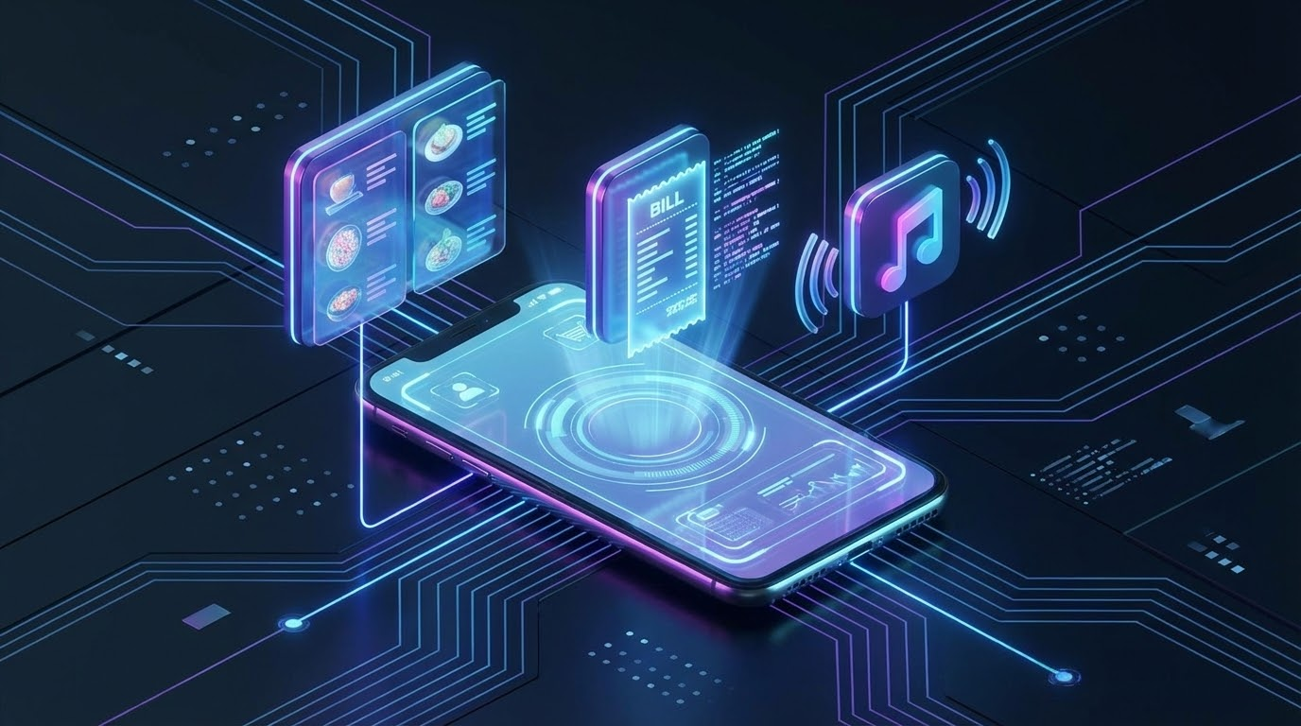
One App.
Total Control.
Seamlessly integrating
food ordering,
payments, and entertainment.
CrowdTune
Sirasit Sachdev
Confidential & Proprietary Material of Tech Care Academy. Do Not Distribute.

Slide 4
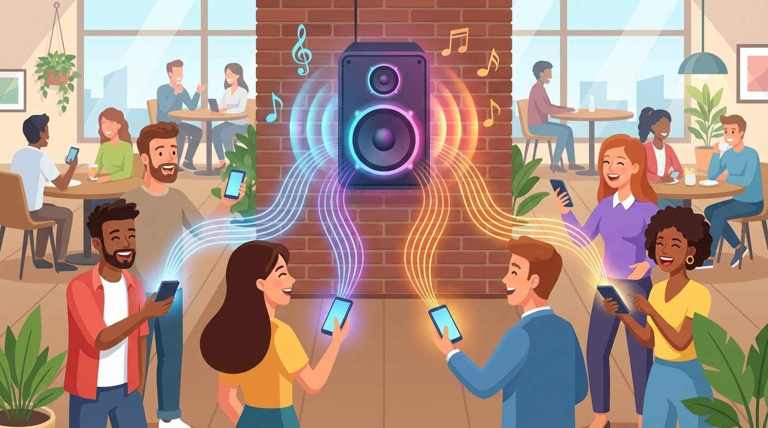
Meet the "Social Jukebox"
Turn passive listeners into active DJs.
CrowdTune
Sirasit Sachdev
Confidential & Proprietary Material of Tech Care Academy. Do Not Distribute.

Slide 5

Monetize the Melody
Micro-transactions for every track played.
10 THB / Track
20 THB / Track
CrowdTune
Sirasit Sachdev
Confidential & Proprietary Material of Tech Care Academy. Do Not Distribute.

Slide 6
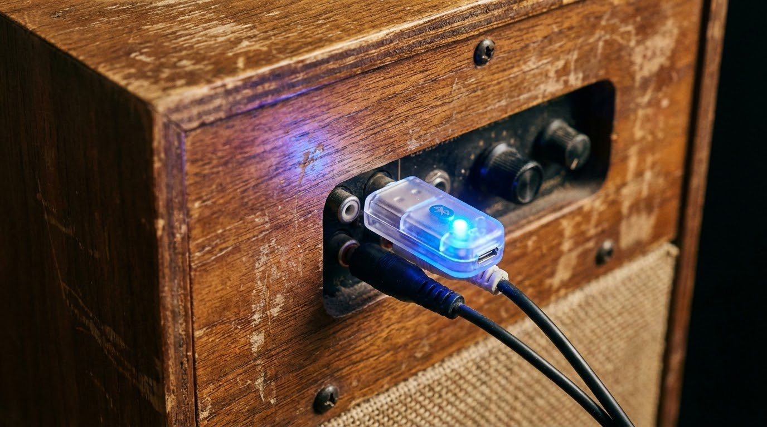
Smart Tech,
Zero Friction.
Compatible with 99% of existing sound systems via Bluetooth or our Plug-and-Play Dongle.
CrowdTune
Sirasit Sachdev
Confidential & Proprietary Material of Tech Care Academy. Do Not Distribute.

Slide 7
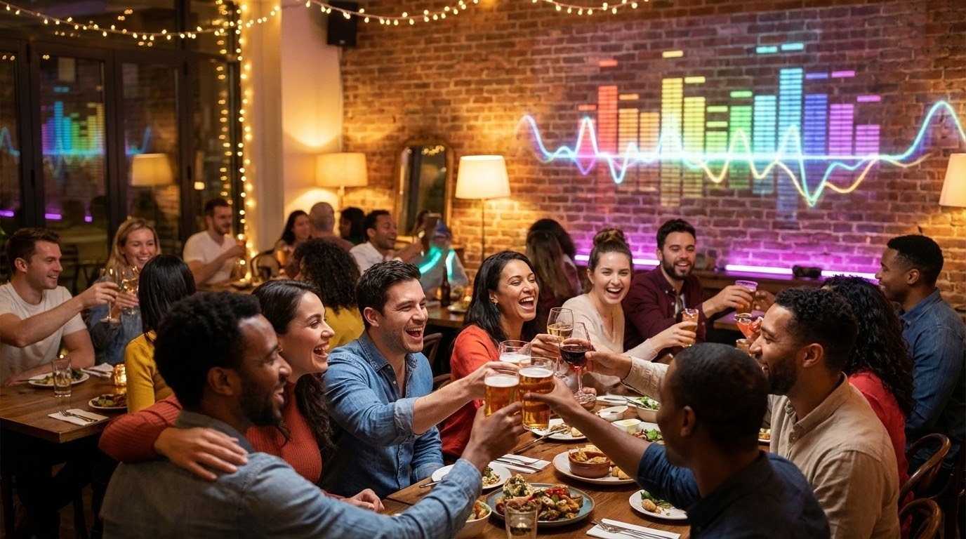

Revive the Dining Experience.
Join us in building the future of interactive social dining.
Investment Opportunity Open
CrowdTune
Sirasit Sachdev
Confidential & Proprietary Material of Tech Care Academy. Do Not Distribute.

